Slide 1
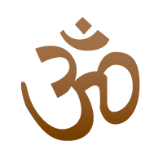
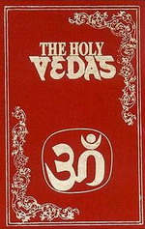
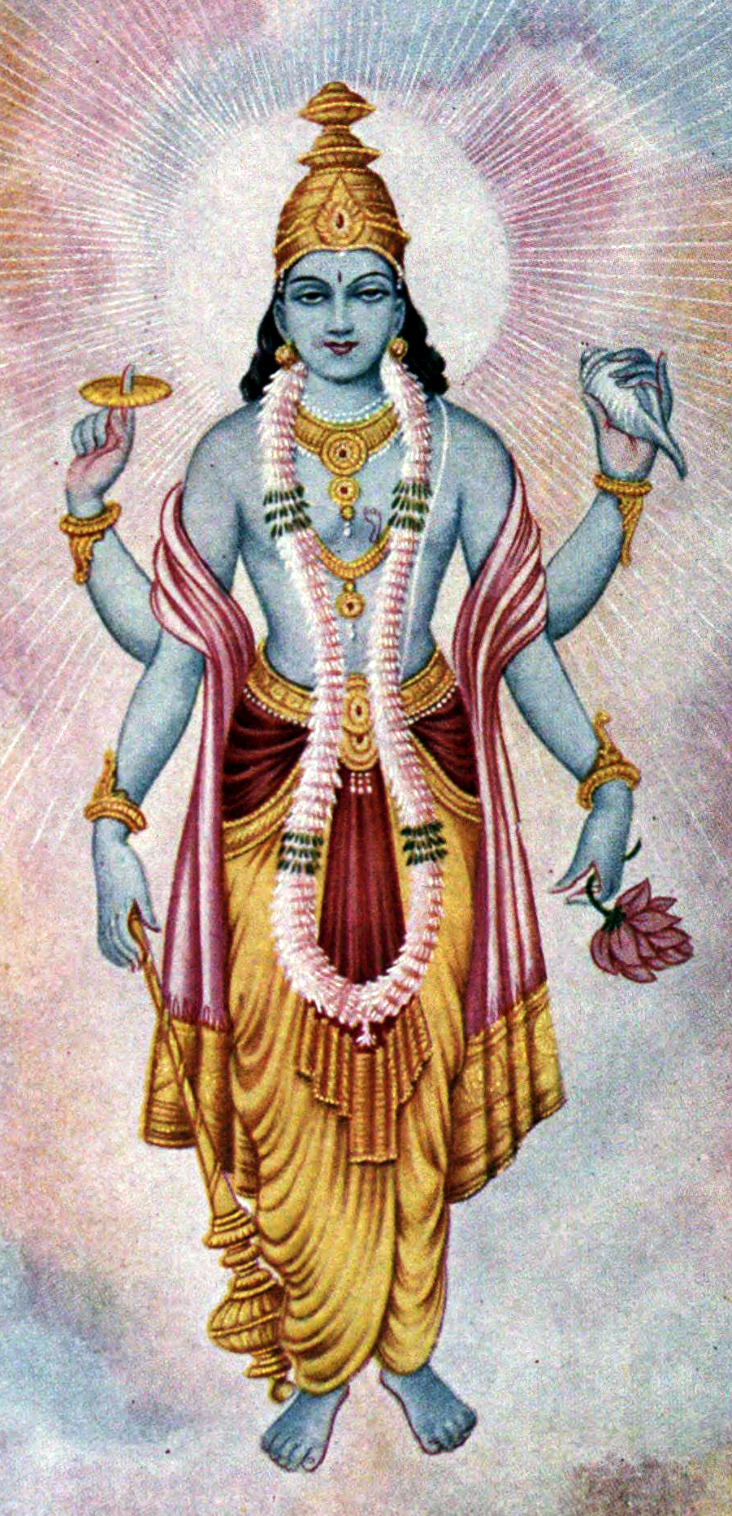
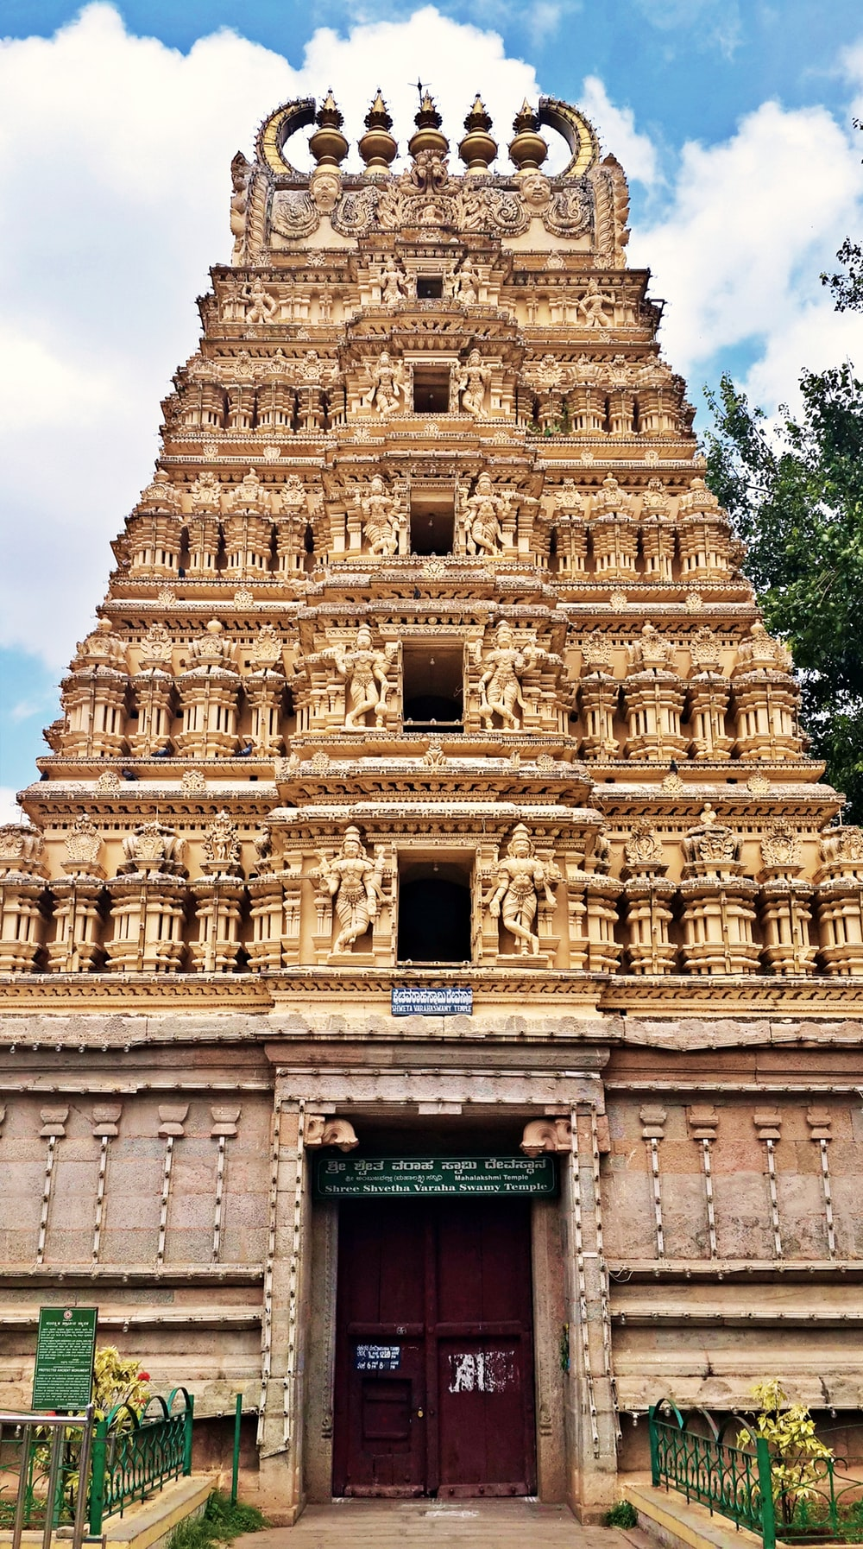
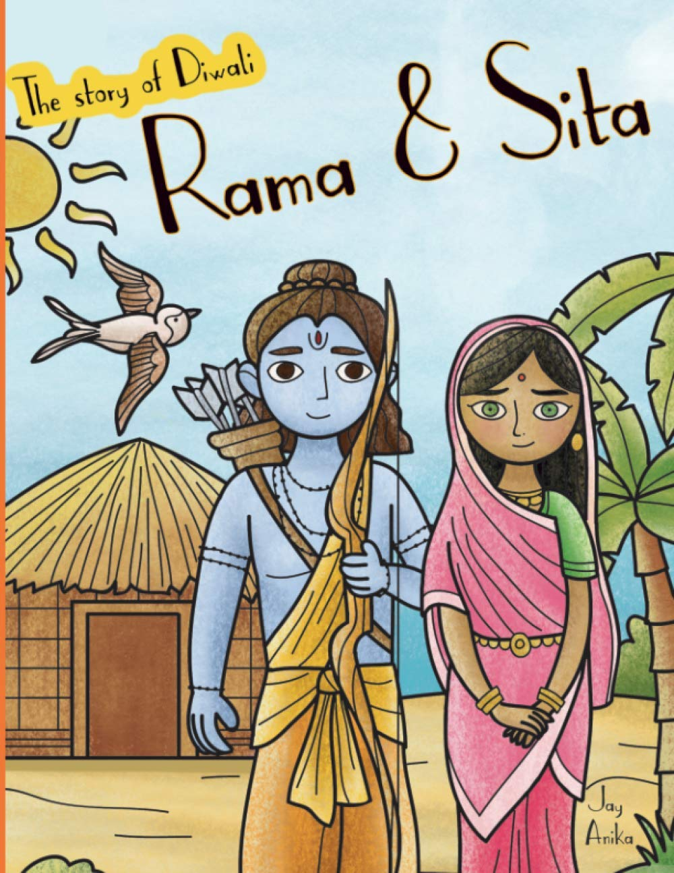
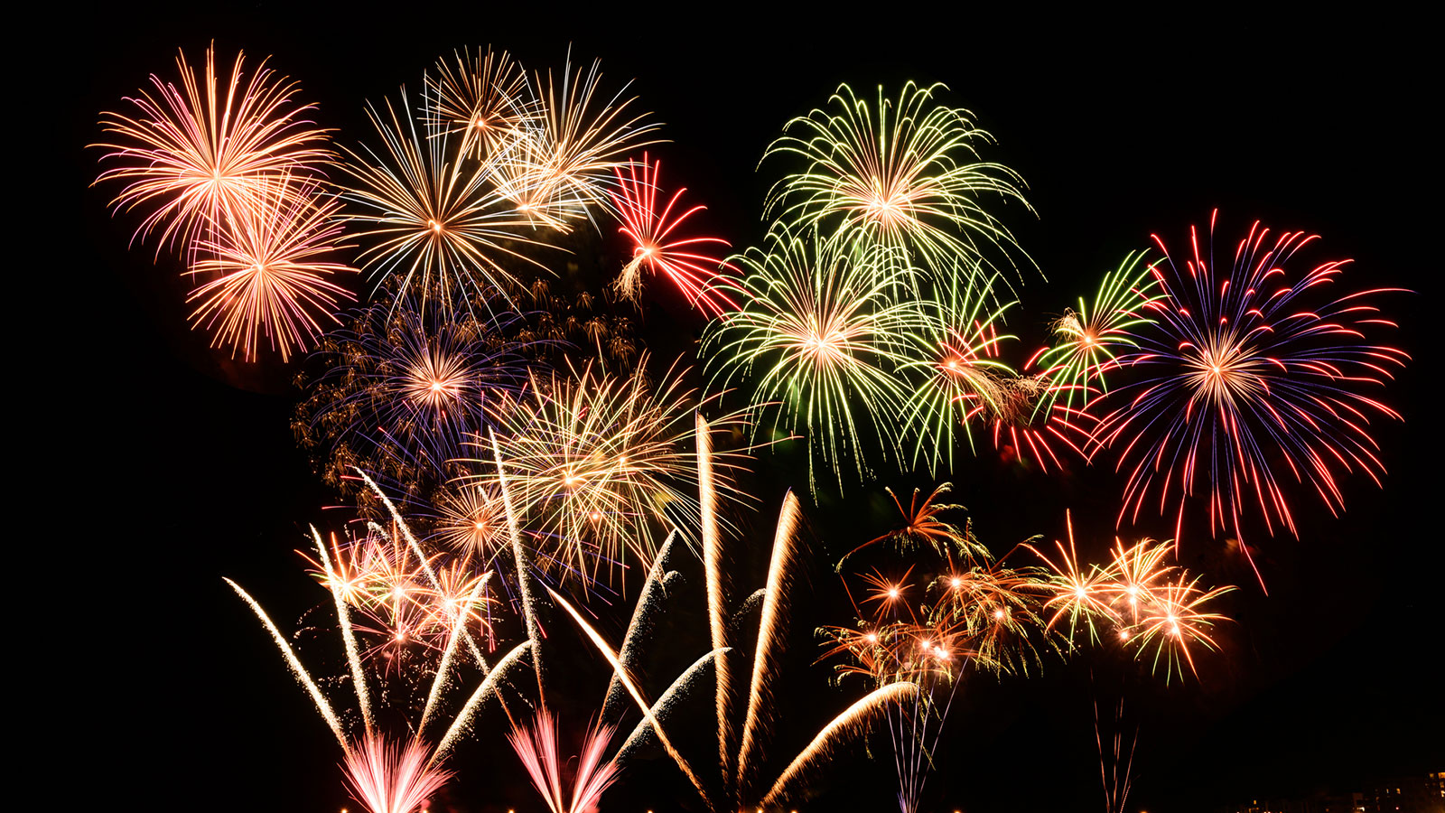
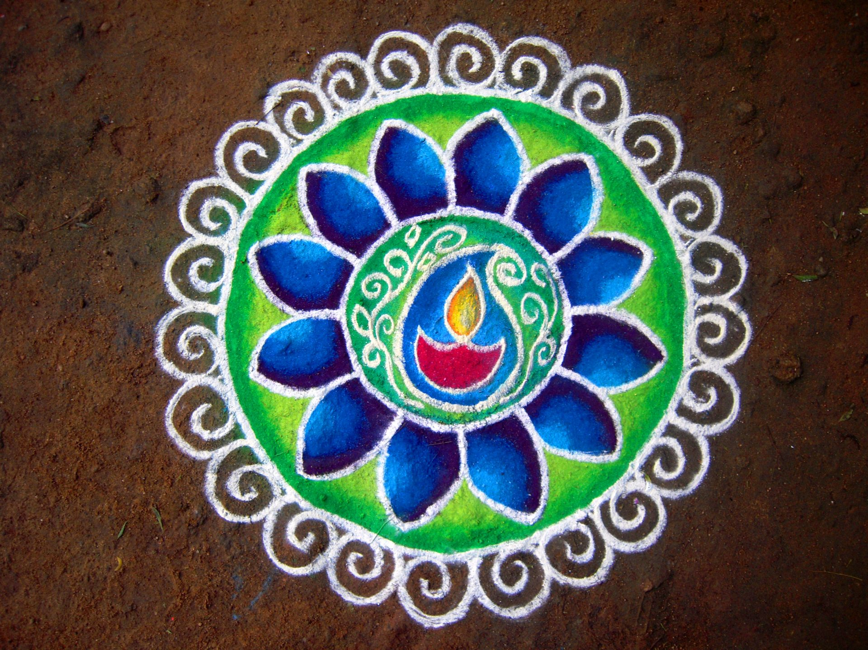
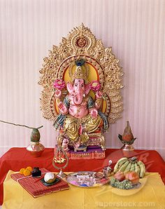
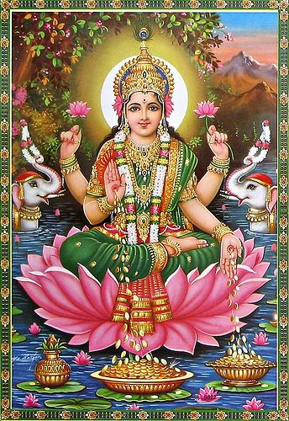
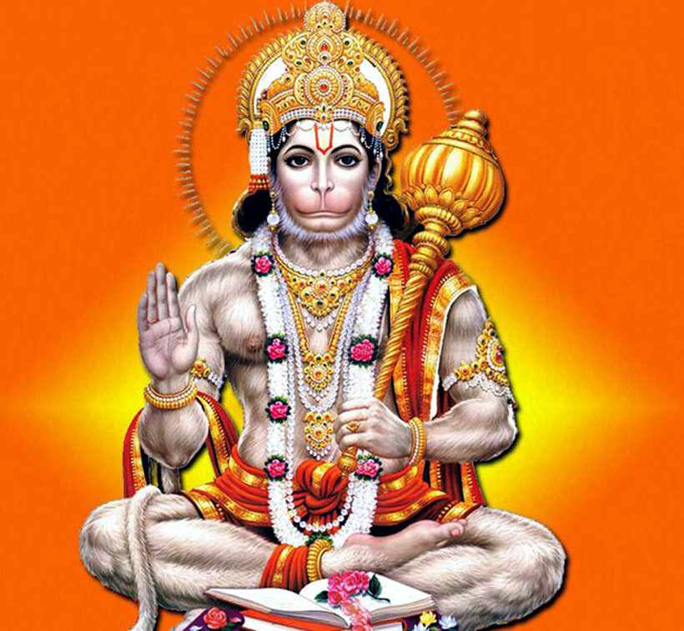
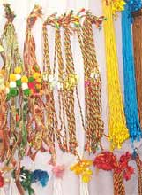
Vocabulary
Hinduism – the religion
Hindu – a person who follows Hinduism
Deity – A God
Mandir – A Temple
Shrine – A cupboard or table containing all the things a Hindu needs to worship.
Dharma – right way of living
Puja - Worship
Hinduism – Y3/4
Where Hinduism Began: India
Sacred Text:
The Vedas
Festivals –These are a few:
Divali, Holi, Raksha Bandhan
Om symbol
Places of Worship:
- The Mandir (temple)
- At home with a shrine
Diwali is a festival that celebrates a story of good winning over evil. Rama and Sita are the main characters.
Diwali is the five-day Festival of Lights, celebrated by millions of Hindus.
Houses, shops and public places are decorated with small oil lamps called divas. People also enjoy fireworks and sweets too, so it’s really popular with children.
Worship
Hindus worship is usually done in front of a shrine
Worshipper must be clean
Remove shoes
Ring bell
Light Diva Lamp and wave around
Light incense sticks and move around.
Place red powder as a dot on forehead of deity.
Place red dot on own forehead.
Say prayers
Share food.
Main Beliefs
Dharma-right way of living
Reincarnation-after death of the body the soul enters another living thing.
Moksha-liberation of the soul from the cycle of death rebirth.
Truth-is eternal
Vishnu – is the preserver God he comes to earth in many forms – most famous he is Rama or Krishna.
Hindu Temple is called a Mandir.
Gods
One supreme being: Brahman
Popular Deities (Gods): Brahma, Vishnu, Shiva, Hanuman, Lakshmi, Ganesh.
Fireworks at Diwali time
Rangoli patterns at Diwali time
A home shrine containing one of the Hindu Gods – Ganesh - he is remover of obstacles and God of wisdom.
Lakshmi–Goddess of wealth and purity.
Festival: Raksha Bandhan, also abbreviated to Rakhi, is the Hindu festival that celebrates brotherhood and love.
Traditionally, during the festival sisters tie a rakhi, a bracelet around their brothers' wrists to celebrate their relationship.
Hanuman – The monkey god – is god of courage and strength.

