Slide 1
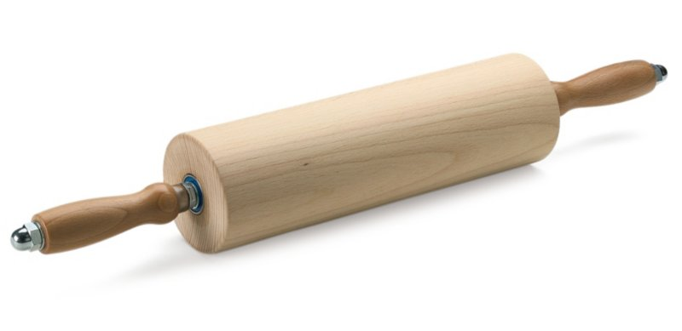
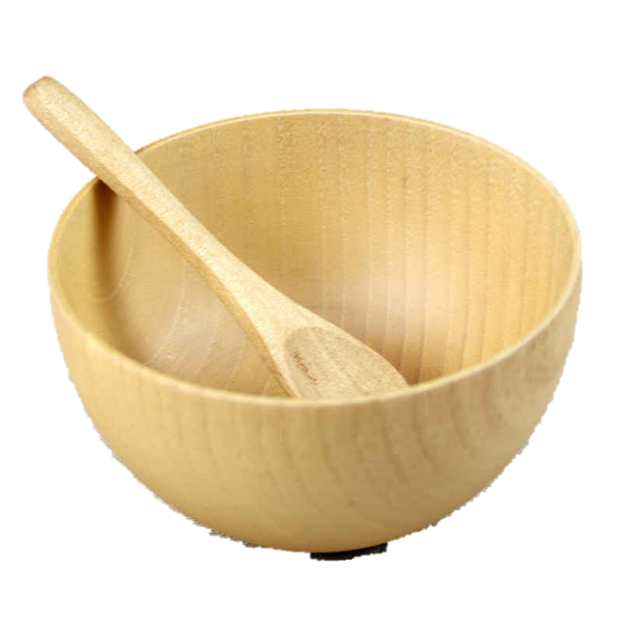
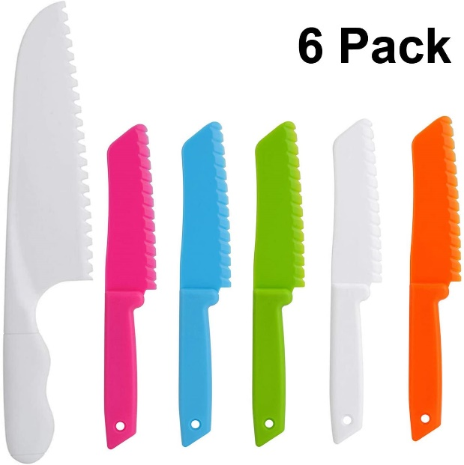
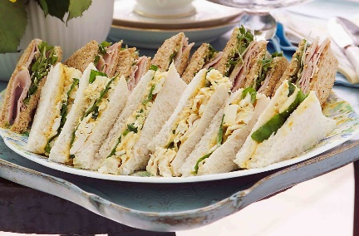
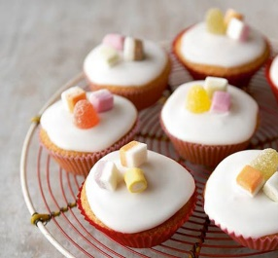
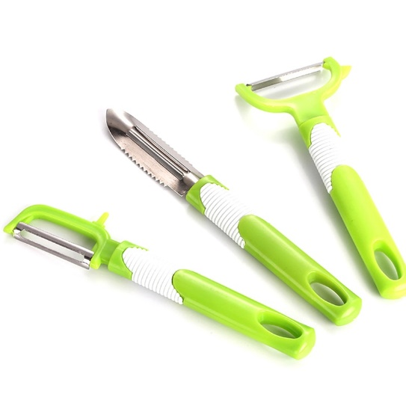
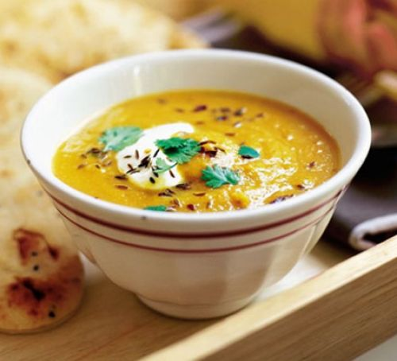
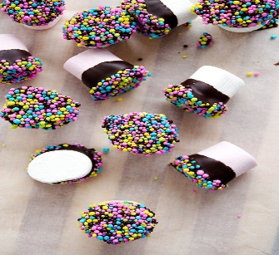
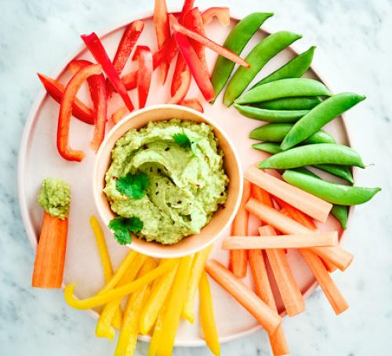
Research
Evaluate
Design
Make
Sherdley Primary School: DT Knowledge Organiser.
Cooking and nutrition: KS1
Cool cooking and nutrition vocabulary!
Year 1
Year 2
C
Use a range of basic skills to prepare a simple dish for purpose.
hygiene | Actions which maintain good health and prevent the spread of disease and bacteria.
safety | Protecting yourself or others from risk of danger or injury.
peeling | To remove the outer layer of an ingredient i.e. the skin of an apple.
purpose | The reason that a product is made. I.e. sandwiches for a picnic.
Use a range of basic skills such as knife skills, rolling, peeling, mixing and chopping to prepare a simple dish for purpose.
Cooking and nutrition tools!
C
Red riding hood’s picnic food!
C
Seasonal soups!
C

Slide 2
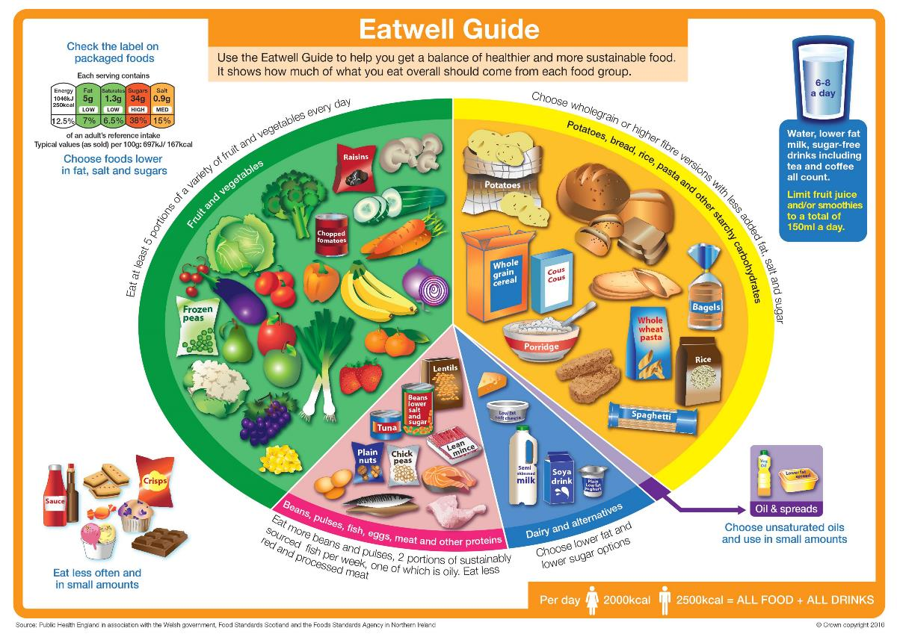
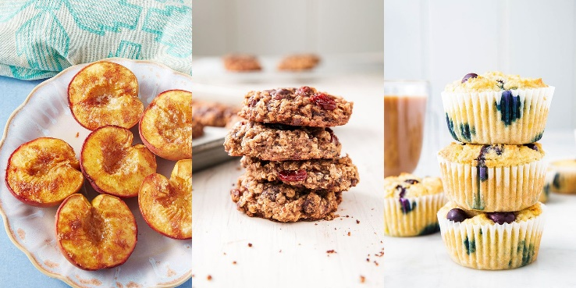
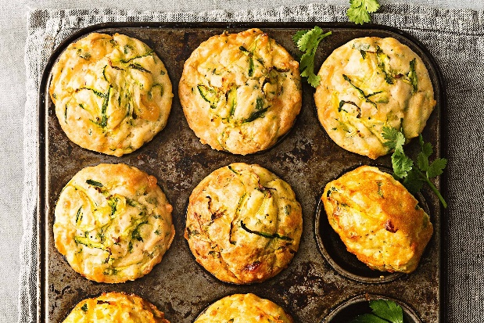
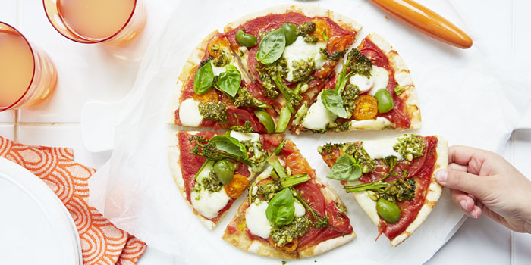
Research
Evaluate
Design
Make
Sherdley Primary School: DT Knowledge Organiser.
Cooking and nutrition: LKS2
Cool cooking and nutrition vocabulary!
Year 3
Year 4
C
Create a healthy dish by understanding the components of a healthy balanced diet.
hygiene | Actions which maintain good health and prevent the spread of disease and bacteria.
safety | Protecting yourself or others from risk of danger or injury.
baking | To cook food by dry heat. Baking does not expose food to a flame.
healthy foods | A natural, balanced food which aids health, growth and repair.
Create a healthy series of dishes using various cooking techniques such as baking.
Eat well guide!
C
Sweet and savoury healthy baking!
C

Slide 3
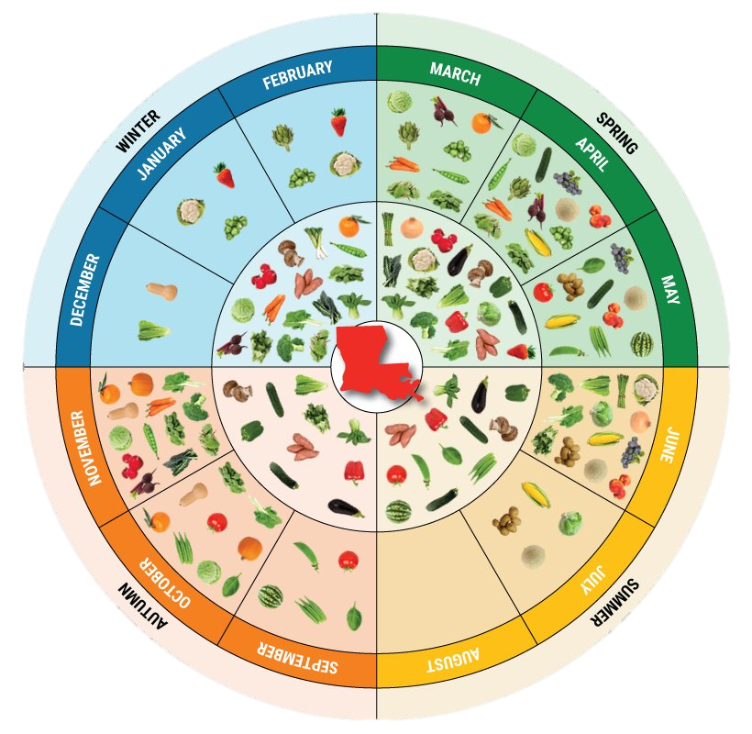
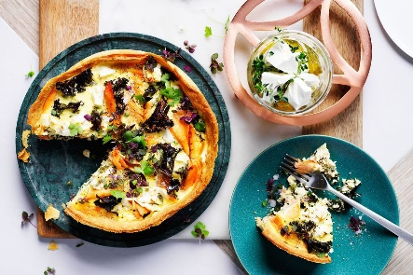
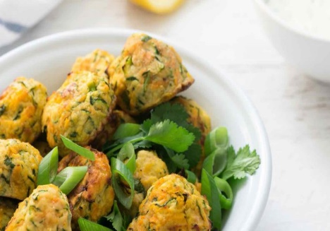
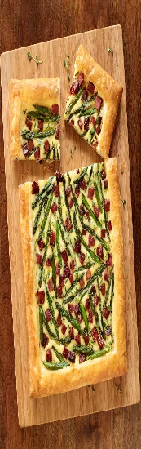
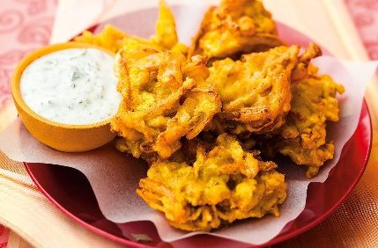
Research
Evaluate
Design
Make
Sherdley Primary School: DT Knowledge Organiser.
Cooking and nutrition: UKS2
Cool cooking and nutrition vocabulary!
Year 5
Year 6
C
Create a predominantly savoury dish, understanding the concept of seasonality using a range of cooking skills.
hygiene | Actions which maintain good health and prevent the spread of disease and bacteria.
safety | Protecting yourself or others from risk of danger or injury.
seasonality | Seasonality or seasonal produce refers to the time of year when the harvest or flavour of a type of food is at its peak or best. For example July = strawberries, raspberries and beetroot.
rearing | A large scale operation where produce is farmed/cared for on a large scale i.e. cows for their milk and meat.
processing | This term refers to the transformation of agricultural products into food. I.e. grain into flower and milk into cheese.
agriculture | The process of farming such as growing crops and rearing animals to provide products such as food, milk and wool.
savoury | A food which is largely salty or spicy. The opposite of sweet.
Understand how ingredients are grown, reared, caught and processed, Create a savoury meal using a range of cooking skills.
Seasonality guide!
C
C
Healthy savoury dish ideas!

