Slide 1
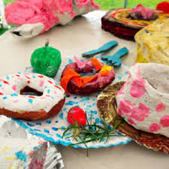
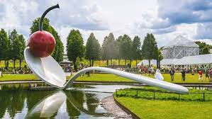
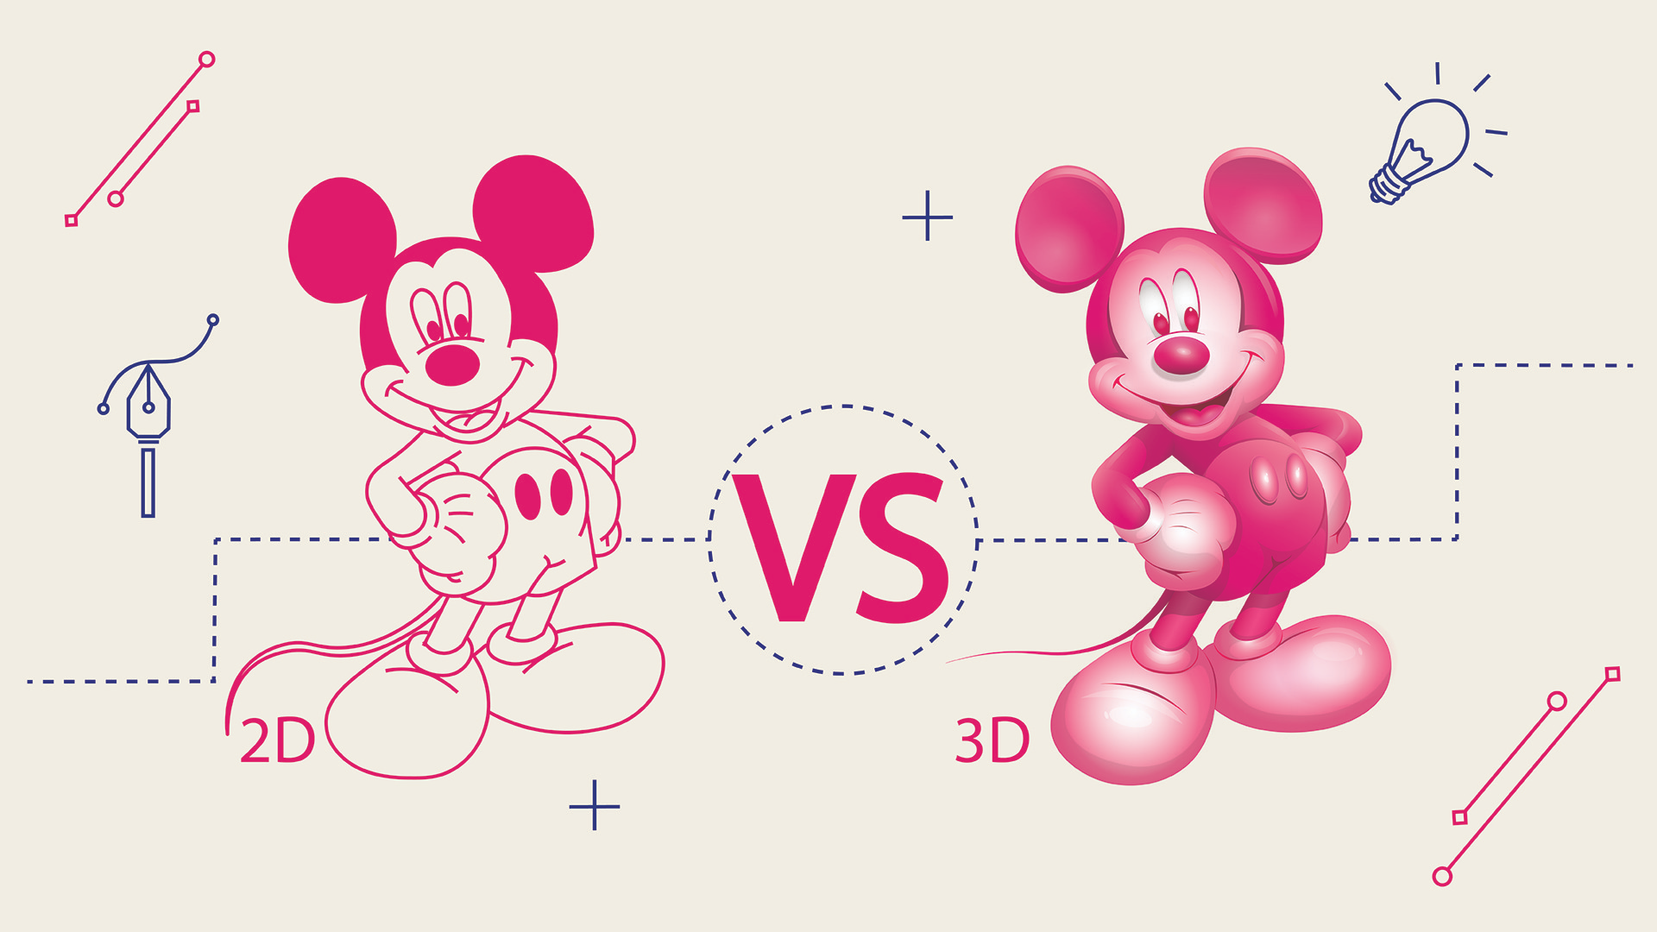
Key Vocabulary
Key Word | Definition
Relationship | The way that different elements of a work of art are connected to each other or relate to each other.
2 Dimensional (2D) | Something that exists in the two dimensions, height and width. Drawing, painting, and photography are all forms of two-dimensional artwork.
3 Dimensional (3D) | Shapes with three dimensions, width, height and depth.
Design through making | When artists go straight into making something, rather than drawing it out, and then make changes as they go.
Construct | To build or make something.
Installation | Setting something up in a space in order for it to be used or looked at.
Fabric | Cloth or other material produced by weaving or knitting fibres.
Present | To show and talk about you work with others.
Share | Show work to others.
Collaborative | Produced by or involving two or more parties working together.
Art: Summer Term
Festival Feast (Sculpture)
Learning Sequence
Explore who Claes Oldenburg, Lucia Hierro and Rowen Briggs Smith represent food through sculpture.
1
Use drawing skills to create pictures of food.
2
Use Modroc to create sculptures of food.
3
Complete Modroc sculpture.
4
Create a collaborative observational drawing on fabric.
5
Share, review and reflect on artwork.
6

