Slide 1

Welcome to our
FS2 Phonics Workshop

Slide 2
What is phonics?
Phonics is how we teach reading and writing. We teach the children to break down the sounds in words. This enables them to read and write independently.
Phase One FS2 | Sound discrimination
Phase Two FS2 | Single sounds
Phase Three FS2 | Diagraphs and Trigraphs
Phase Four Y1 | Adjacent Consonants
Phase Five Y1 | Alternative spellings

Slide 3
Phase One
Environmental Sounds | Animal sounds, Listening walks, barrier games.
Instrumental Sounds | Which instrument, Match the sound (loud & quiet), Making shakers
Body Percussion | Pass the sound, Songs/ stories where the children can join in.
Rhythm and Rhyme | Syllables, rhyming songs / stories.
Voice sounds | Boom chikka boom, Old Macdonald, Voice trumpets.
Alliteration | Recognizing the first sound in words. Silly soup, I spy, Bouncing the first sound.
Oral blending and segmenting | Blending – c-a-t ---→ cat Segmenting – cat ---→ c-a-t (CVC words)

Slide 4
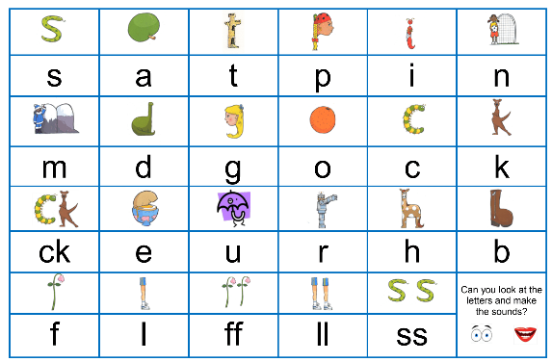
Phase Two
Reading – Look at the letters, make the sound, blend the sounds together.
Writing – Say the word, robot the word, write the word.
Some sounds are long and stretchy.
Some sounds are short and bouncy.
Each sound in Phase 2 has a picture and rhyme that reminds the children how to form the letter correctly.

Slide 5
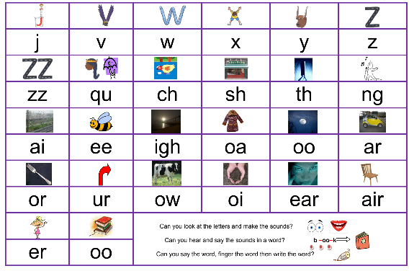
Phase Three
Digraph – Two letters that make one sound.
Trigraph – Three letters that make one sound.

Slide 6
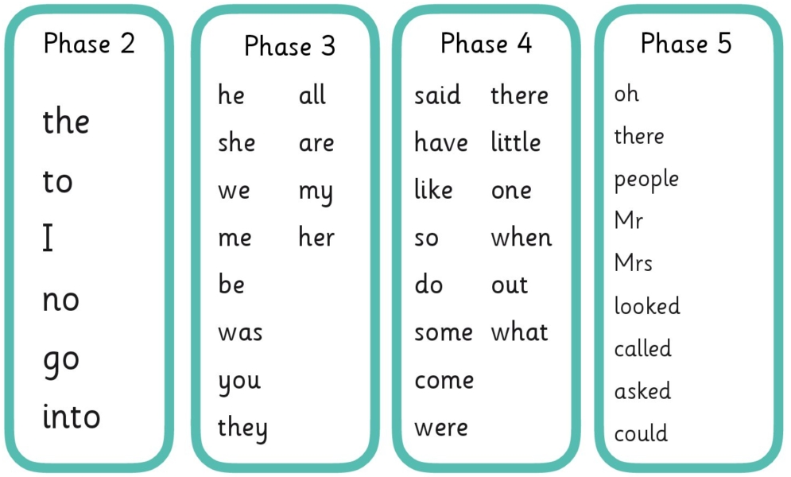
Sight words
We see it and we say it!
We never sound out a sight word – use letter names.

Slide 7
How can you help?
Phase One – Initial sounds – their name, I spy etc
Oral blending and segmenting. CVC words: c-a-t, d-o-g
Simon says…
Phases Two/ Three – Flashcards
Spotting sounds/sight words when reading.
Reading and writing CVC words with sounds learnt.
Using reading mantra and sight words when reading at home.
Using phonics and sight words to write simple sentences e.g The dog is red.

Slide 8
Questions…

