Slide 1

Meet the Teacher y6
September 2024

Slide 2

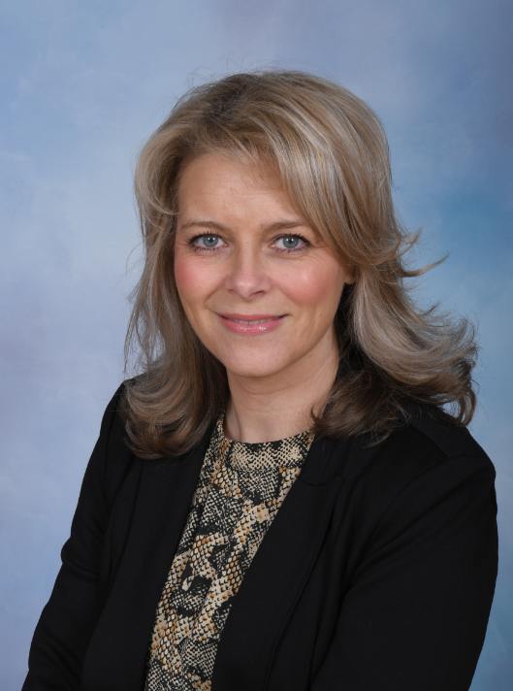
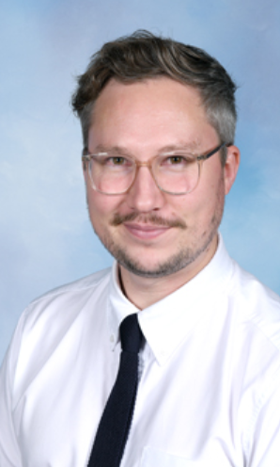
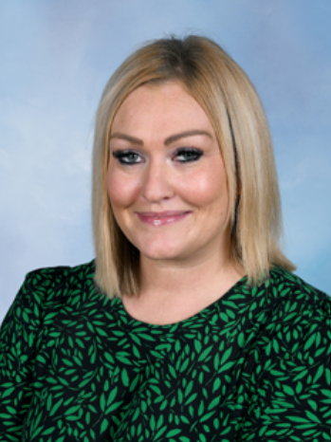
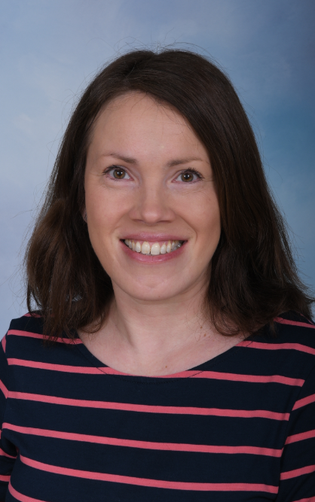
Sherdley SLT
Mrs Bennett
Acting Headteacher
Mrs Davies Mrs Stroud Mrs Fleming
Assistant Head Acting Deputy Head KS1 Lead
& SENCO

Slide 3
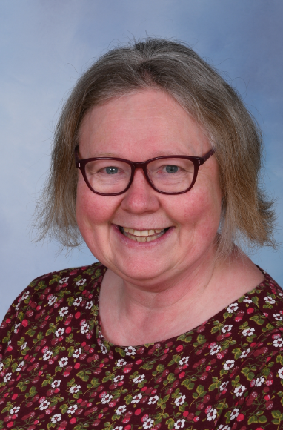
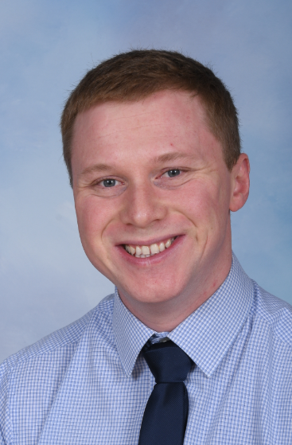
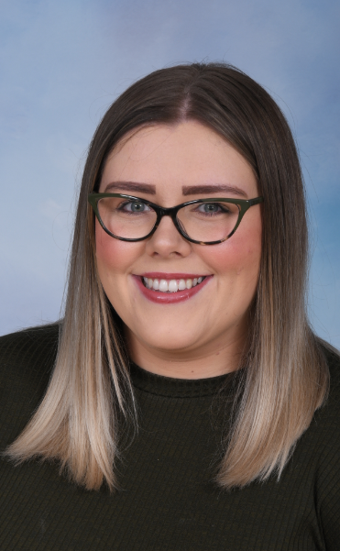
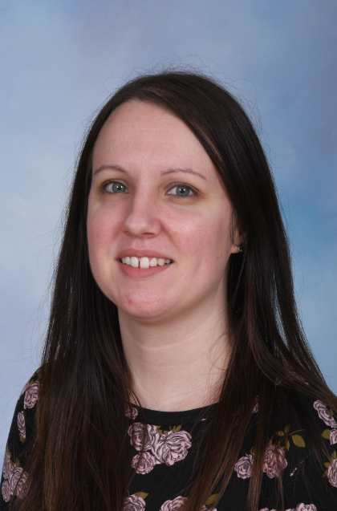
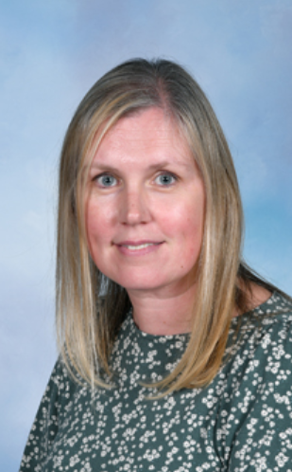
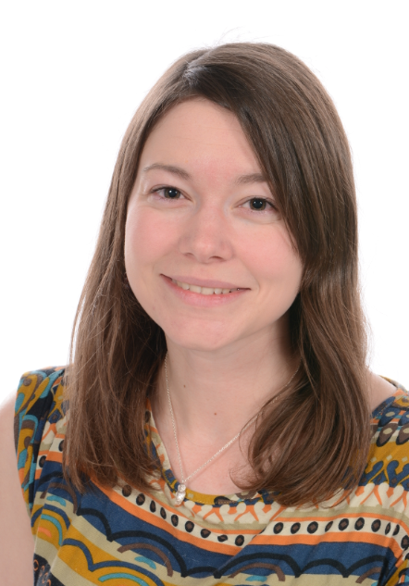
Sherdley MLT
Mrs Roberts Mr Hughes Miss James Mrs Williams Mrs Orbison Mrs Wrenn
EYFS Lead LKS2 Lead UKS2 Lead Deputy SENCO English Lead Phonics & Early
Reading

Slide 4
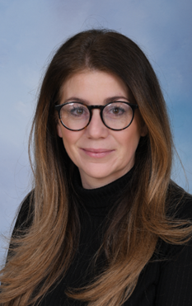


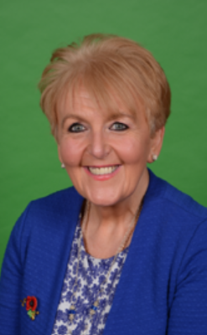
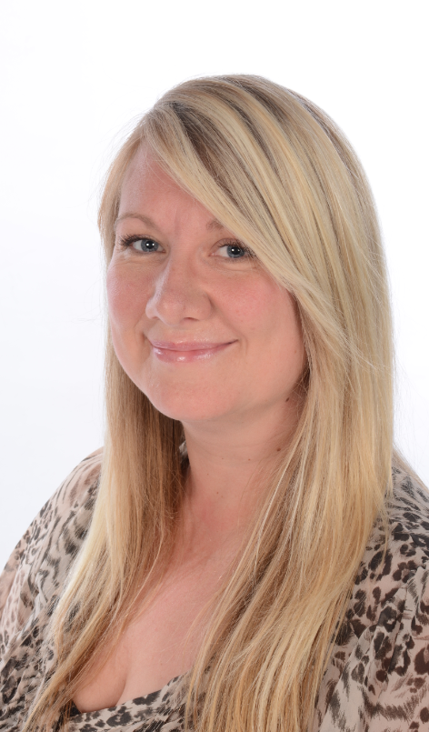
Sherdley Pastoral & Safeguarding Team
Sherdley DSLs
Mrs Stroud Mrs Eccleston
Sherdley DDSLs/pastoral team
Mrs Bennett Mr Davies Miss James Mrs Lakey Mrs Bridge

Slide 5


Slide 6

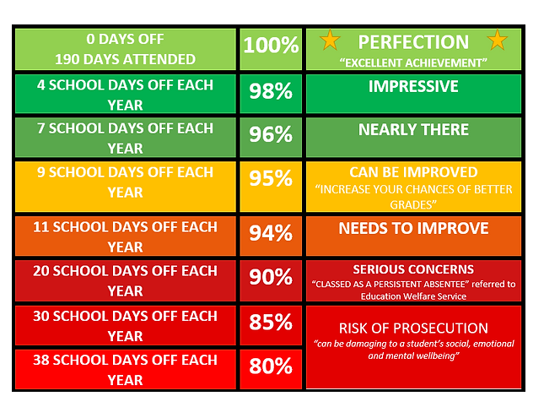


Notes:
As a parent, you are legally responsible for making sure your child gets a suitable fulltime education.
​
To help your child attend as much school as possible, you can:
Promote positive and healthy attendance patterns with your child and set good bedtime and morning routines.
​
Ensure your child arrives at school every day, on time and equipped and ready to learn.
​
Ensure we have at least three up-to-date addresses and telephone numbers so we can contact you quickly when required.
​​
Report absence via Class Charts before 8:30am each day until your child returns to school.
​
Ensure medical appointments are made outside of school time.
​
Avoid making holiday requests during term time.
​
Contact school if you are experiencing difficulty getting your child to attend school.
​
Work with the school and any other agencies of support to resolve any difficulties which may affect regular school attendance.

Slide 7
What we expect from parents / carers: | What you can expect from us:
As a parent, you are legally responsible for making sure your child gets a suitable fulltime education. ​ To help your child attend as much school as possible, you can: Promote positive and healthy attendance patterns with your child and set good bedtime and morning routines. | Celebration of excellent student attendance and punctuality on a weekly and termly basis in assemblies with a variety of rewards and recognition.​ ​
Ensure your child arrives at school every day, on time and equipped and ready to learn. | An onsite Attendance Team dedicated to working with students, families and staff to improve attendance each and every day.
Ensure we have at least three up-to-date addresses and telephone numbers so we can contact you quickly when required | A pastoral team to carry out pastoral work with students in raising their attainment and achieving their full potential.
Report absence via school app before 8:30am each day until your child returns to school. Aim for medical appointments to be made outside of school time. | Counselling service that children can access (waiting lists apply)
Avoid making holiday requests during term time
Contact school if you are experiencing difficulty getting your child to attend school.
Work with the school and any other agencies of support to resolve any difficulties which may affect regular school attendance.

Slide 8
New attendance legislation: Sherdley will adopt from 19th August 2024
Holidays during term time will not be authorised.
Parents can request ‘Leave of Absence’ in exceptional circumstances. Evidence of this will be required to support any decision made by the head teacher.
Thresholds for Penalty Notice have changed. Reduced to 5 days / 10 sessions (am/pm/late after the close of register) in a 10 week period. Fines are £160 per parent, per child. Reducing to £80 if paid within 21 days.
Second year, if a Penalty Notice is issued, the fine is £160 with no option to reduce.
Third year – the family will be legally prosecuted.
National agenda and will cross boroughs.

Slide 9
Parent survey feedback
Communication
Parent App for Trackit Lights is being developed, this will roll out after October Half Term.
A new school communication app is also currently being rolled out, this should reach more parents
We will be sharing the curriculum more frequently with you
After school clubs will be posted on the app for your information
All information you need to know will also be sent via the app well in advance

Slide 10
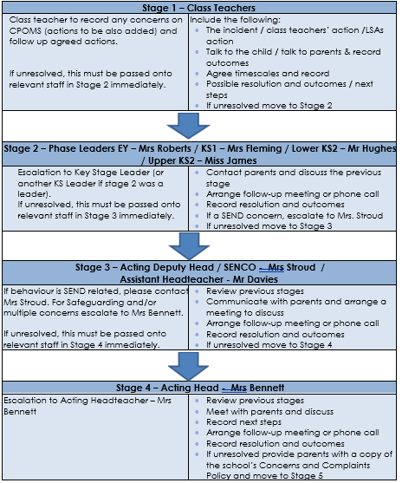






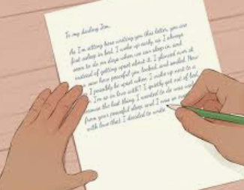

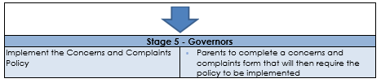
Graduated Approach

Slide 11

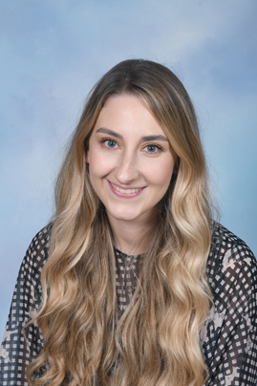
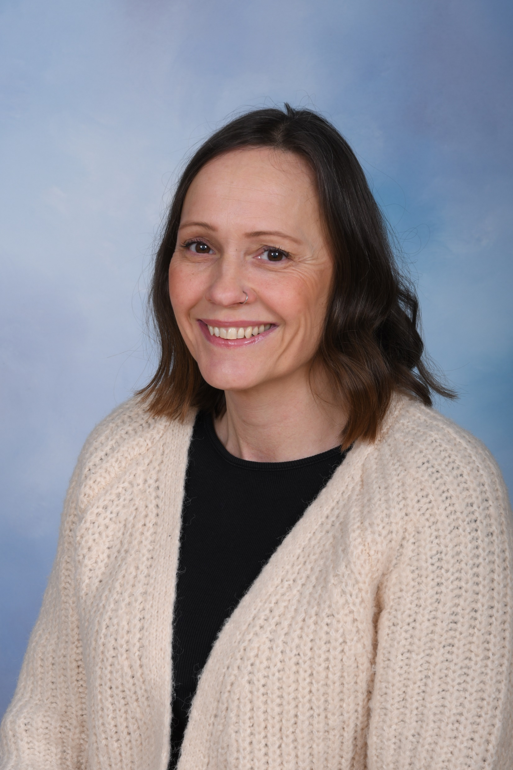
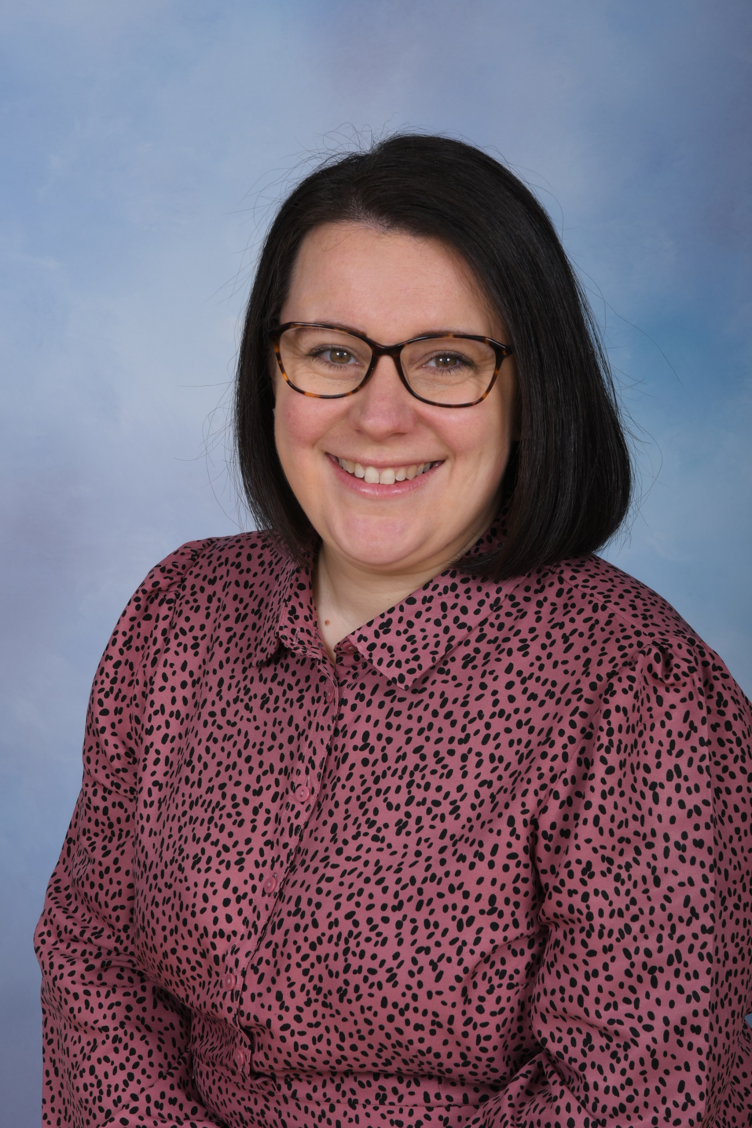
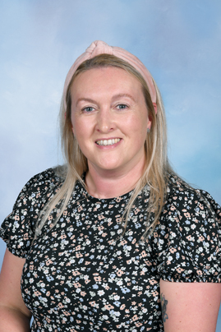
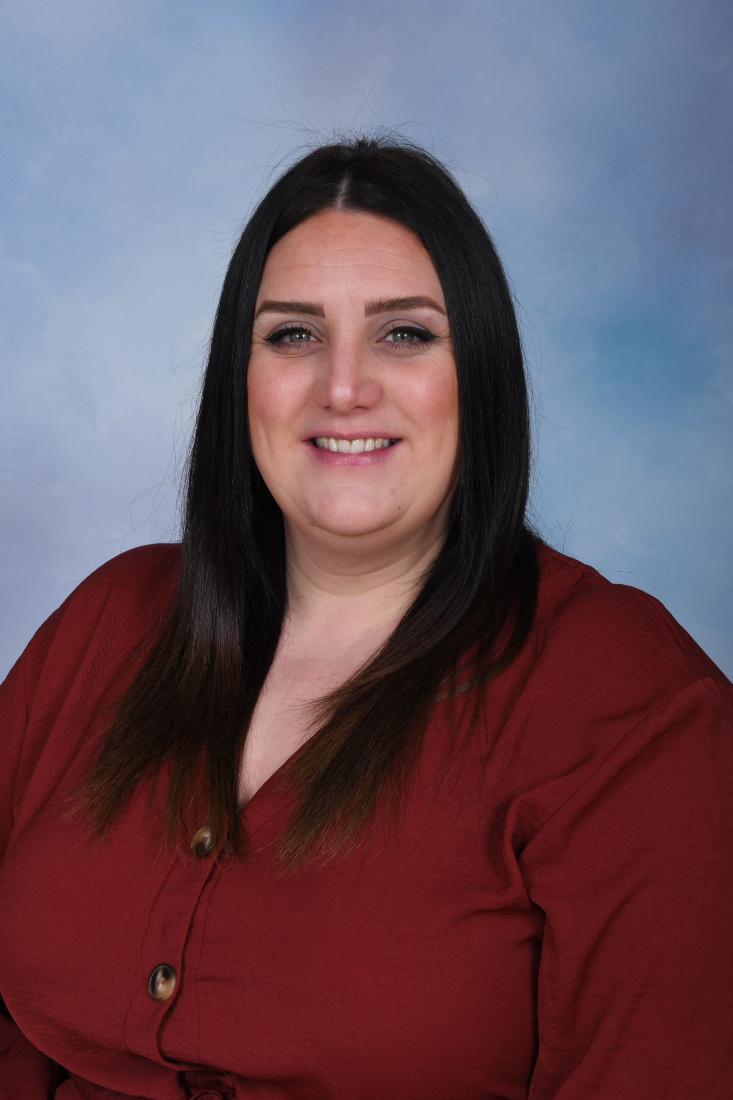
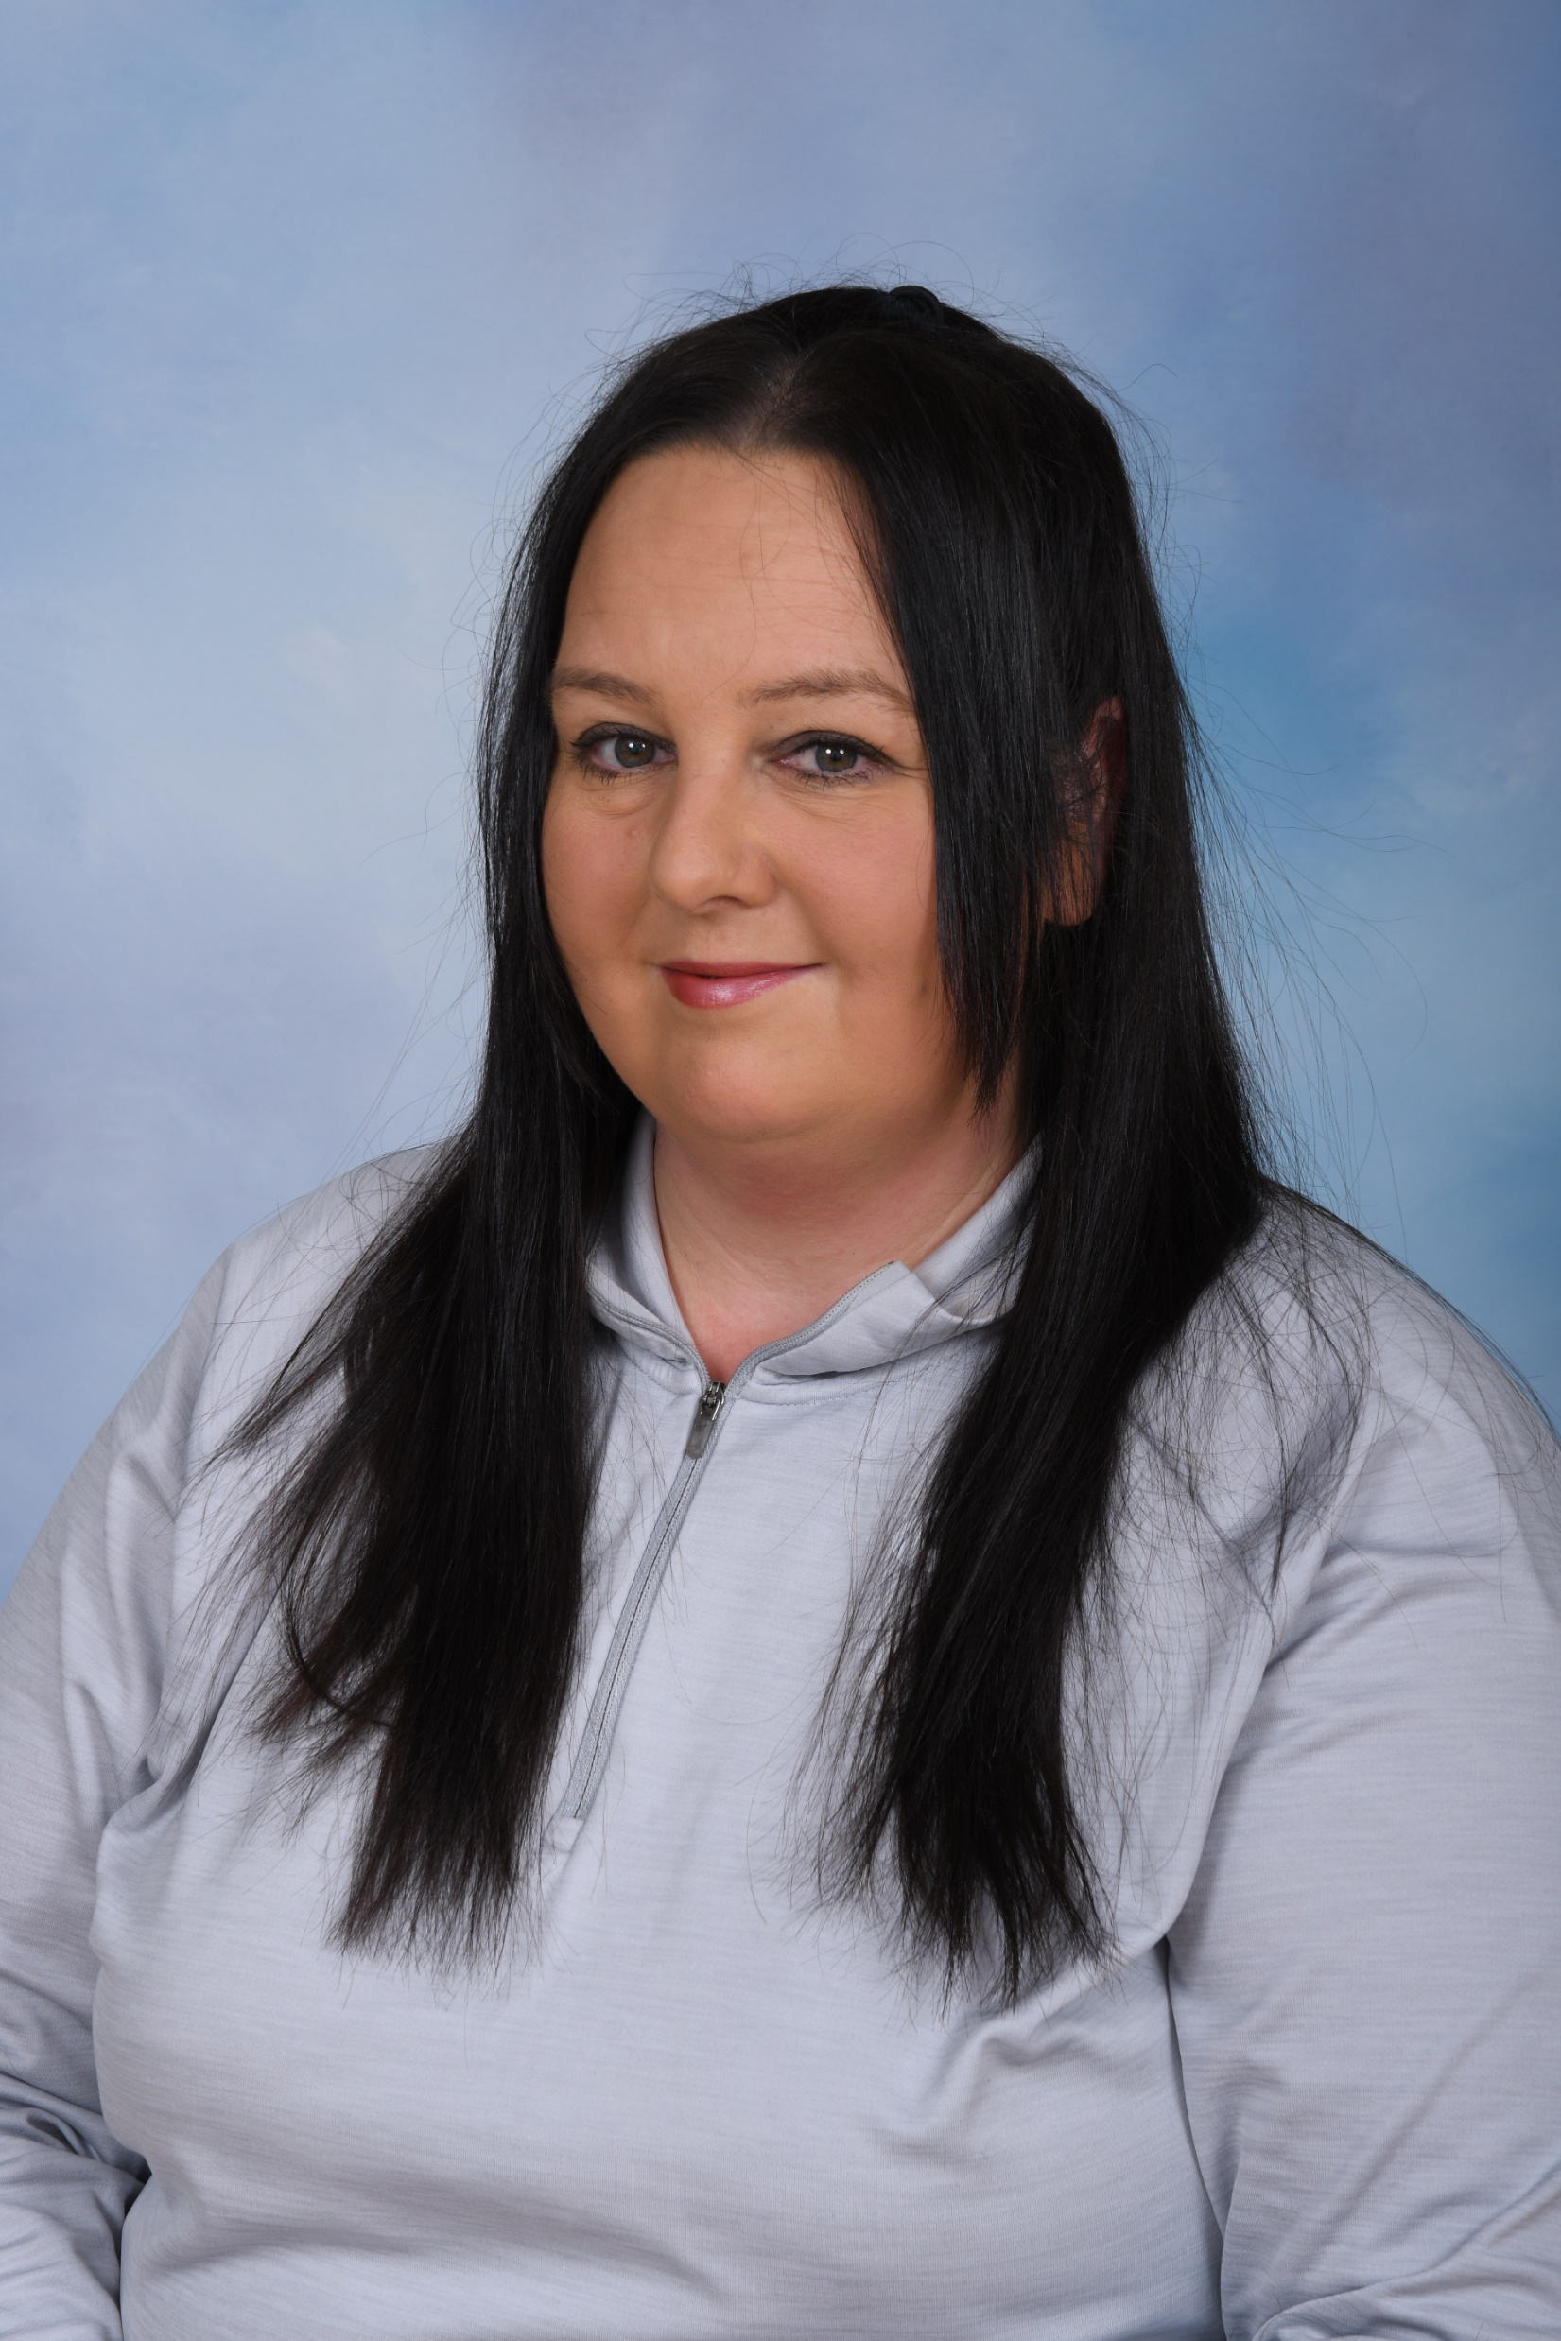
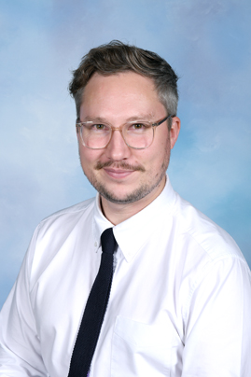
Staff in year 6
Miss James & Mrs Clayton – Y6 Teachers
Mrs Stout
6J LSA
Mrs Pennington
6C LSA
Mrs Tilston
6J 1:1 Support
Miss Tyms
6J/6C LSA
Mrs Leatherbarrow
6C 1:1 Support
Mr Davies
Y6 PPA Cover

Slide 12
The School Day – new times
Year 3 - 6
8:45 – Bell rings to enter school – children to line up on the KS2 yard
3:15 – School closes

Slide 13
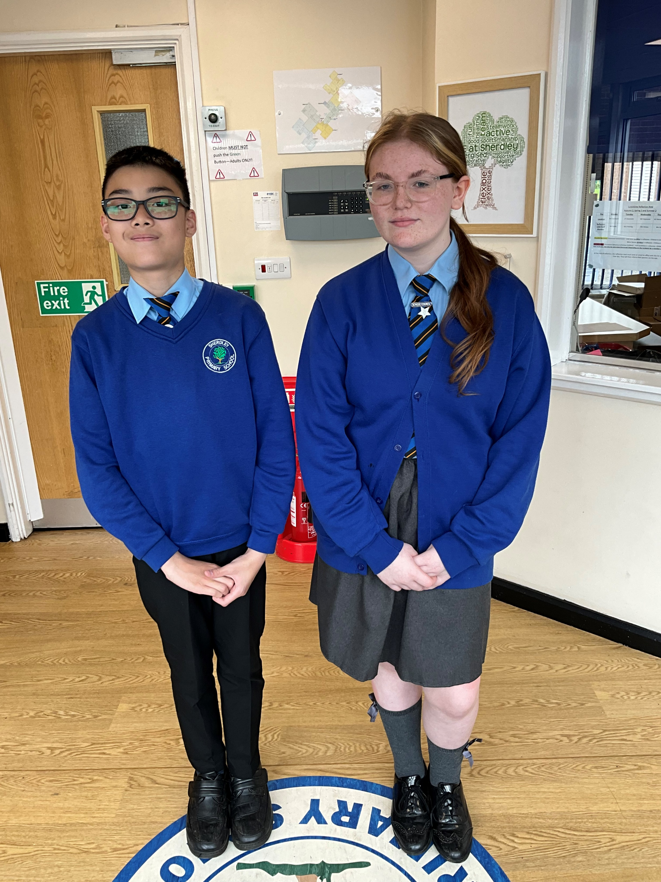
Uniform expectations
Uniform is key in Y6, this again prepares them for the demands of secondary school uniform polices.
Ties must be worn, earrings removed for P.E, school shoes (not trainers) to be worn and longer hair tied back.
P.E Kits remain the same as last year ☺

Slide 14
Autumn 1 Curriculum
Reading – A range of texts and purposes
Maths – Place value, rounding, addition, subtraction
English – Writing based on WW1, War horse, Alma, The Grinch
and Charles Darwin
Science – Light
R.E – Christianity
Art – Paul Nash
History – WW1
PSHE – Being me in my world
Music – Listening and appraising music
MFL – Greetings and all about me
P.E – Hockey, dance and swimming

Slide 15
In Y6, we have an extra level of responsibility to prepare your child for their transition to secondary school.
Our expectations for Y6 are always very high and we aim to mirror some of our local secondary schools’ values to prepare your child for Y7 and beyond.
This includes areas such as behaviour, attitude to learning, homework, uniform and independence.
We would really value your support with this as we are all on the same team - we want the best for your child! ☺

Slide 16
Homework
In Y6, we use an online homework tool called SATs Companion. Letters will come home with login details this week. We will show the children how to use it beforehand.
The children will get 1 piece of maths and 1 piece of reading/SPaG each week.
This will be based on what we have learned the previous week in most cases.
In addition to this, reading and continuing to work on times tables at home is absolutely crucial to Y6 success.

Slide 17
Y6 Key Points
6J P.E days – Wednesday and Thursday (plus Friday for swimming until 27th September)
6C P.E days – Tuesday and Wednesday (Update about 6C swimming nearer to the time)
Y6 Residential – 16th – 18th October – more info nearer the time
Y6 SATs week – Week beginning Monday 12th May 2025

Slide 18
Y6 SATs
Y6 SATs week will be week beginning Monday 12th May 2025
The children will sit 6 tests – Spelling, SPaG, Reading, Arithmetic, Reasoning 2 and Reasoning 3
There will be plenty of information closer to the time about the SATs, including SATs breakfast – the children’s favourite!
Attendance/punctuality is absolutely crucial in this week – it is very rare the DFE will allow a child to do their test another day

Slide 19
Thank you for your time today!
Does anyone have any questions?
☺

