Slide 1
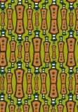
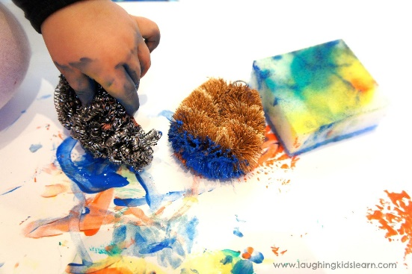
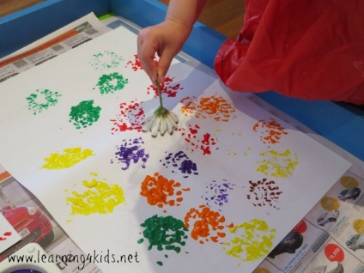
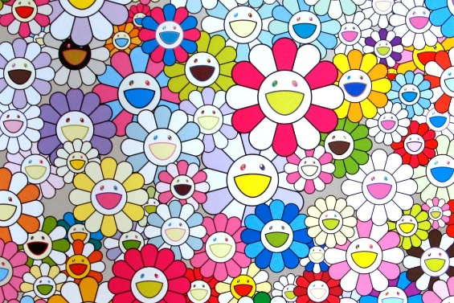
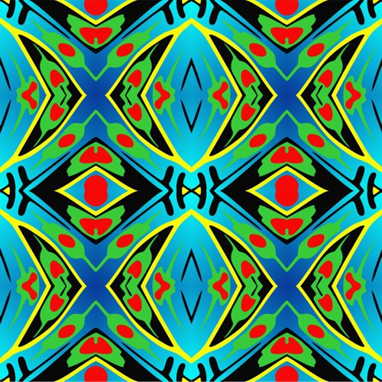
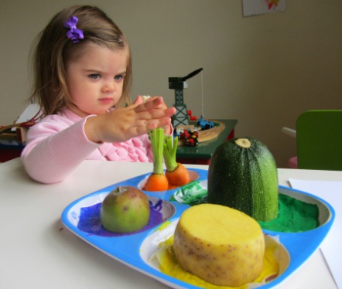

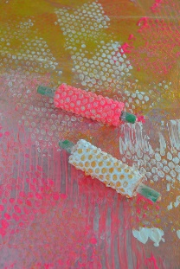

Perfect printing vocabulary!
Sherdley Primary School: Art Knowledge Organiser.
Printing: KS1
C
tools | An object which helps us to complete a task.
materials | The objects and substances used to create a piece of artwork.
printing | A reproduction of an original piece of art done using paint/ink. Often by pressing on top of the original with another material to create a copy.
patterns | A design consisting of colours, shapes and position in a piece of work. This is often repeated for effect.
repeating | The appearance of the same line, colour, shape or other visual element of a design.
Year 1
Year 2
Create simple, repeating and interesting patterns.
Develop imprinted images onto paper using a range of tools.
Print with a growing number of objects and materials.
Identify the different forms printing takes.
Repeating patterns
C
Pretty printing tools and techniques!
Takashi Murakami patterns!

Slide 2
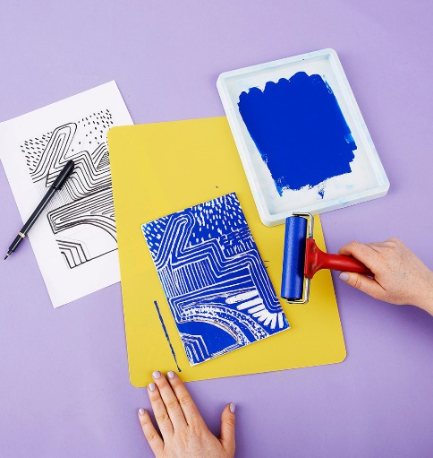
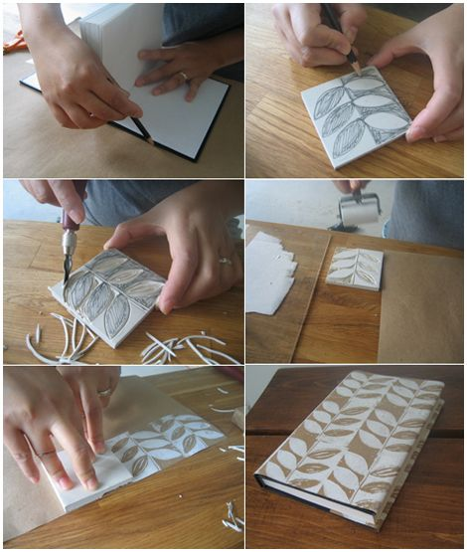
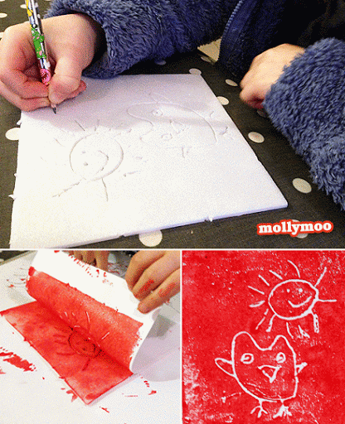
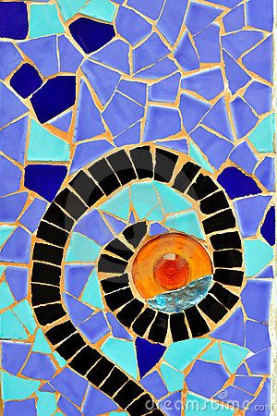
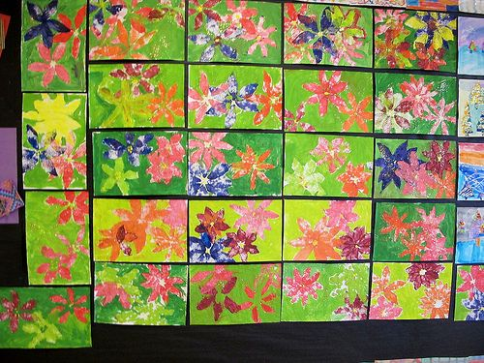
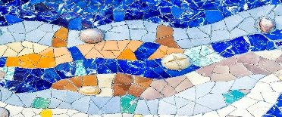
Perfect printing vocabulary!
Sherdley Primary School: Art Knowledge Organiser.
Printing: LKS2
C
relief printing | A method of printing where ink/paint is applied to a printing block (covering raised areas) and pressed onto paper.
impressed printing | An impressed printing block is created by carving out the surface of the material. The relief printing method is then used on this block.
mono printing | Mono printing is a printing tile or block that is only used once with no adaptations to the original pattern.
texture | The feel and appearance of a surface.
man made patterns | A noticeable pattern of artwork/architecture which has been designed by someone. It is often repeated.
modifying | To amend or change an aspect of a piece of art work. For example adding extra details to a printing block.
Year 3
Year 4
Create relief and impressed printing using a range of printing media. Using colour mixing and overlapping colour prints.
Recording textures, patterns of mono printing.
Using sketchbooks for recording various printing ideas, textures and styles.
Modify and adapt print to reflect man made patterns and artists’ work.
1
2
Georgia O’Keefe printing!
C
Antoni Gaudi man-made patterns!
3
C
1.Relief printing
2.Impressed printing
3.Mono printing
examples
C
C

Slide 3
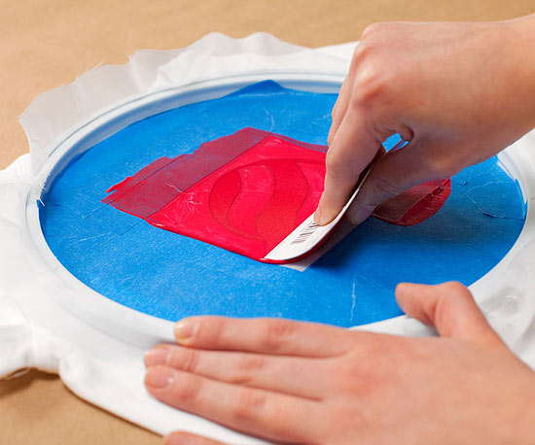
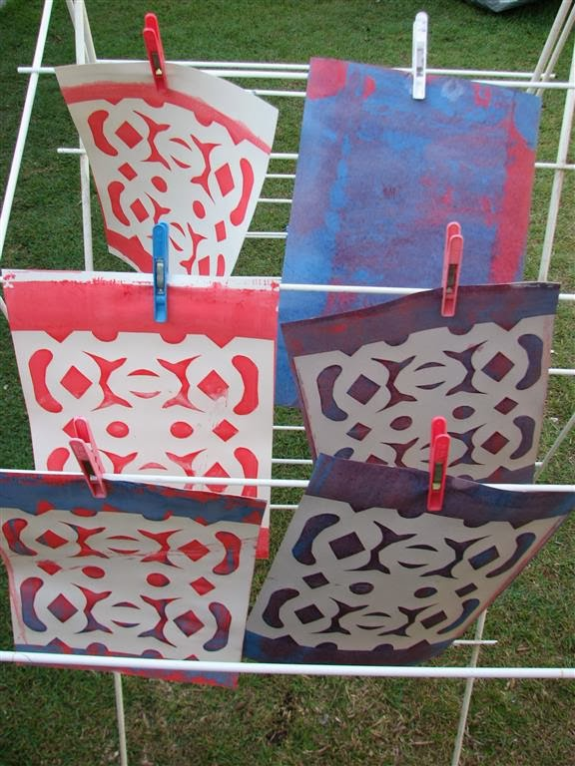
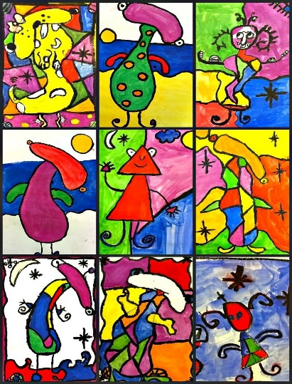
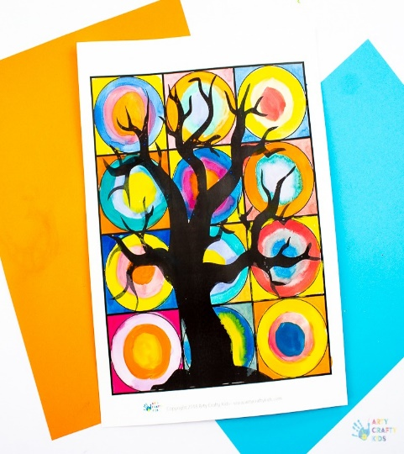
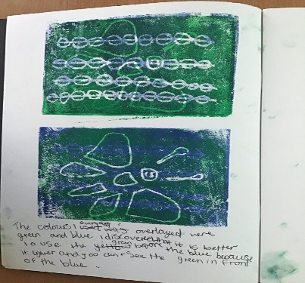
Perfect printing vocabulary!
Sherdley Primary School: Art Knowledge Organiser.
Printing: UKS2
C
screen printing | A printing technique where a mesh is used to transfer ink/paint onto fabric or paper. A stencil is used to block out certain areas of the print.
materials | The objects and substances used to create a piece of artwork.
printing | A reproduction of an original piece of art done using paint/ink. Often by pressing on top of the original with another material to create a copy.
evaluate | Discussing work to assess its particular strengths and weaknesses.
techniques | The manner in which an artist employs his/her skills to complete a piece of artwork. Here, this includes screen, mono, impressed and relief printing.
Year 5
Year 6
Design different prints and combining these using different materials.
Discuss and evaluate own work and that of others,
Build up drawings and images of whole or parts of items using various techniques.
Printing types
C
Miro printing ideas!
C
Kandinsky printing ideas!
C

