Slide 1

Art & Design at Holte School

Slide 2
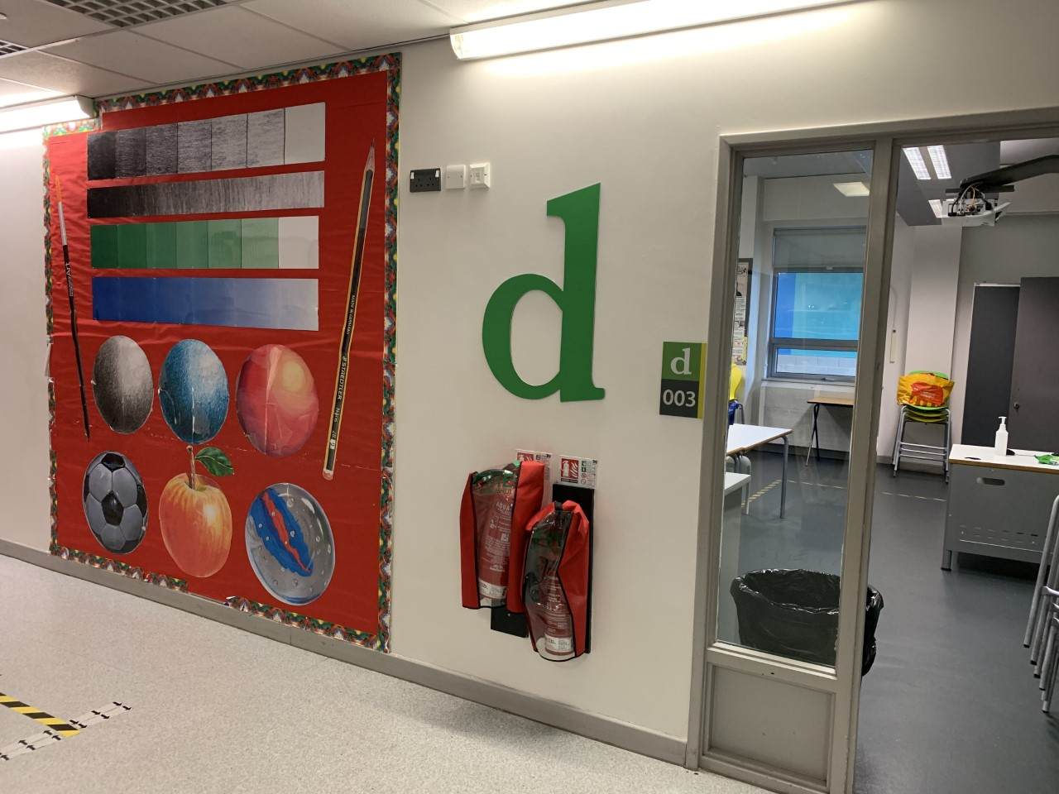

Welcome to Art & Design at Holte School. You will find us located in D Cluster. We have 2 Art classrooms, an Art office and a kiln room; as well as a cluster area outside our 2 classrooms which is being used as an exhibition area by Y12 at the moment.

Slide 3
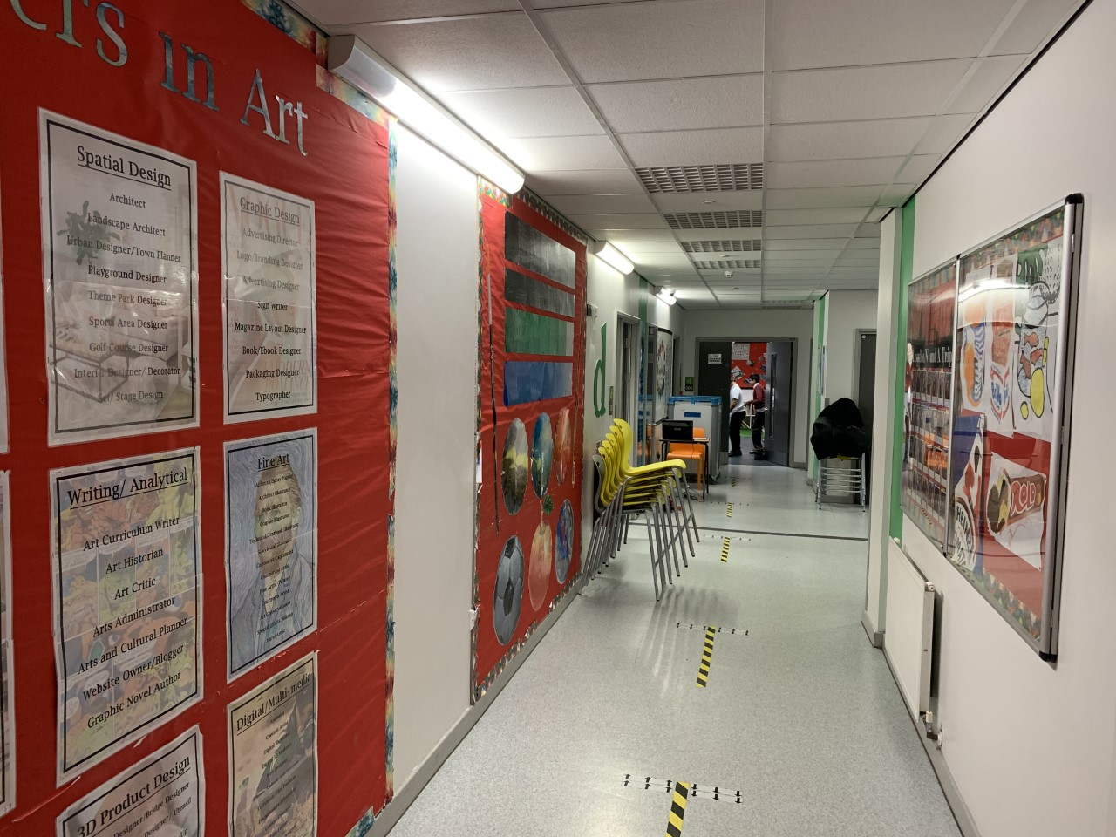
This is the entrance to D Cluster and this is what you will see when you come into our Art department.

Slide 4
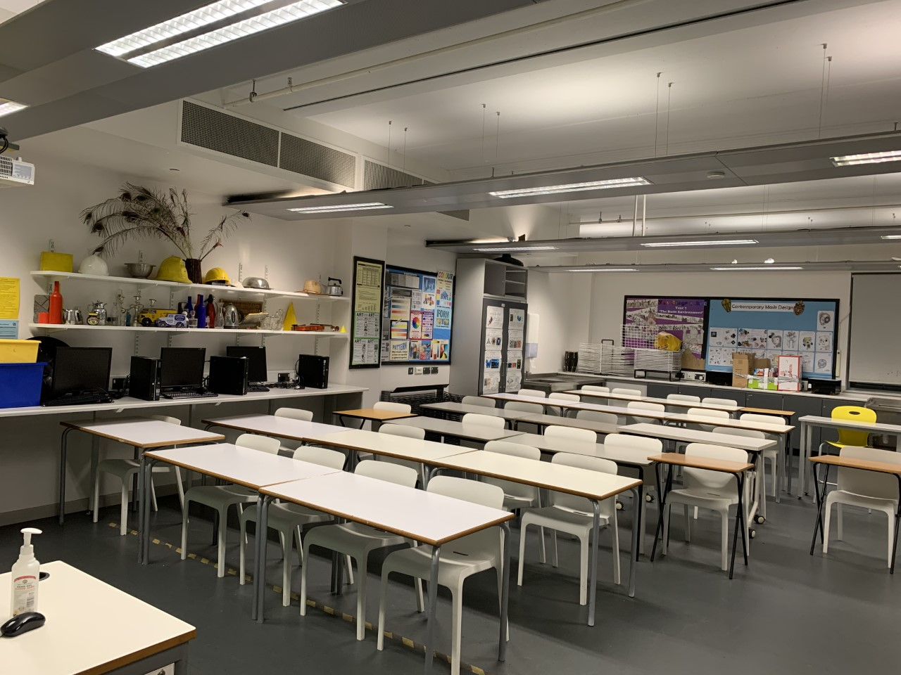
This is our first Art classroom it is called D003

Slide 5
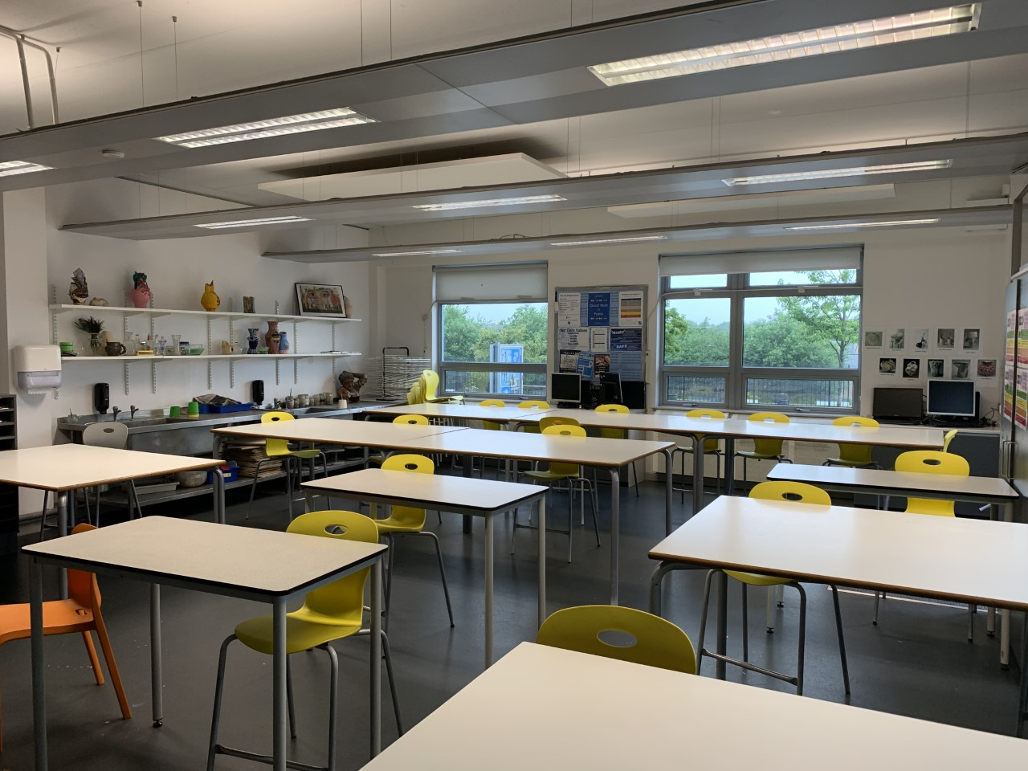
This is our second Art room it is called D007. This room is also used for teaching Ceramics – which is like Art, but instead we work in clay.

Slide 6
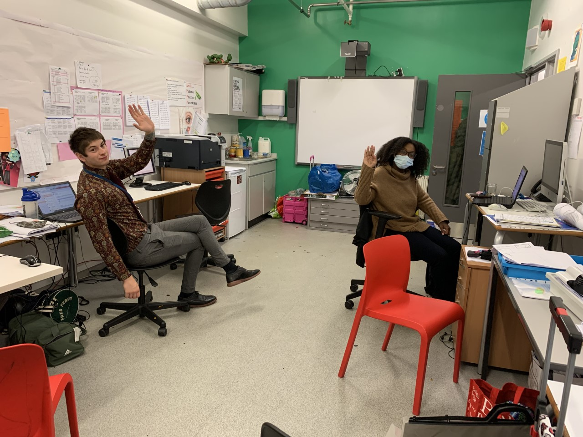
Here you can see 2 members of our Art department staff working in our Art office. We have 2 fulltime teachers of Art, 2 part time teachers of Art and a full time Art technician.

Slide 7
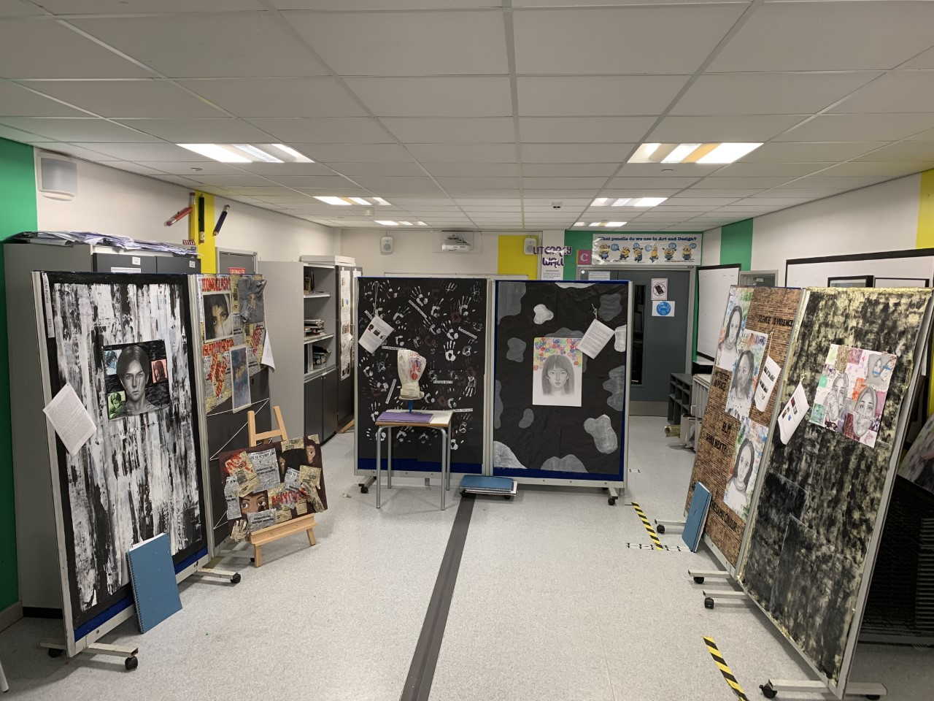
This our cluster area outside our two Art classrooms. At the moment this is an exhibition space for Year 12, A’Level Art.

Slide 8
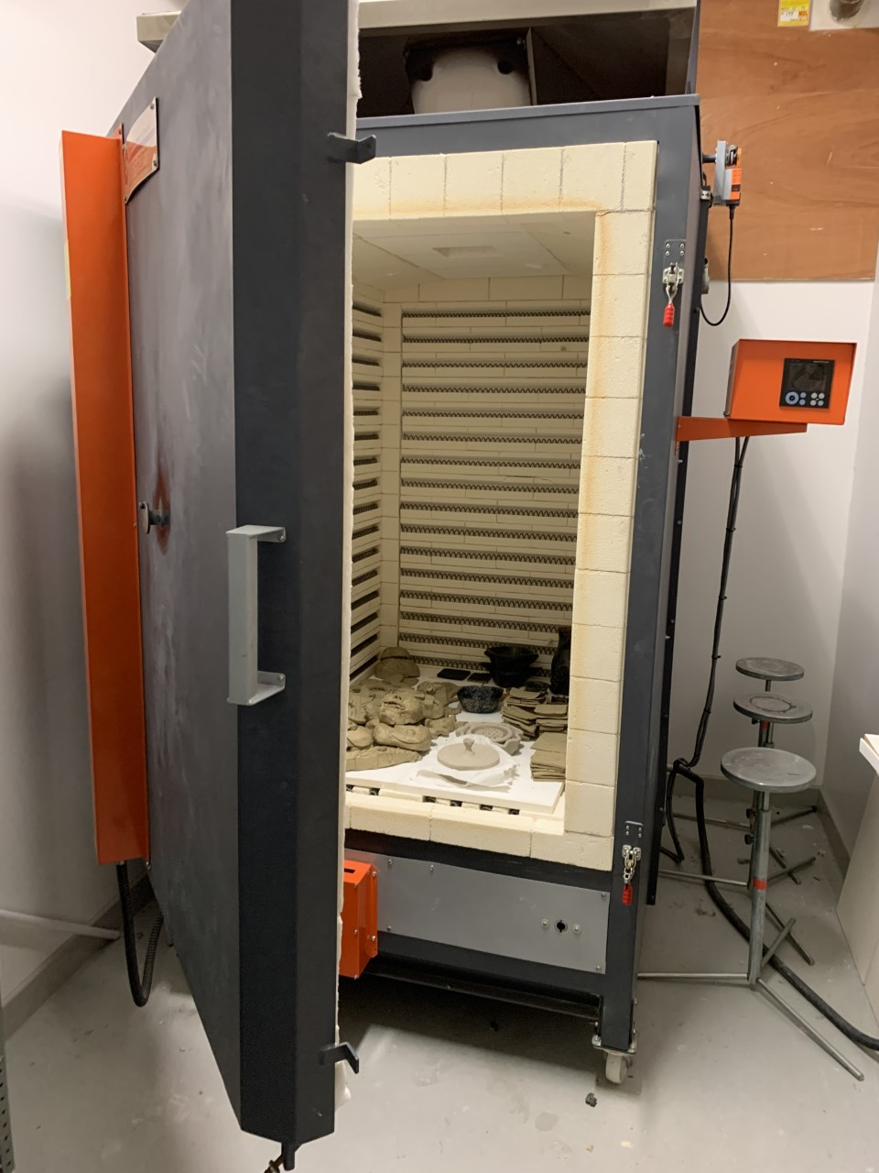
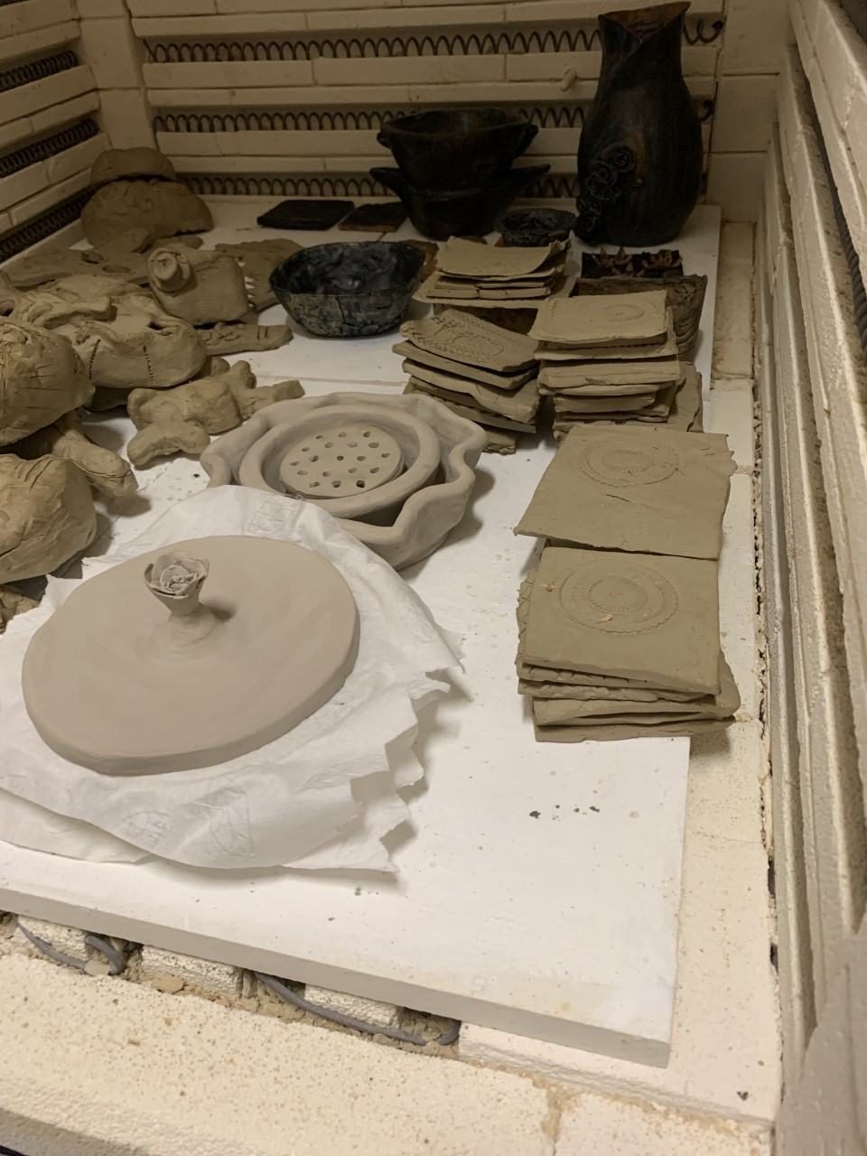
This is our kiln which we use to vitrify the clay - it is fired to a temperature above 1000 degrees centigrade.

Slide 9
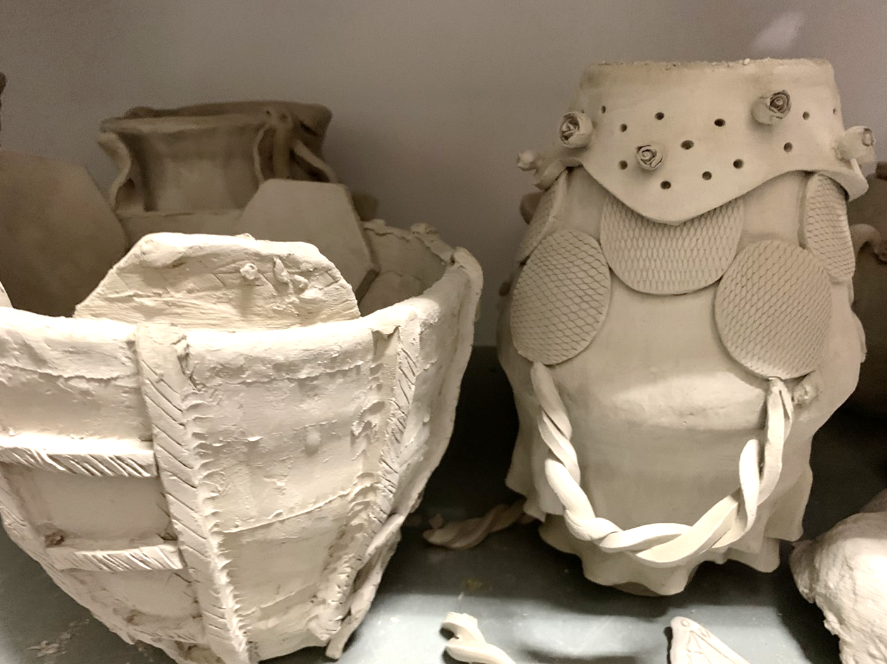
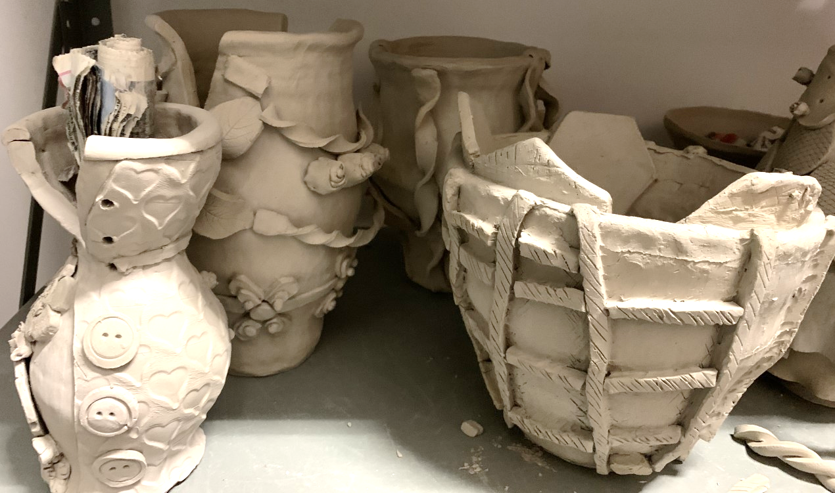
Here are some examples of unfinished clay pieces from Year 11, at Holte Ceramics is a GCSE subject

Slide 10
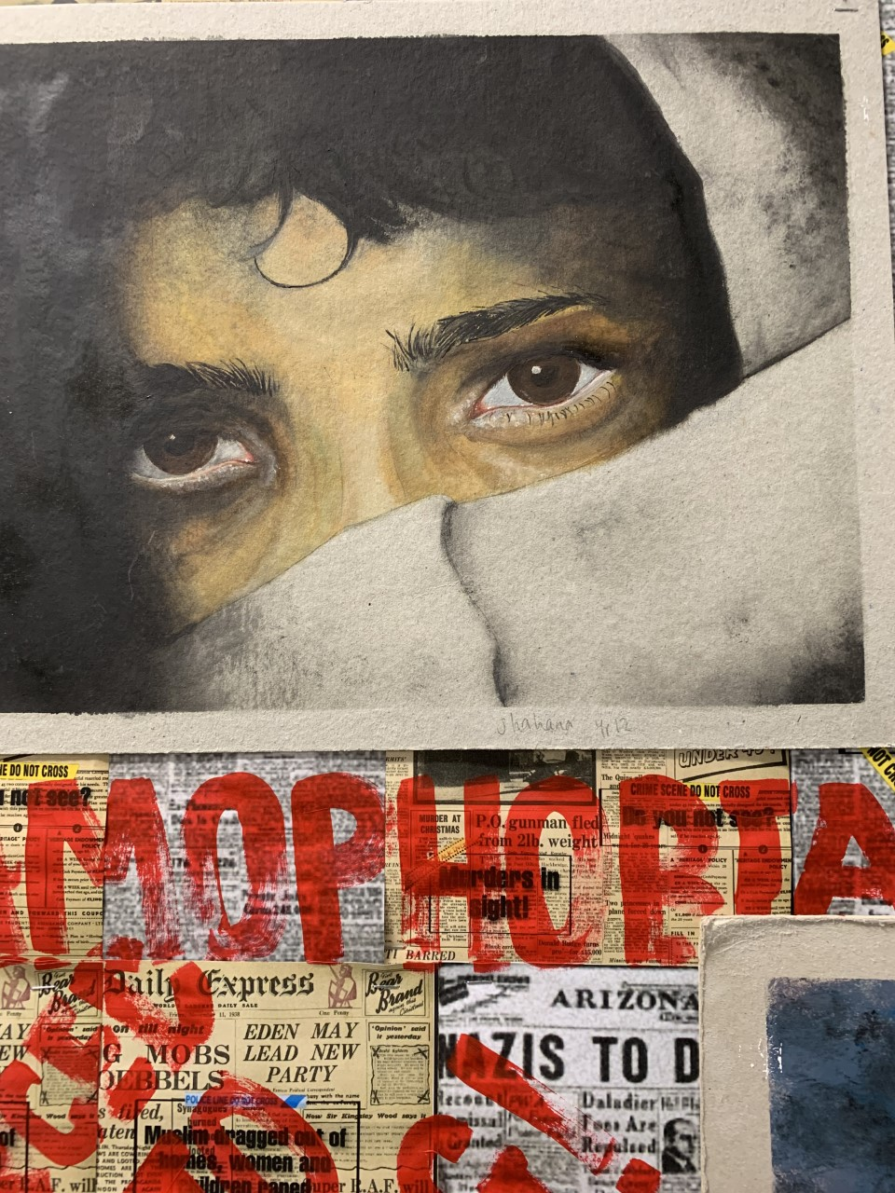
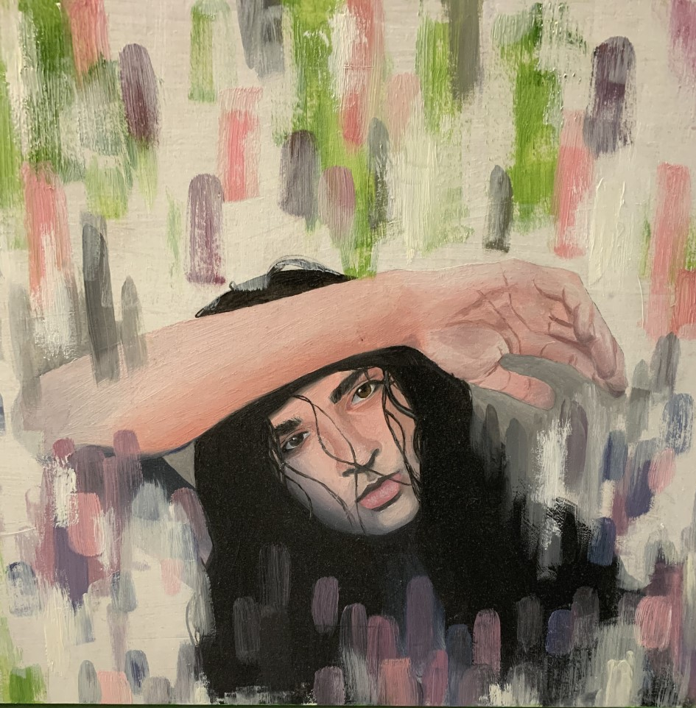
Here are some examples of Art & Design work from Year 12 & Year 11 at Holte, Art is a GCSE subject.

Slide 11

So, it’s a goodbye for now from the Art Department, and we shall see you in September – take care and keep drawing!

