Slide 1
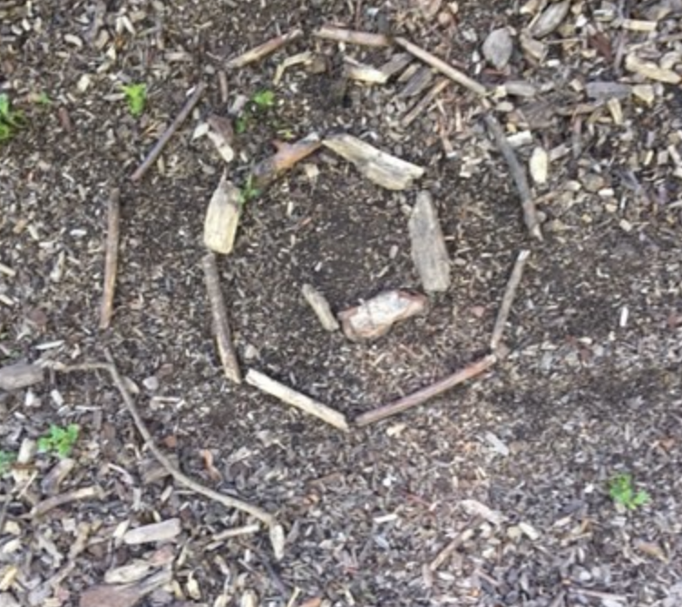
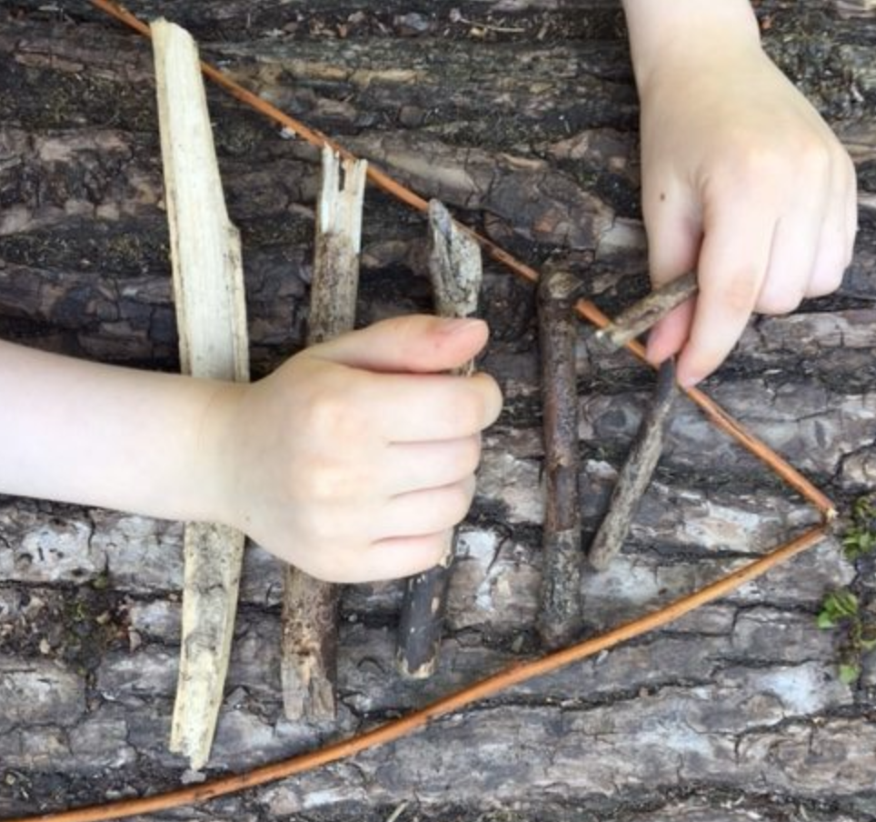
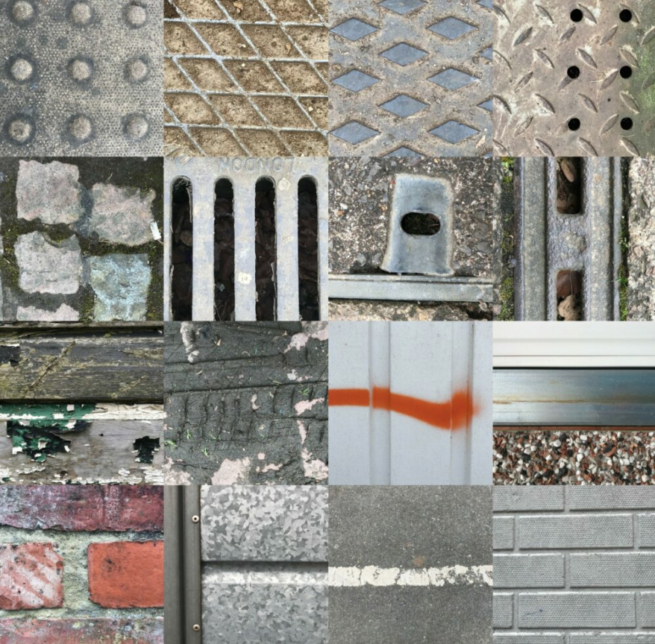
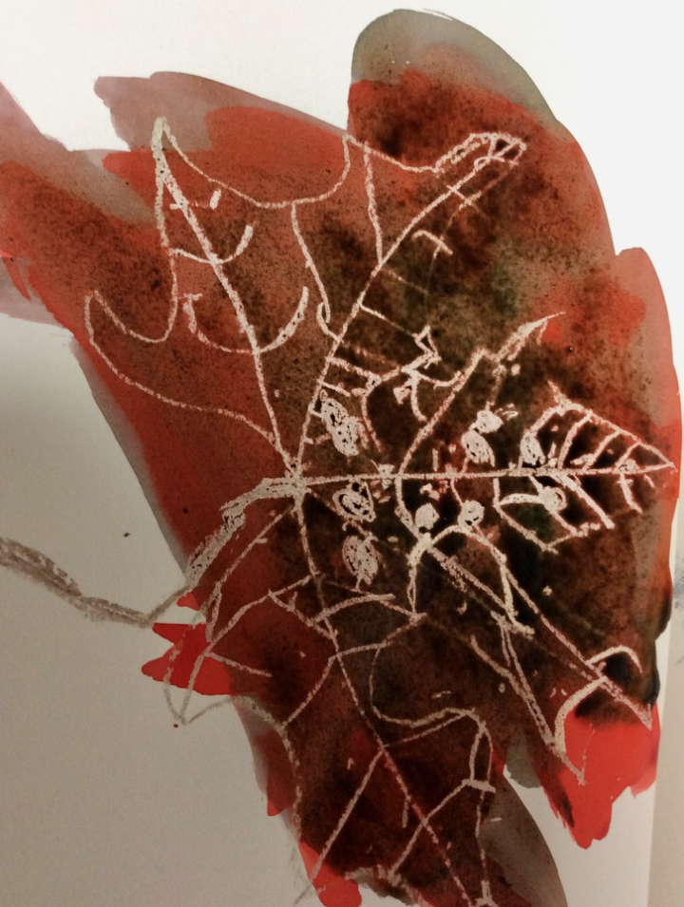
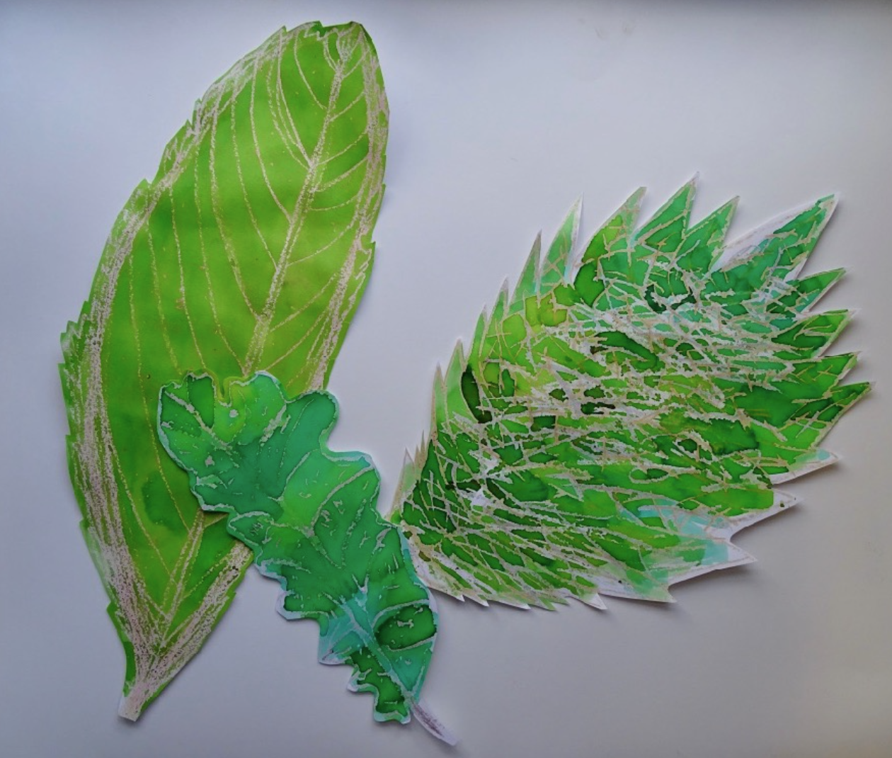
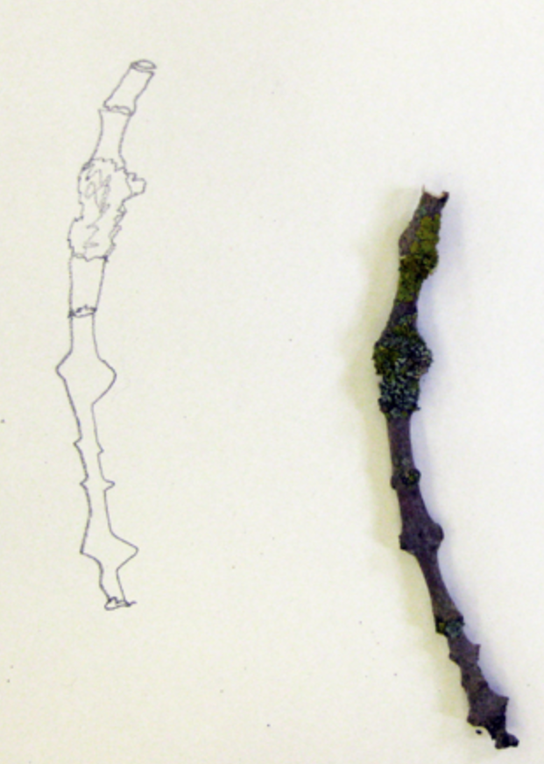
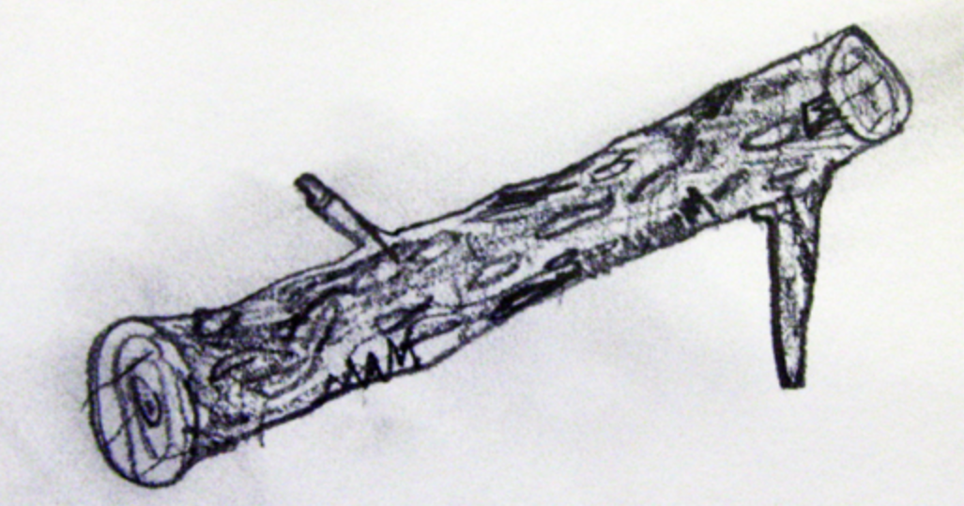
Key Vocabulary
Key Word | Definition
composition | How the art is put together.
observational drawing | A drawing showing something in real life.
wax resist | Using wax and paint to create patterns and effects.
water colour | A type of paint.
line | A mark starting at one point and ending at another point.
shape | A shape is made when a line encloses space.
shade | A shade is where an artist adds black to a colour to make it darker.
tone | The lightness or darkness of colours.
pencil | A writing or drawing tool.
pressure | The amount of force you use. How hard you press down.
mark making | The different lines, dots, marks, patterns, and textures we make in an artwork.
Art: Autumn Term
Explore and Draw
(Drawing)
Learning Sequence
Explore and create patterns with nature.
1
Collect found patterns around the school.
2
Create a feely drawing.
3
Create pictures using wax resist.
4
Create artwork using patterns and wax resist.
5
Share, review and reflect on artwork.
6

