Slide 1

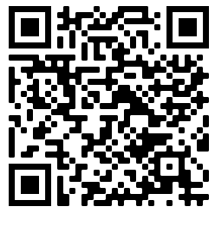
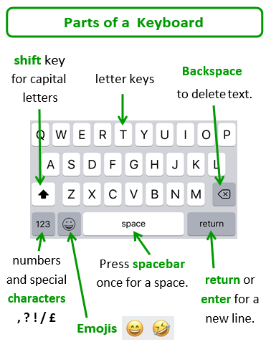
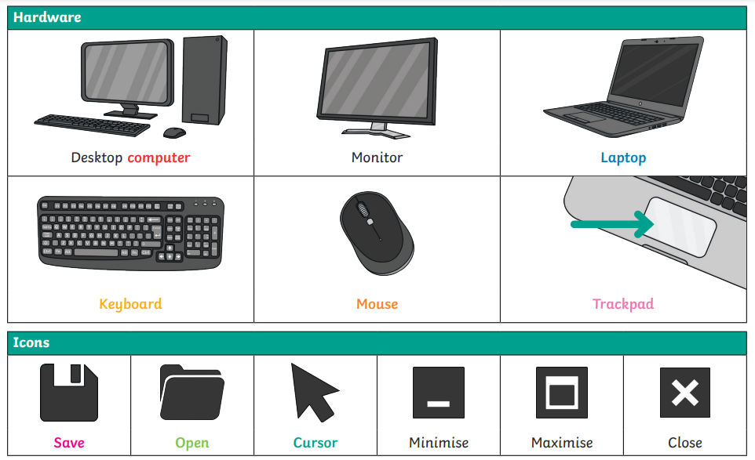
Sherdley Primary School Computing Knowledge Organiser
Year 1: Functional Skills
F1.1 | Be able to enter text using single fingers, beginning to use more than one hand.
F1.2 | Be able to log into and out of an account on a computer or program independently, and shut down a device at the end of a session.
F1.3 | Be able to save and retrieve work with support.
F1.4 | Be able to use a mouse/trackpad to move and place items accurately on a screen. Use double click or tap where needed.
Practise your keyboard typing skills on Dance Mat Typing.

Slide 2
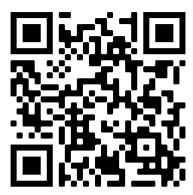
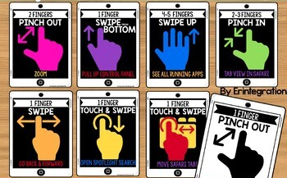
Sherdley Primary School Computing Knowledge Organiser
Year 2: Functional Skills
F2.1 | Be able to enter text using more than one finger, beginning to use both hands
F2.2 | Be able to use basic keyboard keys e.g. backspace, space bar, and return.
F2.3 | Be able to save, retrieve and begin to organise work with support.
F2.4 | Be able to use a range of methods of interacting with a program e.g. right click, drag and drop, long tap etc. Use double click or tap, pinch to zoom, swipe etc.
Practise your keyboard typing skills on Keyman – Typing Games.
Gestures for using tablet devices.

Slide 3
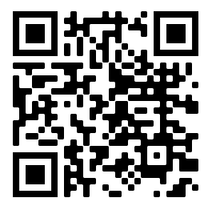
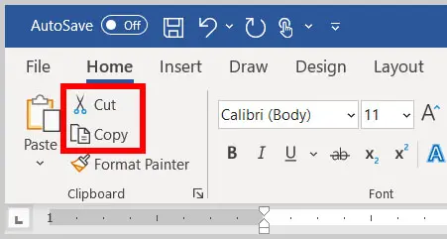
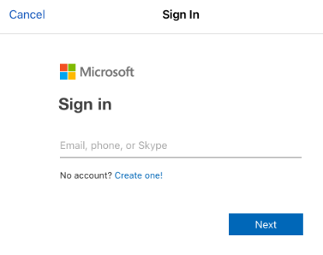
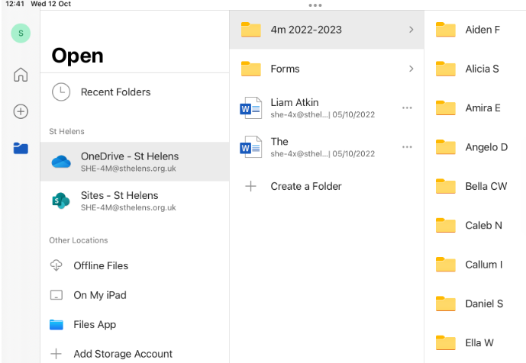
Sherdley Primary School Computing Knowledge Organiser
Year 3: Functional Skills
F3.1 | Be able to use more than one hand to enter text, using the keyboard.
F3.2 | Be able to use cut, copy and paste tools by right clicking or using the edit toolbar.
F3.3 | With support, be able to save work effectively navigating a folder system e.g. Shared Drive, iPad camera roll, Google Drive or OneDrive.
F3.4 | When using a mouse or trackpad, be able to use left/right/double click and scroll.
Practise your keyboard typing skills on Key Tower – Typing Games.
Saving and Storing Work
1. Login into the class Teams account.
2. Find your subfolder in the ‘OneDrive’ tab.
Use the ‘cut’, ‘copy’ and ‘paste’ tools on the Home tab to change media and text.

Slide 4
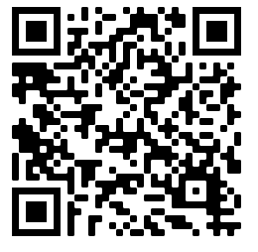
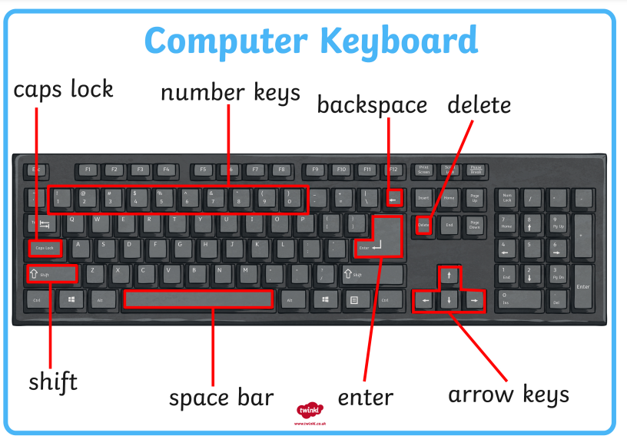
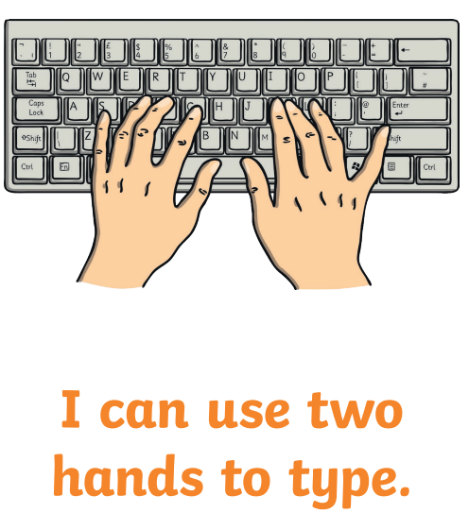
Sherdley Primary School Computing Knowledge Organiser
Year 4: Functional Skills
F4.1 | When typing, be able to use more than two fingers to enter text.
F4.2 | Know and be able to use keyboard function keys e.g. shift, caps lock, num lock, space bar, return.
F4.3 | Be able to rename a previously saved digital document or file appropriately.
F4.4 | If appropriate, be able to print a document.
Practise your keyboard typing skills on Free Typing Games.net

Slide 5
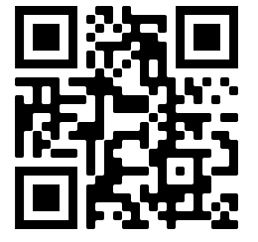
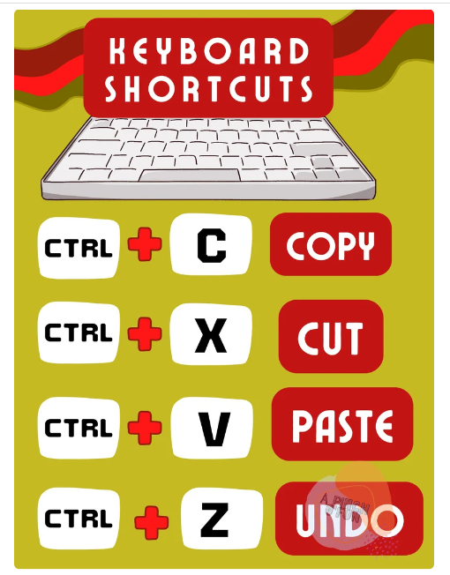
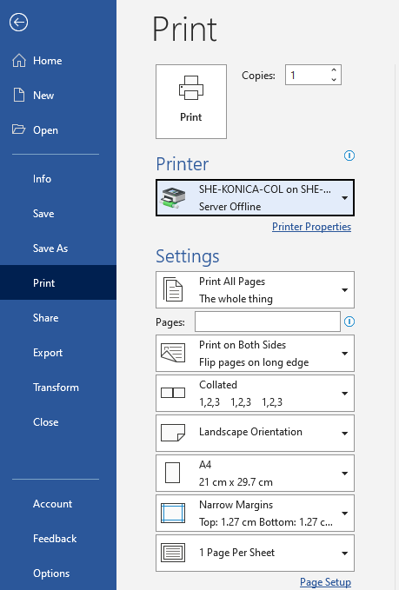
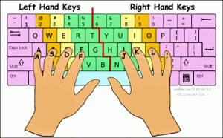
Sherdley Primary School Computing Knowledge Organiser
Year 5: Functional Skills
F5.1 | When typing, be able to hold two hands over different halves of the keyboard and use more than two fingers to enter text.
F5.2 | Know and be able to use more advanced keyboard function keys e.g. insert, delete, ctrl+c, ctrl+v, ctrl+z.
F5.3 | Be able to navigate a folder system to move files or work to a suitable location within e.g. Shared Drive, iPad camera roll, Google Drive or OneDrive.
F5.4 | If appropriate, be able to change print properties to affect the appearance of a printed document.
Practise your keyboard typing skills on Nitrotype (Google login required).
Print properties

Slide 6


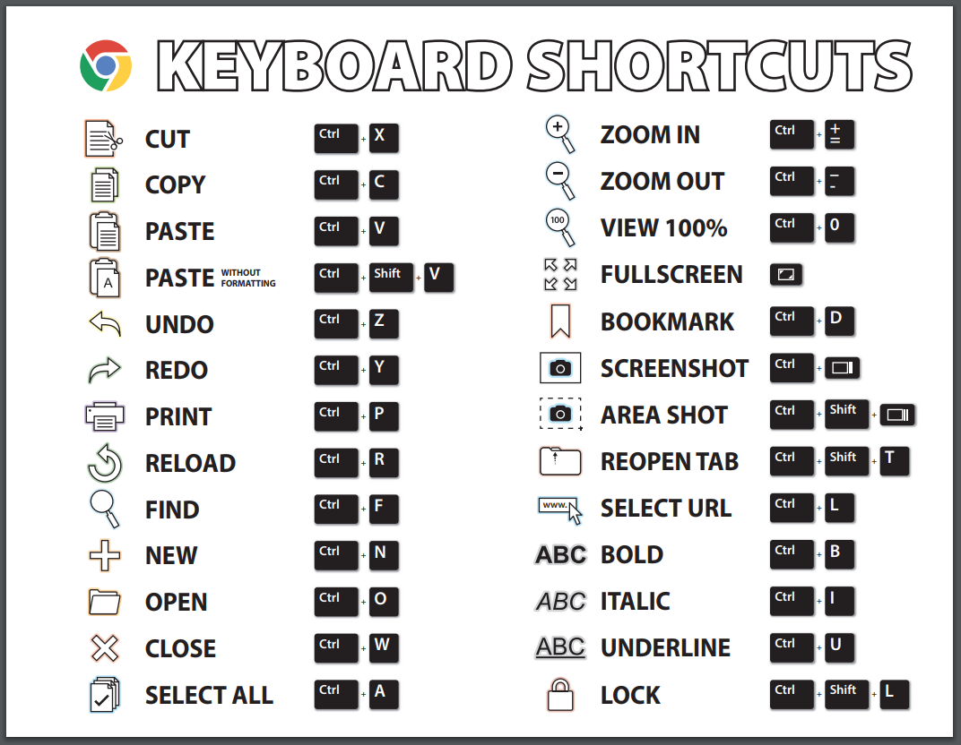
Sherdley Primary School Computing Knowledge Organiser
Year 6: Functional Skills
F6.1 | When typing, be able to use more than two fingers to enter text, with increasing speed and accuracy.
F6.2 | Can show knowledge of and be able to use more advanced keyboard function keys e.g. print screen, window /chromebook search key.
F6.3 | Be able to independently create suitably named folders to organise documents, using appropriate file paths.
Practise your keyboard typing skills on Typing Club.

