Slide 1
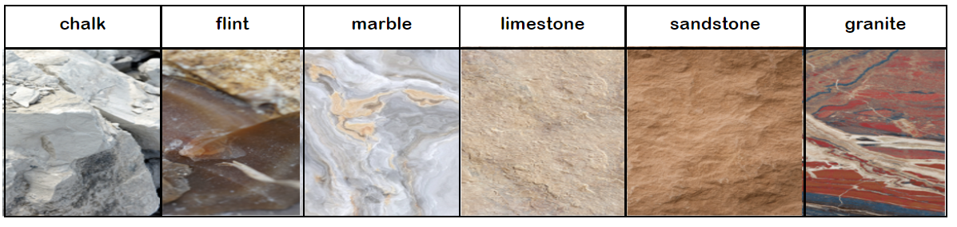
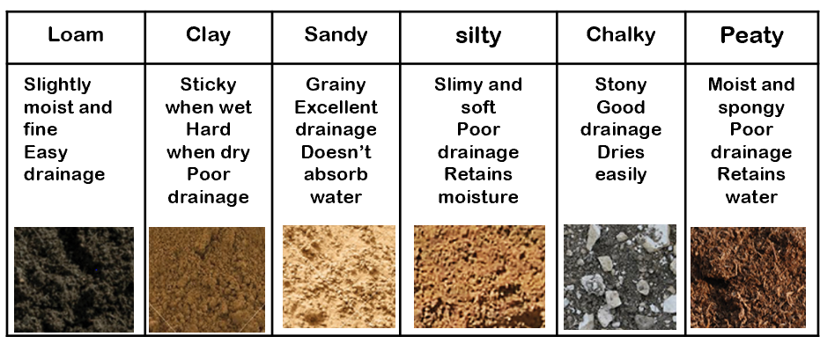



Key Vocabulary
Key Word | Definition
boulder | a large rock that comes from a natural source – a river/ glacier, moved from its original location to its present one
rock | Smaller boulders
Stone/pebble | Pieces of boulders
grain | Rocks are grains of minerals clumped together.
crystals | Crystals are made of minerals, and rocks are also made from minerals or sediments, but they are different.
Minerals | Are natural solid substances that occur naturally
layers | The earth is formed in layers the outer layer of Earth is the Earth’s crust
absorbs | The water soaked up by the soil or rock
texture | Hard soft
fossil | The remains of a animal or plant embedded in a rock
Year Science
Rocks and Soils
Learning Sequence
How can rocks be grouped ?
Types of Rocks
Lesson
1
Which rock is the hardest?
Lesson
2
Types of Soil
Which rock absorbs the most water?
Lesson
3
Lesson
4
How much water can different soils retain?
Working Scientifically Skills
How can soil be separated?
Lesson
5
Science Enquiry
How can fossils be formed?
Lesson
6
Notes:
Add more visuals as prompts eg thermometer, spring etc

Slide 2

Today, we are focusing on:

Slide 3
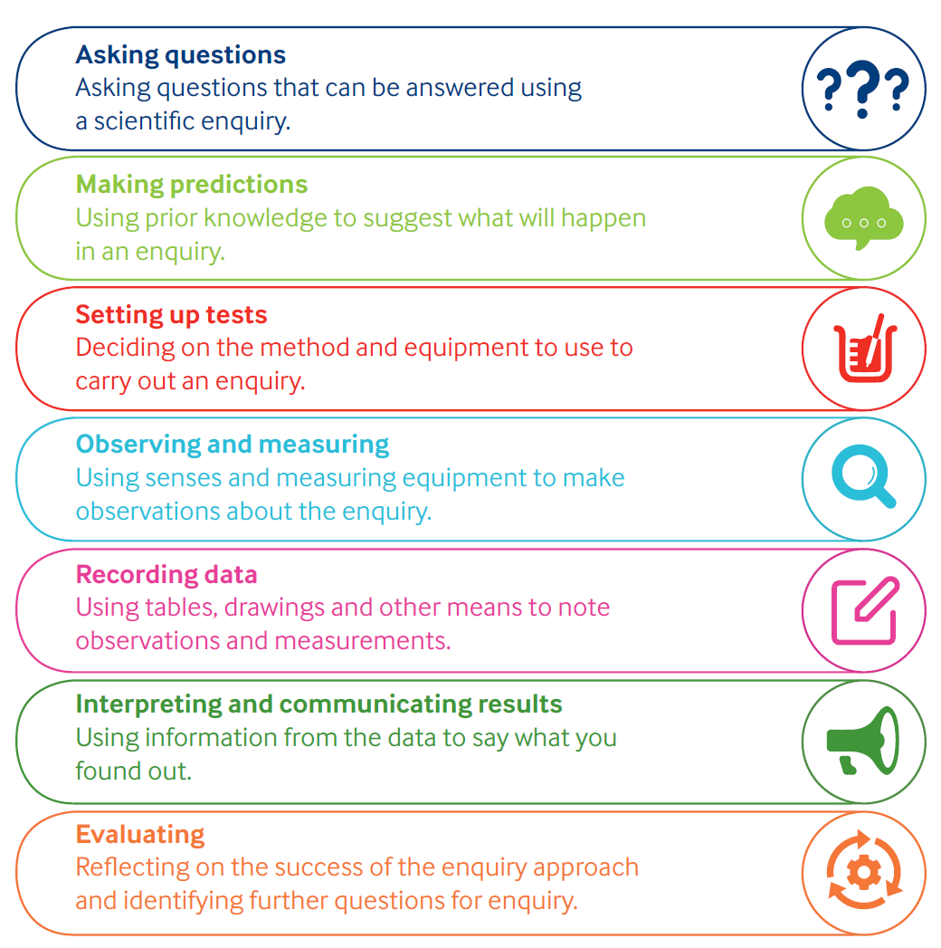
Working Scientifically

Slide 4
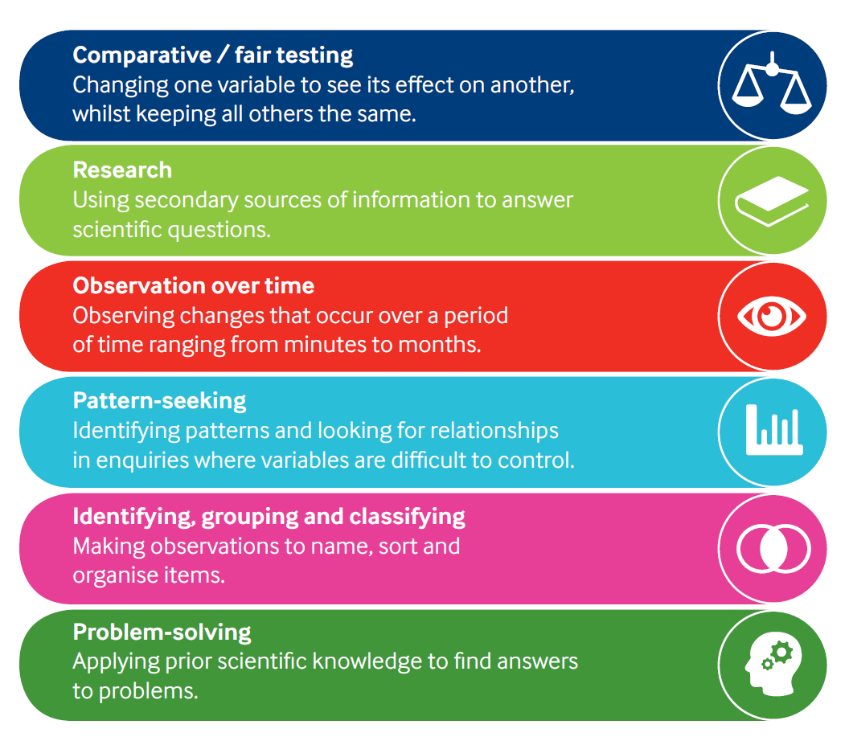
Types of Enquiry

