Slide 1
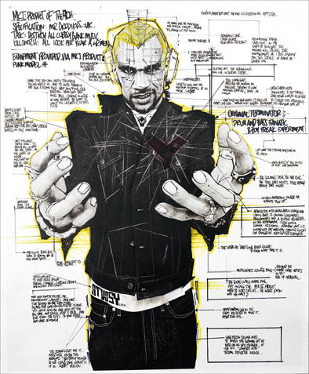

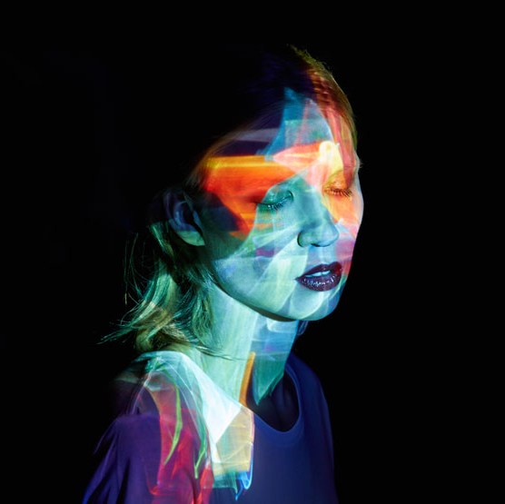
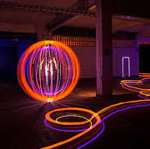
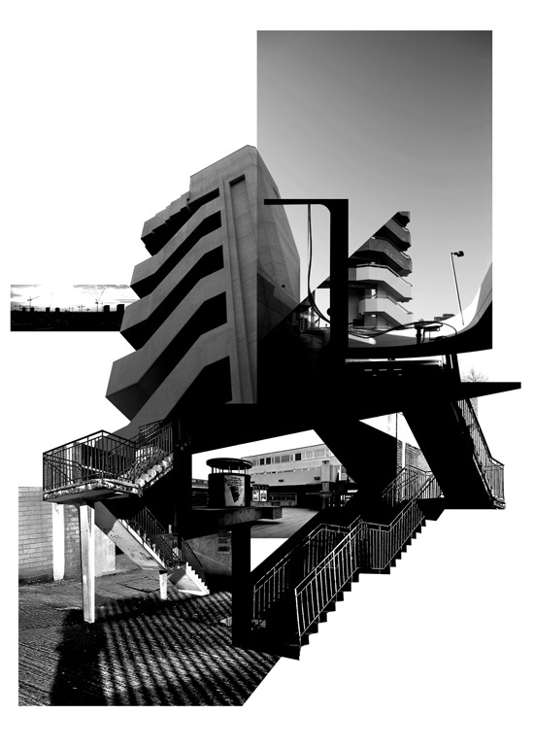
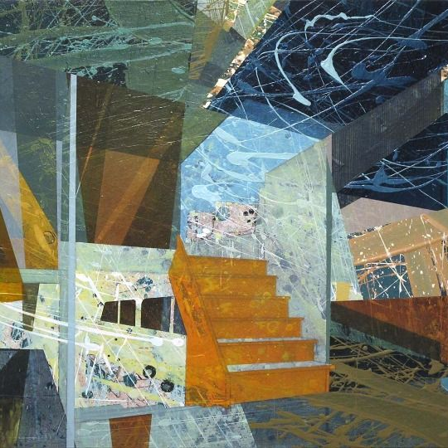
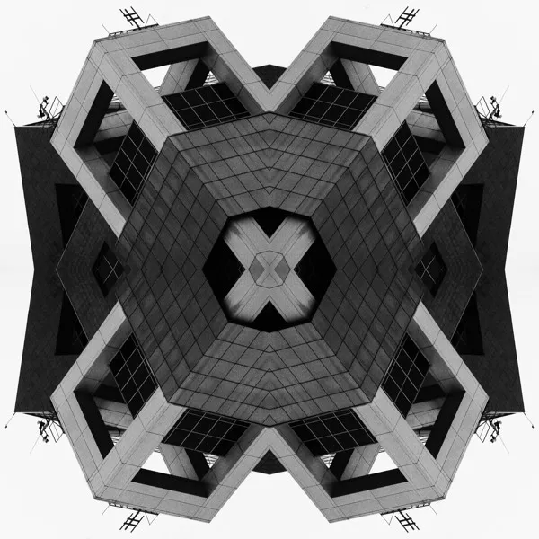
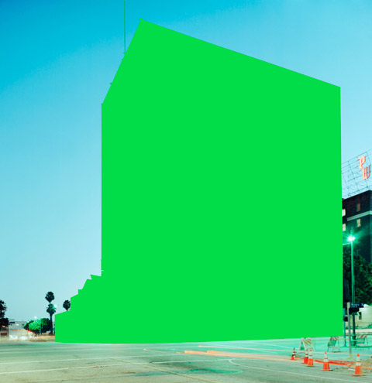



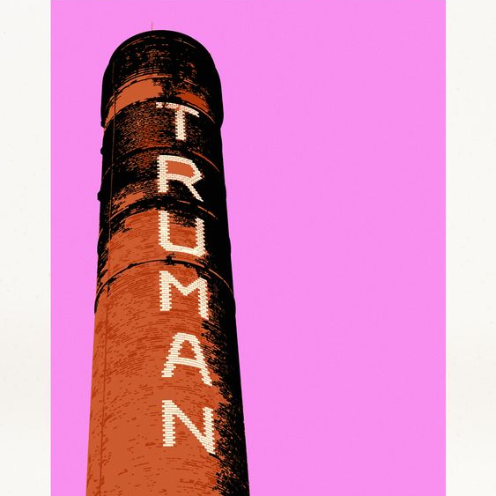
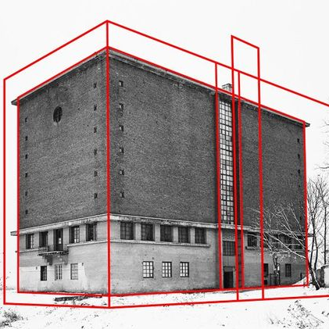
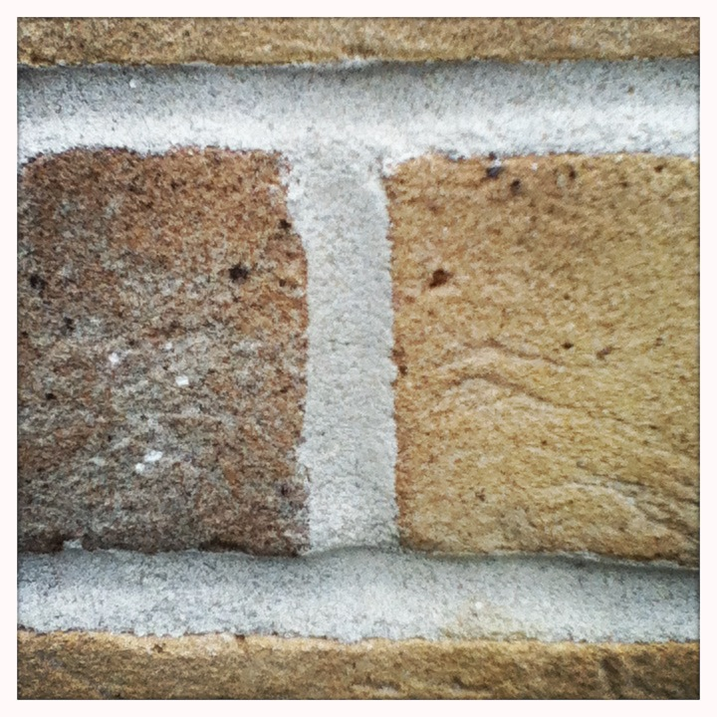

YR 10 PHOTOGRAPHY
RANKIN
MADS PERCH
Destroy Project – Handmade Edits
Light Projections
YR 11
Q1
Q2
Q3
Q4
SUZANNE SAROFF
LAPP PRO
CYCLE 3
Water Distortions
Light Painting
MILES DONOVAN
HELDER SANTOS
Urban Landscape – Experimental Photography
Photographic Collage
Photographic Kaleidoscopes
Skills & Inspiration Overview
Q4
Q3
Q2
Q1
Learn how to apply and experiment with the Visual Elements through a variety of skills, techniques and processes
CYCLE 2
BEN BOOTHBY
MAUREN BRODBECK
Developing how to talk and write about your own and other’s work
Layering Visual Elements
Visual Element Adjustment
JAYSON LILLEY
TOM MANLEY
Photoshop and Digital Art
How to create a Photographic Essay – Why do we document?
Learning how to create original artwork inspired by the work of others
Q1
Q2
Q3
Q4
CYCLE 1
Learning how to evaluate your own and others work
ALEXEY BOGOLOPOV
PHOTO SAFARI
Introduction to Photoshop and editing skills
‘Ways of Seeing’ – The Rules of Composition – How to be a better Photographer

