Slide 2
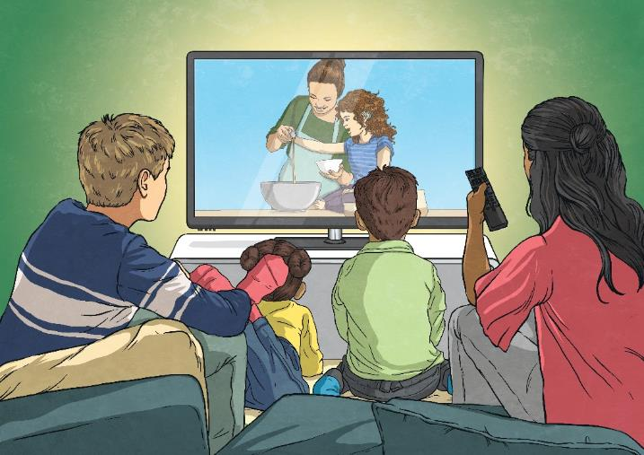

Electricity
Today, we use electricity all of the time in our daily lives. It is difficult to imagine life without it. However, the ability to use electricity in our homes is a relatively modern technology. The first house to be lit by an electric light bulb was less than 150 years ago. The way we use electricity today has been developed by a number of famous and influential inventors and scientists.
Talk About It
Can you name all of the things that you have used today that require electricity?

Slide 3


Early Discoveries
3100 BC
The ancient Egyptians did not understand electric currents but were aware that they could get a shock from some electric fish, which they called ‘Thunderer of the Nile’.
600 BC
The ancient Greeks discovered that rubbing amber made light objects attract to it. They thought that this happened because the rubbing was making the amber magnetic but they were actually observing static electricity.
Did You Know...?
It wasn’t until the 1600s that William Gilbert made the distinction between static electricity and magnetism. He introduced the word ‘electricus’ which means ‘like amber’ in Latin.

Slide 4
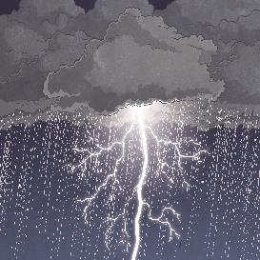
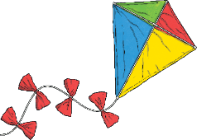
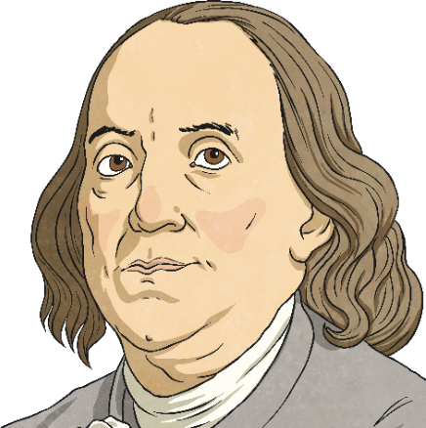
Benjamin Franklin
1752
Benjamin Franklin was the first person to investigate electricity in depth. In his famous kite experiment, conducted in 1752, he aimed to prove that lightning was electrical. Franklin attached a key to a kite and flew it into a thunderstorm. When the kite was struck by lightning, he observed sparks coming from the key.
Warning!
This was an extremely dangerous experiment that should not be repeated. Franklin was extremely lucky that he was not electrocuted!

Slide 5
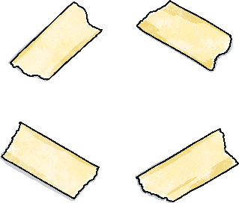
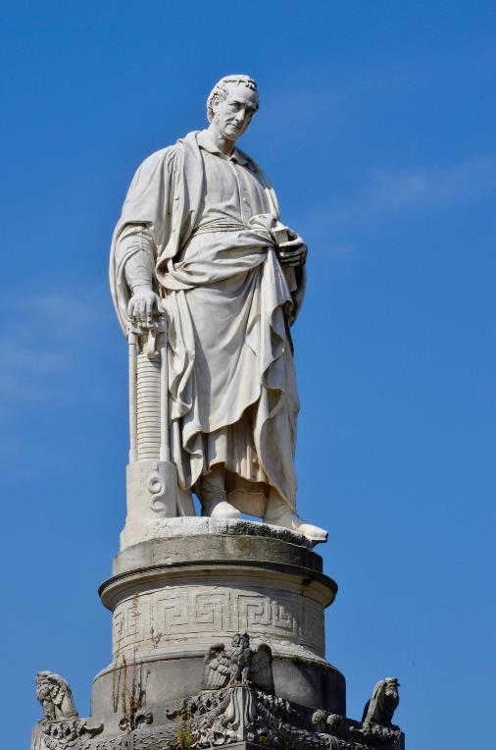
Alessandro Volta
1800
In 1800, the Italian scientist, Alessandro Volta, invented the first battery called the voltaic pile. It was made from alternating layers of zinc and silver (or copper) disks. Each disk was separated by paper (or cloth) soaked in salt water.
Today, the scientific words voltage and volts are named after him.
This statue of Volta shows him holding a model of a voltaic pile.

Slide 6
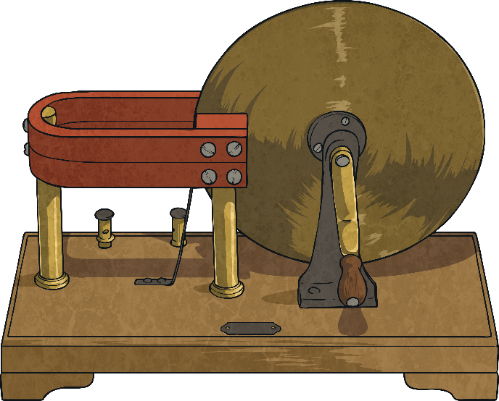
Electromagnetism
1831
Michael Faraday was able to produce an electric current from a magnetic field by using a magnet inside a coil of wire. This discovery, known as electromagnetic induction, is the process used by modern power stations today.
Did You Know...?
Faraday’s work on electromagnetism eventually led to the invention of the radio.

Slide 7
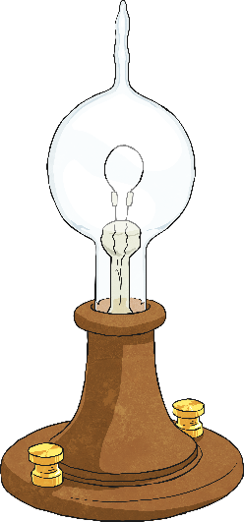

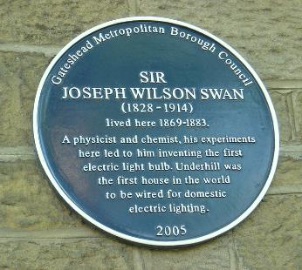
Electric Light – Joseph Swan
1860
In 1860, English inventor Joseph Swan invented the first electric light bulb. However, the early bulb was not very efficient and did not stay lit for very long.
In 1880, Swan improved his design and patented his light bulb. His house in Gateshead was the first in the world to be lit by an electric light bulb.
A blue plaque at Joseph Swan’s home in Gateshead.
patented – To gain a special licence which shows legal ownership of an invention and prevents others from making, using or selling it.

Slide 8
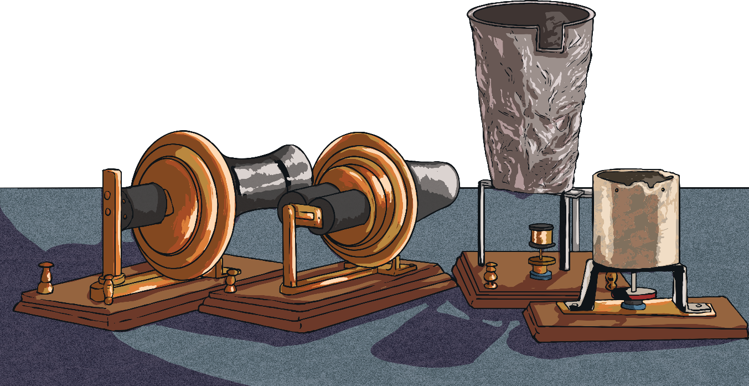
The Telephone
1876
Alexander Graham Bell is often credited with inventing the telephone.
His invention used electromagnetism to transfer speech over long distances.
Did You Know...?
The first words spoken on a telephone by Alexander Bell to his assistant, Thomas Watson, were: ‘Come here Mr Watson, I want to see you.’

Slide 9
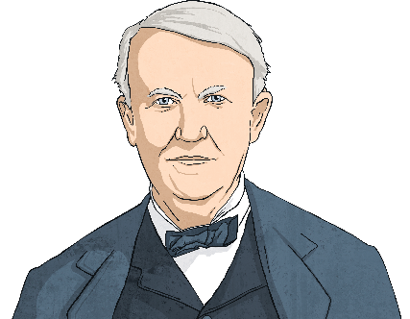
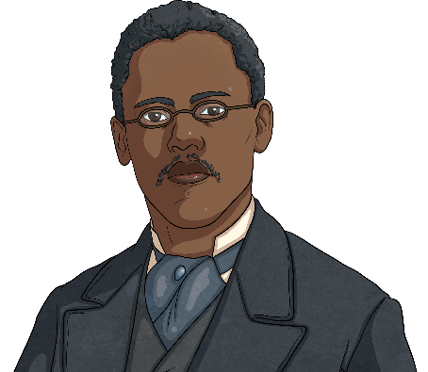
Electric Light – Thomas Edison
1879
While Joseph Swan was experimenting with light bulbs in England, Thomas Edison was working to improve Swan’s initial basic design, in the United States. Believing that he had developed the modern light bulb, Edison tried to sue Swan. Eventually, they decided to work together and formed the Edison and Swan Electric Light Company Limited to improve on their designs.
Lewis Latimer worked for Thomas Edison and developed the filaments which enabled the light bulbs to stay lit for a long time. Lewis also did all the legal work to ensure Edison got the credit for the design.
filaments – A filament in a lightbulb is a metal wire that conducts electrical currents. The electrical currents cause the filament to glow.

Slide 10
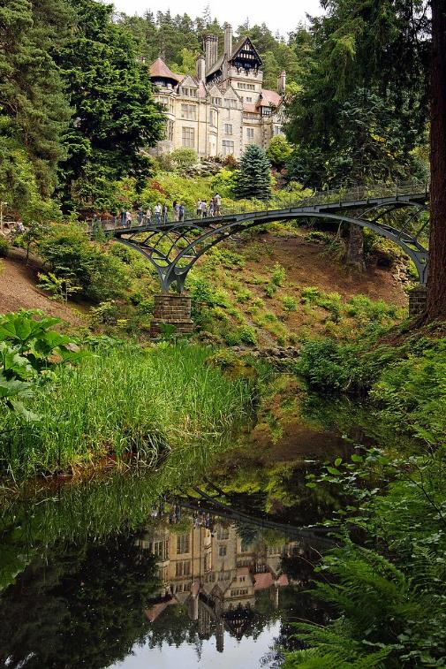
Hydroelectricity – William Armstrong
1880
William Armstrong was an engineer and a close friend of Joseph Swan. He worked with Swan to fit electric lighting in his country house, Cragside, in Northumberland, using electricity generated from the surrounding river. Cragside became the first house in the world to be lit using hydroelectricity.
You can visit Cragside today and see the restored hydroelectric equipment in action.
hydroelectricity – Electricity that is generated by the movement of water.

Slide 11
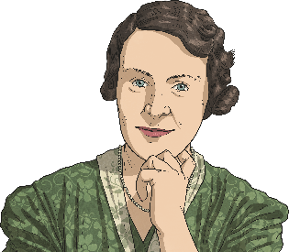
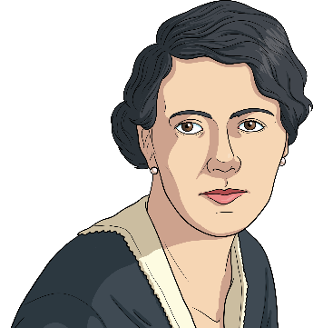
Electricity in the Home
1895
Caroline Haslett was a British electrical engineer. She was born in 1895, in Sussex. Caroline saw how hard her mother worked on household tasks and wanted to use modern inventions to change this. In 1922, she asked women which new inventions would be the most helpful to make life easier for them at home. The most popular suggestions were a dishwasher and a vacuum cleaner. Two years later, Caroline became head of the new Electrical Association for Women. She promoted the safe use of electricity in the home and taught women how to maintain their electrical appliances.
1914
In 1914, Florence Parpart invented the electric refrigerator, something that almost everyone still uses today.
1917
Another prominent female inventor was Ida Forbes who invented the first electric hot water heater.

Slide 12
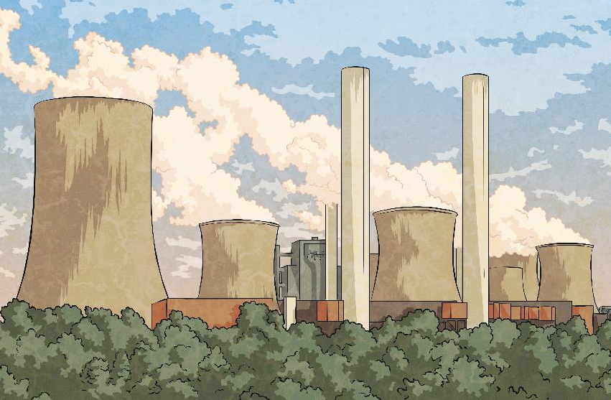
The Supergrid
The network of power stations that provide us with electricity in the UK is known as the National Grid, which first became operational in 1935 and was the first of its kind in the world. In 1950, it became clear that the system couldn’t meet the demands of the growing amount of electricity needed by customers and the Supergrid was created.

Slide 13
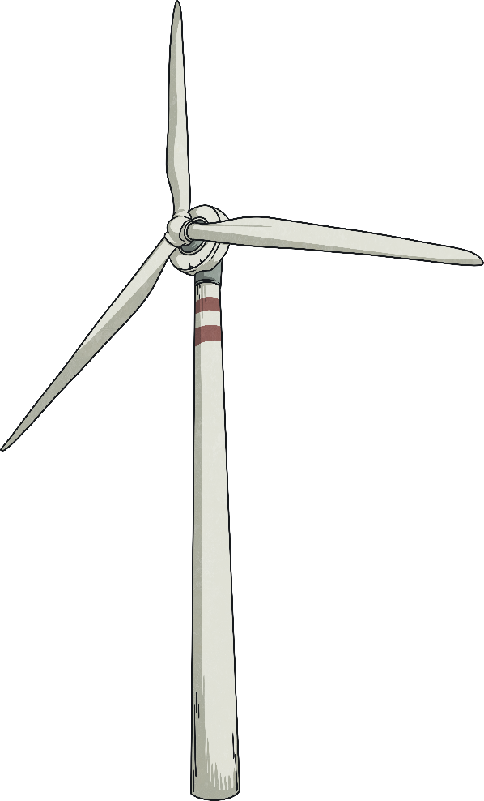
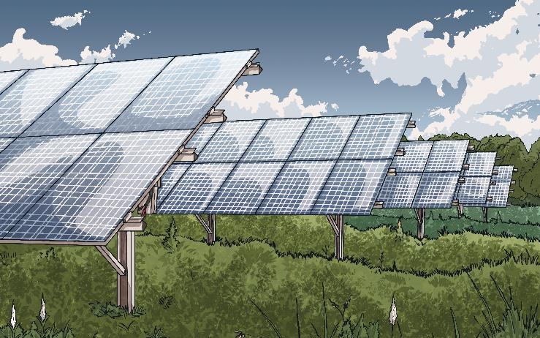
Generating Electricity in the Future
In the past, most electricity was generated by burning fossil fuels. However, in recent years there has been a focus on using more sustainable methods, such as solar power and wind power to generate electricity. 2019 was the first year when more electricity in the UK came from carbon neutral sources than fossil fuels.
carbon neutral sources – Sources of energy that do not release carbon dioxide into the atmosphere.

Slide 14
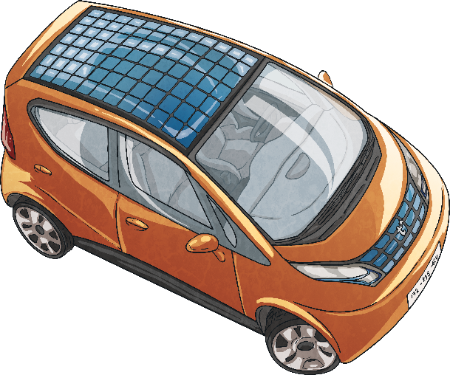
Electric Cars
Electric cars are not a new invention. The first ones were invented in the 19th century but, as time went on, they became less popular because petrol cars were more efficient. Although we often talk about saving electricity to help the environment, electric cars are seen as an important step to preventing climate change as they do not emit carbon dioxide.
Electric cars are now seen as the future of motor vehicles.
The UK government aims to make it illegal to sell new petrol cars by the year 2030.
Lots of automobile companies are
looking into the possibility of producing
solar cars. This would be a much more sustainable and environmentally friendly
way to travel.

Slide 15

Over to You
How can you save electricity at home and at school?
How do you think electricity will be used in the future?
Which of the inventors that we have learned about today would you like to meet? What would you like to ask them?

