Slide 1

Welcome to
Meet the Teacher
Miss Stone

Slide 2
Aims for this meeting:
Expectations this year
What the day looks like for your child
The Curriculum
Home Learning
Home School Agreement
Uniform and PE kit
Communication

Slide 3
New Year … New Start
Your child is now in Year 1!
Expectations this year include…
Being on time – gate is open from 8:45 – 8:55
Correct uniform and PE kit
Being organised and ready for learning – planners signed each day
Completing classwork to the best of their ability
Engagement in school life
Challenging themselves
Rewards and opportunities in school
Notes:
Challenging themselves – attempting harder activities to push themselves, not always going for the thing that they know they can do
Rewards – house points, stickers, praise

Slide 4
What the timetable looks like…
Phonics
Maths
RE
Science
History & Geography
Art & Design
Music
PE – Monday and Friday
PSHE
Computing
Library – Monday
https://www.williamhogarthschool.co.uk/ - scroll down to year group notice boards, year 1 notice board
Notes:
Daily phonics and maths lessons
RE – study Christianity and Judaism in Y1
History/ geography – embedded within the topic lessons
Art – class artist, family portraits
PSHE – being me in my world – being safe
Explain where you can find the curriculum maps

Slide 5
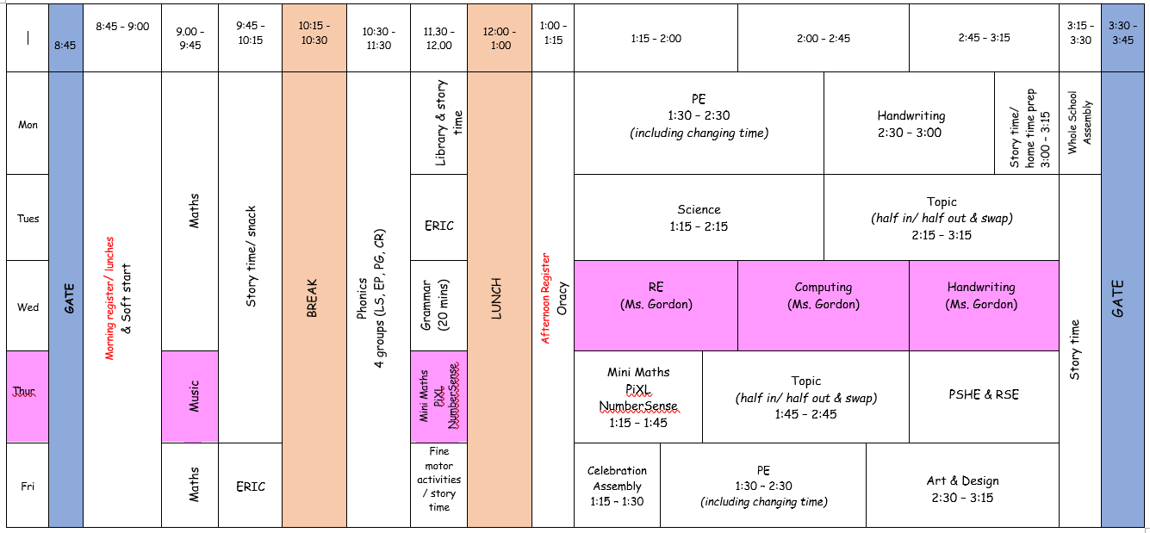
Timetable

Slide 6
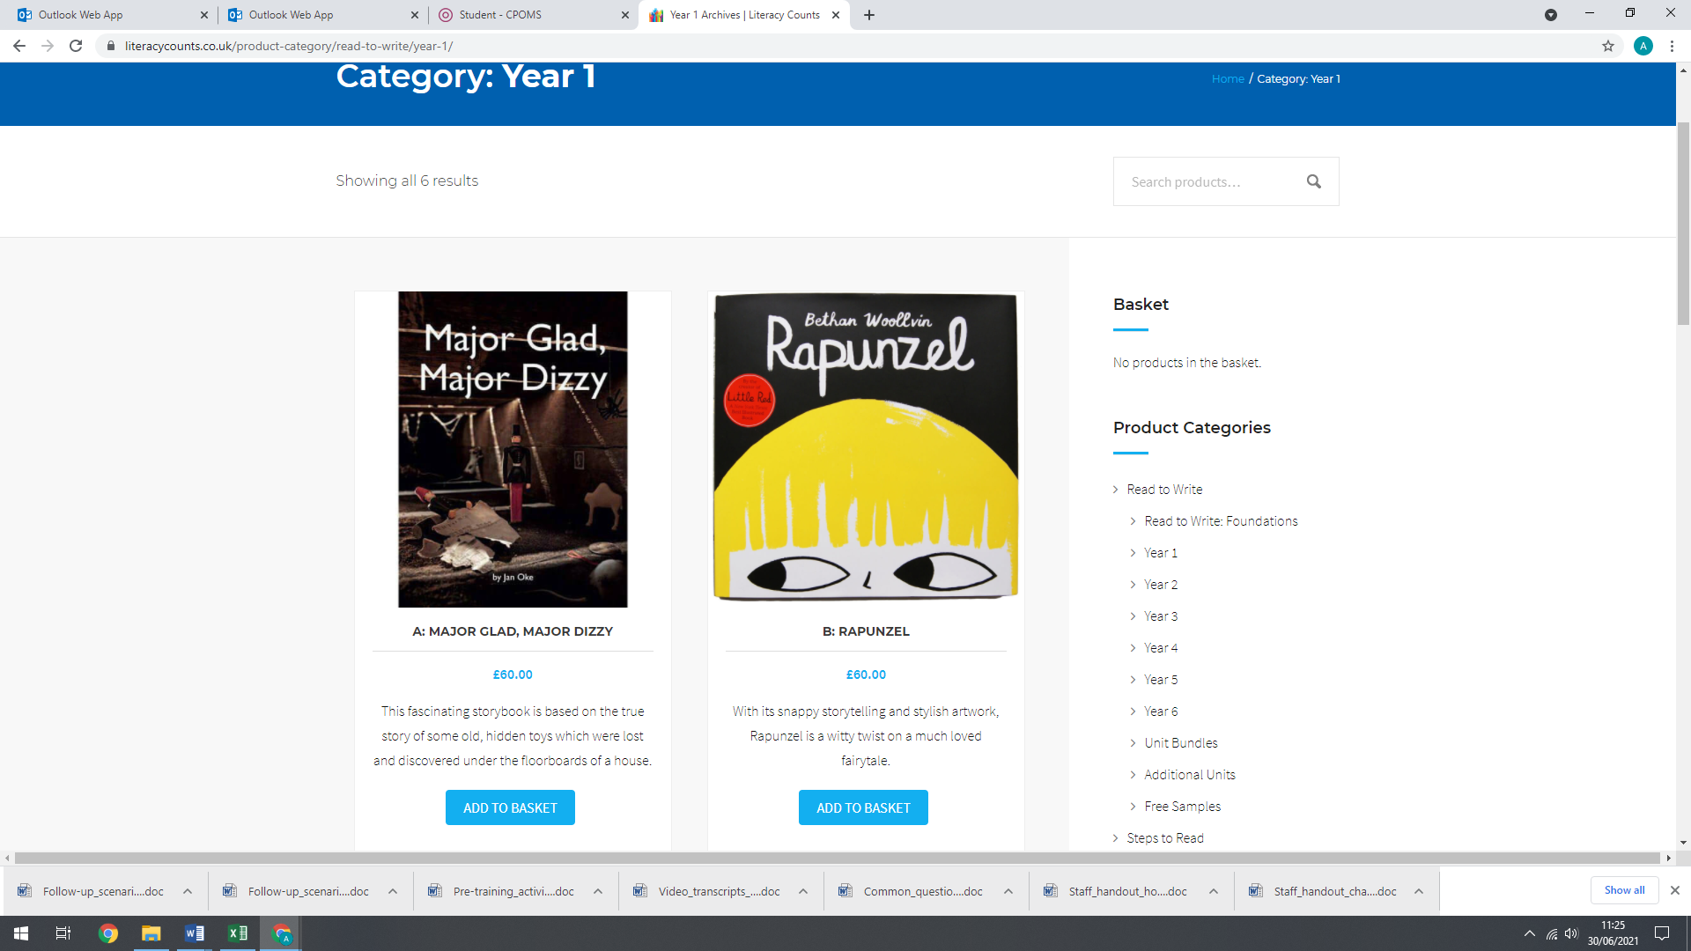
The Curriculum
Topics this year:
-Memory Box (A1)
-Moon Zoom (A2)
-School Days (SP 1)
-Bright Lights, Big City (SP2)
-Dinosaurs (SU1)
-Coastline (SU2)
Notes:
Memory Box – History – looking at the past, diary entries
Major Glad, Major Dizzy - based on the true discovery of a hidden hoard of Victorian toys under the author's floor. It will introduce some of the milestones of recent British history and hopefully interest children in tracing the past through found objects and old photographs.

Slide 7
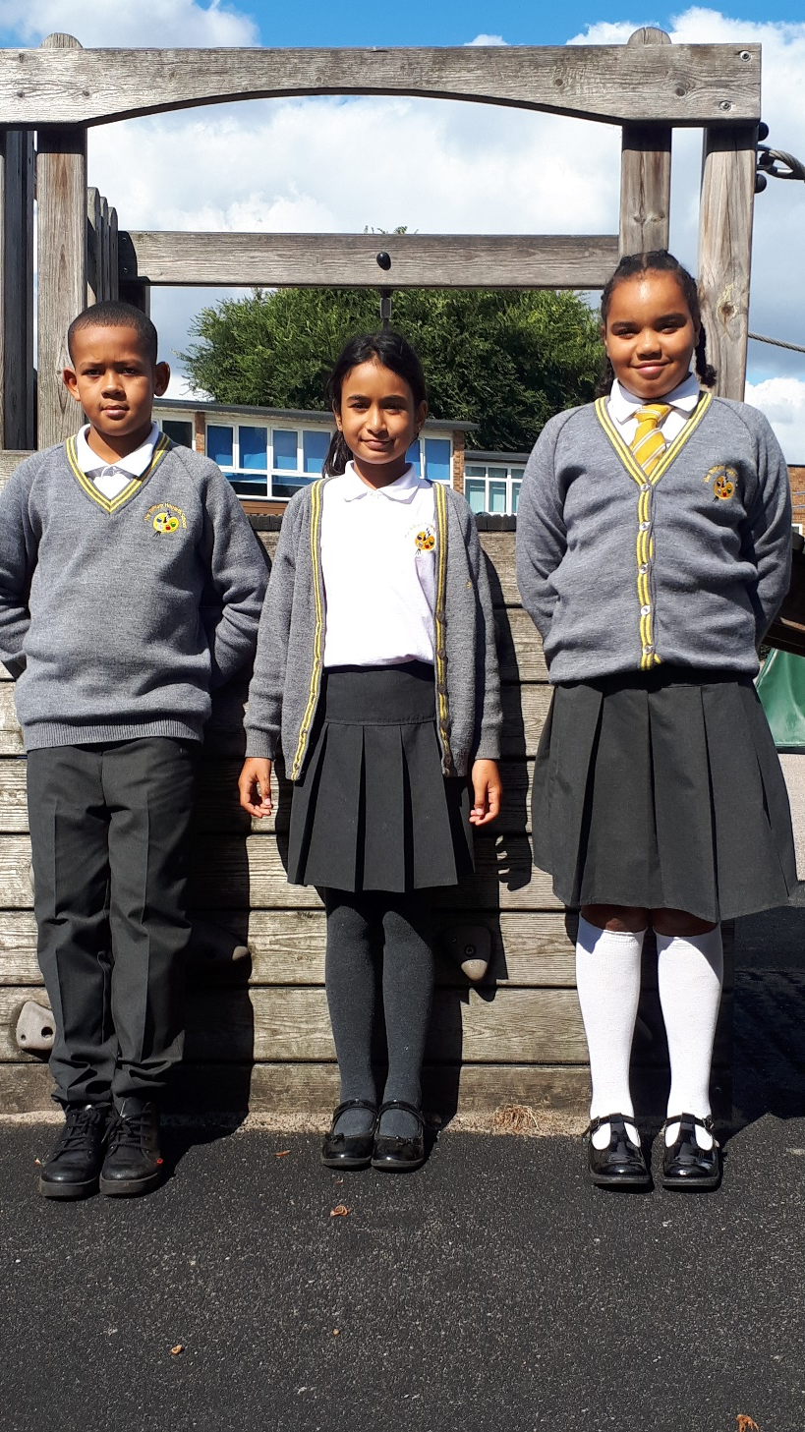
School Uniform
White short or long-sleeved logo’d polo shirt
Grey logo’d ‘V’ neck cardigan or jumper with double gold stripe
Plain grey trousers, shorts, skirt, pinafore or gingham dress (in summer)
Plain long or short, grey, black or white socks or tights
Sensible black flat shoes or boots (in winter)
Black reversable logo’d school coat or plain black or navy coat (Winter is coming!)
Grey or black scarf, hat and gloves
Grey, black or white kippa or turban
Grey, black, white or yellow hijab
Plain grey, black, white or yellow hair accessories (shoulder length hair tied back)
Black logo’d rucksack or plain black rucksack

Slide 8
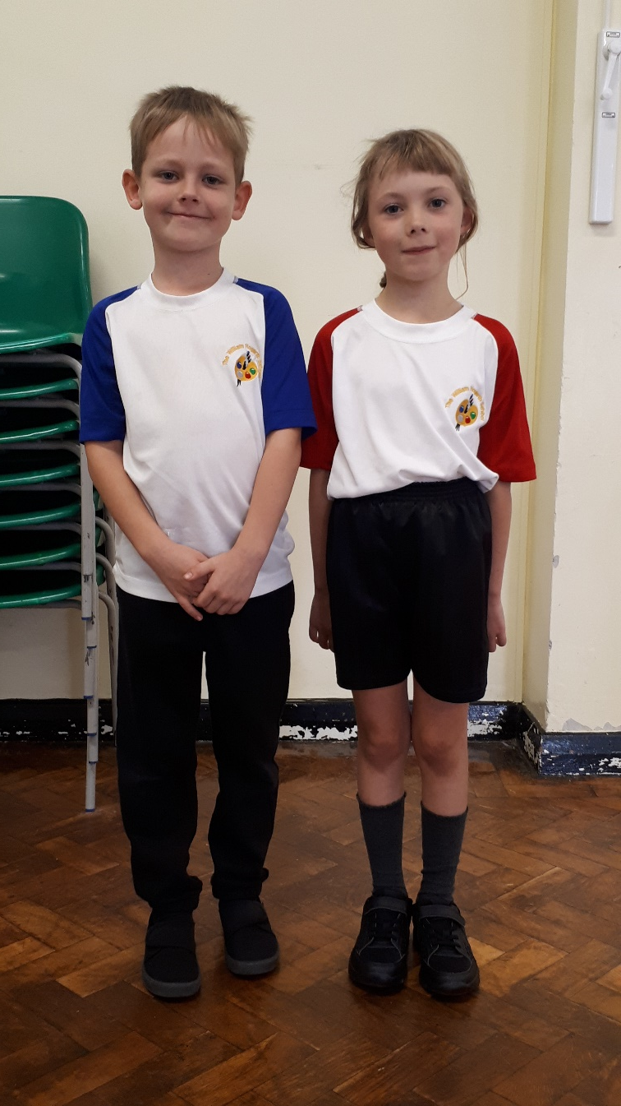
PE Kit
White logo’d sports top with house coloured sleeves
Black shorts
Black logo’d hoodie with black tracksuit bottoms
Trainers or plimsolls
Water bottles
Key Stage 1: PE Kits should be in school every day. They will be sent home half-termly.
Key Stage 2: Clean PE Kits should be brought in every Monday.

Slide 9
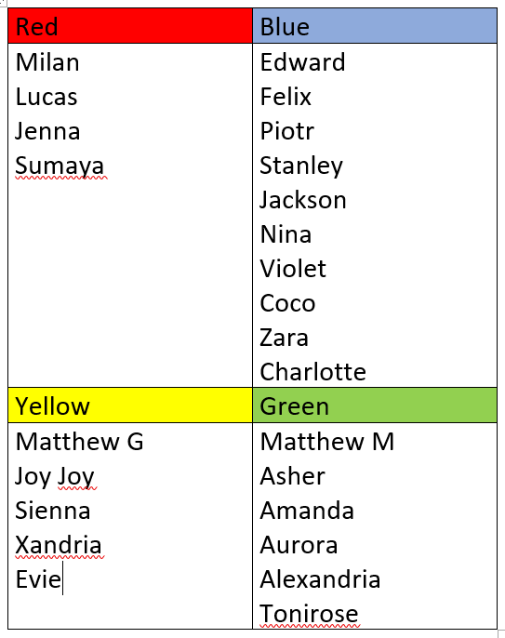
House groups

Slide 10
Home Learning
Aims of home learning
To give children an opportunity to practice basic skills linked to learning in school
To engage all children in learning in a cross curricular manner.
To allow children to shine in all subject areas
To generate pride and excitement about what they are producing.
Traditional homework is scientifically proven to have very little impact on pupils learning
Research says that home learning which has the most impact on learning is practising basic skills through repetition and giving children ownership over what they are doing.

Slide 11
Reading
Reading at home, whether to an adult, with an adult, or being read to by an adult is the most important form of homework.
Children are encouraged to read regularly for their own development and also for enjoyment.
The frequency that books are taken home from school varies:
Nursery & Reception | Children will take home 2 books a week. One levelled book and one choice book that parents can read and share with them at home. We encourage books to be re-read several times as the evidence shows this has a positive impact on children’s learning.
Years 1 & 2 | Children will take home 2 levelled books a week, plus one choice book that parents can read and share with them at home. In Year 1, children will take home their RWI book / pack plus another book which is at their phonics level.
Years 3 - 6 | Children will independently choose a new home book. These are to be brought in daily and changed when completed.
Notes:
We will aim to listen to your child read as often as we can (once a week)– children will be reading in daily phonics lessons so we also listen to them at this time.
Daily reading – at least 10 minutes per day. Little and often goes a long way. The more children practice reading the easier it becomes – become more fluent and recognise words quicker. Once they become more fluent the more motivated they are/ get more enjoyment out of reading – not so much of a chore anymore.
Parents are their child’s most influential teacher – play a big part in their reading journey – modelling a love for books and stories, encouraging them to love books too.
Looking after and caring for our books – sharing the same attitude at home – consistency

Slide 12
Home Learning
Daily Reading – signed planners everyday
Books changed – Monday and Wednesday
Topic – half termly project
Weekly Maths – MyMaths/ DoodleMaths or Google Classroom task
Spellings – Common Exception words, phonics ‘Red words’, or words containing a certain sound that they have recently learnt/ recapped.
Notes:
DAILY READING – Every child has (will have soon!!) a Pupil Planner with a dedicated space to record children’s reading at home.
Should be filled in when children read or are read to. This enables us to see how much reading is being done at home.
Each entry needs: the book being read
what/ how much was read
any comments about how they got on – any sounds/ words that they struggled with so we can work on these in school, positive comments too – how well they read, what they enjoyed about the book/ didn’t enjoy so much
Books are changed Monday and Wednesday – Monday we changed the RWI phonics book, Wednesday we change their other book which will be at their phonics level.
Library books will also be returned and changed on Monday. Please remember to bring these in on Monday otherwise we cannot give your child a new book.
Easier to make sure that all books are in the bag every day to avoid problems.
TOPIC – project can be found same place as curriculum map
WEEKLY MATHS – link to current learning – posted to google classroom every Thursday – hand in on google classroom – any problems with accessing the work pls let me know
SPELLINGS – posted weekly on Google Classroom

Slide 13
Home School Agreement
Commitment to make sure your child is equipped and ready for learning
Bring your child into school on time every day
Healthy lunches and snacks
Daily reading and homework is completed – Google Classroom - Thursday
E-safety and interest in your child’s use on social media to keep them safe
Attend meetings about your child’s progress
Respect the staff and other parents and families at The William Hogarth School
Read newsletters on a regular basis for communication
Understand we are an equal opportunities school that respects race, gender, creed and the beliefs of others.
Notes:
Equipped – planners, PE kit, books in bags/ school
Being on time – 8:45 – 8:55
Snacks – Y1 children are given a piece of fruit which they eat during morning story time.
Milk – Must sign your child up for milk – put them on the milk list.
E-safety – Y1 computing focus on internet safety this half term
Newsletters – every Friday

Slide 14
Communication
Weekly newsletters
Communication through planner
Parent teacher meetings
Letters – Google Classroom
Information sessions for parents
Notice Boards
Request meeting via the office admin@hogarth.hounslow.sch.uk
Notes:
Planner – who is picking up your child if it is someone different, uniform, general questions
Letters – check google classroom often – environmentally friendly, paper free!! – little reminders (mufti days, etc)
Year group notice boards on website
Gate – can be quite a hectic time!! Maybe not best time for a chat but can always catch me then, ask a quick question, etc

Slide 15
Thank you for coming

