Slide 1

Emotional Regulation
Dr Aaron Reynolds, Educational Psychologist (SEMH/Behaviour Lead)

Slide 2
Outline of the session
What is emotional regulation?
How do we promote emotional literacy?
How do we promote emotional regulation?
How do we respond to emotional dysregulation?

Slide 3
What is emotional regulation?

Slide 4
What is Emotional Regulation?
“The ability to respond to the ongoing demands of experience with the range of emotions in a manner that is socially tolerable and sufficiently flexible to permit spontaneous reactions as well as the ability to delay spontaneous reactions as needed” (Cole, Michel, Teti, 1994, p. 76).
“An individual’s ability to modify an emotional state so as to promote adaptive, goal-oriented behaviors.” (Shaw, Stringaris, Nigg, & Leibenluft, 2014).

Slide 5
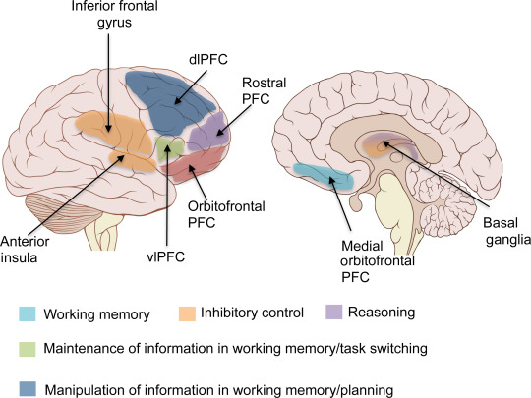
The Executive Function Areas
Your executive functions can be thought about as the conductor or air traffic control of the brain.
They include a range of cognitive skills (E.g., WM) and your capacity to regulate your behaviours and emotions.

Slide 6
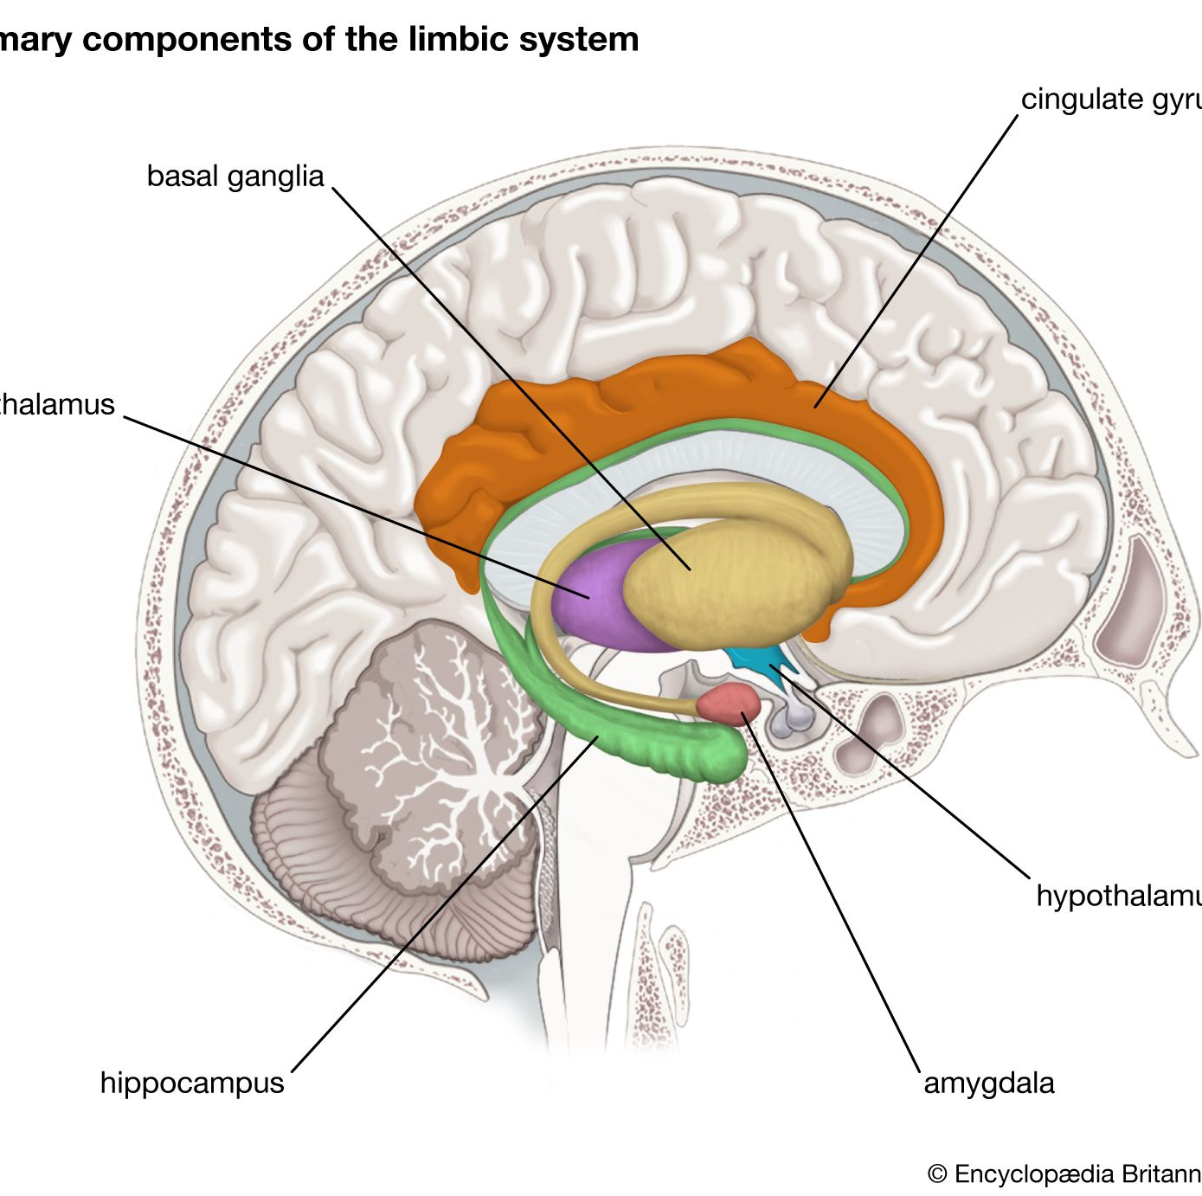
The Limbic System
The limbic system has many functions but is heavily associated with the experience and expression of our emotions and behaviours.

Slide 7
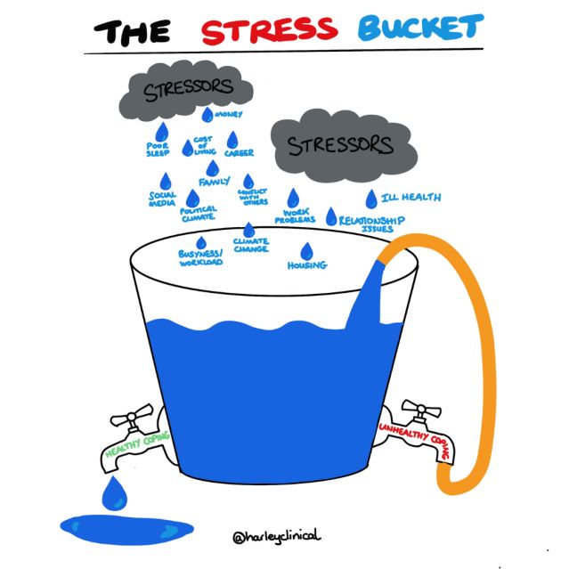
The Stress Bucket Analogy
There is a finite capacity for stressors.
Once the capacity is overwhelmed, we become dysregulated.
Good regulation skills can help reduce the stressors over time.
Some individuals have smaller capacities than others or poorer regulation skills.

Slide 8
Developing Emotional Regulation

Slide 9
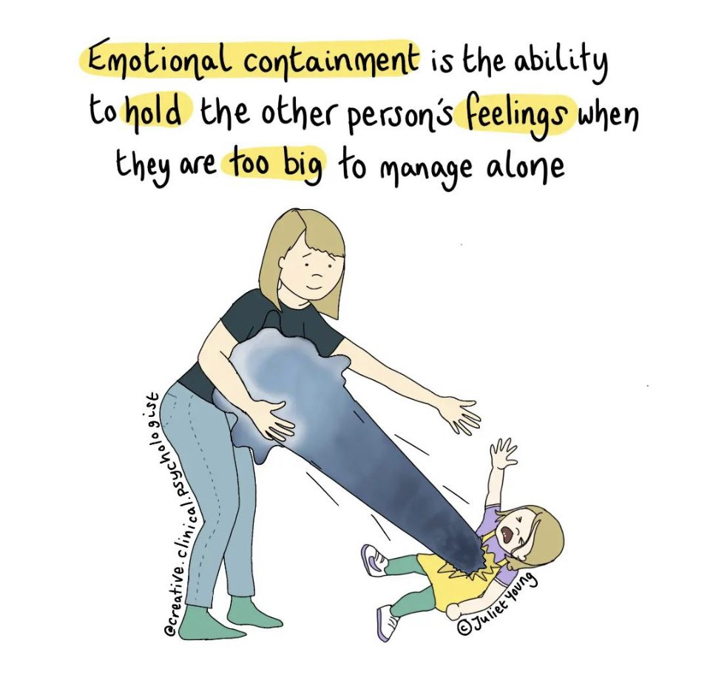
Developing Emotional Regulation
Develops over time from birth to young adulthood
Dependent on “co-regulation” by parents or other adults
  Containment
Skills can be strengthened and taught from caregivers
  Repeated practice in supportive context
Develops in context of social relationships
Over time we progressively learn how to self-regulate.

Slide 10
Containment
Containment:
Originally described by Bion (1984)
The process through which powerful emotions can be projected from one person to another who acts as a ‘container’ for these emotions.
The ‘container’ can empathically explore and process these emotions through ‘projective identification’, breaking down these raw emotions into more understandable and less harmful forms which can then be passed back to the original individual who can then better process them.
Containment facilitates the child's self-regulation development (Siegel, 2012) and there is increasing evidence that inadequate containment, whether actual or just perceived, is associated with greater problem behaviour throughout development (Fite et al., 2020).

Slide 11
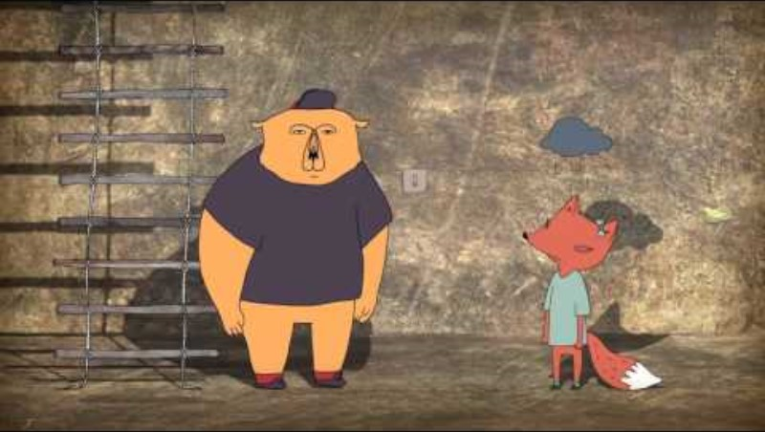
A relational trinity: Containment, Attunement and Holding
Containment:
It requires space and time.
It requires you to be present.
Allocate ample time for this.
It requires clear boundaries.
It also requires empathy, not sympathy.

Slide 12
Process of Self-Regulating Emotions
Develop the capacity to identify internal emotions
  Understanding different feeling states
  Applying appropriate labels (“Happy” or “Sad”)
Develop ‘socially appropriate’ and safe ways to express emotions
  Through talking, writing, drawing, through play etc.
Learn how to regulate internal experience using successful strategies

Slide 13
Emotional Regulation Interventions

Slide 14
Components of an emotional regulation intervention?
Intervention starts with co-regulation of emotions.
Psychoeducation on emotions and how they arise in context. I prefer the Cross-Sectional formulation.
Learning to identify the emotions within.
Teaching and practicing of self-regulation strategies for when emotions are arising.
  If they are finding regulating difficult, you need to be practicing every day for at least 15 minutes.

Slide 15
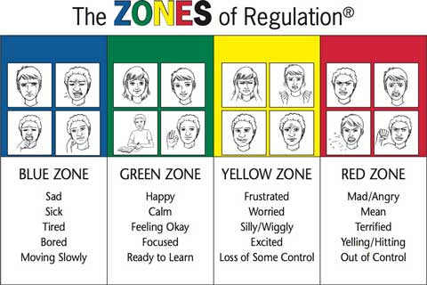
The Zones of Regulation approach
Further information:
https://zonesofregulation.com/

Slide 16
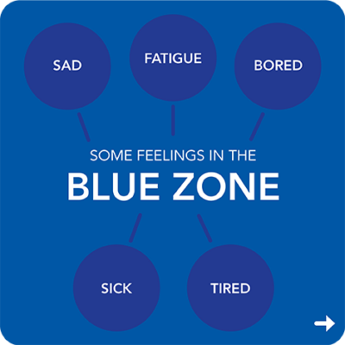
Blue Zone (-1 Deflated)
Teach the pupils the different thoughts, feelings, behaviours and bodily sensations that might occur in this stage:
Thoughts: I can’t be bothered, I’m bored, I’m fed up, I’m so sad.
Bodily sensations: Low heart rate, slow breathing, droopy eye lids etc.
Emotions: Sadness, Depression, Tired.
Behaviours: Lying down, yawning etc.

Slide 17
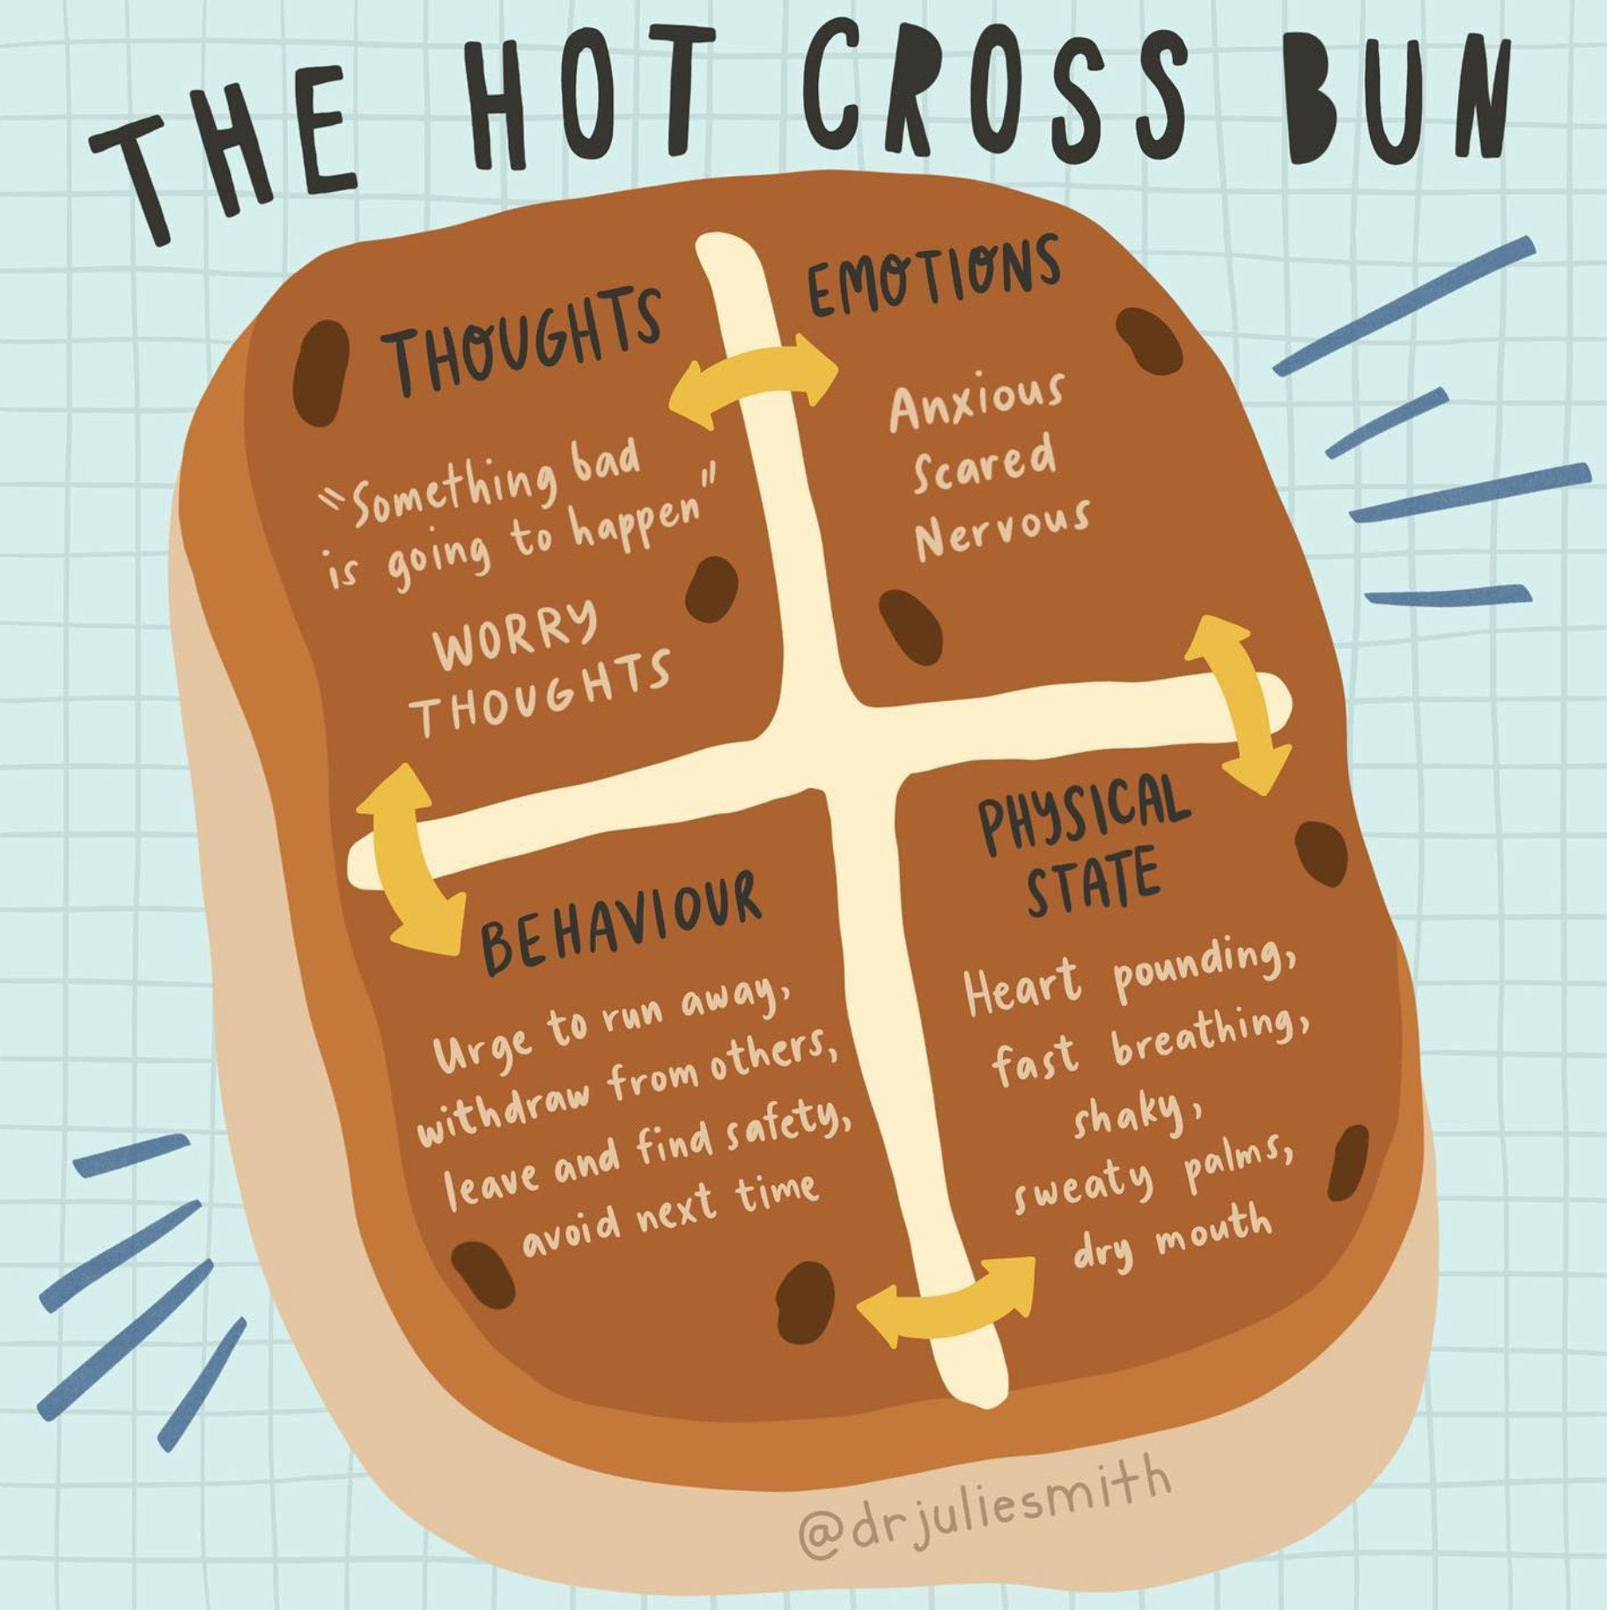
The Cross-Sectional Formulation
This is model from CBT. It highlights that the following are inextricably linked and bidirectionally antagonistic to each other:
  Behaviour
  Emotions
  Thoughts
  Bodily Sensations
It also highlights that these factors are influenced by different contexts, for example going into an exam, being on a roller coaster etc.

Slide 18
Blue Zone (-1 Deflated)
Everyone needs to be sufficiently stimulated to be able to engage and to be happy.
Some individuals can have great difficulty obtaining the right level of stimulation to be engaged, such as those with Sensory Processing Differences:
  Hyposensitivities
  Sensory Seeking

Slide 19
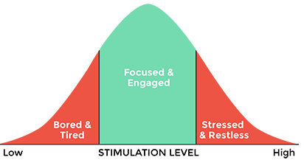
Arousal levels
Where we all want to be and will work towards
Hyposensitivity
and
Sensory Seeking
Hypersensitivity
Notes:
The way I find helpful to envisage;
Adapatation of the Yurkes Dodson
We all want to be around the green, easy for most of us
Children with SUR and SS are here and want to move up
Children with SOR are here and want to move down.
Can use this as an explanation for children

Slide 20
Blue Zone (Under Stimulated)
Alerting Strategies:
  Circuit training
  Musical chairs
  The bean game
  https://www.buckshealthcare.nhs.uk/cyp/pifs/alerting-ideas/
Talk to someone
Positivity journal
https://www.theottoolbox.com/zones-of-regulation-activities/

Slide 21
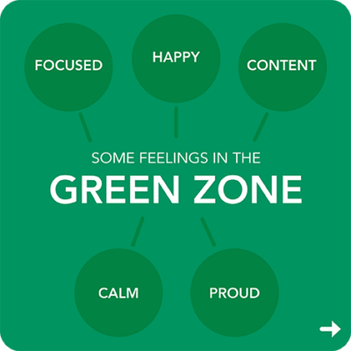
Green Zone (1 Calm and Relaxed)
This is where we have the optimal amount of arousal to engage with learning.
Things to do when in this zone:
  Learn
  Help others
  Practice our regulation strategies

Slide 22
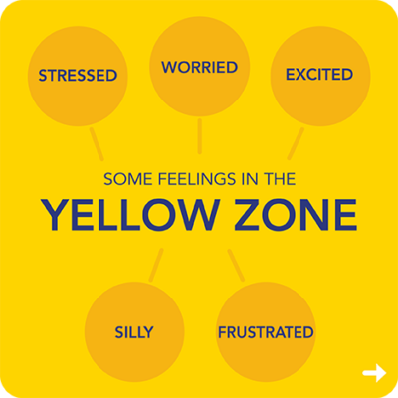
Yellow Zone (3/4 Little Nervous/Getting Angry
This is probably the most important zone.
This is the time to take action and avoid disaster.
What to do:
  Remove stressors where possible
  Direct children to engage with calming strategies
Strategies:
  Getting water
  Mindfulness activities e.g., colouring, reading etc.
  Deep breathing exercises, square breathing etc.
  Progressive Muscle Relaxation
  https://www.theottoolbox.com/zones-of-regulation-activities/

Slide 23
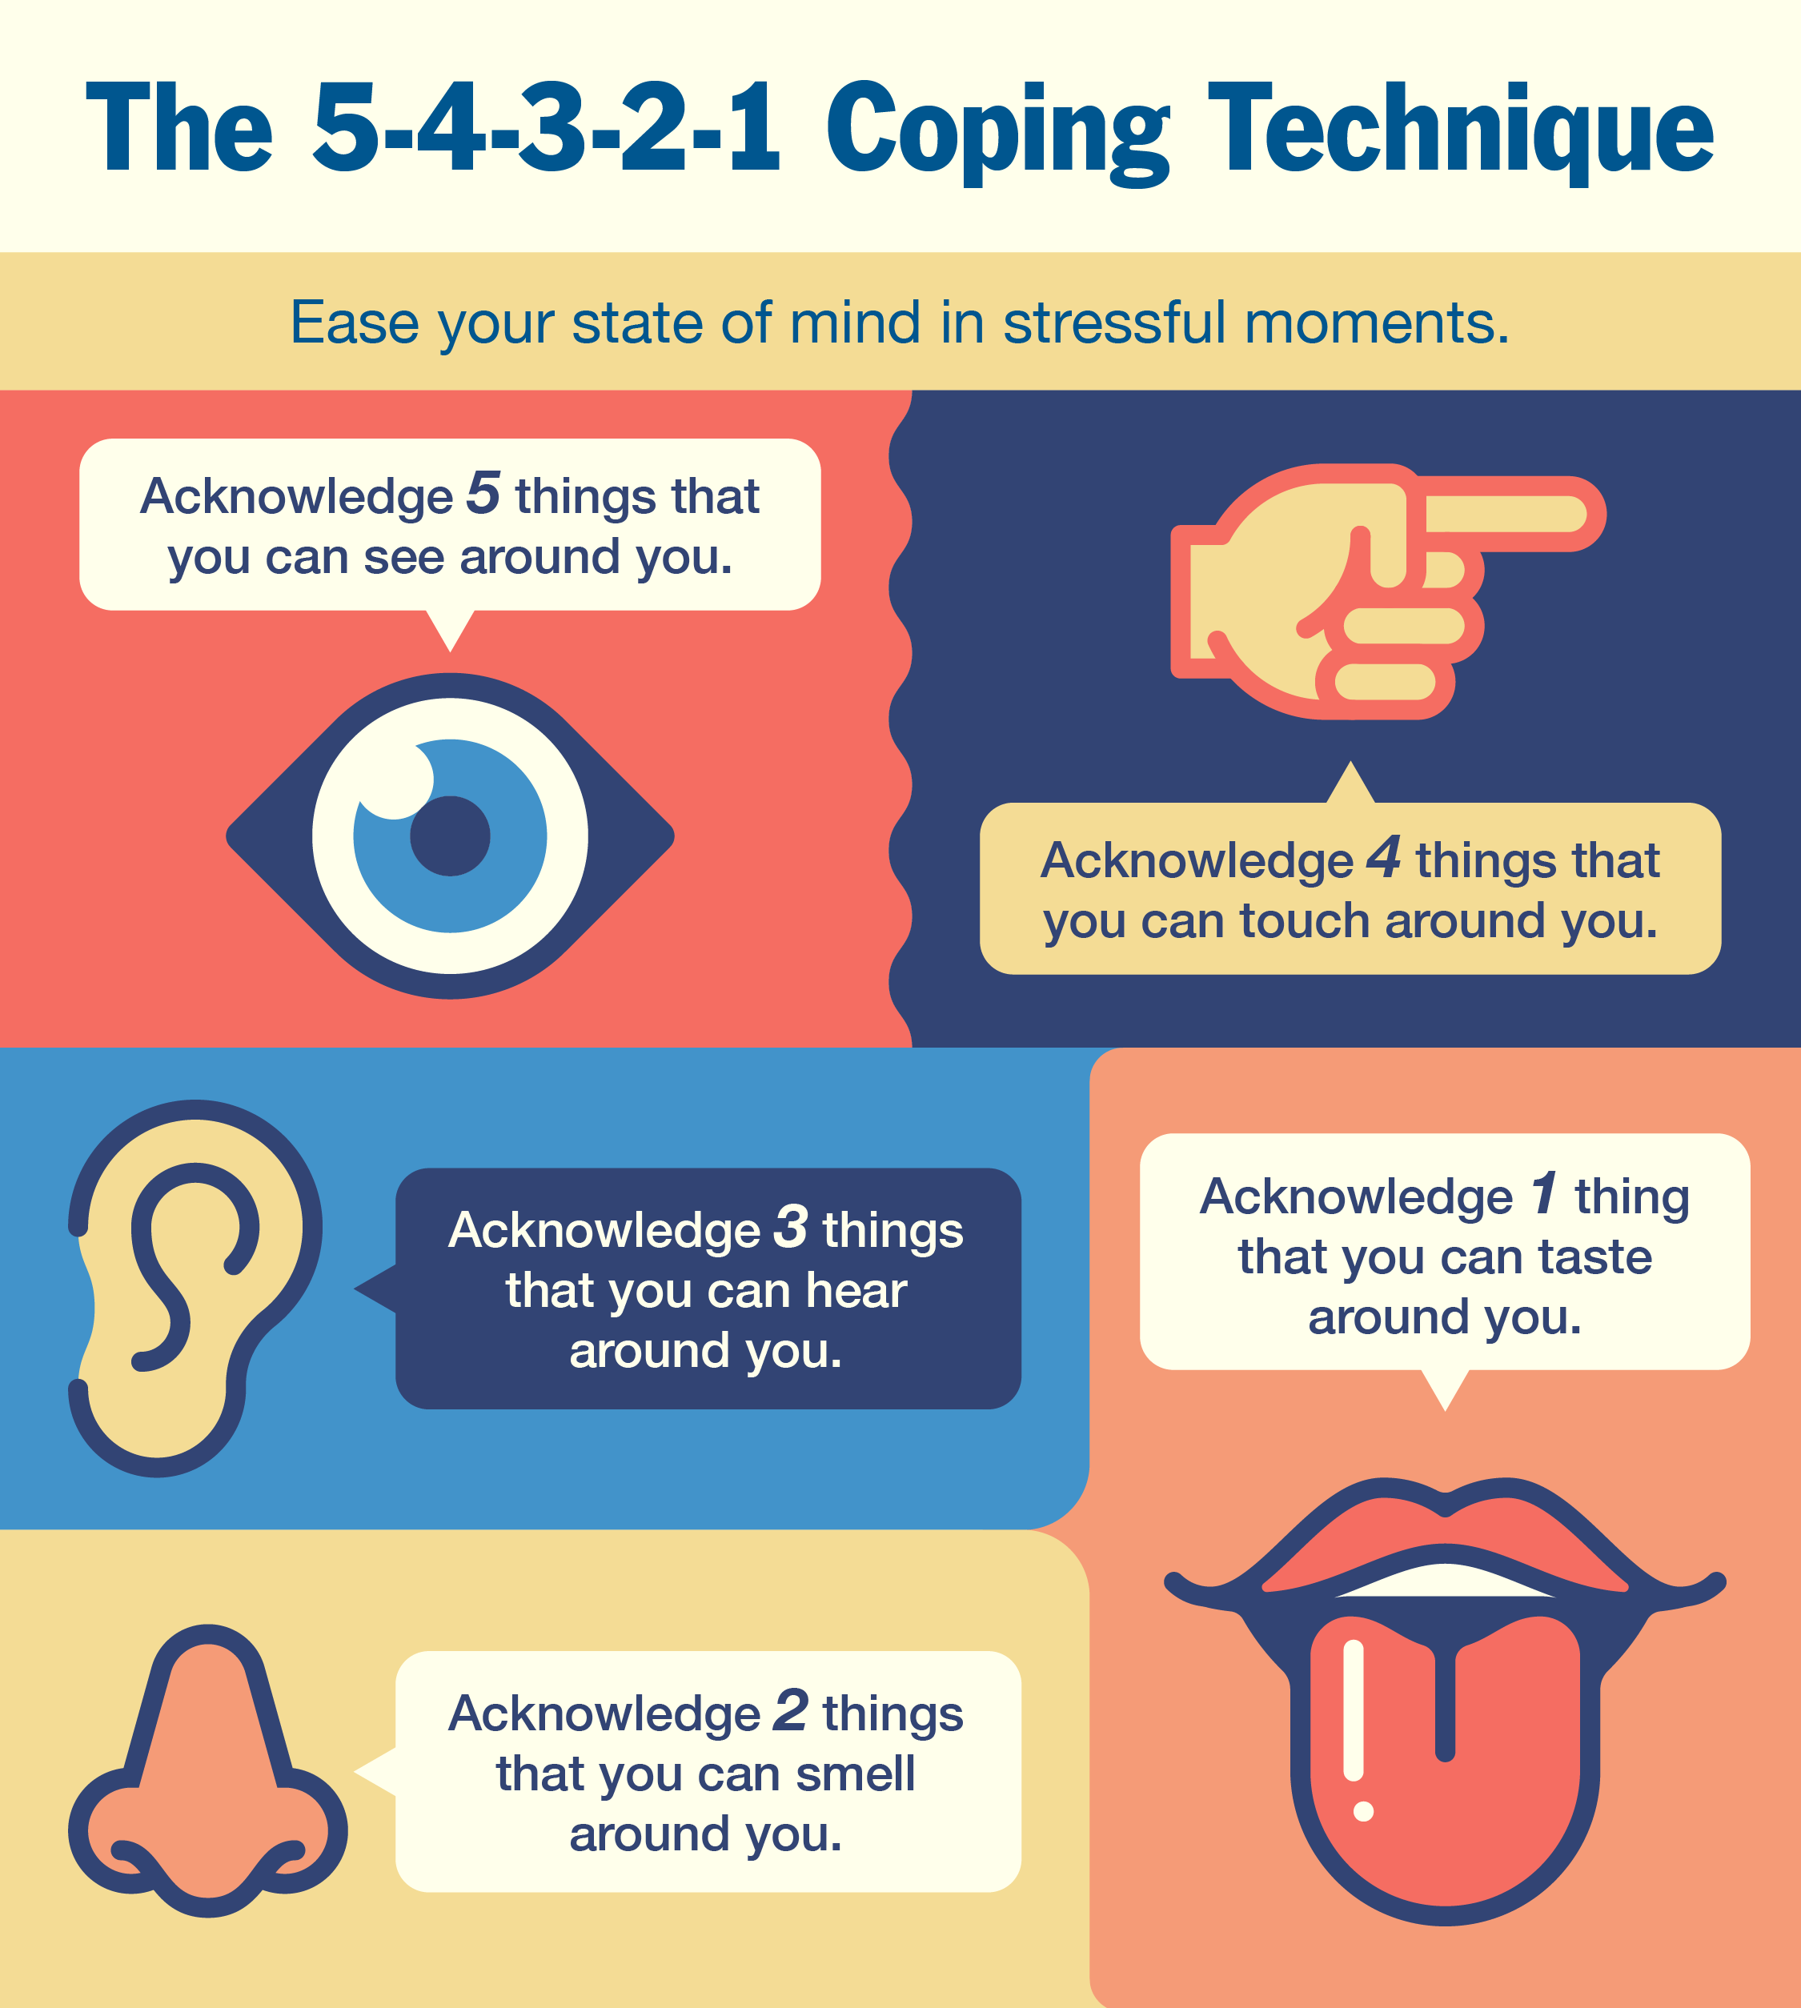
5, 4, 3, 2, 1 Grounding Technique
https://www.lpft.nhs.uk/young-people/lincolnshire/about-us/whats-new/grounding-activity

Slide 24
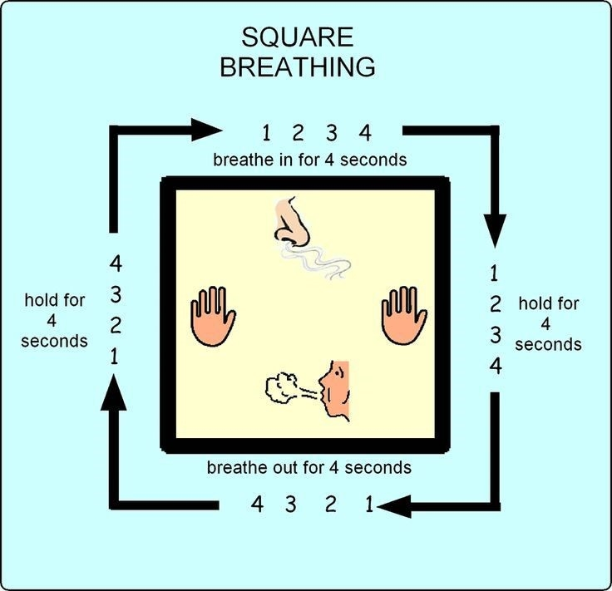
Square Breathing
If you are not activating the diaphragm, you are not breathing deep enough.
You can try the +2 breathing exercise. Here you count the number of seconds needed to take a deep inward breath, then add two seconds to this time and breath out for that duration.

Slide 25
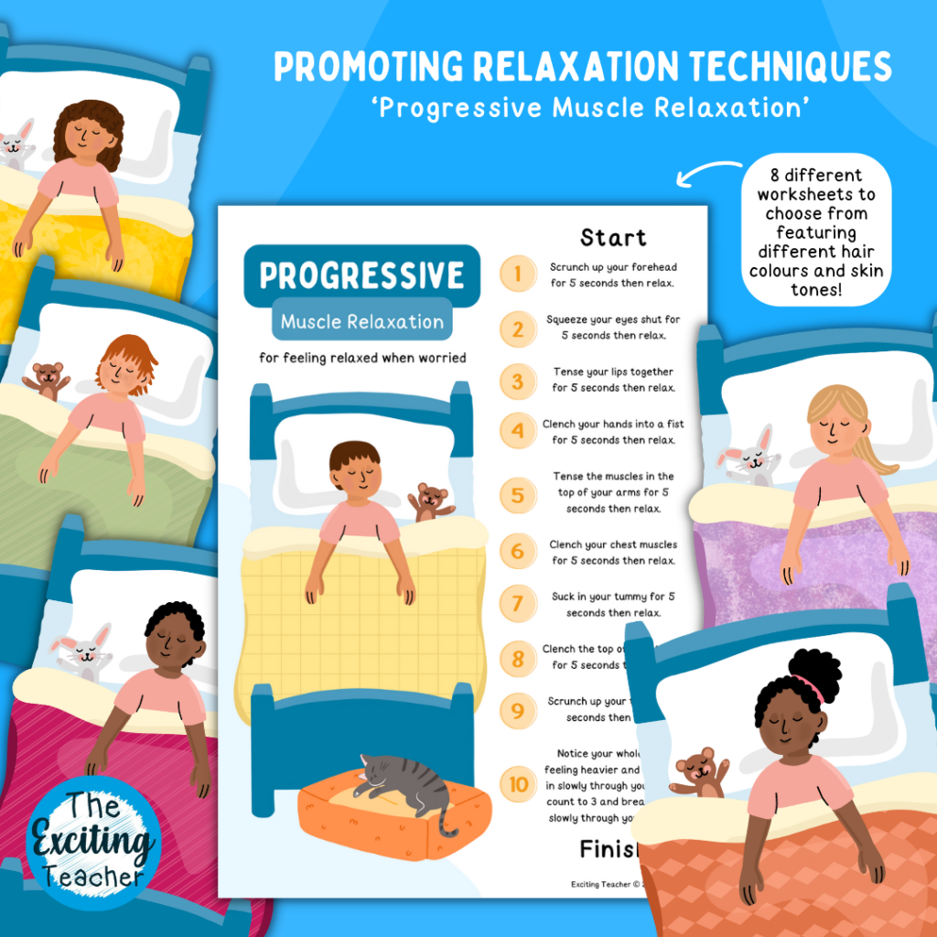
Progressive Muscle Relaxation
https://raisingchildren.net.au/guides/activity-guides/wellbeing/muscle-relaxation-activity-children-parents

Slide 26
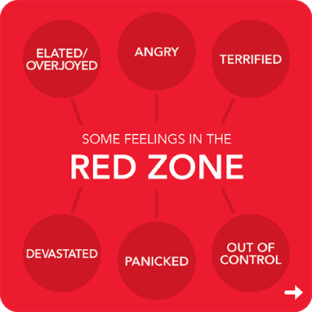
Red Zone (5 I’m going to explode)
The time for intervention has gone.
It is now time to just focus on keeping everyone safe.
Things to do:
  Direct the child to their ‘safe space’.
  Evacuate the other pupils.
  Give them space provided they are not hurting themselves or others.
The ‘safe base’ should be a well practiced and trialled instruction.

Slide 27
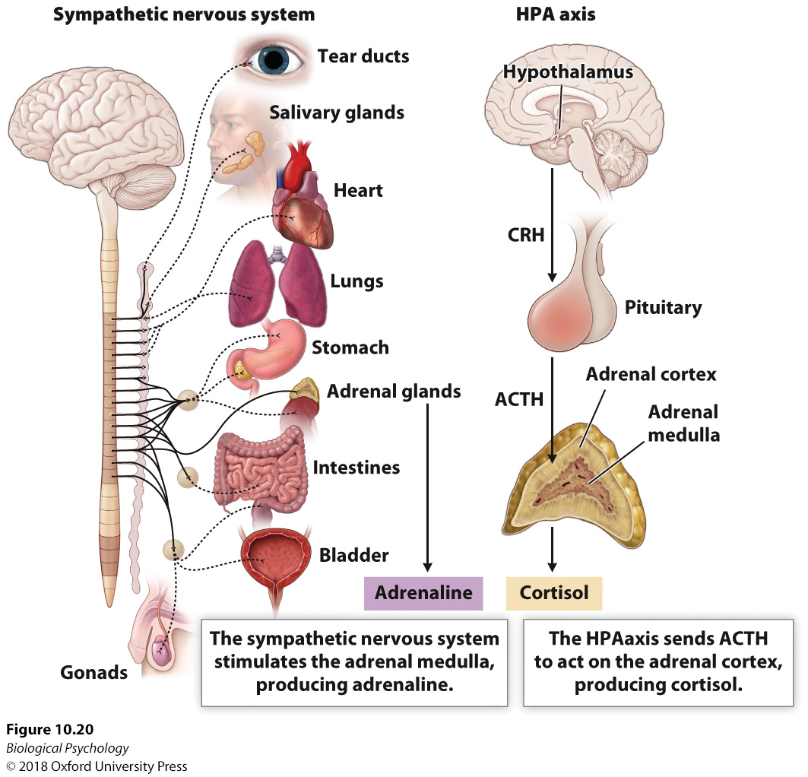
Final Tips: Manage the day through after a red zone event
After a red zone event, the inhibition of the sympathetic NS can lead to a quick reduction in externalising behaviours.
However, stress hormones will remain heightened.

Slide 28
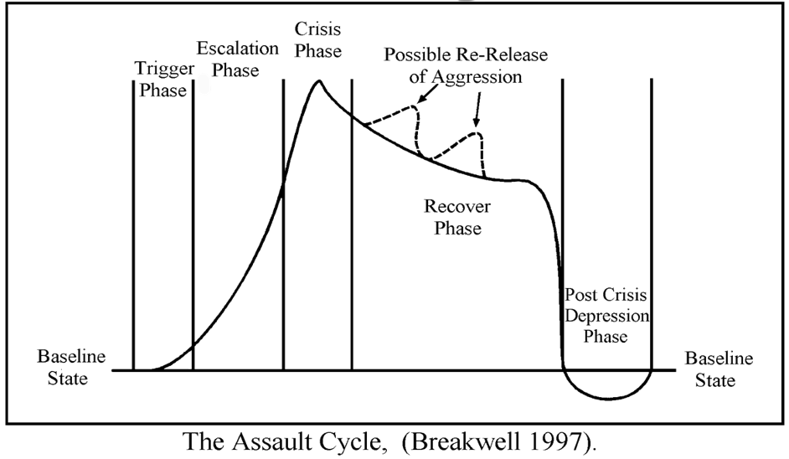
Final Tips: Manage the day through after a red zone event
As such, recurrent anger episodes can quickly re-occur.
As such, try to avoid addressing behaviour until much later in the day or the following day.

Slide 29
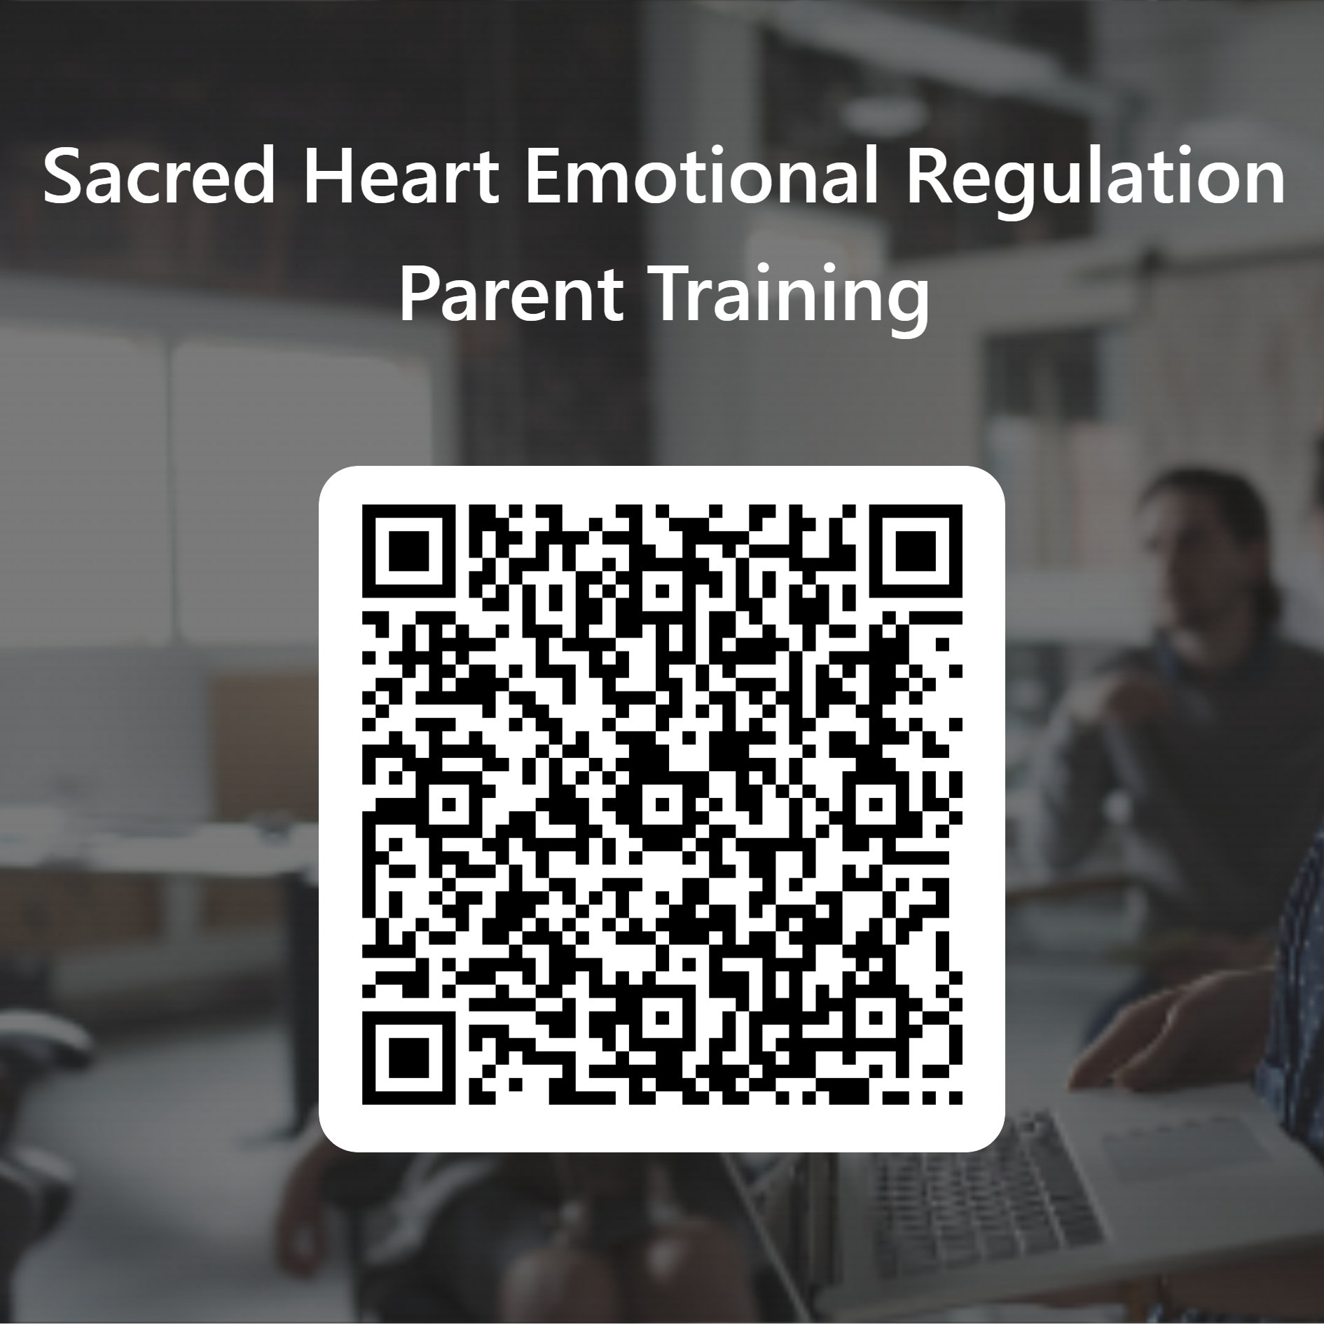
End
Thank you for attending.
Please take a moment to complete this feedback form.
I welcome any questions

