Slide 1
Parental Engagement
Increased number of proactive parental meetings for individual students in Y11 since January (Target students)
Increased uptake in parents eveing appointments
  42 out of 59 students booked to attend
  Individual calls to late replies
  Catch up evening for non-attenders
First Parent forum (see next slide)

Slide 2
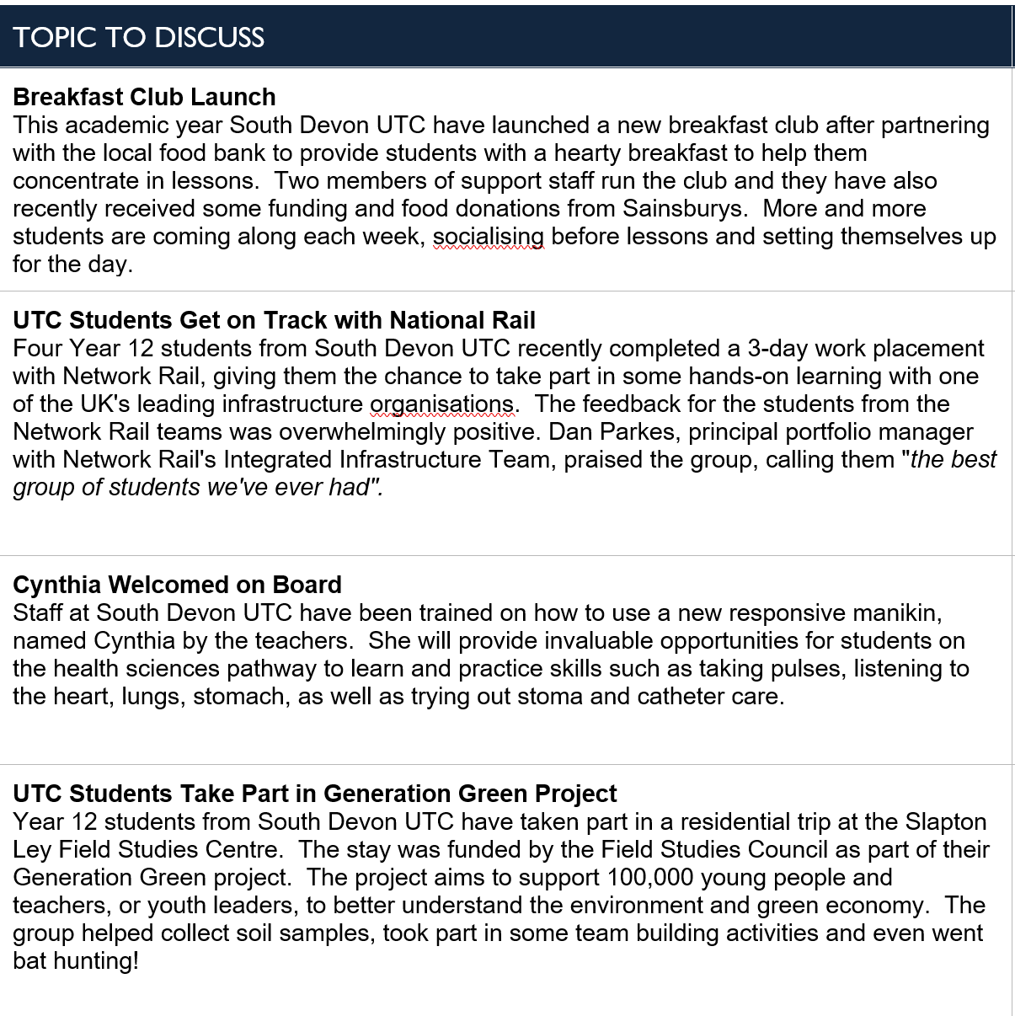
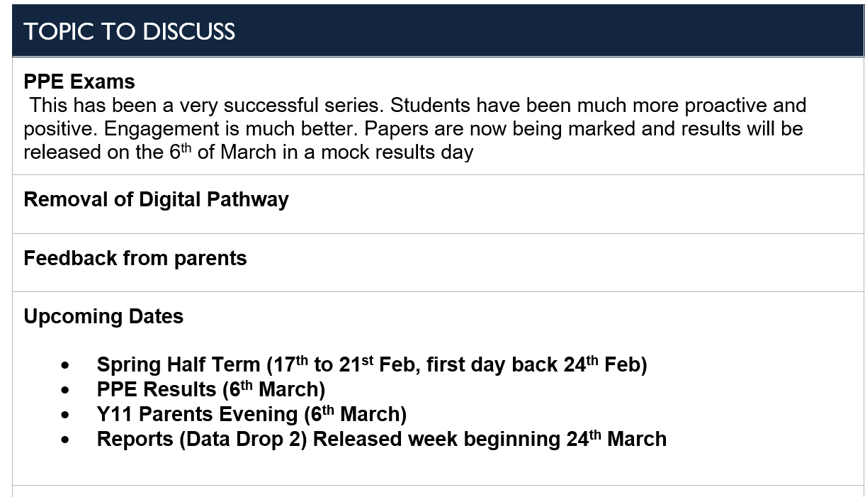
Parent Forum

