Slide 1

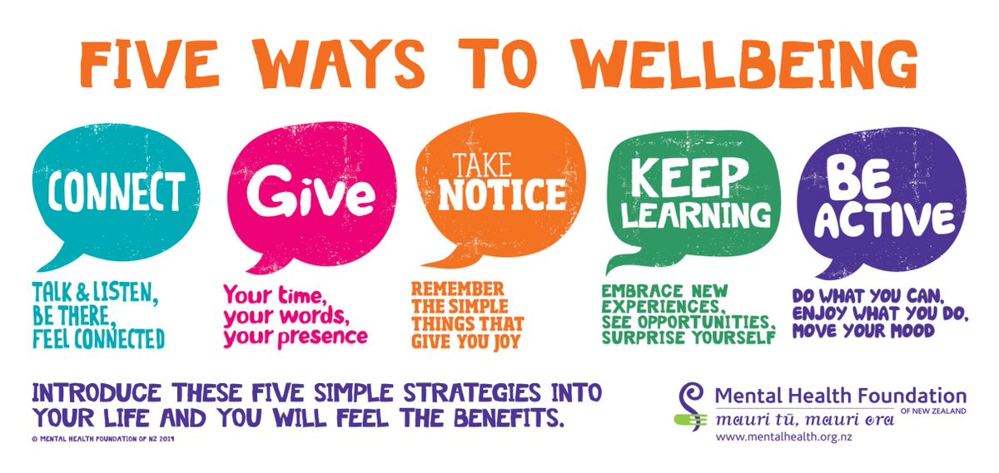
KCC Wellbeing
Article 24 (health and health services)
Every child has the right to the best
possible health. Governments must
provide good quality health care, clean environment and education on health
and well-being so that children can stay healthy.
With school closures and cancelled events, we know you are are missing out on all kinds of life events that you might have been looking forward to ( birthday celebrations, holidays, festivals, proms and parties) and events that you just expected to happen (exams!) — as well as everyday moments like chatting with friends and participating in class.
For those of you facing life changes due to the outbreak and for those of you who are feeling anxious, isolated and disappointed, know this: you are not alone.
We want to make sure you have information about what you can do to practice self-care and look after your mental health.
Each week we will have a different focus – this week we are looking at how to manage anxiety.

Slide 2
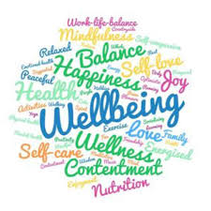
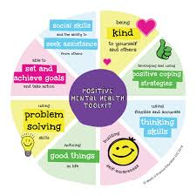
KCC Wellbeing
Article 24 (health and health services)
Every child has the right to the best
possible health. Governments must
provide good quality health care, clean environment and education on health
and well-being so that children can stay healthy.
If school closures and alarming headlines are making you feel anxious, you are not the only one. In fact it is a totally normal reaction.
Psychologists have long recognized that anxiety is a normal and healthy function that alerts us to threats and helps us take measures to protect ourselves.
If the current news on coronavirus (COVID-19) is making you feel anxious, concerned or stressed then we have some ideas for how to help you with your anxiety.

Slide 3
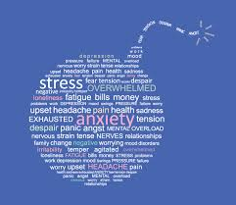
KCC Wellbeing
Article 24 (health and health services)
Every child has the right to the best
possible health. Governments must
provide good quality health care, clean environment and education on health
and well-being so that children can stay healthy.
What is anxiety?
We all get anxious and worried - especially during times of uncertainty. Anxiety is a natural way of dealing with the dangers around us and can impact the way we feel both emotionally and physically.
We might find we are struggling to sleep, being teary, feeling overwhelmed, getting headaches, getting into arguments and just generally feeling stressed.
The science behind anxiety!
When we are exposed to a threat our brain springs into action. Specifically a bit of your brain buried behind your ear called the amygdale. This is the bit in our brain that is in charge when we are frightened.
Right now for many people this bit of our brain is working overtime. People react in different ways. Maybe through physical signs, stomach upsets, headaches, insomnia, changes to eating, changes to the way we talk. We can become bad at making decisions, absorbing information and generally thinking rationally. So we can see these are ‘normal’ reactions. So what can we do to manage our ‘anxious’ thoughts and feelings. Lets take a look at some suggestions ……

Slide 4

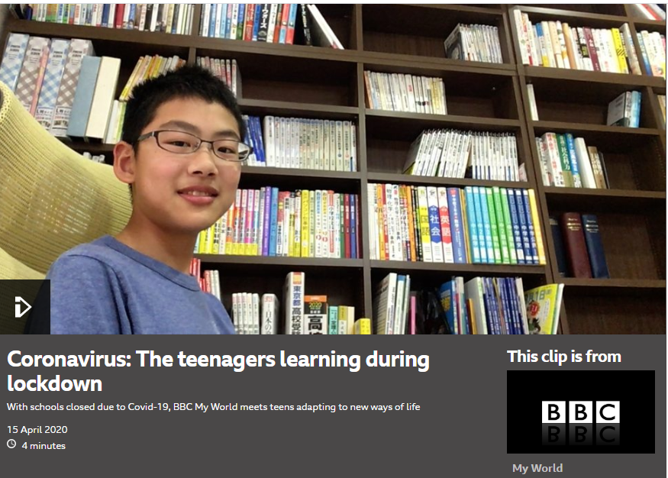
KCC Wellbeing
Article 24 (health and health services)
Every child has the right to the best
possible health. Governments must
provide good quality health care, clean environment and education on health
and well-being so that children can stay healthy.
You are not alone
https://www.bbc.co.uk/programmes/p089kss4
Young people around the world are experiencing lockdown situations and huge changes to their daily lives.
Take a look at the clip below and see how other young people are feeling around the world

Slide 5


KCC Wellbeing
Article 24 (health and health services)
Every child has the right to the best
possible health. Governments must
provide good quality health care, clean environment and education on health
and well-being so that children can stay healthy.
2.Talk to someone about how you feeling
While it is normal to feel worried, if you are starting to feel overwhelmed, it’s important to acknowledge your feelings and speak to someone you trust, whether that’s a friend, a family member, a teacher or a helpline.
3. Get the right facts
There is a lot of information about the virus out there and false reports can fuel anxiety. Stay on top of what’s happening by using the government website; it is the most up-to-date and reliable source of information. The NHS coronavirus page can also be useful if you are worried about symptoms or family members.
You might see stories or posts on social media that makes you feel anxious. It can be very hard to know whether or not social media posts are true, so try not to rely on updates from these outlets.

Slide 6

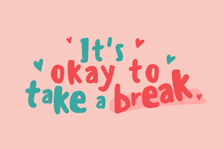
KCC Wellbeing
Article 24 (health and health services)
Every child has the right to the best
possible health. Governments must
provide good quality health care, clean environment and education on health
and well-being so that children can stay healthy.
4. Take a break from the news
Staying informed can make you feel in control but the constant news reports could also become overwhelming. Try to get your information from reputable websites (like those we’ve mentioned before ).
If you do want to read or watch the news, try to limit the amount of time you spend and stick to regular intervals in the days
Do take a break from social media if you feel like the updates are getting too much.
Remember you are in control of what you see on your feed. Take breaks when you do feel like things are getting too much or mute and unfollow accounts that make you feel more worried. For more advice and tips on looking after your mental health on social media, check out the Young Minds #OwnYourFeed campaign.

Slide 7
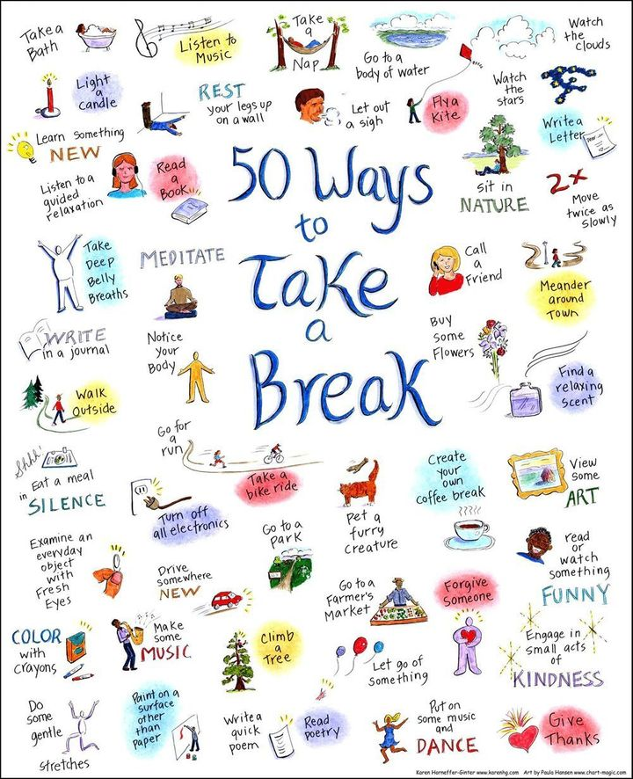
KCC Wellbeing
Article 24 (health and health services)
Every child has the right to the best
possible health. Governments must
provide good quality health care, clean environment and education on health
and well-being so that children can stay healthy.
5.Distract yourself with something you enjoy
Try to plan some activities that you enjoy and which will take your mind off things, whether that's texting or face-timing a friend, watching a film, reading a book or going for a walk. You can find the latest government guidance on leaving your home here.

Slide 8
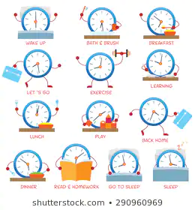
KCC Wellbeing
Article 24 (health and health services)
Every child has the right to the best
possible health. Governments must
provide good quality health care, clean environment and education on health
and well-being so that children can stay healthy.
6. Plan your time
We understand that this is a very different time for you but try to think of this as a chance to live in a different way for a while.
Think about what you might want to do during this time, how you will stay connected and how you will prioritise your wellbeing
Maintaining normal daily routines can make it easier for us to deal with stressful events
Planning might help reduce any anxiety or troubling thoughts. With so much uncertainty in the news, creating a routine you stick to can really help maintain a sense of structure and normality.
Maintain your routine as much as possible by getting up in the morning and going to bed at the same time. Eating regular meals and staying hydrated will help also, as well as taking breaks throughout the day to talk to someone or do something you enjoy.
A good routine helps us to keep our body clock set so we can get a good rest at the right time
It helps us to keep our good habits
It can make us feel less stressed
It allows us to build in time for exercise, social time, work and breaks

Slide 9

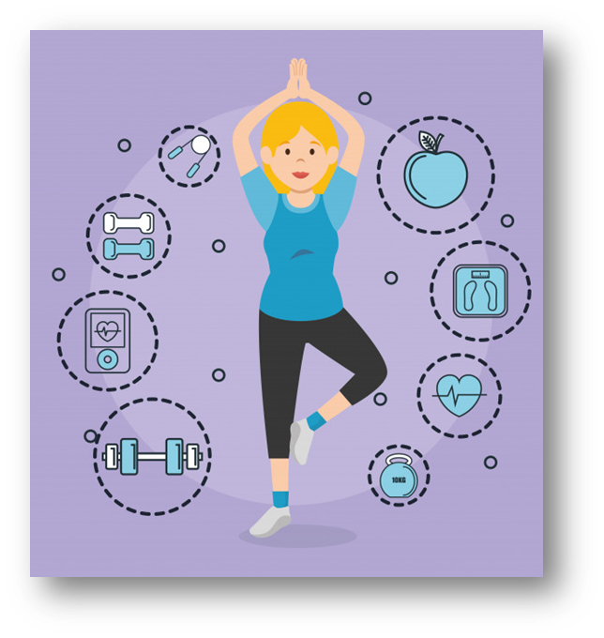

KCC Wellbeing
Article 24 (health and health services)
Every child has the right to the best
possible health. Governments must
provide good quality health care, clean environment and education on health
and well-being so that children can stay healthy.
7. Make sure you find time in your routine for activities that help you feel calm.
Like at any other time, it’s important that you are not only looking after your physical health, but your mental health too.
Think about some activities that can help when you are feeling overwhelmed, like breathing techniques, writing down how you feel, playing music or talking to a friend. For some ideas, have a look at how you can make a self-soothe box, or these coping techniques.

Slide 10
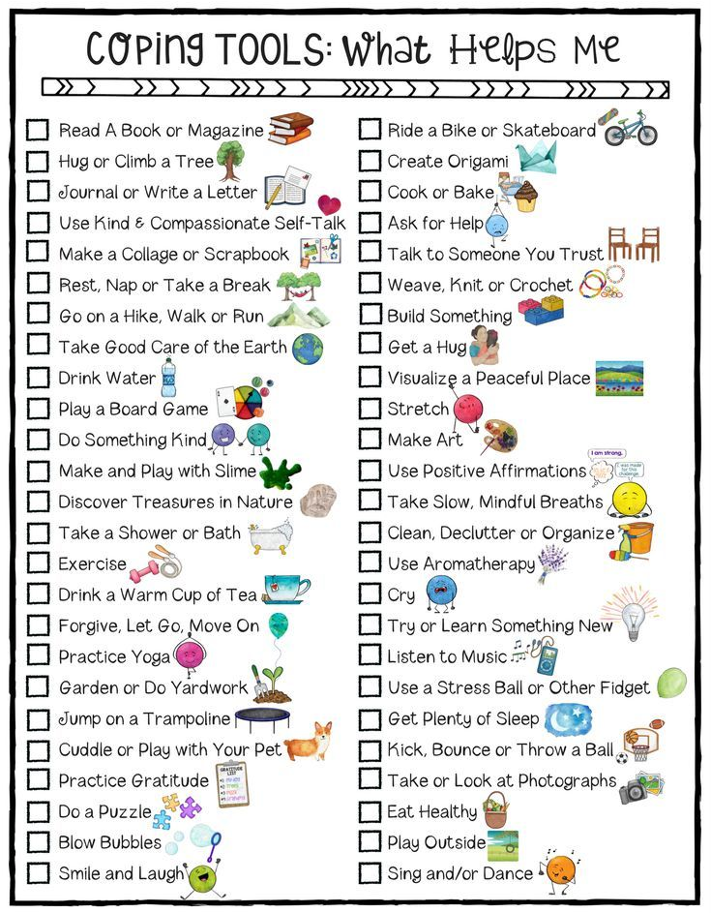
KCC Wellbeing
Article 24 (health and health services)
Every child has the right to the best
possible health. Governments must
provide good quality health care, clean environment and education on health
and well-being so that children can stay healthy.
7. Make sure you find time in your routine for activities that help you feel calm.
.

Slide 11
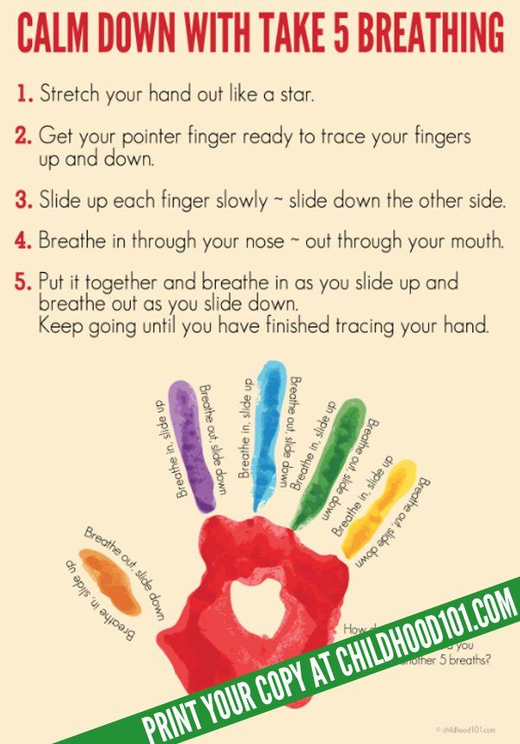
KCC Wellbeing
Article 24 (health and health services)
Every child has the right to the best
possible health. Governments must
provide good quality health care, clean environment and education on health
and well-being so that children can stay healthy.
Breathing activities that can help with anxiety
.

Slide 12

KCC Wellbeing
Article 24 (health and health services)
Every child has the right to the best
possible health. Governments must
provide good quality health care, clean environment and education on health
and well-being so that children can stay healthy.
Breathing activities
THE MEASURED BREATH
Here's how to do it:
You can sit or stand, but be sure to soften up a little before you begin. Make sure your hands are relaxed, and your knees are soft.
Drop your shoulders and let your jaw relax.
Now breath in slowly through your nose and count to four, keep your shoulders down and allow your stomach to expand as you breathe in.
Hold the breath for a moment.
Now release your breath slowly and smoothly as you count to seven.
Repeat for a couple of minutes.

Slide 13
KCC Wellbeing
Article 24 (health and health services)
Every child has the right to the best
possible health. Governments must
provide good quality health care, clean environment and education on health
and well-being so that children can stay healthy.
THE BUMBLE BEE BREATH
You might prefer to be alone for this one as you'll be making a noise. Strange though it sounds, this little technique has been used for thousands of years for calming the mind and it feels so good that you probably won't care what people think. Whenever I teach workshops on meditation or reducing stress and anxiety the Bumble Bee Breath is always a favourite.
Here's how to do it:
Relax your shoulders
Close your throat slightly so you can hear your breath when you breathe in
Cover your ears with your thumbs and your eyes with your fingers
Keep your lips closed but lightly and your teeth slightly apart with your jaw relaxed and breathe out slowly making a long, low humming sound
Make your exhalation long and smooth
Repeat 5-10 times
Then sit with long slow breaths for a couple of minutes and enjoy the peace.

Slide 14
KCC Wellbeing
Article 24 (health and health services)
Every child has the right to the best
possible health. Governments must
provide good quality health care, clean environment and education on health
and well-being so that children can stay healthy.
BELLY BREATHING FOR RELAXATION
Breathe in slowly and deeply through your nose. Make sure your shoulders are down and relaxed. In this exercise, your stomach should expand, but your chest should rise very little. So, if you want, you can place one hand on your stomach and the other on your chest so you can feel how you are breathing.
Exhale slowly through your mouth. As you blow air out, purse your lips slightly, but keep tongue and jaw relaxed. You may hear a soft “whooshing” sound as you exhale. That's good, listen for that sound every time your practice and learn to value it as the sound of relaxation.
Repeat this breathing exercise for several minutes. Make your outgoing breath as long and smooth as you can. The out breath is the key to relaxation so give it your full attention and practice breathing out in a long slow controlled breath and you will quickly feel the benefit.

Slide 15
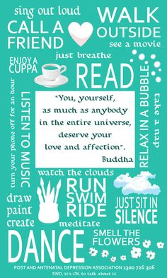
KCC Wellbeing
Newsletter
Accessing support
You may find that you need extra support, so think about who you can turn to. It could be someone you know, or a helpline that you can talk to about how you might be feeling
Anxiety UK - 0844 475 774 www.anxietyuk.org.uk
Childline - 0800 1111 24 hours a day. Confidential advice for children and young people. www.childline.org.uk
Relate - 0300 100 1234 Relationship support for all ages.
https://www.relate.org.uk/
Samaritans - 116. Confidential support for people experiencing feelings of distress or despair https://www.samaritans.org/
YoungMinds - 0808 802 5544 9.30am - 4pm Monday to Friday. Committed to improving the emotional wellbeing and mental health of children and young people. www.youngminds.org.uk
Kooth- provider of online mental health services for children, young people and adults
https://www.kooth.com/

Slide 16
KCC Wellbeing
Article 24 (health and health services)
Every child has the right to the best
possible health. Governments must
provide good quality health care, clean environment and education on health
and well-being so that children can stay healthy.

