Slide 1



Maths Calculations Year 5
Methods for teaching the four calculations at St. David’s.

Slide 2
Year 5 National Curriculum objectives.
Addition, Subtraction, Multiplication and Division
Add and subtract whole numbers with more than 4 digits, including using formal written methods (columnar addition and subtraction)
Add and subtract numbers mentally with increasingly large numbers
Solve addition and subtraction multi-step problems in contexts, deciding which operations and methods to use and why
Multiply numbers up to 4 digits by a one- or two-digit number using a formal written method, including long multiplication for two-digit numbers
Multiply and divide numbers mentally drawing upon known facts
Divide numbers up to 4 digits by a one-digit number using the formal written method of short division and interpret remainders appropriately for the context

Slide 3
Vocabulary related to the four calculations for Year EYFS – Year 6
EYFS/Year 1
more (than) less (than) total
fewer (than) equal (to) most
least
sum difference between total
first
plus add(ition) subtract(ion)
minus ones tens column(s) multiples
Year 2
multiple commutative
>as ‘greater than’
< as ‘less than’ partition
place holder
place value estimate
estimation
inverse
array
calculate
multiplication division
times tables
Year 3
multiple(s) inverse operations integer(s) decimal(s) remainder
Year 4
round rounding
negative
operation
Factor
factor pairs distributive associative derive remainder
odd even double halve pair
how much how many larger smaller estimate compare together
Year 5
power(s) prime complement
composite prime factor square(d)2 cube(d)3 equivalence
Year 6
long division Multi-step common factors common multiple

Slide 4
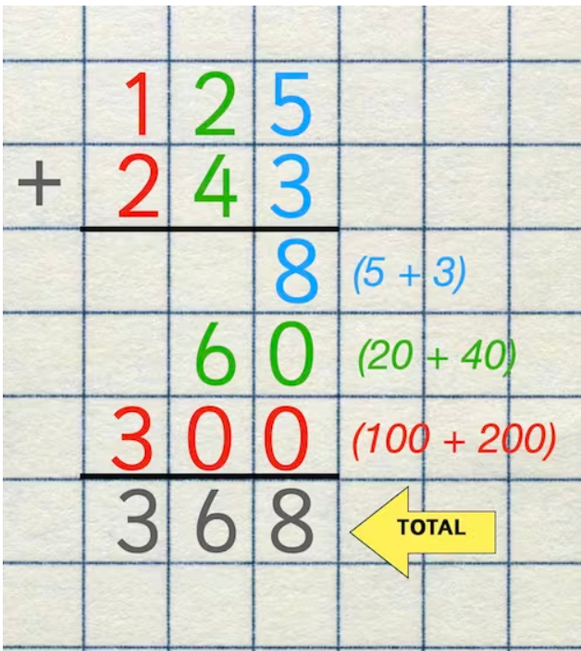
Addition
Expanded Column Method
The expanded column method is so called because each part of the addition is 'expanded' and recorded. The expanded column addition method is effective because it ensures that when children move on to the compact method, they understand what they are doing in each step rather than simply learning a process by rote.
Add the ones column (9+5) and write this answer following the correct place value columns.
2. The same method is followed for the tens column and the hundreds column.
By writing the numbers they have added in brackets next to their work, children can see where their answer comes from.

Slide 5
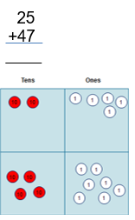
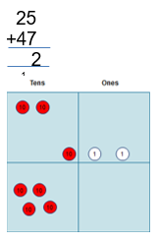
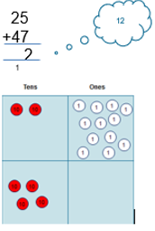
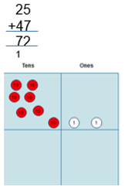
Addition
Compact Method
The concept of exchange is reinforced through continued use of manipulatives.
1.
“I have two
tens and five ones, which need
adding to four tens and seven ones.”
2.
“I add five ones to seven ones,
which gives me twelve ones.”
3.
“I exchange ten of my twelve ones for a ten counter.”
4.
“I add my three tens and four tens to make seven tens.”
“Altogether, I have seven tens and two ones.”

Slide 6

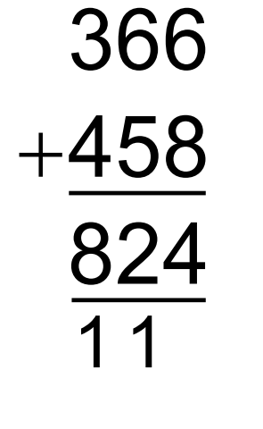
Children then advance to model the addition of two 3-digit numbers through a compact method and then go beyond.
Need to be able to:
•Add in columns.
•Have place value awareness.
•Organisation (layout)
•Ability to estimate.
•Can check answers for reasonableness

Slide 7
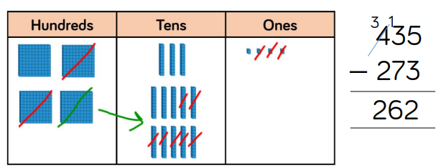
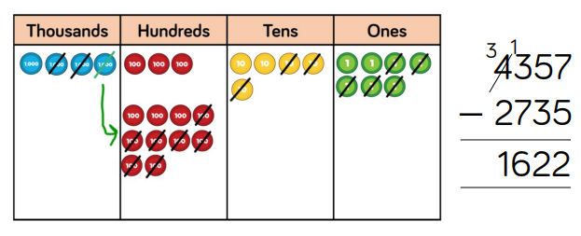
Subtraction
Using Dienes/Place Value Counters is an effective way to support children’s understanding of column subtraction. It is important that children write out their calculations alongside using or drawing Base 10 so they can see the clear links between the written method and the model.
Start with the smallest place value column. When there are not enough ones/tens/hundreds to subtract in a column, children need to move to the column to the left and exchange e.g. exchange 1 ten for 10 ones. They can then subtract efficiently.

Slide 8
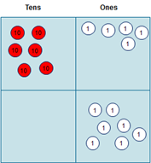
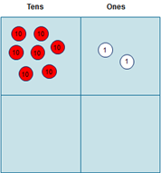


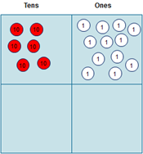
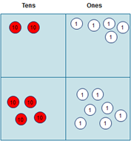


Subtraction
The concept of exchange is continued through use of manipulatives when moving on to the formal column method.
“I have seven tens and two ones. I need to subtract four tens and seven ones.”
3. “Now I can take away seven ones from twelve ones, so that I have fives ones left.“
2. “At the moment, I cannot subtract seven ones from two ones, so I need to exchange one ten to become ten ones.”
4. “I can now subtract four tens from six tens, which leaves me with two tens.”
“I recombine two tens and fives ones to understand that I am left with twenty-five.”

Slide 9
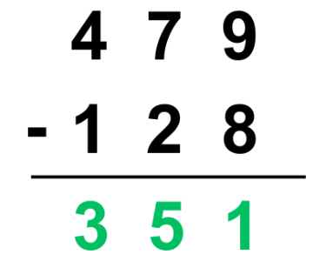
Children then advance to model the subtraction of two 3-digit numbers through a compact method and then go beyond.
Need to be able to:
•Subtract in columns.
•Have place value awareness.
•Organisation (layout)
•Ability to estimate.
•Can check answers for reasonableness

Slide 10
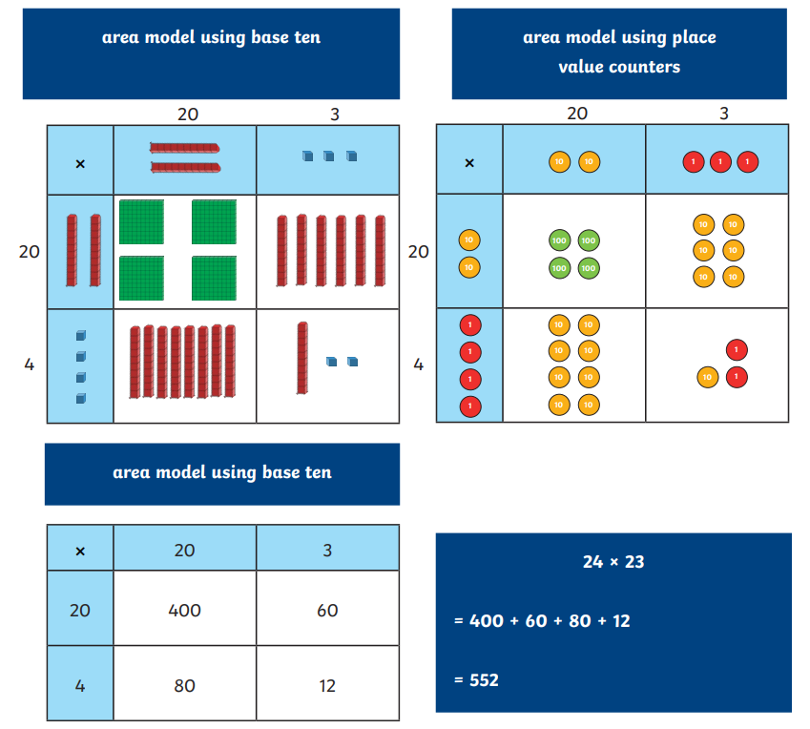
Multiplication
Initially, dienes (base 10)/ place value counters can be used to help understand the place value of two 2-digit numbers being multiplied together. Once they have a good understanding, they can move on to using numbers in the area model.
Partition both two-digit numbers.
Next, place the partitioned numbers on the grid.
Multiply the partitioned numbers.
4. Add the values together.

Slide 11
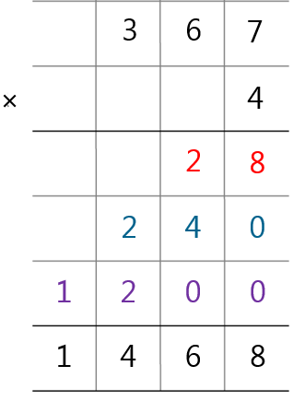
Multiplication
Multiplying by a one-digit number
4 x 7 ones = 28 ones = 2 tens + 8 ones (28)
4 x 6 tens = 24 tens = 2 hundreds + 4 tens (240)
4 x 3 hundreds = 12 hundreds = 1 thousand + 2 hundreds (1200)
Add them all together

Slide 12
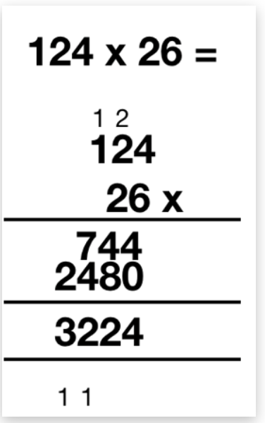
Multiplication
Multiplying by two-digit numbers
Set the question in the formal method, making sure the digits are aligned.
Start the process of multiplication with the ones. Multiply each digit by the number in the ones place, adding any exchanges above the next column.
Add a zero (placeholder) in the ones column below as we are now multiplying by a number in the tens column.
Follow the same process as before to multiply each digit by the number in the tens column.
Add the two answers up correctly.
(124 x 6)
(124 x 20)

Slide 13
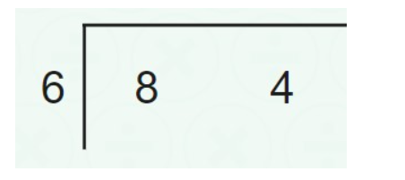
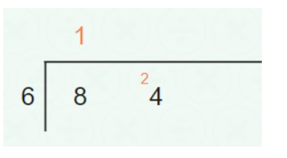
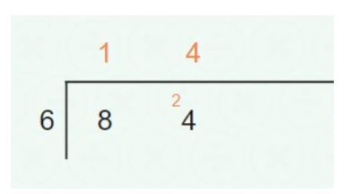
Division
Position the numbers as shown. Write the number you’re dividing by (divisor) in front of the vertical line and write the number that is being divided (dividend), on the right-hand side of the vertical line.
Divide each of the digits in the dividend (84 in our example) by 6 (our divisor). Remember, when dividing, we’ll start from the left - the tens digit first.
Eight is our tens digit, so you divide eight by six. However, this wouldn’t give you an exact answer. What you need to do is think about how many times six can fit into eight. Six can fit into eight only once and you’ll have two as a remainder. The image can show you how to write this down.
So, one goes above the line, right above eight. The remainder goes next to the next digit of the dividend.
Continue this process for each digit, ensuring the correct amount is exchanged each time.

