Slide 1
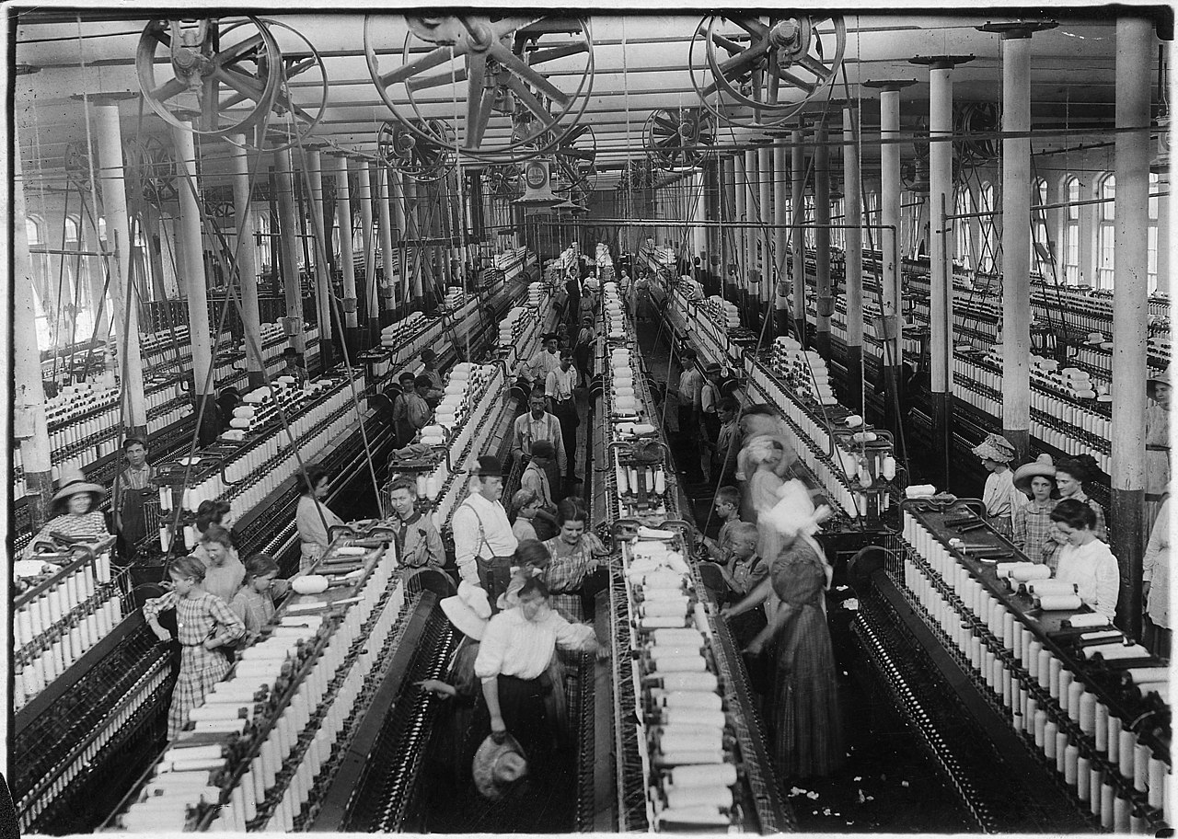
Curriculum Overview
Term: Autumn
Class: Year 6
William Gilbert Endowed Church of England Aided Primary School
Curriculum Overview For Parents
Term – Autumn 2026
Theme: Revolution and Reform
Class: Year 6 | Miss Rice
Curriculum Overview
Term: Autumn
Class: Year 6
English | Mathematics | Science | History
Writing Descriptive narrative Precis Biography Persuasive letter Reading Drawing inferences based on characters’ feelings, thoughts and motives Scanning the text to locate answers Summarising the main ideas of paragraphs Recognising figurative language and its impact Grammar Passive/active voice Using commas, brackets and dashes for parenthesis Structures of formal and informal writing | Place Value within 10,000,000 Writing and partitioning numbers to 10,000,000 Exploring powers of 10 Interpreting number lines to 10,000,000 Comparing and ordering any number Rounding numbers Understanding negative numbers Four Operations Adding and subtracting integers Exploring common factors and multiples Using rules of divisibility Recognising primes, squares and cubes Multiplying up to a 4-digit number by a 2-digit number Using short and long division Understadning the order of operations | Animals including Humans Identifying parts of the circulatory system and describing their purpose Exploring systems within different animals Understanding how exercise affects the body both positively and negatively Evolution and Inheritance Understanding information fossils can give us Exploring inheritance and variation between parents and their offspring Describing how animals are adapted to their environment Recognising Charles Darwin’s theories Understanding how adaptation may lead to evolution | Revolution and Reform Exploring how the industrial revolution came about Recognising the part Derbyshire played in the industrial revolution, including Strutt and Arkwright Describing changes in the local area which were a result of the industrial revolution Understanding positive and negative impacts that it brought to the country Recognising that issues that were reformed during Victorian Britain are still in need of resolution across the world
RE | Computing |  | PE |  | Design & Technology
What kind of king is Jesus? Discussing the Lord’s Prayer Describing what Christians believe the Kingdom of God is like Exploring what kind of king Jesus is Green Religion – How and why should religious communities do more to care for the Earth? Understanding climate justice Exploring the Jewish festival of Tu B’Shevat, Hindu goddess Bhumi and Khalifah in Islam Researching projects from different religions around the world | Online Behaviours Understanding digital footprints Exploring unacceptable online behaviours and how they can impact others Knowing wats to report and evidence concerns of online activity Websites Describing what a website is Identifying features of a websites Understanding copyright laws Using hyperlinks |  | Athletics Identifying good running techniques Completing the triple jump Throwing using body weight for momentum Practising dynamic changeovers. Circuit Training Pacing yourself and breathing to the pace of the beep Completing circuits of high intensity including core strength Maintaining balance when jumping and changing direction |  | Textiles: Waistcoats Considering the target audience/customer Creating a design criteria Designing a waistcoat Using a template to mark and cut out a design accurately Using running stitch to join fabric Attaching fastenings and decoration Evaluating the final product against the design criteria
RHE |  | Music |  | Art & Design |  | German
My Healthy Self Exploring nutritional information and dental hygiene habits Recognising and regulating feelings Explaining how mindset can affect personal growth Connecting with Others Understanding personal boundaries Exploring respectful ways to challenge unfairness Knowing ways to respond to bullying safely |  | Four-Chord Pop: Playing in a Band Making connections between musical choices and feelings Projecting voices when singing Adding rhythms to bass lines and chord sequences |  | Lowry and Wright: Drawing and Perspective/ Painting and Colour Exploring ‘one point perspective’ and the ‘vanishing point’ Using dry media within drawings Using a limited colour palette inspired by Lowry Comparing work by Lowry and Wright |  | Sports and Hobbies Recalling different sports and hobbies Expressing opinions Discussing favourite sports and hobbies
Things to look for and do at home:
Engaging with texts daily to support fluency and understanding Recording page numbers and comments of your reading and ending with a comment if you have finished the book in order to change it | Weekly home learning tasks – Spellings, Maths Whizz and a weekly reading response challenge Spelling tests and home learning tasks due on Mondays PE kits on Mondays and Wednesdays (until October half term)

