Slide 1


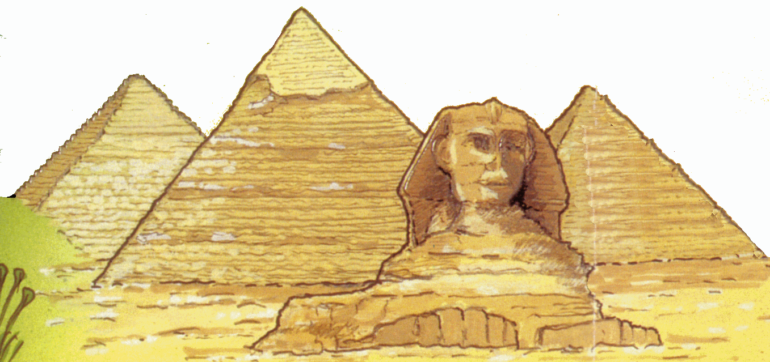
Kestrels Class Curriculum Overview
Maths
Multiplication and division facts up to 12x12
Multiplying 3 numbers together
Factor Pairs
Written methods to multiply a 2 digit number by a 1 digit number
Mental and written division
Solving word problems
Equivalent Fractions
Adding and subtracting fractions with the same denominator
Decimals: writing tenths and hundredths
- Quick recall of times tables (6 seconds allowed per question.) Practice at home using TT Rock Stars and Hit the Button websites.
Times tables to 12 x 12 and related division facts
Science,
Animals including Humans – digestion, teeth and healthy eating
Working Scientifically – ask and answer questions, use investigations to generate new questions, record and report on their findings, use labelled diagrams
English
Reading – predicting, making inferences, summarising, using dictionaries, retrieving information from non-fiction, discussing interesting and imaginative words and phrases
Writing – Biography, non-chronological reports, instructions, diary entry, newspaper reports and posters, list poems, Kennings
Spelling/Grammar – conjunctions, paragraphs, headings, expanded noun phrases, fronted adverbials, inverted commas, homophones, prefixes, suffixes, Y3/4 spelling list
Year 4 2023
Spring
Ancient Egypt
RE, PSHE and Values
RE – Hindu Faith
Places of Worship and Festivals
PSHE - Living in the Wider World -Respecting Rights
Relationships - TEAM
Listening and sharing through circle time.
The importance of rules and routines in daily life, including ways to a happy school and class.
Values – Determination and Truthfulness
Computing
Discussing E-Safety: I am safe
PowerPoint Presentations
Coding
Purple Mash
Art and Design Technology
Art – Using clay to create a Tutankhamun's death mask
Making an Egyptian necklace.
Sketching self portraits
Tracing
DT – Food Technology – Bread
History/Geography
History - Achievements of the earliest civilizations – in-depth study of Ancient Egypt, chronology, investigating sources
Geography - Studying the location & landscape of Egypt, the importance of the Nile, Worldwide map work
Music and Languages
Music – Recorder
Easter Songs for performance
Languages – Animals and ‘I can…
Physical Education and Outdoor Learning
Yoga/ Fitness
Gymnastics
Grafham Water residential trip

