Slide 1
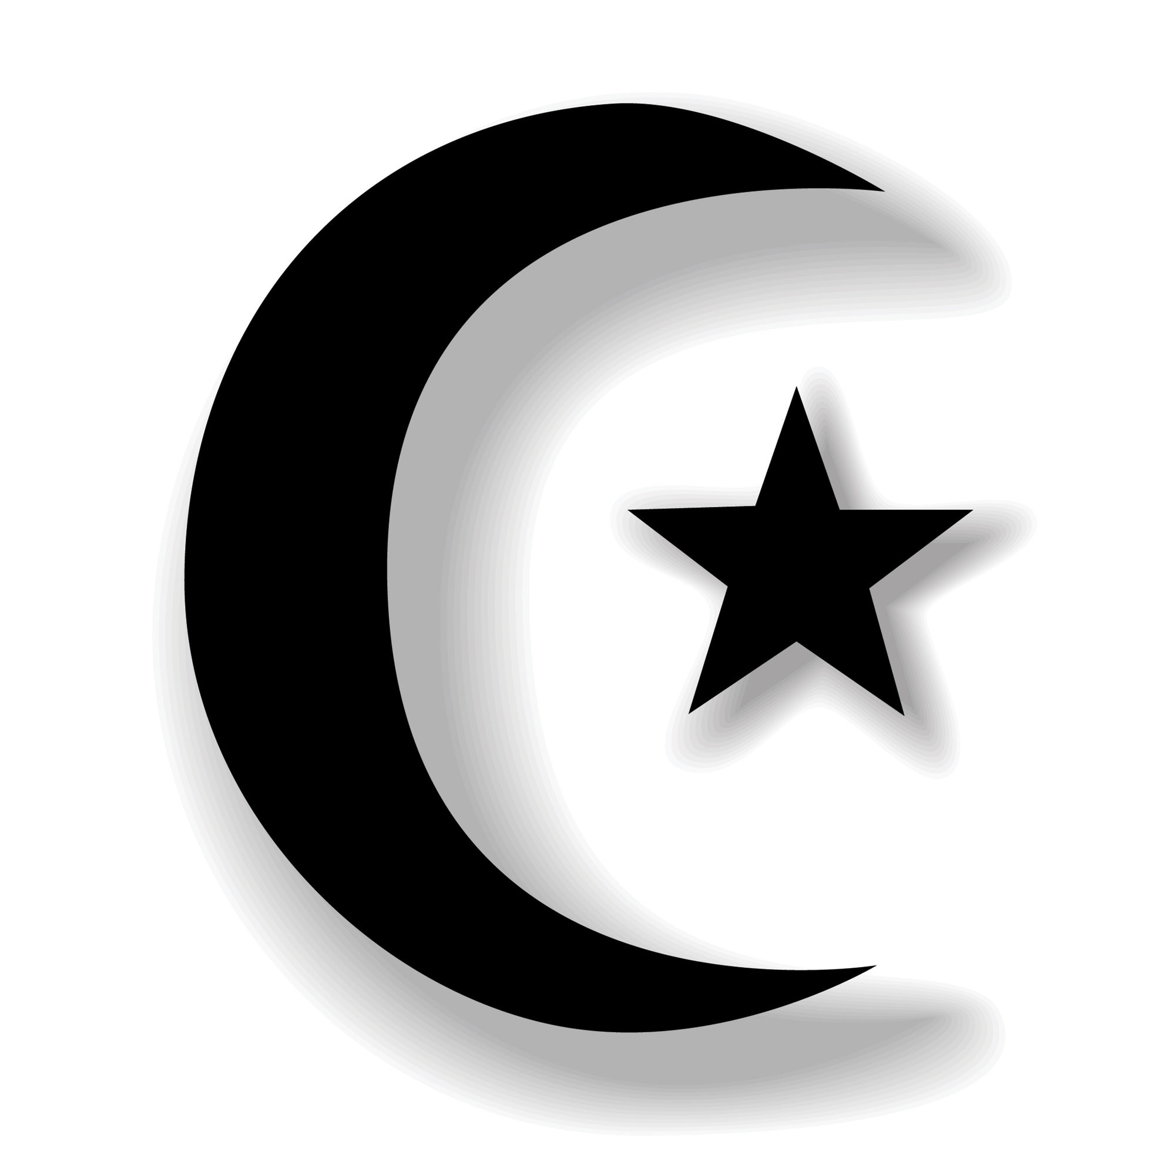
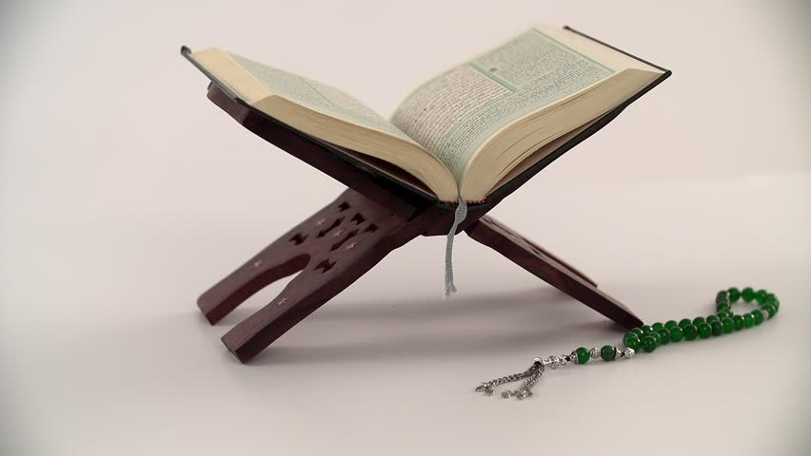
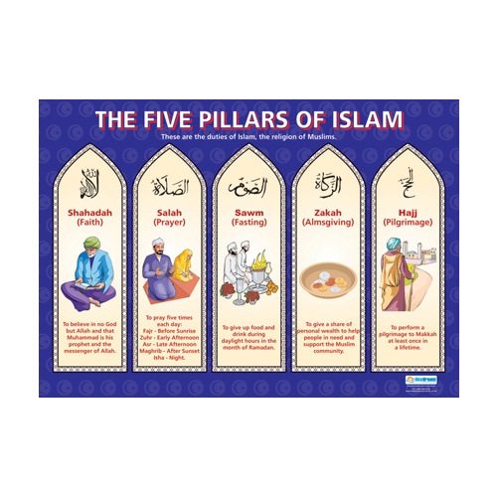
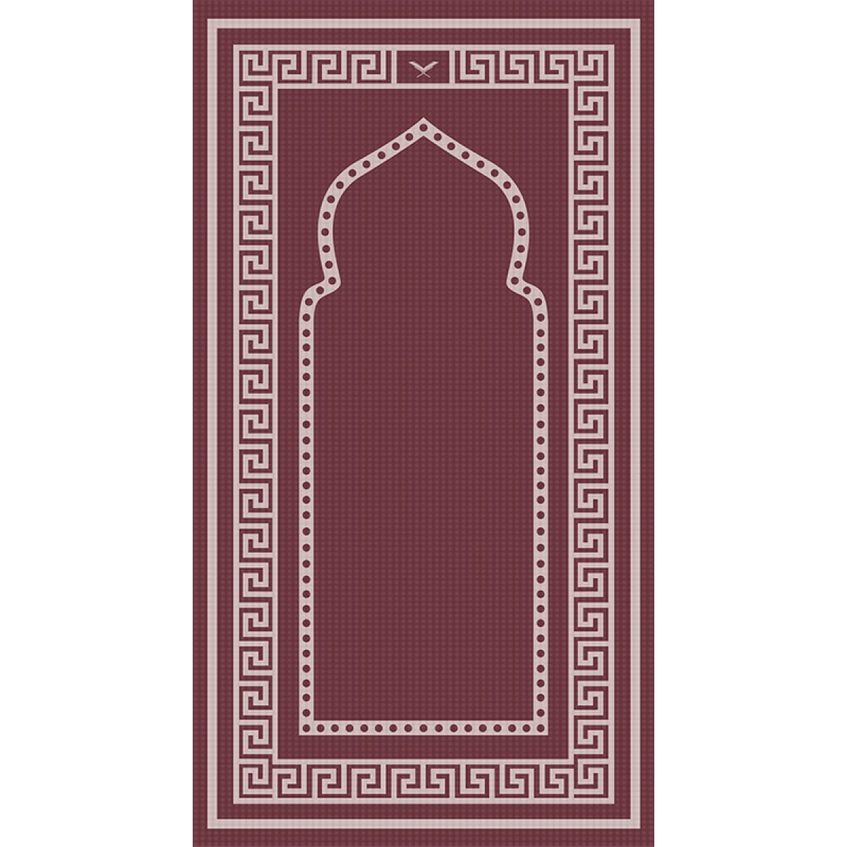
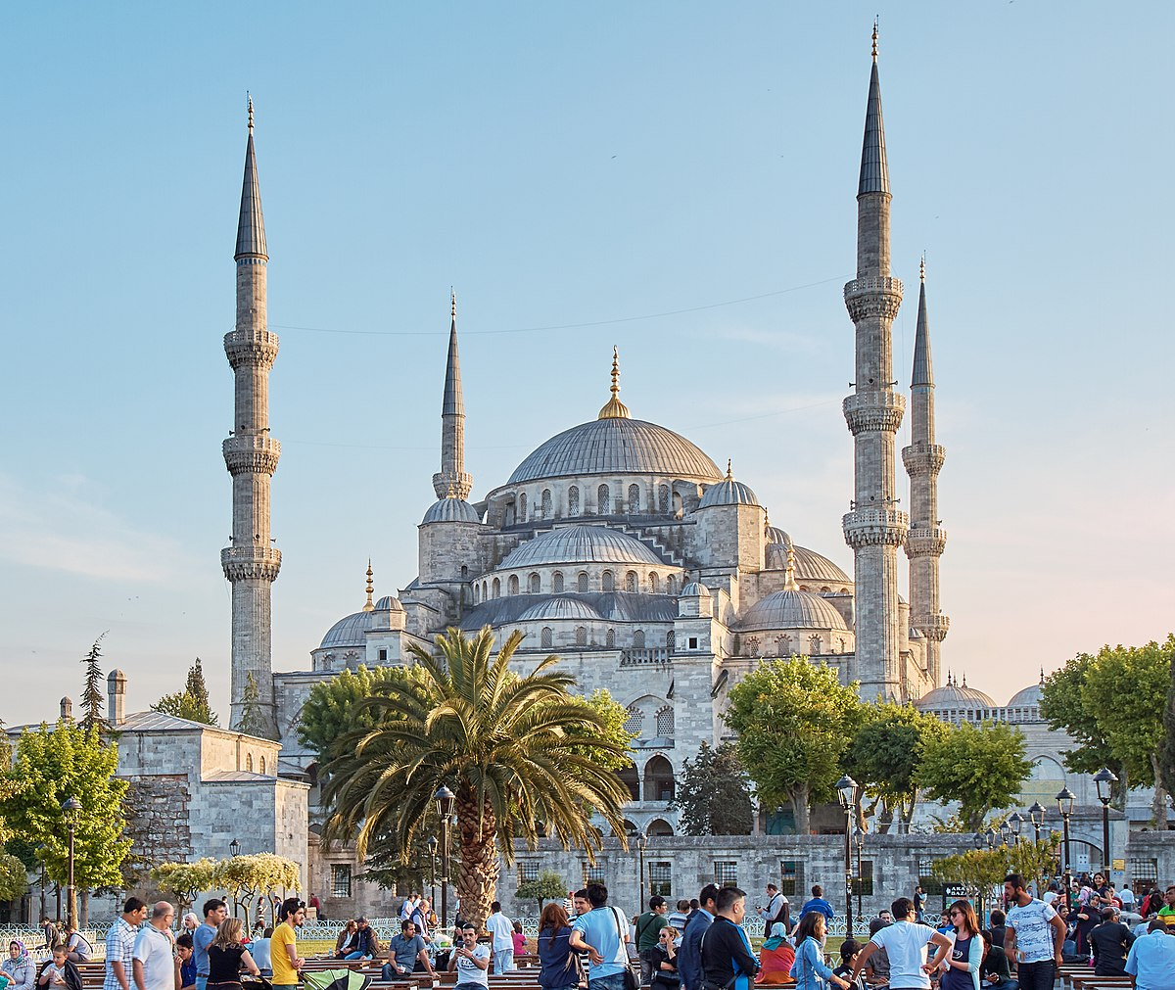
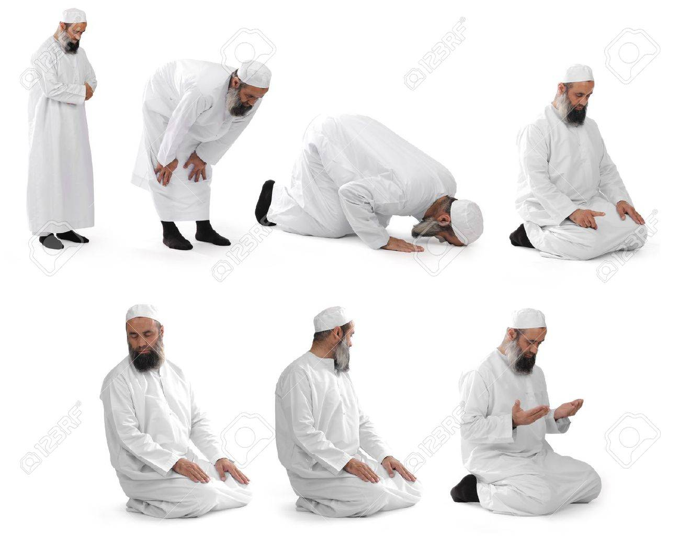
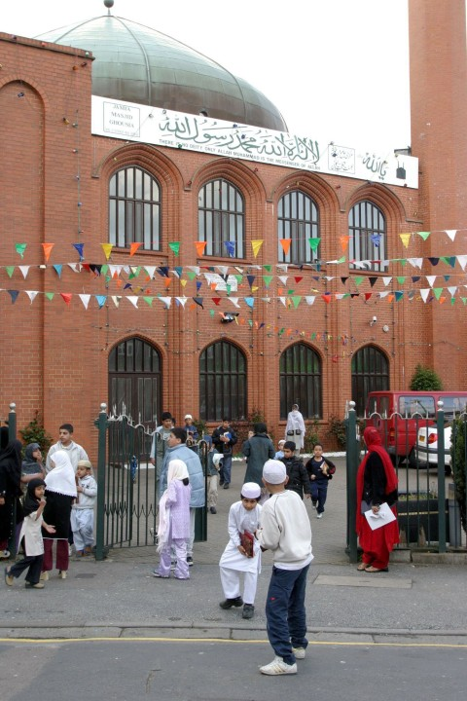
Vocabulary
Muslim – a person who practices the religion of Islam
Qur’an – the holy book.
Mosque – place of worship.
Shahadah – A phrase that Muslims say aloud each time they pray
Prophet – messenger of God.
Khalifah – caretaker of the world (looking after the planet).
Ramadan – A festival where Muslims fast during the day.
Worship – praying
Islam for KS1
Where Islam Began: Mecca, Saudi Arabia
Moon and star is the symbol of Islam.
How Islam Began
Muhammad was meditating in a cave in Mecca, Saudi Arabia, when an angel visited him giving him many messages from God about how he wanted the people to live. These messages from God were written into the Qur’an (Holy Book of Islam).
The Qur’an (holy book) on its stand.
The Shahada
The Shahada is a phrase that Muslims say aloud every time they pray. They say ’there is no God but Allah and Muhammad was his messenger’.
Praying/Worship
Muslims can pray at the mosque or at home. They pray 5 times a day.
They have special prayer movements.
They have to face Mecca when they do this.
When they pray at home. They have a prayer mat to kneel on.
Friday is the holy day of the week when most Muslims to the Mosque.
A prayer mat
Main Beliefs
Muslims believe in one God, Allah
Muhammad was a prophet (messenger) sent by God.
Muslims believe Muhammad was the last messenger sent by God.
They also believe that Allah wants people to be a community looking after each other, looking after all living things and looking after the world, becoming a Khalifah (a caretaker of the world).
The Blue Mosque in Turkey
Mosques
A mosque is a building that Muslims can go to perform their prayers.
They take off their shoes before they go in to stay clean.
They have a wash before praying – this is known as Wudu.
Ramadan is an important festival
This is a special month of fasting.
An English Mosque
Special prayer movements

