Slide 1
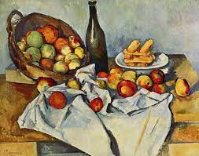
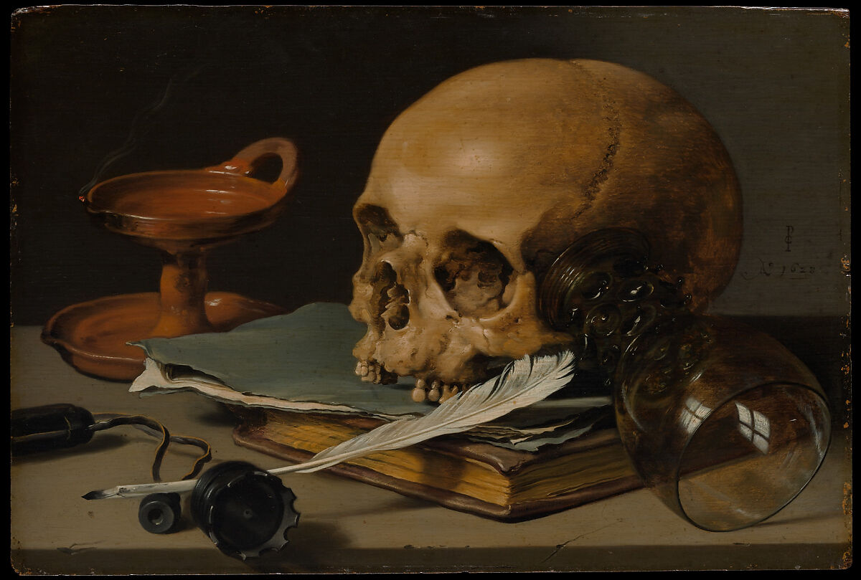
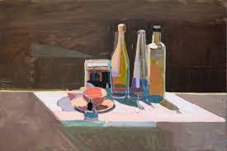
Key Vocabulary
Key Word | Definition
Still life | A painting or drawing of an arrangement of objects
Traditional | Existing of as part of a tradition. Long-established
Contemporary | Art made by artists living today
Objects | A thing that can be seen, held or touched. Usually not living
Viewfinder | A simple square or rectangle allowing the artist to focus on an object
Background | The furthest object
Foreground | The closest object
Pattern | A design that repeats
Texture | The physical feeling of something e.g rough, smooth
Colour | When light reflects back off an object (hue, lightness, brightness)
2 Dimensional (2D) | Flat with two dimensions – length and width
3 Dimensional (3D) | Everything in the physical world has three dimensions – length, width and height
Y5 Art: Autumn Term​
​Exploring Still Life
Learning Sequence
Explore the impact of composition, colour, line and shape through the work of Paul Cezanne.
1
Compare and contrast still life art created by modern artists and 16th century Dutch and Flemish artists.
2
Create a still life scene and photograph it. Start to sketch out the scene.
3
Finish sketching and then start to paint the scene.
hen start to paint the scene
4
Complete the final painting considering the use of texture and tone in creating depth and interest.
5
Share, review and reflect on artwork.
6

