Slide 1
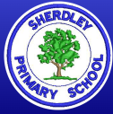
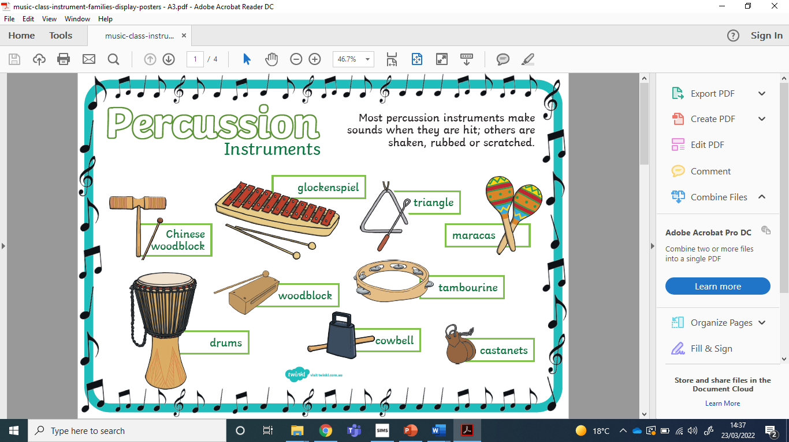

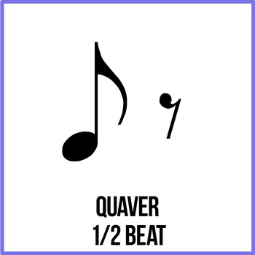
Music Knowledge Organiser – Year 2
Some Genres of Music
1 | Rock
2 | Pop
3 | Rhythm and Blues
4 | Classical
5 | World Music
6 | Jazz/Funk
7 | EDM (Dance)
8 | Rap/Hip-Hop
Which genres do you know?
Can you name any pieces of music and their genre?
Rhythm Notation
Can you play and create your own rhythms using these note durations?
Key Vocabulary – can you demonstrate an example to explain?
Pulse | A steady beat. Does the beat change?
Rhythm | Long and/or short notes. Is there a repeated rhythm?
Pitch | How high or low a note is. How does this change in a piece of music?
Tempo | Speed – fast or slow? How does this change?
Dynamics | levels of sound – loud or soft?

