Slide 1
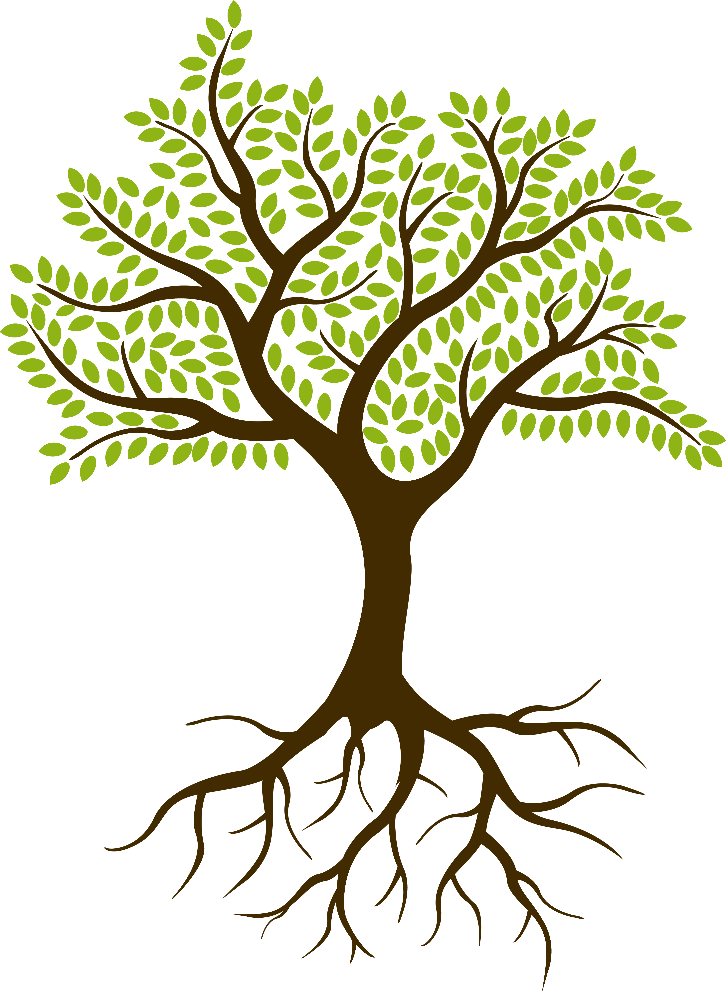



Key Vocabulary
Key Word | Definition
Flower/ blossom | The flowering part of a plant that will form a seed or fruit
Petal and bud | Petal is a part of the flower. The bud is the start of a new flowering part of the plant.
fruit and berry | The fruit is the flowering part that contains a seed. A true berry is a fruit that grows from a single flower. Blueberries, cranberries, currants, and gooseberries
Root and stem | Roots grow underground and the stem supports the plant above ground
seed | Plants produce seeds so they can grow again
trunk | The trunk of a tree grows above ground and is covered in bark. Branches grow from the trunk to support leaves, fruit, flowers/blossom
Day Length | The sunrise and sunset give us the day length
Weather | Sunny, rainy, raining, shower, windy, snowy, cloudy, hot, warm, cold, storm, thunder, lightning, hail, sleet, snow, frost
Year 1 Science
Autumn Seasons and Plants
Learning Sequence
What changes can we observe in the autumn weather?
How many daylight hours do we have in the autumn season?
Flowering and non-flowering parts of a plant
Lesson
1
flower
How can we group and classify different leaves from our local area?
leaf
Lesson
2
branch
seeds
leaf
What are the basic parts of a tree? What are the basic parts of a plant? Are there any similarities and differences?
truck
stem
Lesson
3
roots
roots
Lesson
4
What is the difference between deciduous and evergreen trees?
Working Scientifically Skills
What trees do we have in our locality?
What wildflower/tree seeds can you find?
Lesson
5
Science Enquiry
Lesson
6
Can children discuss changes from Summer season to Autumn season?
Notes:
Add more visuals as prompts eg thermometer, spring etc

Slide 2
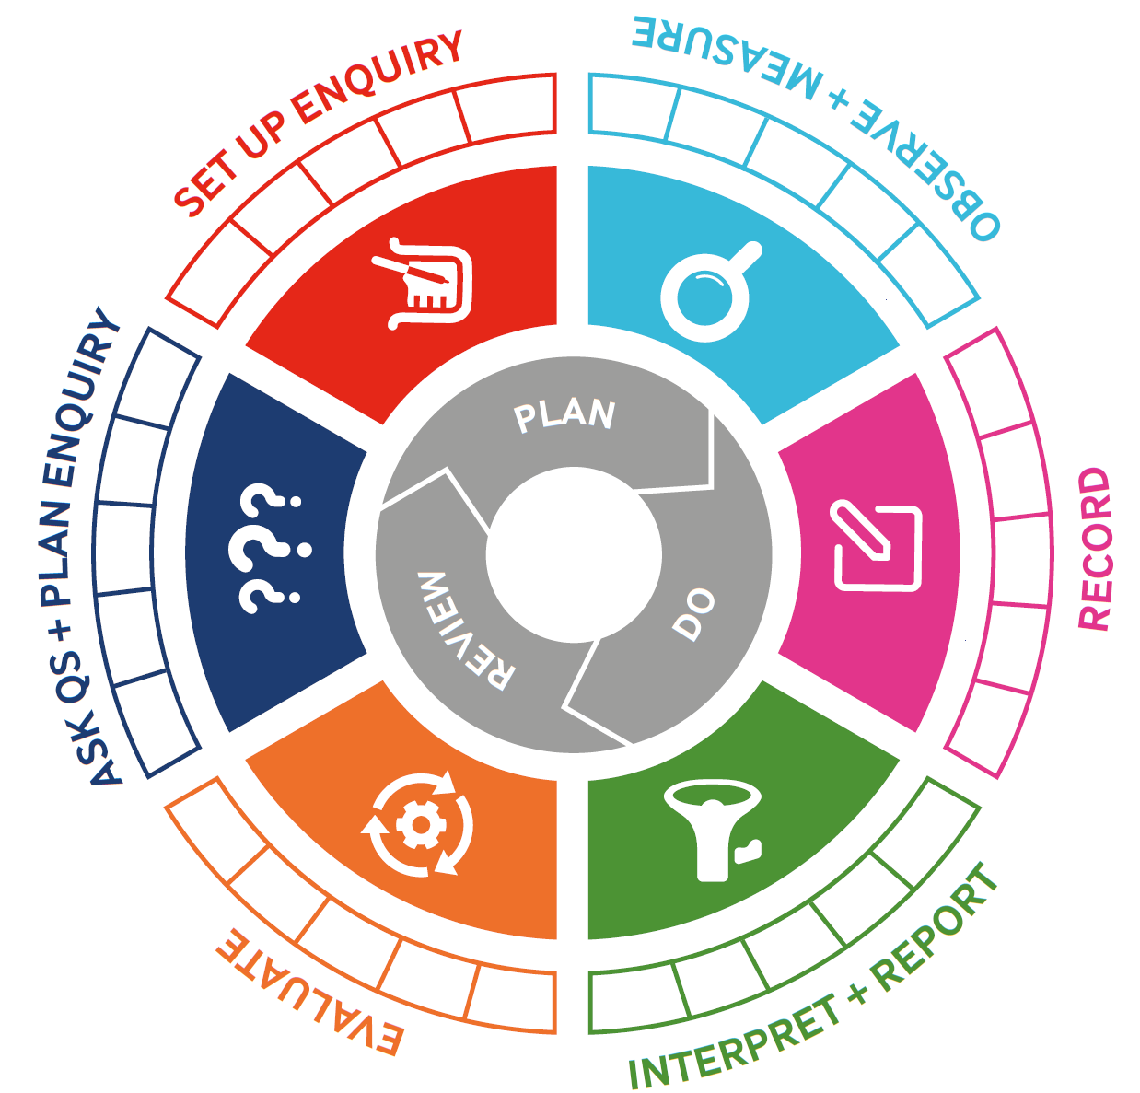
Today, we are focusing on:

Slide 3
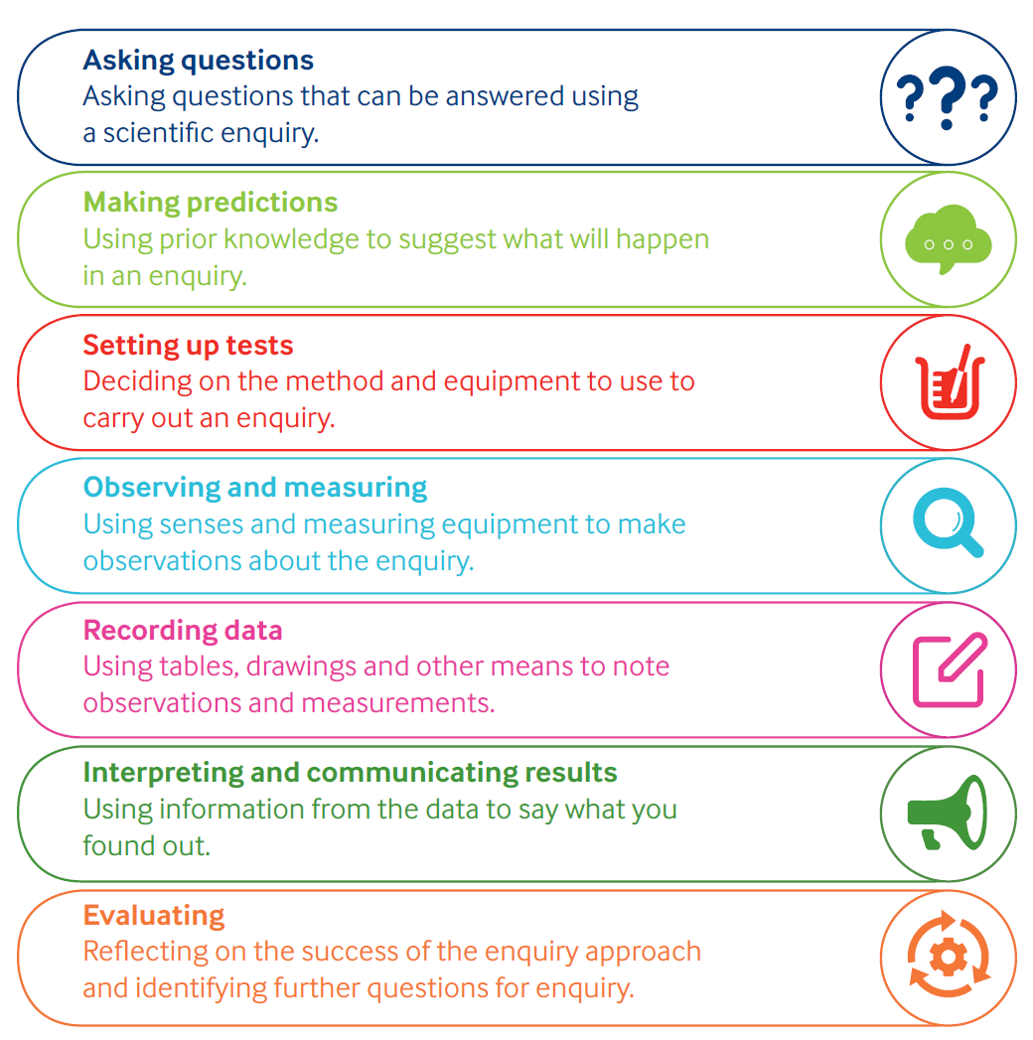
Working Scientifically

Slide 4
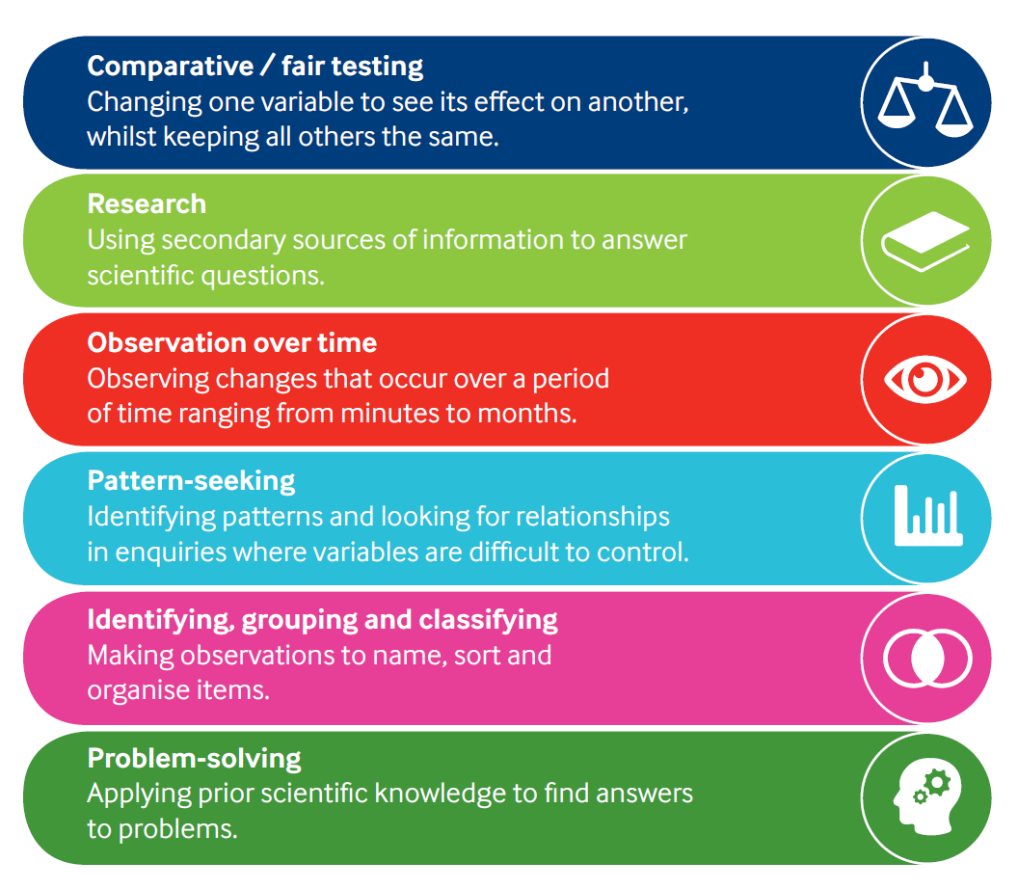
Types of Enquiry

