Slide 1
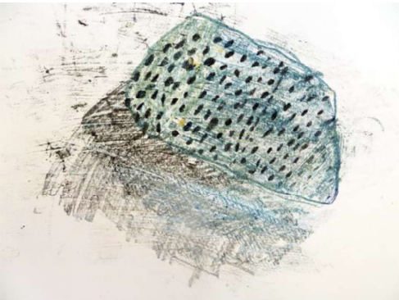
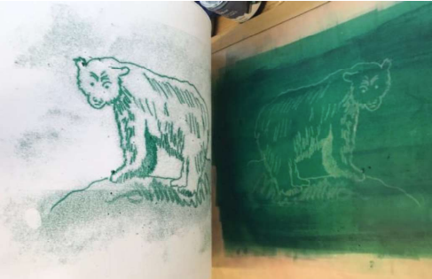
Key Vocabulary
Key Word | Definition
close looking | Looking carefully at detail.
mark making | To create patterns, lines and shapes.
experiment | To test something out.
represent | To show the likeness of something.
life size | The same size as the object.
scale | The physical size of objects.
form | 3D objects.
shadow | The dark side of an object not facing the light.
feedback | What someone has done well and could improve.
respond | Describing what we see.
monoprint | A print which can only be made once.
monotype | A single print taken from a painting.
carbon paper | A thin paper coated in ink.
image | A picture of something.
Art: Summer Term
Exploring the World through
Monoprint
Learning Sequence
Draw landscapes.
1
Draw small objects with detail.
2
Create a carbon paper monoprint.
3
Plan and begin to create an animal monoprint.
4
Complete monoprint.
5
Share, review and reflect on artwork.
6

