Slide 1
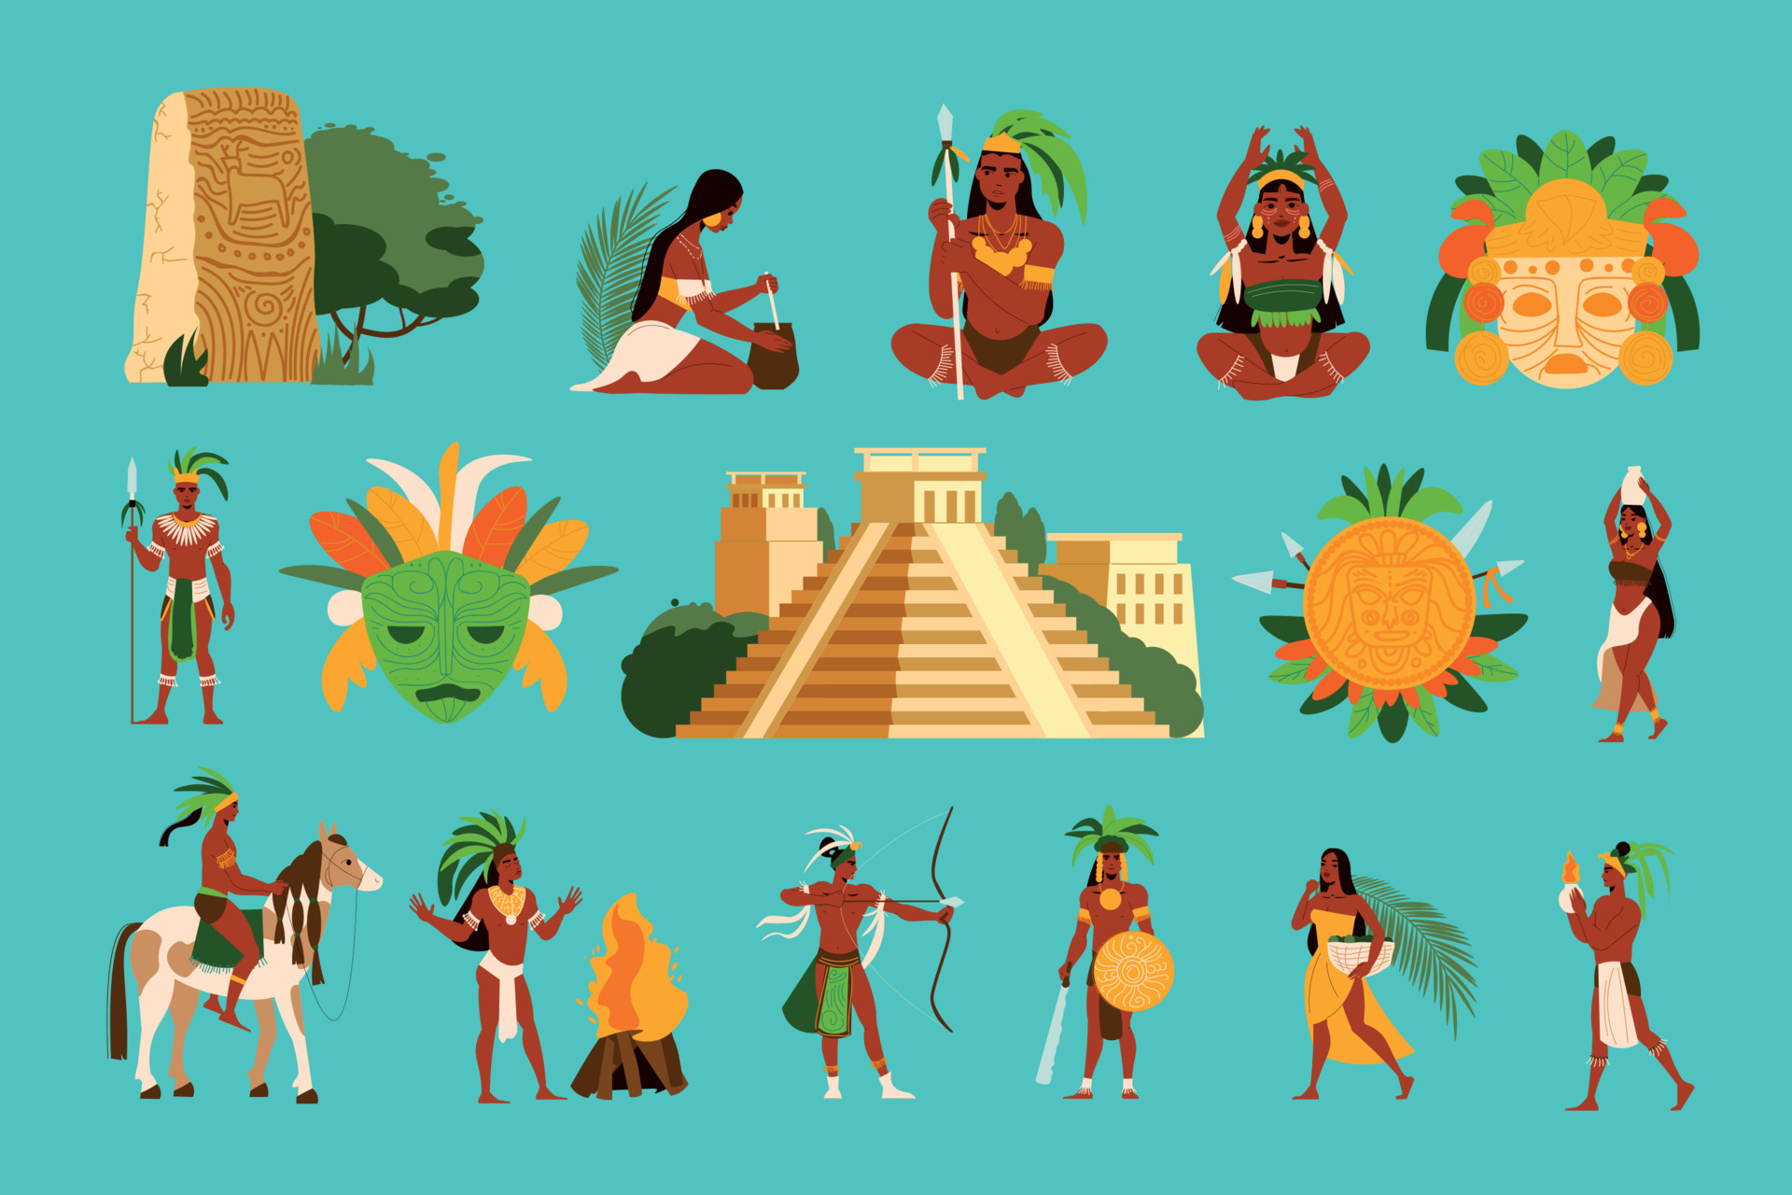
Curriculum Overview
Term: Summer
Class: Year 3
William Gilbert Endowed Church of England Primary School
Curriculum Overview For Parents
Term – Summer 1 2026 |  | Year: 3
Theme: Mysteries of the Maya
Class: Year 3 | Miss Pearce
Curriculum Overview
Term: Summer Class: Year 3
English | Mathematics | Science
Class text: The Chocolate Tree by Linda Lowery Writing Write a non-chronological report about Maya civilisation. Write a diary entry to show the sequence of events for King Kukulkan or the Night Jaguar. Write descriptively using similes and causal conjunctions. Reading Identify language features from fiction and non-fiction and explain their function and how they help the reader gain information. Discuss the plot, setting, themes in a wide range of age-appropriate books, retelling some of these orally. Grammar Inverted commas for direct speech. Adverbs, conjunctions and prepositions of cause – meanings and examples. Apostrophes for possession and contraction. | Fractions Add and subtract fractions. Calculate fractions of a set of objects. Find fractions of amounts. Solve word problems about fractions. Money Record money in £ and p. Convert money. Add and subtract amounts of money. Solve problems including ones that find change. Time Learn about hours, days, months and years. Estimate times. Tell the time to the nearest minute. Calculate time problems. | Electricity Common appliances often run on electricity powered by electrical mains or battery. Cells, wires, bulbs, switches and buzzers are part of a simple series circuit. A lamp will light in a simple series circuit, based on whether or not the lamp is part of a complete loop. A switch opens and closes a circuit and impacts whether a lamp lights in a simple series circuit. Electrical conductors let electricity through, and insulators do not.
Computing | History |  | RE
Word Processing​ Text can be changed by font, size and colour​. Different punctuation can be inserted to punctuate sentences​. Text can be underlined and made bold. Bullet points can be inserted to create a list. | Mysteries of the Maya The ancient Maya lived in Mesoamerica within the countries of Guatemala, Mexico, Belize, Honduras and El Salvador.​ Civilisations began in the rainforest areas.​ Around 6 million Maya are living today in Central America.​ Maya cities include Tikal, Copan, Chichen Itza and Palenque.​ Maya people lived in settlements. Their cities had similar layouts including palaces, ballcourts, marketplaces and temples in the form of pyramids. ​ The structure of Maya society was organised according to class and importance. Kings were at the top, right down to slaves at the bottom. ​ The Maya’s diet included crops they grew, fruit and vegetables they gathered and animals they hunted.​ Maize was their main crop and they discovered the cacao plant.​ It is believed they created the first team sport which was called Pok ta Pok.​ The Maya were expert mathematicians and astronomers, and they used their knowledge to create calendars and a zero in their number system.​ Their writing consisted of hieroglyphs (symbols).​ The Maya believed in many gods, who they thought controlled natural elements. |  | What is it like to follow God? The story of Noah is in the book of Genesis in the Bible. Noah was given responsibilities by God – he was trying to live by God’s commands. God made a promise to us – he will always be with us. Abraham showed he had faith in God – no matter what he was asked to do. Abraham’s descendants are called the People of God. Christians are inspired to have faith and follow God.
Art and Design | RHE | Music | German | PE
Sculpture: wire/foil structures Wire is malleable and can be twisted and moulded into new shapes to create a sculpture. Wire can be covered with malleable materials such as Modroc, paper-mache or foil to create a 3D object. | Economic Wellbeing How people pay for things. Budgeting. Spending money. Careers. Zones of Regulation | Pentatonic Melodies and Composition + Derby Cathedral Music in Schools Programme | Names and Feelings | Orienteering Amber Valley Sport Health and Wellbeing Education Programme
Things to look for and do at home:
Reading with an adult multiple times at home – asking questions and discussing what has been read Maths homework is 3 blue gems on Maths Whizz every week New spellings are set each Tuesday to practice for spelling tests every Tuesday Reading homework is set every Thursday and due for the following Thursday

