Slide 1

Welcome to Year 5 with:
Teacher: Miss Scannell
TA: Ms Mclaughlin
“Living and learning, inspired by our faith”

Slide 2
General
- School and PE uniform
- PE
Break time and after school snacks
Homework

Slide 3
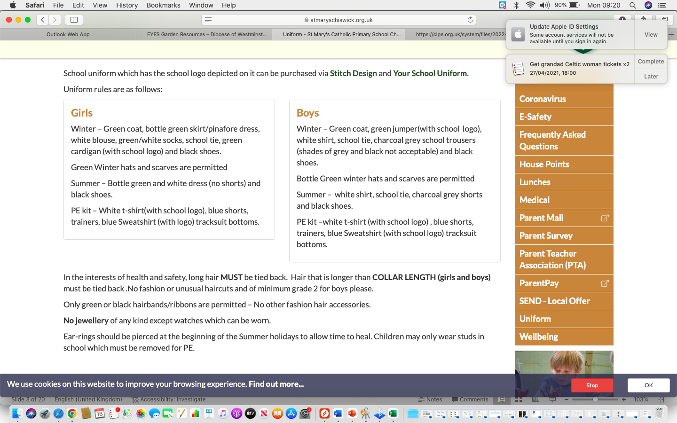
School and PE uniform
Please ensure that your child is wearing correct school uniform
All clothing and bags should be labelled with your child’s name.

Slide 4
PE in Year 5:
P.E. will be on a Tuesday and Thursday for this term. This may change termly or occasionally, but we will always let the children be mad aware of any changes and we will put a note up on class dojo too!
The children are required to wear their P.E. kits for the whole day when taking part in P.E.
If your child is in a club before or after school, and PE is not happening, then they must be in school uniform during the school day.

Slide 5
Snacks and drinks for break time and after school (clubs)
Help your child get their five a day by including some fruit or vegetables as a snack for their morning break.
Alternatives are allowed such as fruit yoyo bars.
Only water is allowed during class time.

Slide 6
Homework
Homework will all be handed out on Thursday and placed on the homework page on the website.
If you need a paper copy, please write in your child’s diary in advance so it can be printed at school. Thank you.
The homework is due on the following days, and it’s important it’s handed in on time to ensure I have had time to look at it and give feedback if needed. If homework is handed in late, I can’t promise I’ll always have time to check it.
English – Monday
Mental Arithmetic test – Tuesday
Maths – Wednesday
Spelling test – Thursday
For any tests, I encourage children to write down their scores to share with you how they do.

Slide 7
Timetable

Slide 8
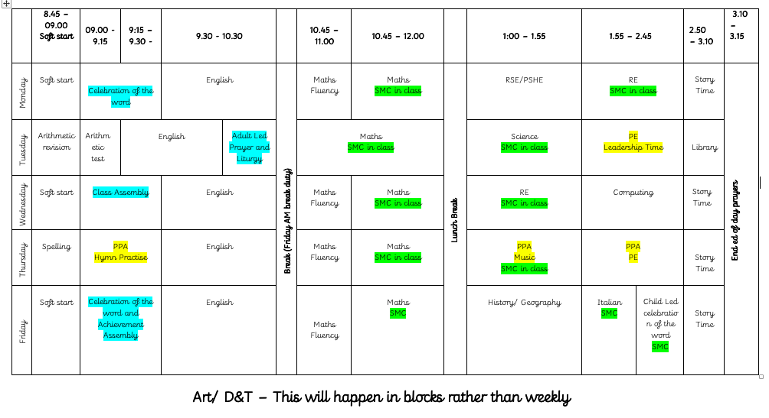
Example of our Y5 timetable – subject to change

Slide 9
Our Curriculum
Year 5 curriculum map
Trips
English: Reading focus
Library
English: Handwriting
Maths: Fluency focus
RSE
Other subject areas. Information regarding these subject areas can be found on the curriculum newsletters.

Slide 10
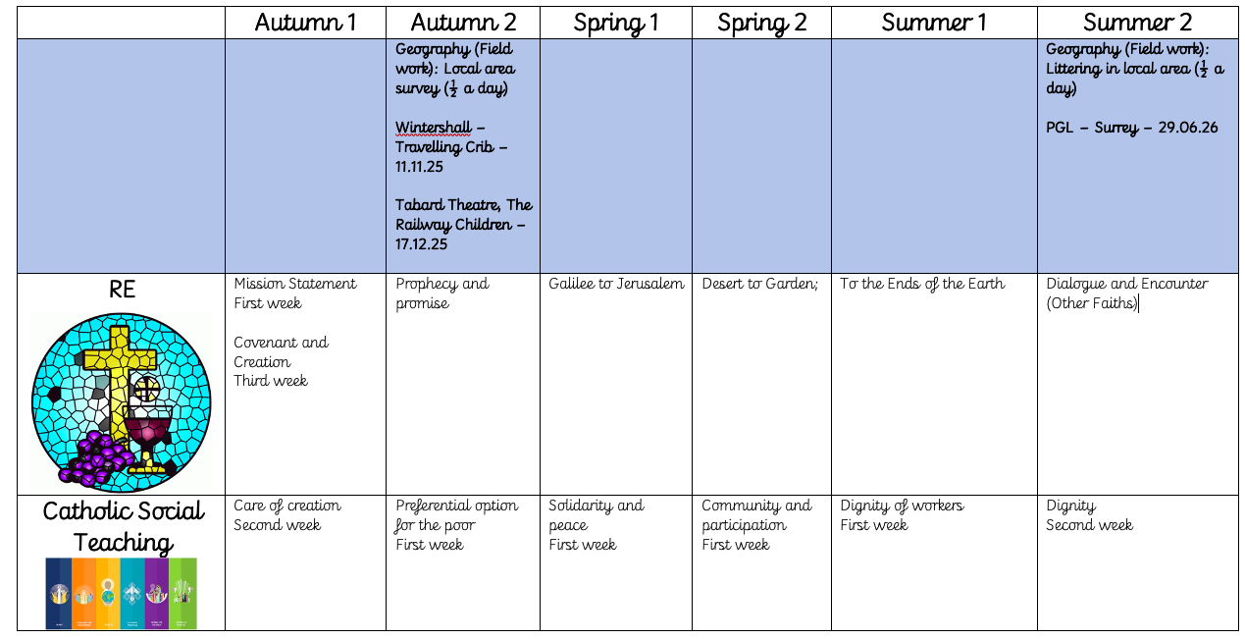
Overview of our learning in Year 5
School trips:

Slide 11
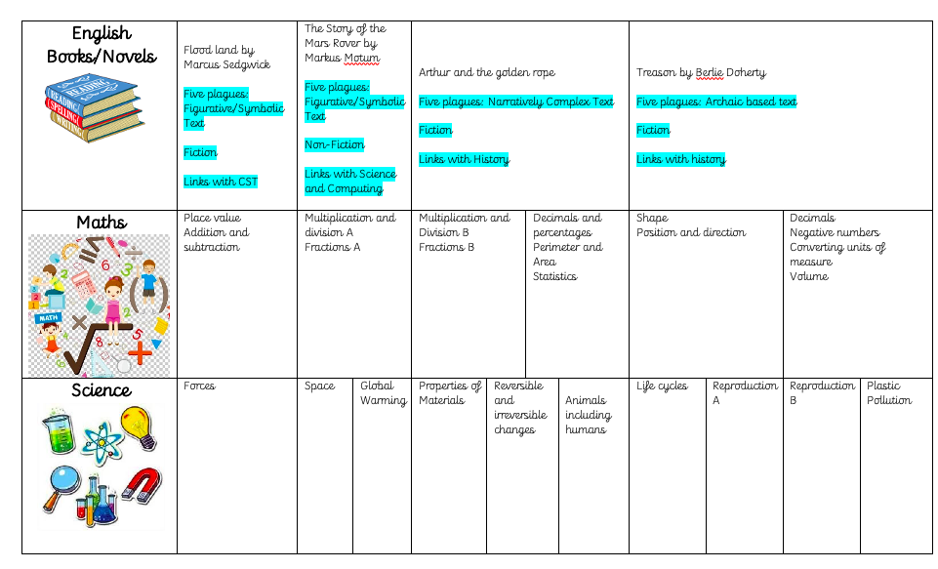

Slide 12
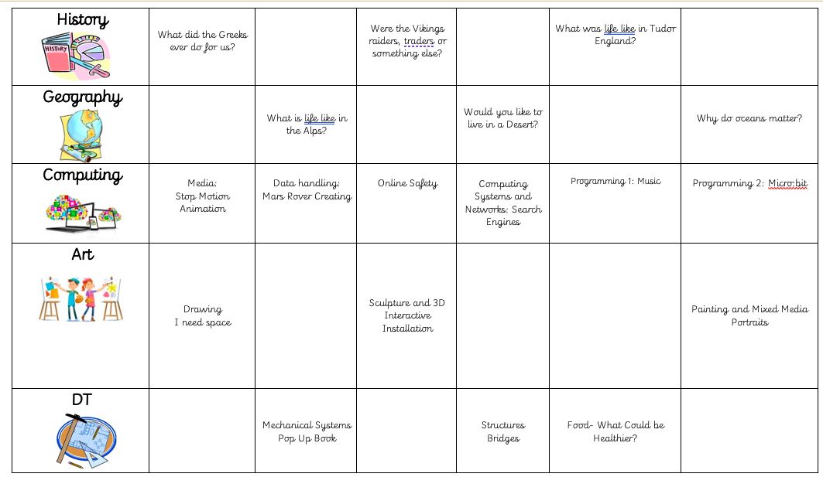
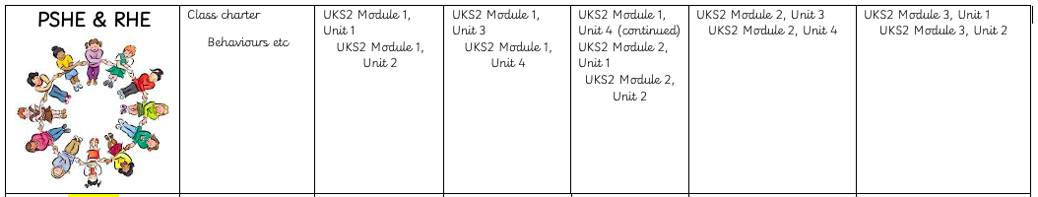

Slide 13


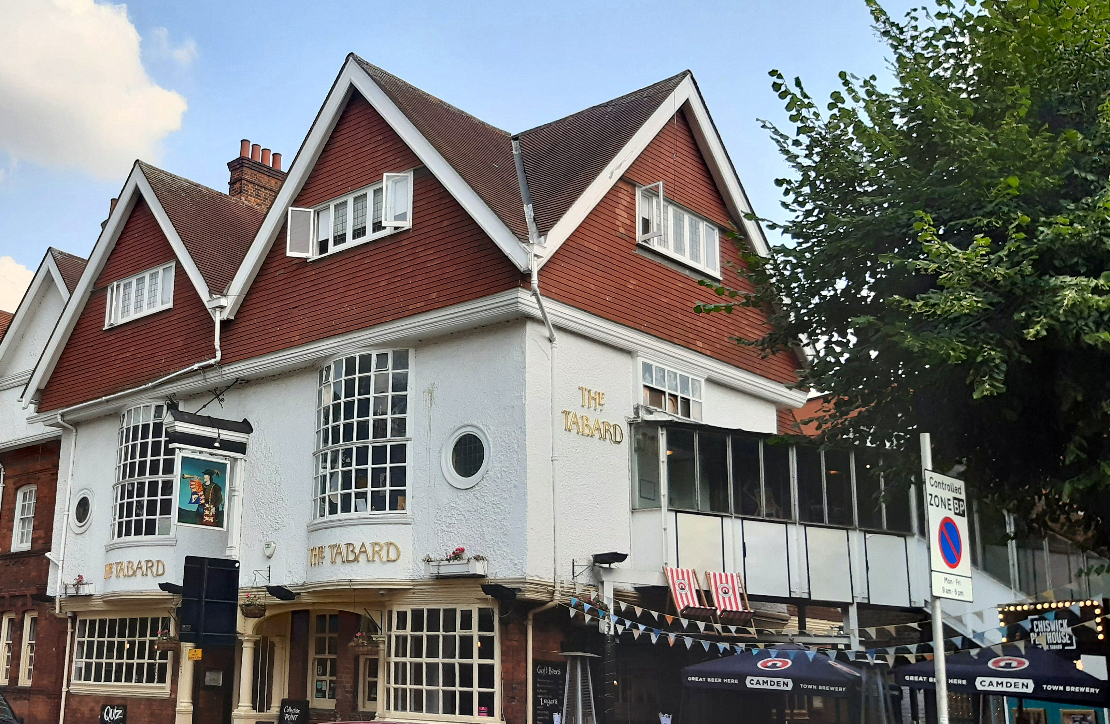
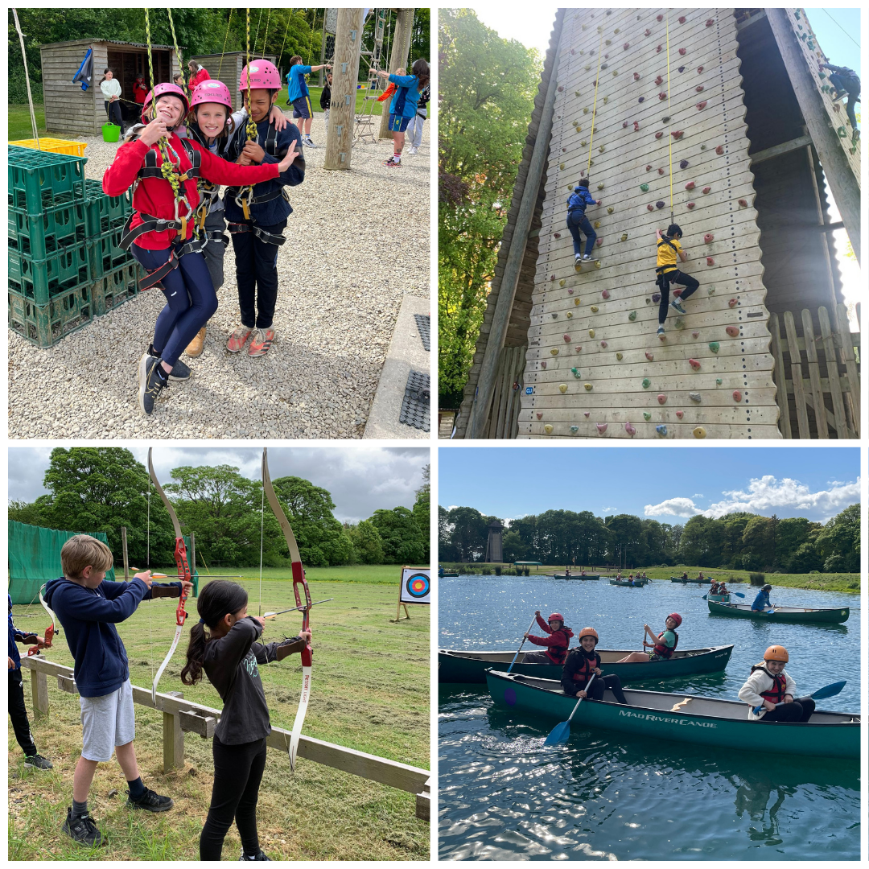
Trips
Wintershall – Travelling Crib – Lambeth Palace – 11.11.25
The Railway Children – Tabard Theatre – 17.12.25
Residential – PGL – Provisionally booked – 29.06.25 – This can only go ahead if we have the numbers.

Slide 14

Reading is a big focus for us this school year
KS2 Reading Workshops for parents
Autumn Term – Date TBC
How we teach reading in school
How you can support your child at home to become a confident, fluent, independent reader
The skills they need to practice and develop for each book band
Reading with prosody, fluency, automacity

Slide 15

Reading at home
Every child should be reading at home each night for 20 minutes.
Parents need to hear children reading aloud, even when they have become fluent. This is to ensure they understand what they’re reading.
Please use the bookband guides for parents, which can be found in their reading record, so that you know which skills your child should be working on and how you can support them with reading at home.
Please sign the reading diary every day and write a comment where you can, so that we know how your child is progressing with reading at home.

Slide 16
Developing Reading Comprehension
We will be working on this in school and focusing on the following skills and domains –
Vocabulary
Retrieve
Summarise
Infer
Predict
Link ideas
Effect of Language
Compare

Slide 17
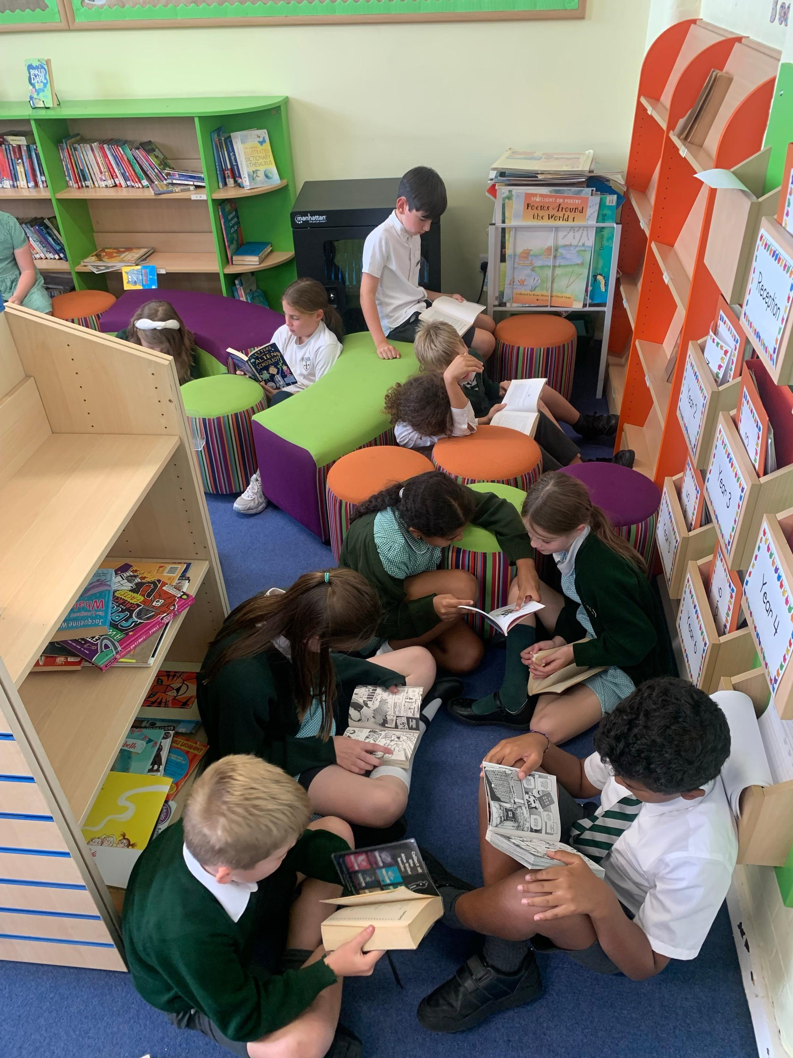
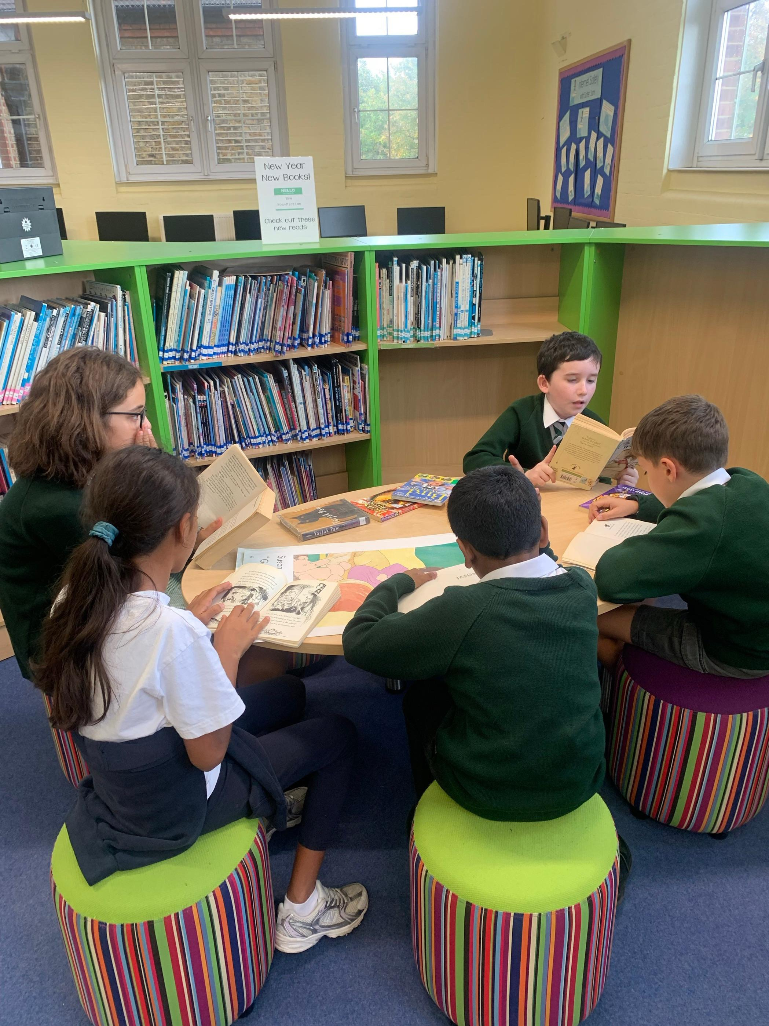
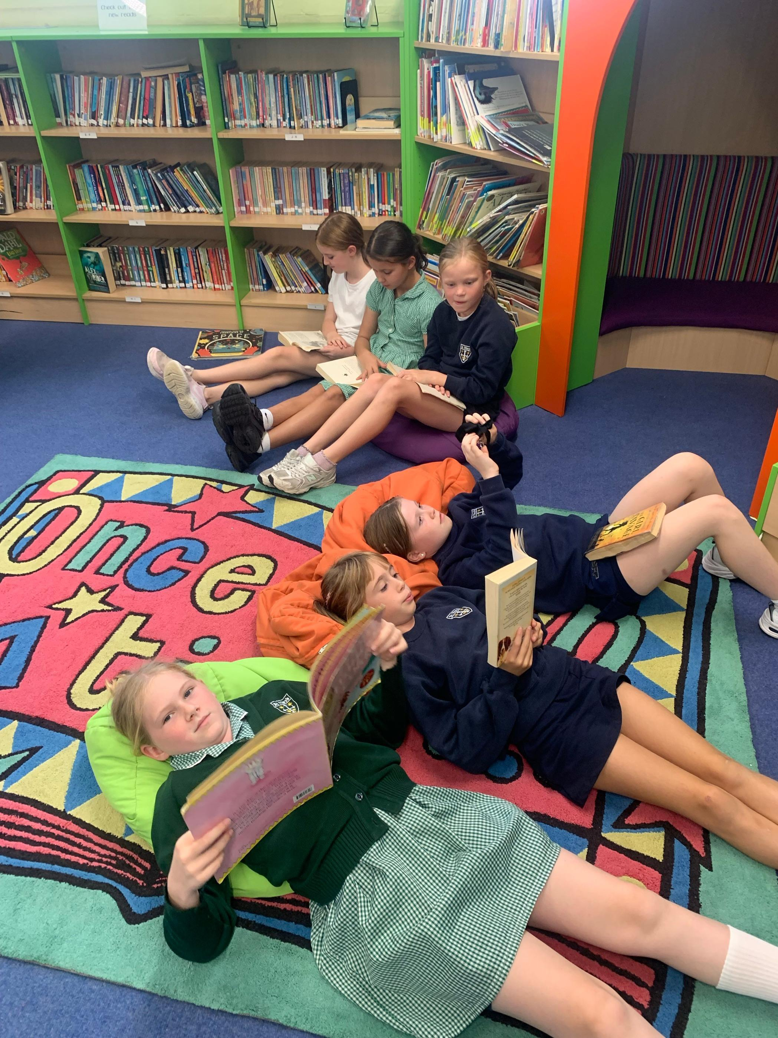
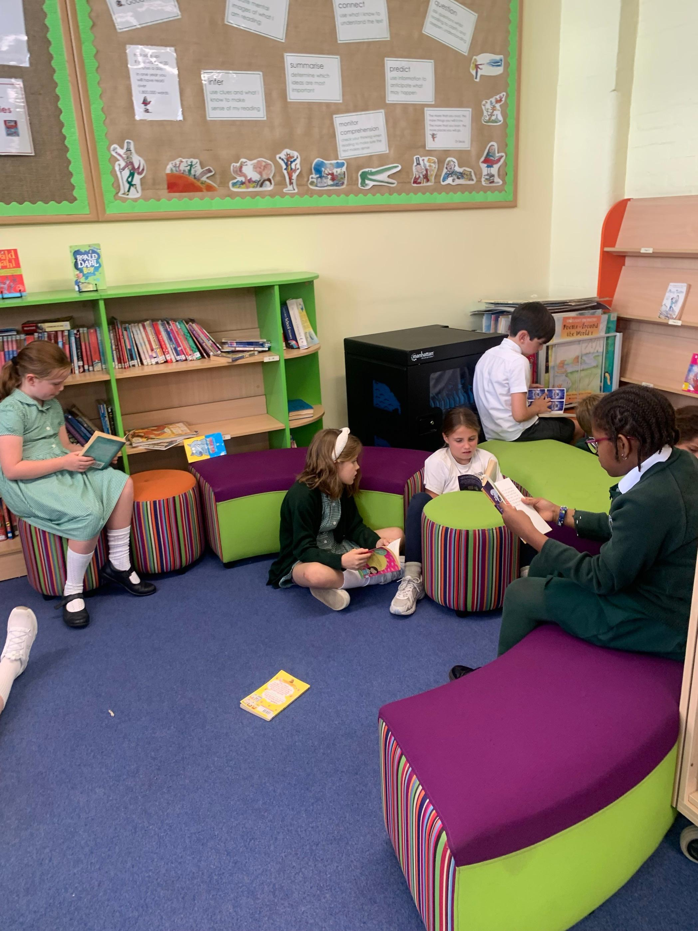
Library
Children are able to ‘borrow’ one library book each week to encourage a passion for reading

Slide 18
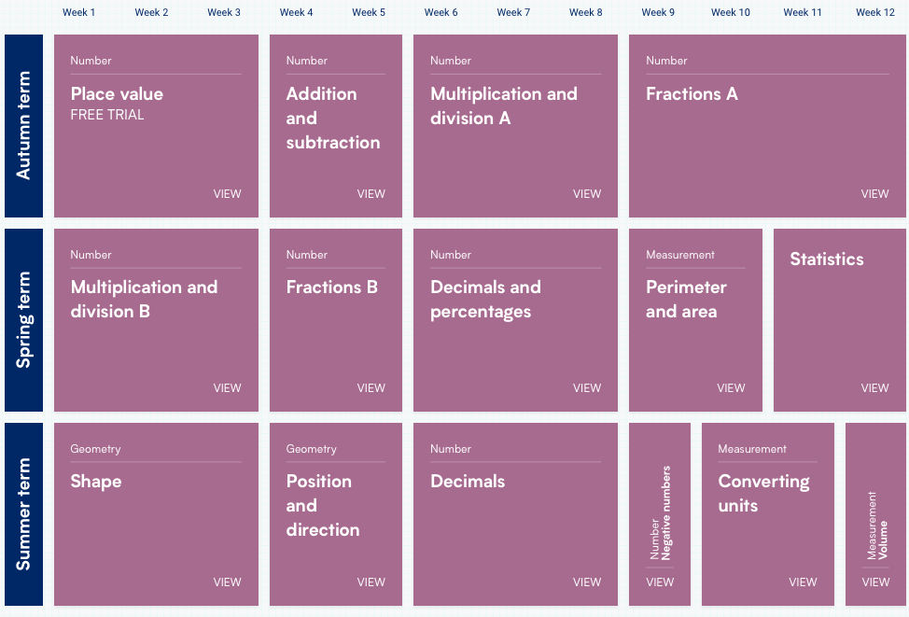
White Rose Maths continued…
Notes:
Here at St Mary’s, we are committed to ensuring that children are able to recognise the importance of maths in the wider world and that they are also able to use their mathematical skills and knowledge confidently in their lives in a range of different contexts. We want all children to enjoy mathematics and to experience success in the subject, with the ability to reason mathematically.
We do this through the White Rose Mathematics Scheme. For each year group, the scheme of learning includes an overview of the maths that your child should be learning at any point in the year. Each year is split into three terms (Autumn, Spring and Summer), and each term comprises individual blocks of learning about a particular topic.

Slide 19
Maths - KIRFs
KIRFs or Key Instant Recall Facts support the mental skills and key knowledge that children need to secure for Maths. They include number bonds and times tables, and are particularly useful in developing confidence and understanding in addition, subtraction, multiplication and division.
These will be added to our class page on the website every half term so that you can support your child with building fluency with these concepts. This will enable them to apply this knowledge to other areas of Mathematics and to develop higher order thinking, problem solving and reasoning.
We recommend that you spend 5-10 minutes a day working on these at home as often as you can.
I also set the KIRFS as the children’s arithmetic test each week.

Slide 20
RSE
Relationship Sex Education (RSE) has been compulsory in all primary schools since September 2020
As a School, as part of your child’s RSE teaching, we will be using the ‘Life to the Full’ programme which is based on the structure of 'A Model Catholic RSE Curriculum' by the Catholic Education Service.
We do as teachers adapt our planning based on the circumstances of children in our classroom.
The core themes for each year group are: Families and people who care for me; Caring friendships; Respectful relationships; Online relationships and Being Safe – This includes the concept of personal privacy
All teaching RSE will take in a safe learning environment and be underpinned by our school ethos and values. A variety of opportunities will be provided for pupils to ask questions to further their understanding and to find out more about what affects them personally. The TenTen RSE scheme of learning will be taught weekly from Autumn 2 in every class in a dedicated session.

Slide 21
RSE
We have arranged for all parents and carers to be able to access the parent portal and see the planned content, where you can engage with the teaching carried out in school and where you can deepen the experience with your children. This is available for you to access at any time.
The log in details for TenTen's parent portal are:
Username: StMarysW42DF Password: rainbow
Later in the year, a letter will be sent out regarding lessons that aren’t statutory if you wish to remove your children from these lessons.
RSE workshop - Thursday 9th October 2025 at 2.15

Slide 22
Other subject areas and members of staff: Music, Italian and P.E.
Music – Junior Jam (company)
Italian – SIAL (Company)
P.E. – Coach Kyle from Brentford

Slide 23
How to contact me

Slide 24
Contact
If you need to contact me, please:
Speak to me at the end of the day once I have dismissed the children, not before;
School diaries;
Email: classenquiries@stmarys.hounslow.sch.uk
We are not using the messenger aspect of class dojo.

Slide 25
Questions?

Slide 26
Questions
Any questions?
Thank you all for listening and I look forward to a positive academic year with the class ☺

