Slide 1

Meet the Teacher

Slide 2
Morning routine
Arrive at the gate before 9am.
Walk to the bottom of the Year 3 stairs and come straight up.
Put my things in my box
Choose my lunch
Grab a whiteboard and pen
Work on my Soft start activity
Mrs Luciani will take the online register at 8:55am

Slide 3
Communication
The key to a successful working relationship
FAMILIES (PARENTS & CARERS)
Check the Calendar of Events regularly
Read the newsletter
Check the Year Group Noticeboards weekly
Attend parent teacher consultations
Communicate effectively with the class teacher
Notify the school of any issues of concerns which may affect a child’s well-being or learning as soon as possible
Respond promptly to requests from the school for information regarding your child(ren)

Slide 4
Home Learning
Traditional homework is scientifically proven to have very little impact on pupils learning
Research says that home learning which has the most impact on learning is practising basic skills through repetition and giving children ownership over what they are doing.
Aims of home learning
To give children an opportunity to practice basic skills linked to learning in school.
To engage all children in learning in a cross curricular manner.
To allow children to shine in all subject areas
To generate pride and excitement about what they are producing
To be more open ended so children have more flexibility over what they are producing and how

Slide 5
 | Monday | Tuesday | Wednesday | Thursday |  | Friday
0845 | Threshold – meet children at the classroom door
0845 | SOFTSTART: Maths (Yesterday, Last Week, Last Half Term) & Registration AVRIL TO PLAN. KATY TO REGISTER & BE IN CLASS
0900 | English
0945 | Gratitude
0955 | Storytime (20 minutes)
1015 | WHOLE SCHOOL BREAK – Number Facts Practise when lining up Adults to escort children to playground. Adults to be in playground by 1025 for whistle and lining up.
1030 | Milk & Fruit MATHS (AS)
1130 | Timestables (AS) | Handwriting (AS) | Library (AS) | Handwriting (AS) |  | ERIC (AS)
1200 | WHOLE SCHOOL LUNCH
1300 | ORACY |  |  | Spanish (Carolina) 1300-1345
1315 | PE (KL) | RE (KL) | PSHE (KL) |  | Celebration Assembly 1.15 – 1.45
1400 | Comprehension KL | SCIENCE (AS) Daily Mile Break in the Middle | ART (AS) Daily Mile Break in the Middle | Singing 1345-1430 |  | PE (KL) 1.45 – 2.45
1445 | COMPUTING (KL) |  |  | Comprehension (KL)
 |  |  |  |  |  | Comprehension (KL)
1515 | Whole School Assembly | Spelling Test (KL) | Spelling lesson (KL) | Spelling Practice (KL)
1530 | DISMISS CLASS / HOMETIME

Slide 7
Home Learning
Every
Reading
Reading at home, whether to an adult, with an adult, or being read to by an adult is the most important form of homework.
Children are encouraged to read regularly for their own development and also for enjoyment.
The frequency that books are taken home from school varies with age.
Nursery & Reception | Children will take home 2 books a week. One levelled book and one choice book that parents can read and share with them at home. We encourage books to be re-read several times as the evidence shows this has a positive impact on children’s learning.
Years 1 & 2 | Children will take home 2 levelled books a week, plus one choice book that parents can read and share with them at home. In Year 1, children will also take home their RWI book / pack.
Years 3 - 6 | Children will independently choose a new home book. These are to be brought in daily and changed when completed.

Slide 8
Home Learning: posted on Google Classroom
PUPIL PLANNERS
Every child has a Pupil Planner with a dedicated space to record children’s reading at home.
Should be filled in when children read or are read to.
Enables us to see how much reading is being done at home.
Each entry needs:
  the date,
  the book being read,
  how much was read and
  any comments about how they got on.
Pupil Planners should be brought in daily to be checked in class.
Pupil Planners will be signed at least weekly by the class teacher.
SPELLING
Spellings / phonic patterns will be sent home weekly.
Research indicates that the best way for children to learn the spelling of more complex words is to use them in the correct context.
Children’s understanding of the meaning and spelling of these words or of the phonic pattern will be checked through a dictated passage on a weekly basis.
Year Group Noticeboards (website) will give ideas for different ways to make spelling practice fun.
Children have personal log-ins to access vocabulary and spelling activities via the PiXL Vocab App (free download from the App Store, Google Play, Amazon App) and Doodle
https://vocab.pixl.org.uk/

Slide 9
Home Learning
Multiplication Tables
National Curriculum expectation: all children know a range of multiplication tables and facts (at least up to 12 x 12) by the end of Year 4.
To support this, children will note their Challenge Level weekly in their pupil planners.
Children in Years 3 – 6 can use their personal logins to access the PiXL Times Table App (free download from the App Store, Google Play, Amazon App Store). https://timestable.pixl.org.uk
All children can also access Times Tables practice activities using their individual logins to Doodle Maths.
The practice children complete at home will help to prepare them for a timed test in class. It will also help them substantially with their written methods and mathematical problem solving, as they will be able to focus on their reasoning rather than calculations that need to be known by heart.
Mathematics
Years 1 – 6: children use the online learning platform of MyMaths (or Doodle Maths) to build on their maths learning in class. My Maths includes tutorials to support children and parents with methods.
In Years 1 – 4, My Maths or Doodle Maths will form the main Maths home learning. There will be 3 tasks set weekly on a Thursday. These tasks will help the children to practice and consolidate in-class learning.

Slide 10
Home Learning
Half Termly Creative Home Learning
Creative home learning is one of the fundamental principles that underpins our Home Learning Policy and an important way for us to build effective home school partnerships. This is because we believe that learning continues beyond the classroom.
Children will be introduced to their new creative topic at the start of each half term.
Creative home learning tasks all link directly to the topic being studied in class and will support the children’s learning by giving them opportunities to learn new knowledge around their topic, explore a particular area of interest in more depth or further develop their skills.
A selection of different tasks will be provided and displayed on the Year Group page at the start of each half term. Families and children are encouraged to choose one (or more) of these projects to work on together at home, so that parents and carers can share in and further enrich the learning that is taking place in class.
At the end of each half term children should bring their creative home learning work in to school.
At the end of each half term, parents will be invited to a Celebration of Learning open afternoon to give families an opportunity to celebrate the topic work their children have been completing in class and to see how this links to the projects they have worked on together at home.
A selection of pieces will be put on display in shared year group areas, as well as in the school library and front office.
Key Stage 2 (Years 3 – 6): Write That Essay
We encourage all children to log into ‘write that essay’ daily to complete a short daily writing challenge (10 minutes).
Children enjoy the platform, particularly the instant feedback and diagnostic tools.
Holiday Home Learning
We place great value on children having opportunities to spend time with their families, playing, talking and having fun so we will not set homework over school holidays. However, we do expect children to read or be read to every day. Children will also continue to be able to access fun learning activities online or via the Apps.

Slide 11
Home Learning
WHOLE SCHOOL HOME LEARNING
Sometimes, children are asked to contribute to an activity or concert by learning – words to a poem, play or song etc. Learning by heart in these situations helps children develop techniques for learning, contributes to their self-esteem by giving them an opportunity to experience success and participate fully in the activity. It also contributes to the whole school ethos, developing a sense of responsibility for team success. Families and children are encouraged to value this home learning so that it is done alongside any other home learning set by the class teacher.
MARKING
All weekly written home learning will be marked.
All online activities will be monitored by class teachers weekly.
Creative home learning will be shared amongst the children’s peers and they will have the opportunity to receive peer and teacher written feedback, as well as completing some self-assessment. Families will be invited in to celebrate creative home learning projects half-termly.
Home learning that is not being completed
Parents are encouraged to talk to their child’s class teacher if their child is unable or unwilling to complete home learning tasks independently. This is so that class teachers can provide additional support to families.
We will also offer some after school homework clubs in the school library for parents to support their children in a friendly and hardworking atmosphere. If you would like to attend any of these sessions, please speak to your child’s class teacher.
Class teachers will discuss any concerns about home learning tasks initially with children and then parents in order to find out the reasons behind incomplete tasks. Overall, the responsibility for ensuring children are doing their home learning rests with families, but teachers will offer support if needed.

Slide 12
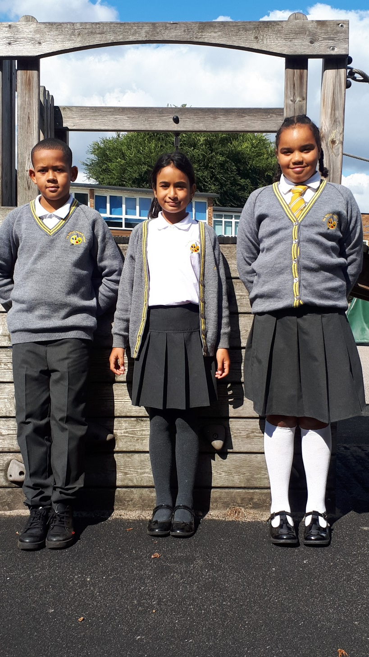
School Uniform
White short or long-sleeved logo’d polo shirt
Grey logo’d ‘V’ neck cardigan or jumper with double gold stripe
Plain grey trousers, shorts, skirt, pinafore or gingham dress (in summer)
Plain long or short, grey, black or white socks or tights
Sensible black flat shoes or boots (in winter)
Black reversable logo’d school coat or plain black or navy coat (Winter is coming!)
Grey or black scarf, hat and gloves
Grey, black or white kippa or turban
Grey, black, white or yellow hijab
Plain grey, black, white or yellow hair accessories (shoulder length hair tied back)
Black logo’d rucksack or plain black rucksack

Slide 13
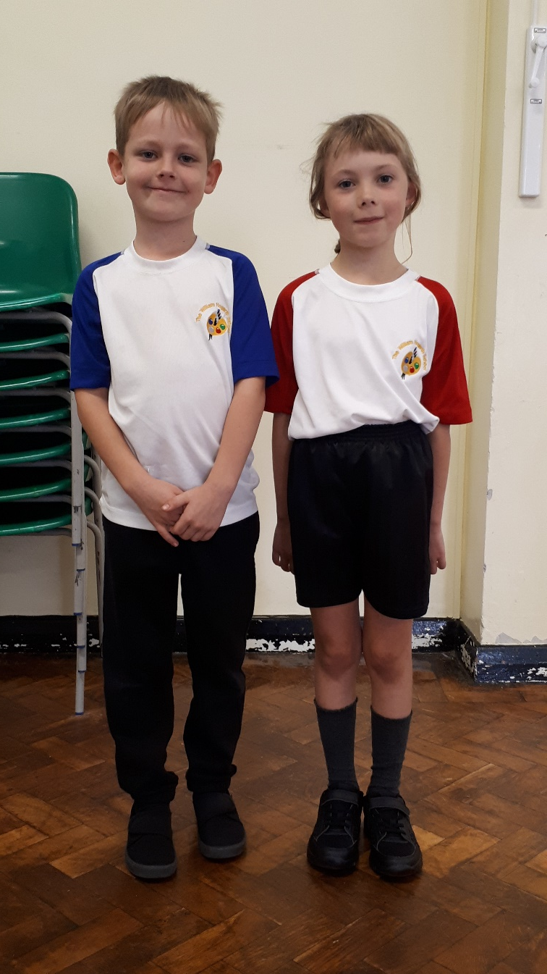
PE Kit
PE Days: Monday and Fridays
White logo’d sports top with house coloured sleeves
Black shorts
Black logo’d hoodie with black tracksuit bottoms
Trainers or plimsolls
Water bottles can be left in school
Key Stage 1: PE Kits should be in school every day. They will be sent home half-termly.
Key Stage 2: Clean PE Kits should be brought in every Monday.

Slide 14
Key Take aways
PE Days: Monday and Fridays
Each child needs a drink bottle
Parents sign the planner every day
Key communication through the planner please
Be on time, important social interactions happen before and after school

