Slide 1
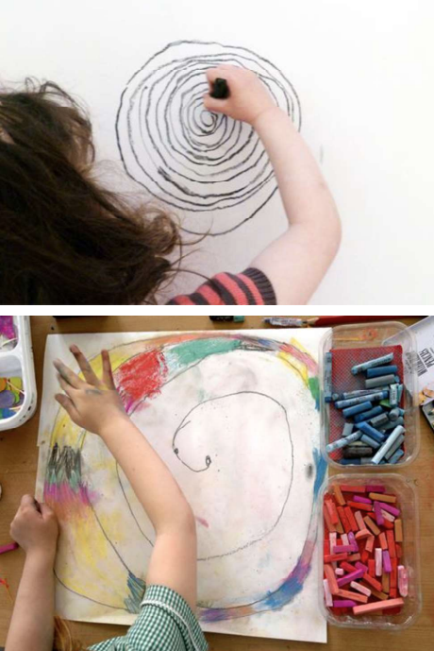
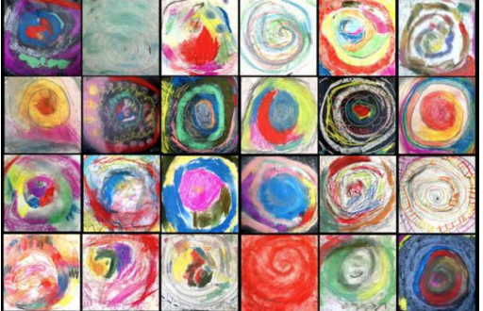
Key Vocabulary
Key Word | Definition
spiral | A coil or a curl.
movement | Change of place or position.
continuous line | A mark starting at one point and ending at another point.
chalk | A powdery white or coloured stick for drawing.
pen | An object which contains ink.
oil pastel | A paint-like stick or crayon.
dark | Little or no light.
light | Pale colours
blending | Mixing colours to create new colours.
colour | What you see when light shines off an object.
pattern | Something that happens in a repeated way.
Y1 Art Autumn Term
Spirals
Learning Sequence
Make spiral drawings using your body.
1
Use colour, spirals and blending to make drawings.
2
Use a continuous line to make an observational drawing.
3
Explore mark making with pen and water.
4
Use drawing skills to create a spiral artwork.
5
Share, review and reflect on artwork.
6

