Slide 1


Year 13: Stepping up the challenge
Timeline
PPEs (practice public exams)
Sources of information
Revision strategies
Use of independent study time
Planning a timetable
Support with exam anxiety and protecting mental health

Slide 2
Year 13 Timeline:
Wednesday 12th November: Year 13 Parents’ Evening
Friday 19th December: End of term (7 weeks)
Monday 5th – Friday 16th January: Year 13 PPE (mock examinations)
Monday 16th- Friday 20th February: Half term break (4 weeks after mocks)
Thursday 2nd March- start of Easter holidays (6 week half term)
Monday 20th April- start of summer term
Thursday 14th May- A Level Exam season begins (4 weeks after Easter)
.

Slide 3
Which looks like this…
Week 1 | Week 2 | Week 3 | Week 4 | Week 5 | Week 6 | Week 7
Xmas | Hols
Week 8 | Week 9 | Week 10 | Week 11 | Week 12 | Week 13
Feb Half term
Week 14 | Week 15 | Week 16 | Week 17 | Week 18 | Week 19
Easter | Hols
Week 20 | Week 21 | Week 22 | Week 23

Slide 4
PPEs
Offer the opportunity to experience formal assessment, as it will be in the summer
(exam space, invigilators, exam timetables, full paper, access arrangements etc.) without the pressure of being ‘real’ exams
Informative: students can learn from their exam performance (exam technique, approaches to exams, revision techniques, areas of strength/ weakness)
Managing anxiety and practicing exam access arrangements

Slide 5
Resources
Now is the time to organise your resources!
Lesson notes should be complete, filed and in order
Do you know where to find resources for each of your subject areas?
Do you have a copy of the specification to check that your notes are complete?
Are you using your independent study time and guided learning time effectively?

Slide 6
How we learn…
Neuroplasticity
AGES
Attention
Generation (relating learning to existing web of knowledge)
Emotion
Spacing

Slide 7
Revision techniques
Revision begins now! Organising your notes is the first step. Your revision needs to include the following processes:
Transformation of your notes (eg summarising in your own words, condensing notes down into a different format such as mind maps/ flashcards)
Repetition of knowledge: learning the information through repetitive processes (eg look, cover, write, check)
Active recall to test that knowledge has stuck (eg testing yourself on flashcards)
Spaced repetition of the revision/ recall process, to strengthen neural pathways

Slide 8
Use of independent study time
Time within the college day:
Guided Learning sessions Use a free classroom, allocate GL sessions to specific subjects. Review your lesson notes and begin making revision materials now.
Free lessons
Planning revision sessions
The optimum time for learning material/ recall is around 20-25 minutes. The pomodoro method suggest 20 minutes, followed by a 5 minute break (x4 max) followed by a longer break

Slide 9
The importance of sleep, rest and hydration
The brain cannot function well when we are tired and not hydrated
Rest and sleep hygiene Are you getting enough good-quality sleep? Is your brain allowed to ‘switch off’ before going to bed?
Distraction: a notification on a phone can break our concentration on a task for up to 20 minutes before we establish full focus again
Maintaining a healthy balance of work and down-time, including physical activity, is crucial

Slide 10
Mental Health and managing stress
Mental health is vital!
Steps you can take:
Plan your revision into manageable blocks so that you don’t become overwhelmed
Make sure you take breaks – they are vital
Use the next few weeks to build healthy routines around the ‘Ten a Day’ for mental health – the routines will support you to manage strength
Talk – to your friends, to your tutor, to your teachers, to Amy and Musky
Open-up – we have counsellors and the Mental Health Support Team
Notes:
We know this year is difficult and will be challenging but we will support you in every way.

Slide 11
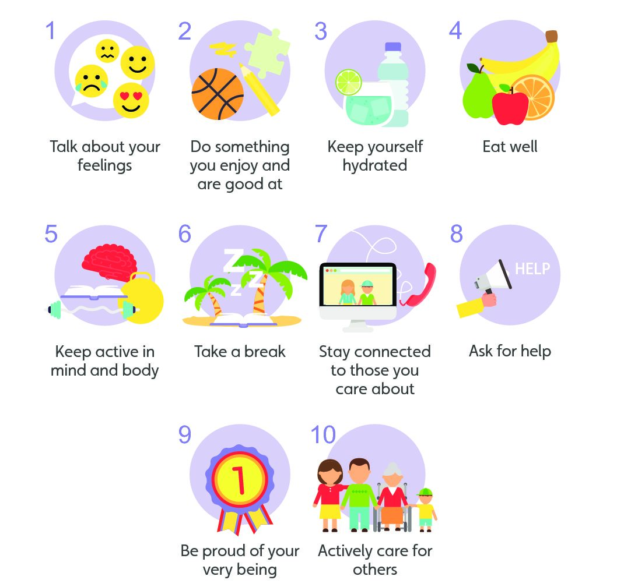
The Ten a Day for Mental Health
Notes:
The routines are key.

Slide 12
The importance of sleep, rest and hydration
The brain cannot function well when we are tired and not hydrated
Rest and sleep hygiene Are you getting enough good-quality sleep? Is your brain allowed to ‘switch off’ before going to bed?
Distraction: a notification on a phone can break our concentration on a task for up to 20 minutes before we establish full focus again
Maintaining a healthy balance of work and down-time, including physical activity, is crucial

Slide 13
Mental Health Support Team (MHST)
The Mental Health Support Team (MHST) are an early intervention service focused on evidence based, guided self-help to help improve children and young people’s mental health. We offer therapeutic support to young people as well as working closely with school to develop the whole school awareness of mental health and emotional wellbeing.
They offer a range of services based around Low-Intensity Cognitive Behavioural Therapy (LICBT)
We can refer you to them on an individual basis and we are intending to run some small group work.
More information about the MHST can be found here: Mental Health Support Team (MHST)

