Slide 1

english
Induction Day!

Slide 2
Welcome to English! Meet the department!
Mr Edwards – Head of Department
Mrs Jagpal – Second in Department
Miss Mahmood – Third in Department
Ms Sadique
Mr Harrison
Mrs Rahman
Miss Begum
Mrs Ali
Miss Hunter
Miss Saiyed
Miss Sutcliffe
Miss Mohammed

Slide 3
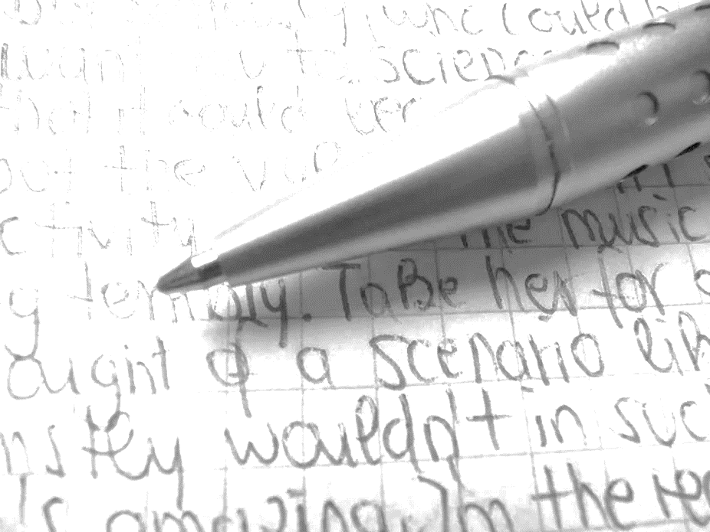
Expectations
You will need to have a reading book at all times – we will expect you to read silently for the first 5 minutes of every lesson.
Make sure you practice your handwriting! We will expect neat handwriting at all times.

Slide 4
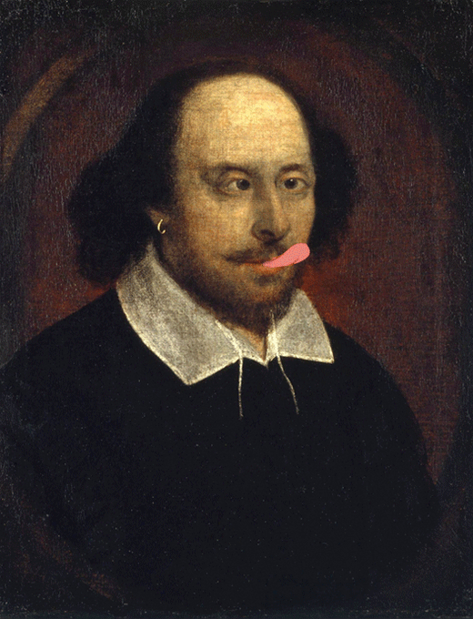
What you will learn…
You will have 7 hours of English over two weeks.
One lesson (one hour) will be dedicated to reading a novel as a class. This lesson may take place in the library, where you will be able to select a library book to read over two weeks.
In your first term of Year 7 you will learn about:
Personal Experiences
Dystopian Writing
Different Cultures and
Focus on the book we have sent you.
During the rest of the year, we will focus on Shakespeare, Freedom, Rights and Responsibilities, War and Conflict short stories and Travel around the World.

Slide 5

What you will learn…
Your class teachers will set you regular spelling tests.
There will be homework projects throughout the year.
There is a planned trip to Harry Potter Studios for the pupils who present the best homework projects!
There are competitions throughout the year in reading and writing and poetry.
You will be asked to complete quizzes based on books you read in and outside of school using a programme called Accelerated Reader.

Slide 6

Summer project
We have given each of you a copy of a non-fiction book called ‘Coming to England’ by Floella Benjamin. Please try and read this during the holidays – you may read this with an adult/older sibling.
You will be working from this book when you start at Holte in September so pack it in your bag ready for your first day at Holte. Write your name in it, this is your copy to keep!
Extra tasks:
Create a fact file on Floella Benjamin.
Find out information on the Windrush movement and create a leaflet on it.
Look at the attached slides that have a reading competition for you. Tick off the books you manage to read and write book reviews on each one.

Slide 7
Reading competition: read as many of the titles listed below as you can!
Speak Up! Speeches by Young People to empower and Inspire by Adora Svitak.
I am not a Rebel by Cerrie Burnell
Tiger, Tiger, Burning Bright! By Fiona Waters
Rise Up: Ordinary Kids with Extraordinary Stories by Amanda Li
Diary of a Young McAnulty by Dara McAnulty
Asterix in Britain By Rene Goscinny and Albert Uderzo
Mayhem Mission by Burhana Islam
The Accidental Diary of B.U.G by Jen Carney
The Boy Who Made Everyone Laugh by Helen Rutter
Kay’s Anatomy by Adam Kay

Slide 8
Reading competition: read as many of the titles listed below as you can!
This Book is Anti-Racist by Tiffany Jewell
Climate Rebels by Ben Lerwill
The Lost Spells by Robert Macfarlane and Jackie Morris
Dare to Be You by Matthew Syed
The Cooking Club Detectives by Eva Jozefkowicz
The Mystery of the Clockwork Sparrow by Katherine Woodfine
Twitch By M.G. Lenoard
The Inkberg Enigma by Jonathan King
Guardians of Magic by Chris Riddell
The Time Thief by Patience Agbabi

Slide 9
Reading competition: read as many of the titles listed below as you can!
The Lightning Catcher by Calre Weze
Donut the Destroyer by Sarah Graely and Stef Purenins
The Person Controller by David Baddiel
Mythologica by Steve Kershaw and Victoria Topping
The Valley of Lost Secrets by Lesley Parr
Windrush Child by Benjamin Zephaniah
Queen of Freedom, Defending of Jamaica by Catherine Johnson
Who Let the Gods Out? By Maz Evans
Rooftoppers by Katherine Rundell
When Life Gives you Mangoes by Kereen Getten

Slide 10
Reading competition: read as many of the titles listed below as you can!
Tamarind and the Star of Ishita by Jasbinder Bilan
The Unadoptables by Hana Tooke
When Stars are Scattered by Victoria Jamieson and Omar Mohamed
Face the Music by Marianne Levy
Wink by Robert Harrell
Macbeth United by Michael Rosen
Stories for South Asian Supergirls by Raj Kaur Khaira
Amari and the Night Brothers by B.B.Alston
When Secrets Set Sail by Sita Brahmachari
The Perfect parent Project by Stewart Foster

