Slide 1

Welcome to Springwood School
A welcome meeting for parents, carers and friends of new pupils

Slide 2
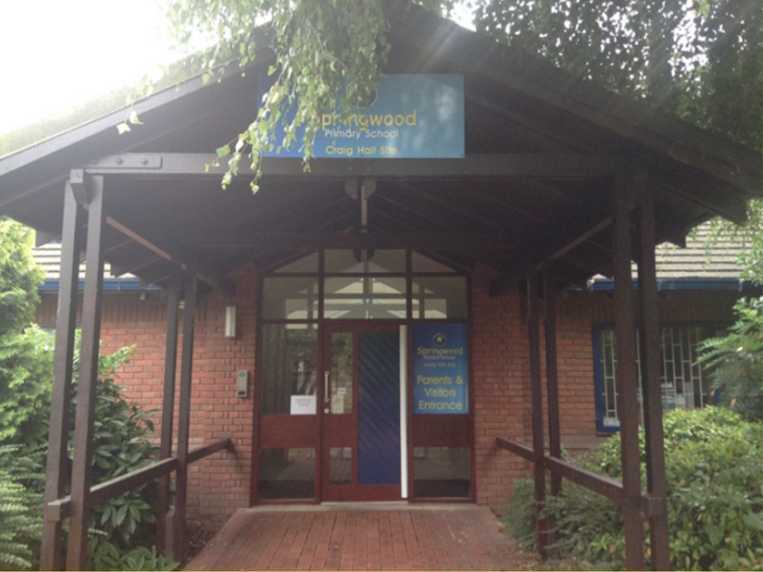
Springwood Craig Hall
Craig Hall- based in Irlam.
For pupils in Early Years and KS1

Slide 3
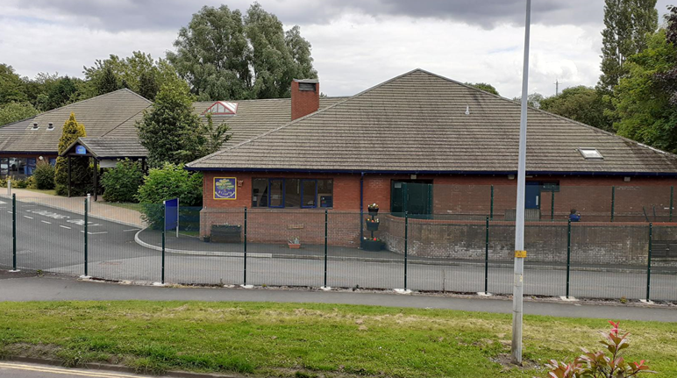
Springwood Craig Hall

Slide 4
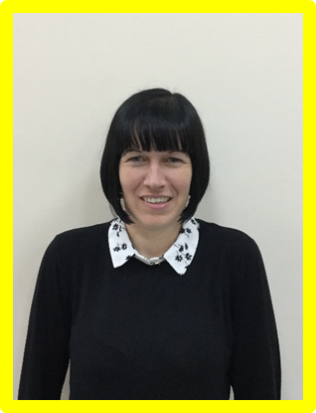
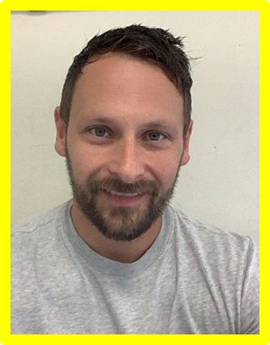
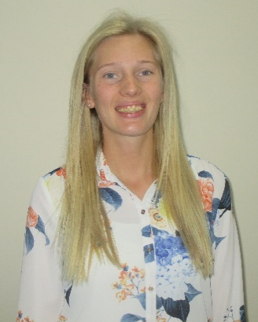
Meet the Teachers
Georgina
Chris
Chloe

Slide 5
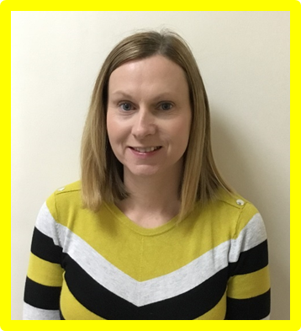
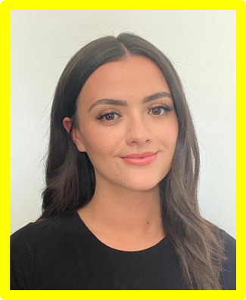
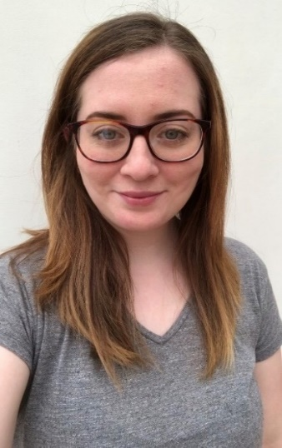
Meet the Teachers
Marykate
Andrea
Louise

Slide 6
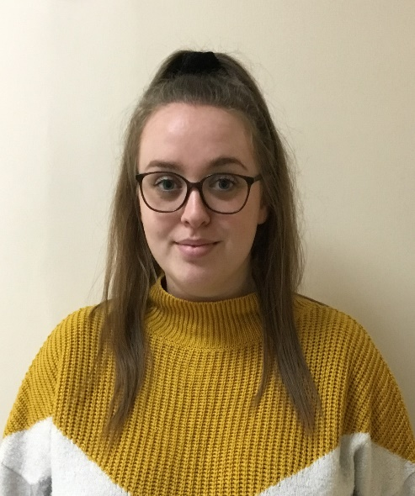
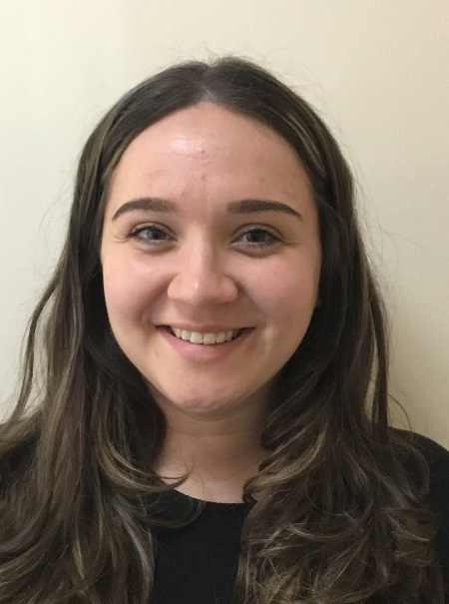
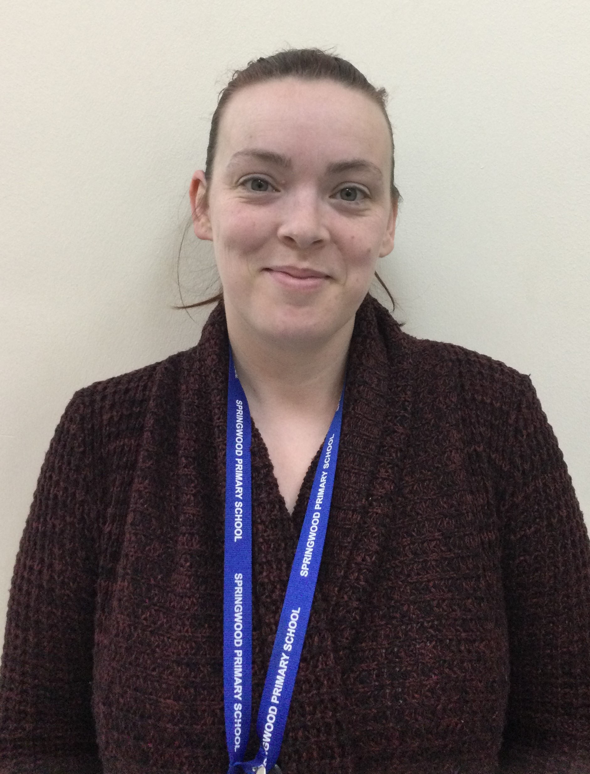
Meet the Teachers
Hannah
Aimée
Lesley

Slide 7
The School Day
9.00- 9.15 Pupils are collected by a member of staff and taken to their classroom
9.15 Learning activities
Around 10.30am- Snack time/Outdoors
11.00 Learning activities
11.45-1.15 Lunch (served in staggered sittings)
1.15 Learning activities
3.00 Prepare for home time
3.15 Home time

Slide 8
Assembly
All pupils take part in a celebration assembly each week
In assembly, a child from each class is given certificates and stickers for the good work they have done that week
Their photo then goes onto the Star of the Week Board in the foyer
Birthdays are celebrated during the assembly with a special song.

Slide 9
EYFS and Key Stage 1
Pupils learning experiences are based on the EYFS and National Curriculum which is differentiated across our 5 curriculum pathways
Learning is based on developing skills across 6 key learning areas
All pupils have an individual Learning Intention Map which identifies specific targets that your child needs to work on
The Curriculum is enhanced through access to real-life experiences and additional facilities in school

Slide 10
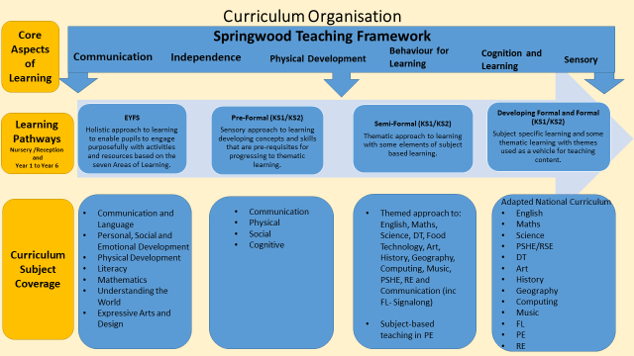

Slide 11
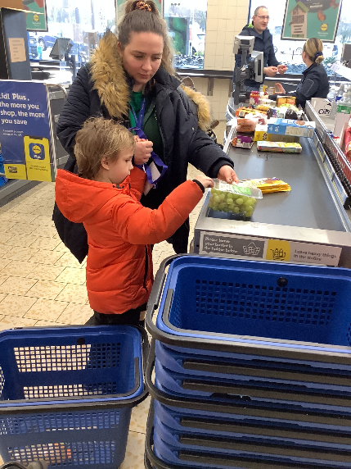
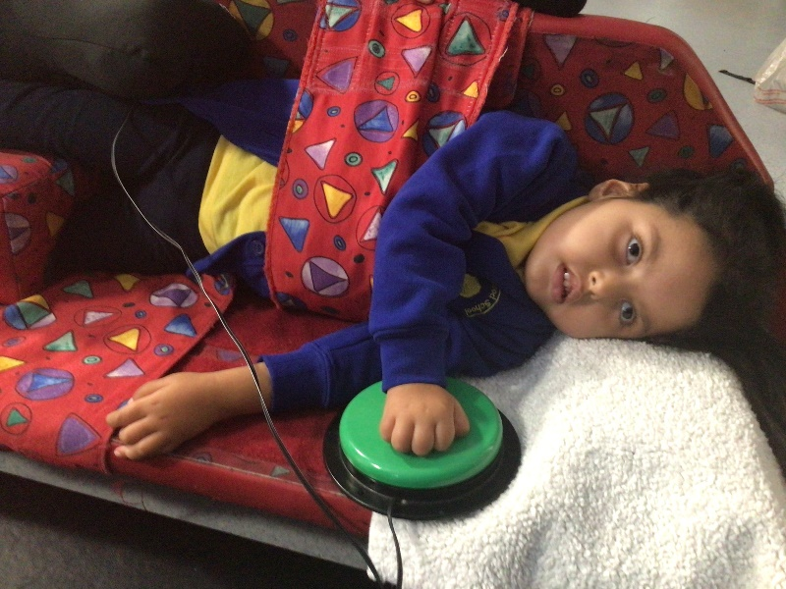
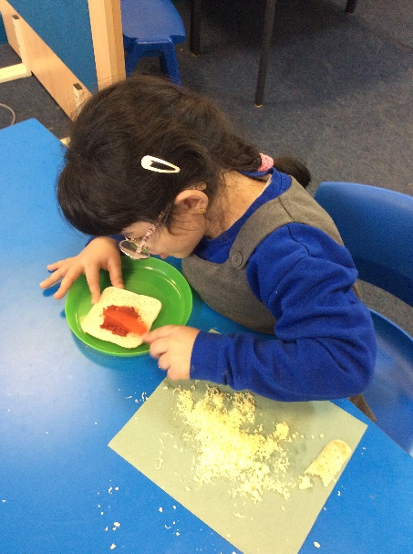
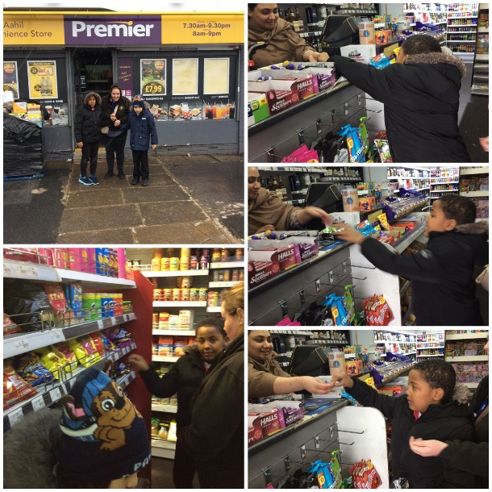
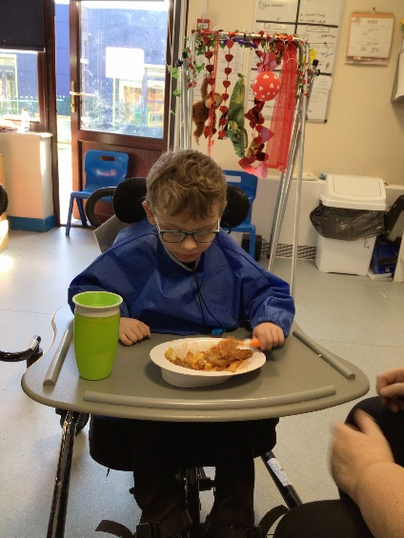
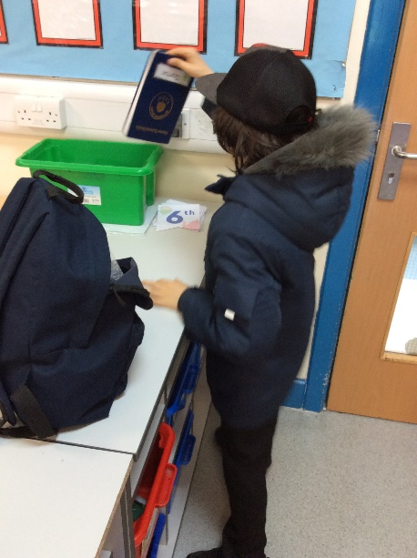
Independence

Slide 12
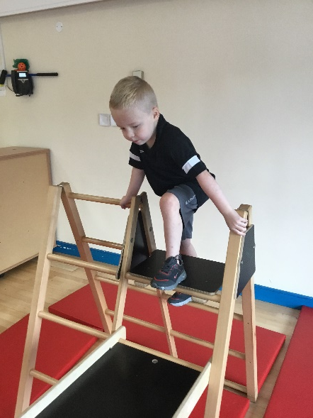
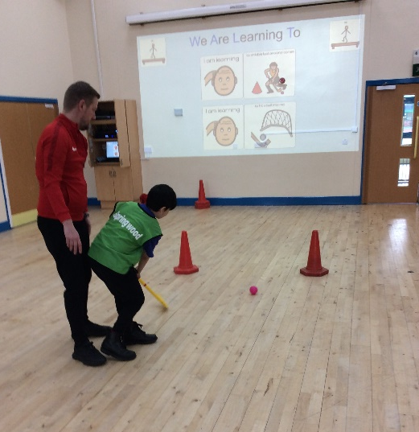
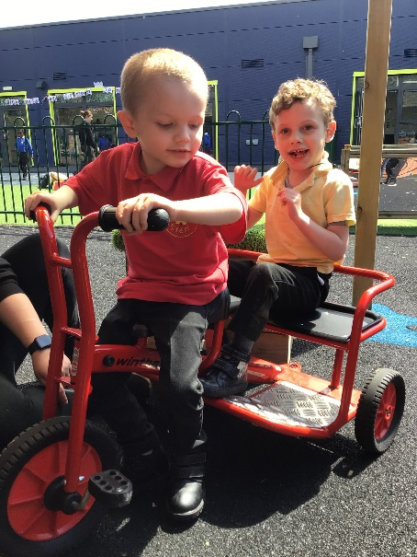
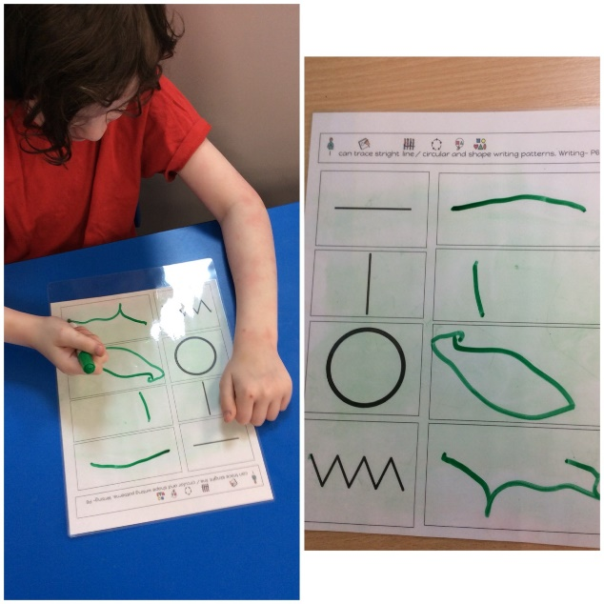
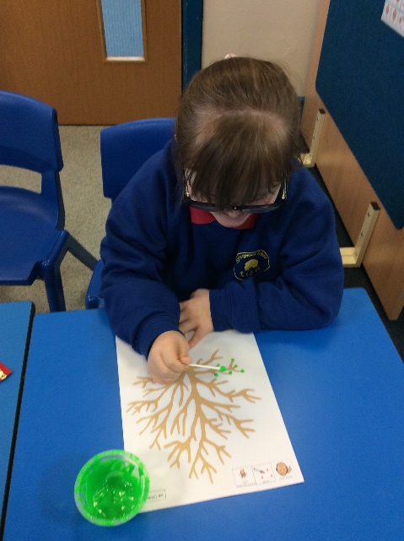
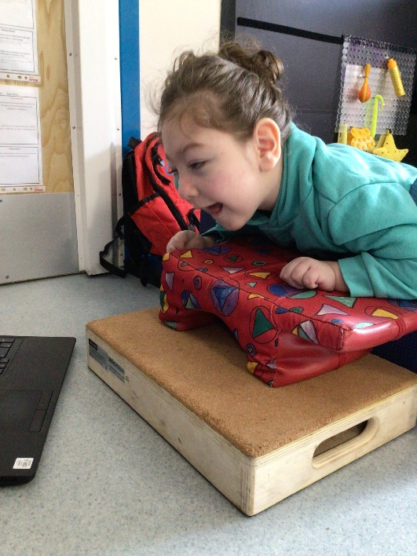
Physical Development

Slide 13
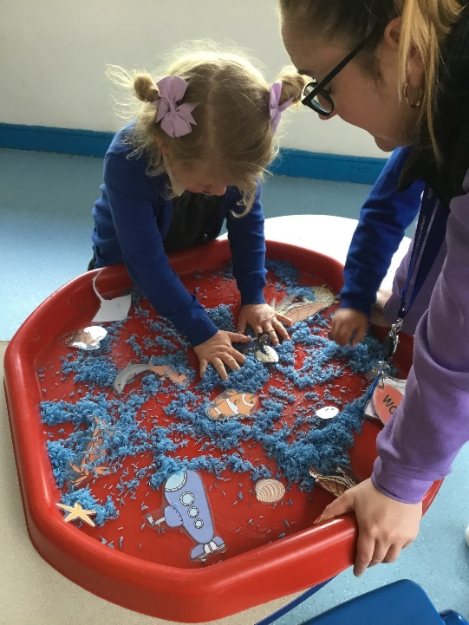
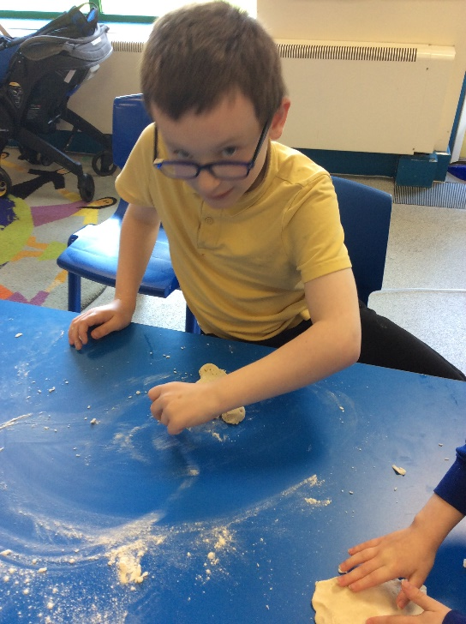
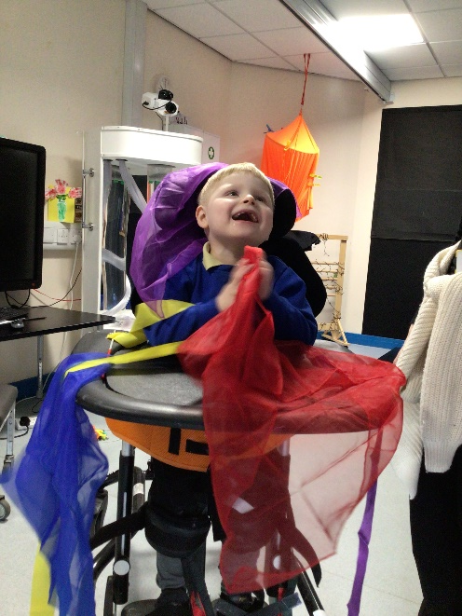
Sensory

Slide 14
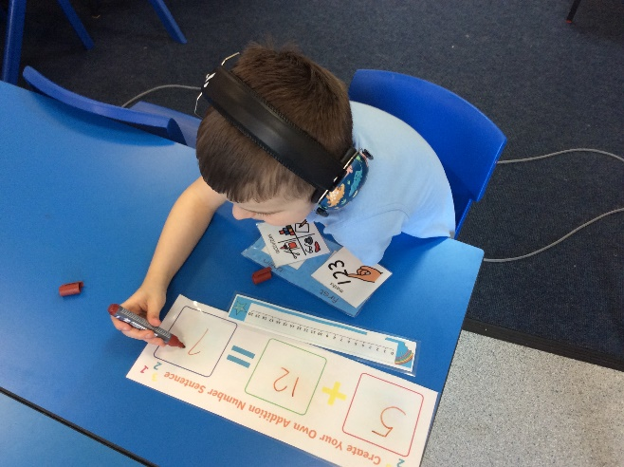
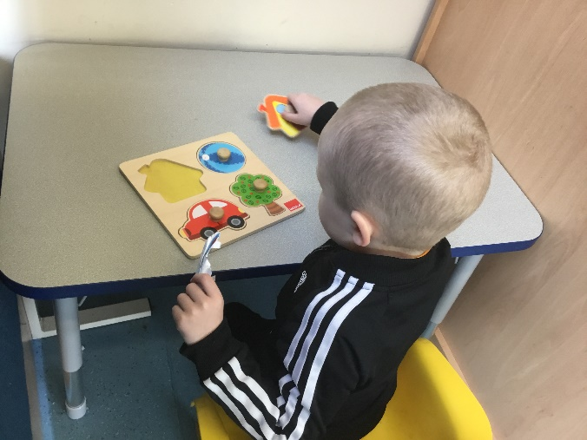
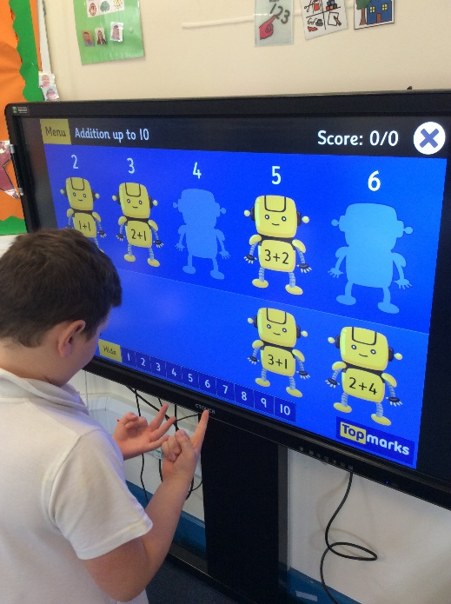
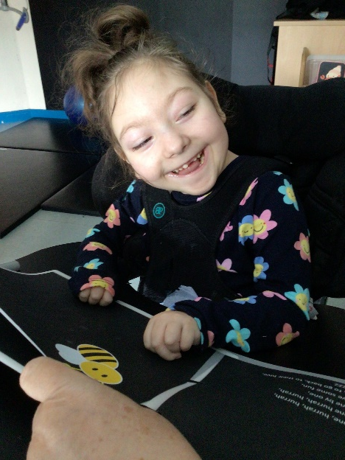
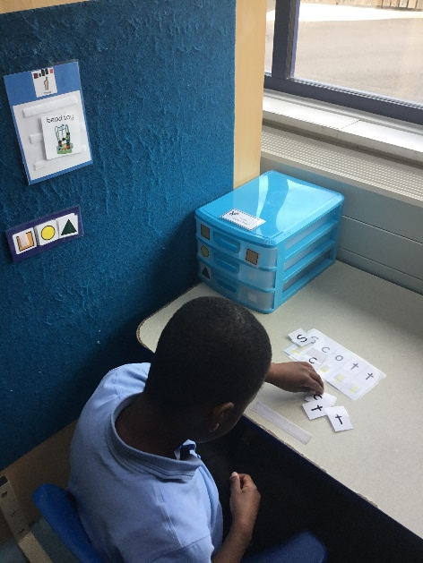
Cognition and Learning

Slide 15
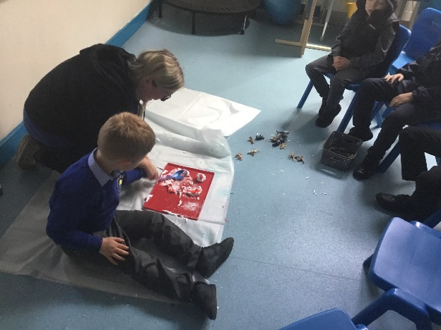
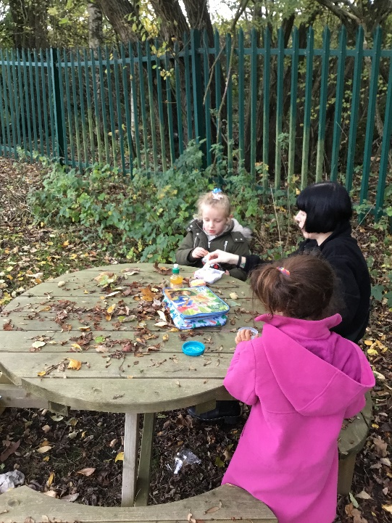
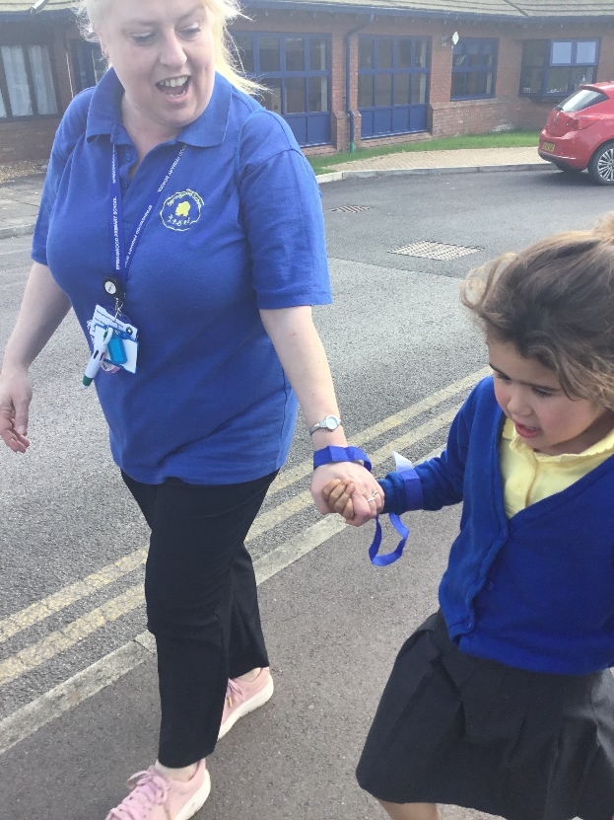
Behaviour For Learning

Slide 16
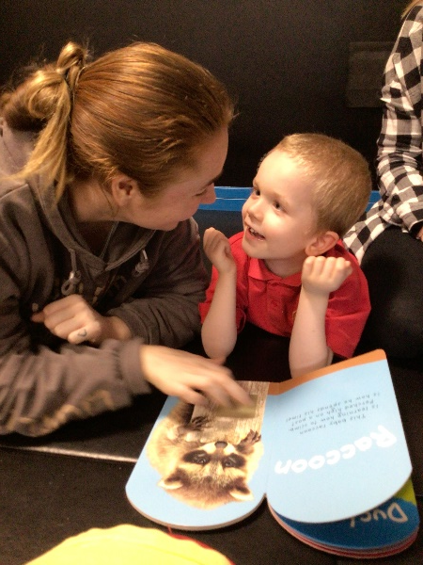
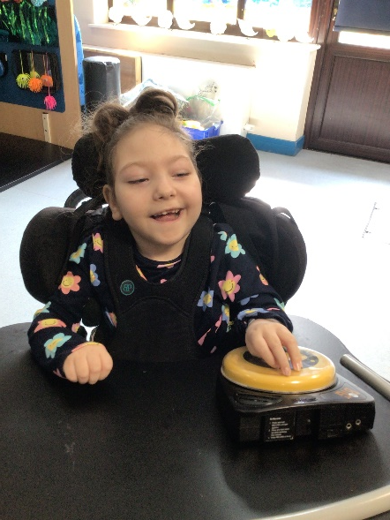
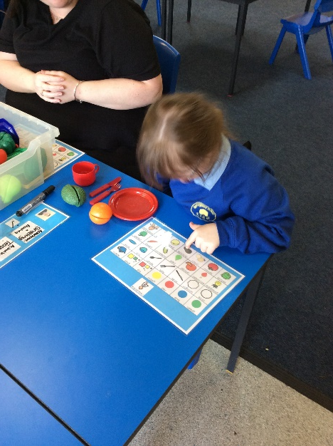
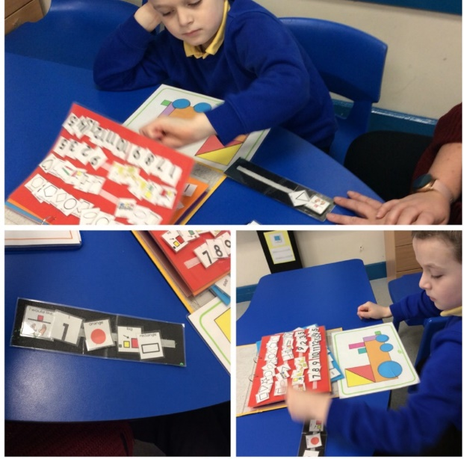
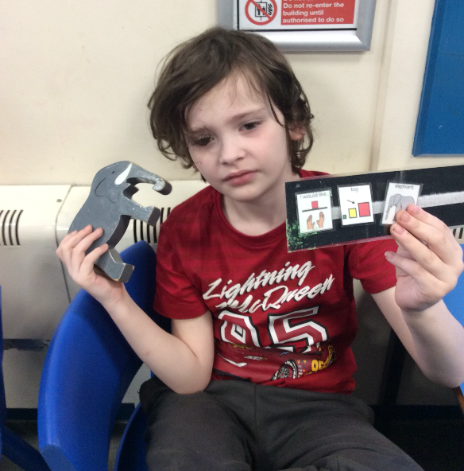
Communication

Slide 17

Communication
A total communication environment provides opportunities for all pupils to develop communication skills. The following methods are used:
Objects of Reference
On Body Cues
Visuals, Photographs and Symbols
Signalong
PECS
Facial expression, vocalisations, pointing
BIGmack sound buttons
iPad – proloquo2go,
Eye gaze technology
PODD
ALD Boards

Slide 18
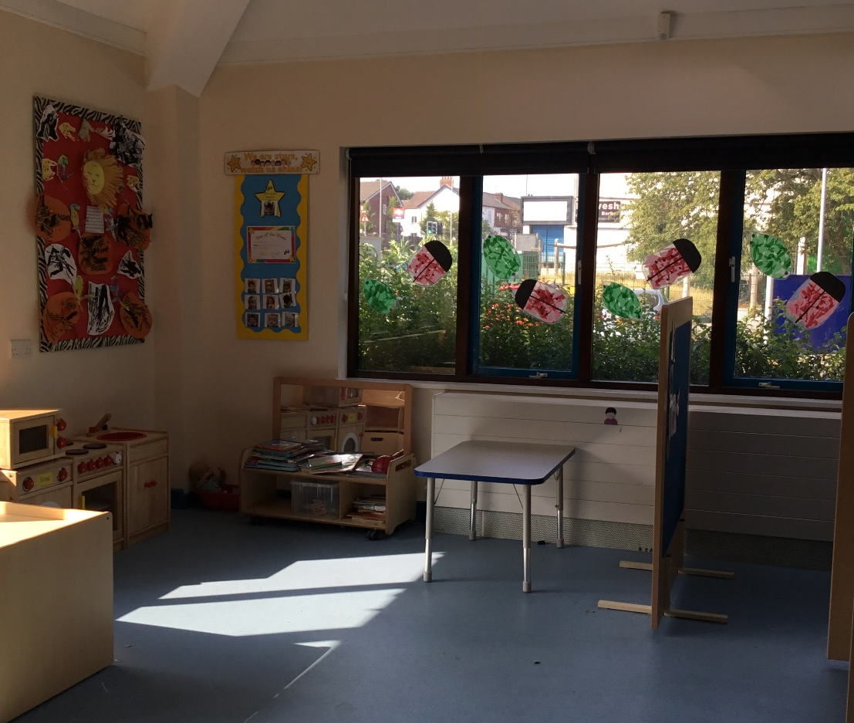
Classes
Classes cater for approximately 8-16 children.
They are supported by 3-6 adults

Slide 19
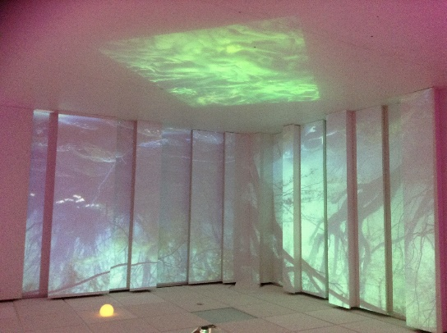
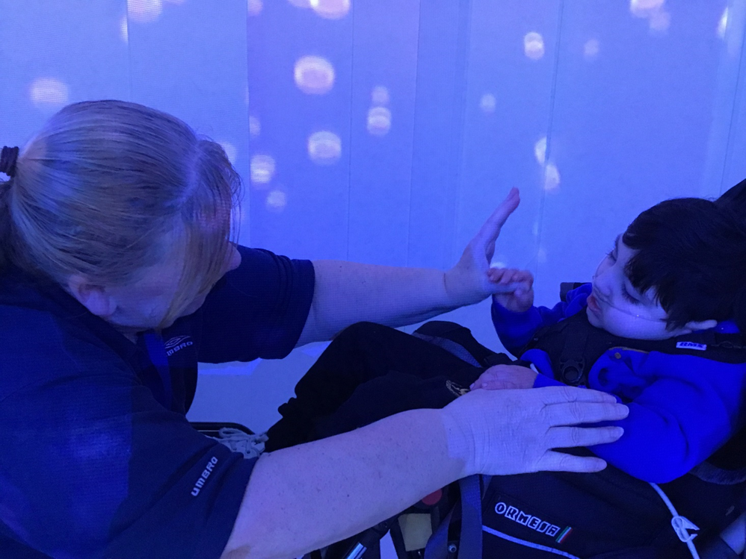
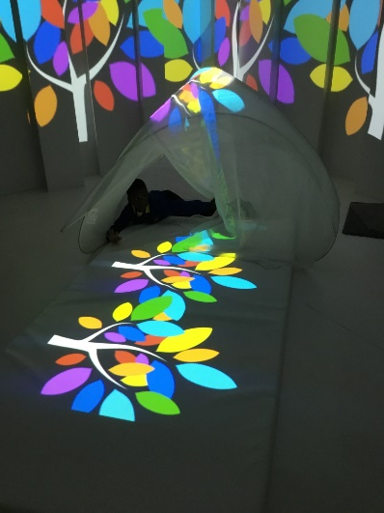
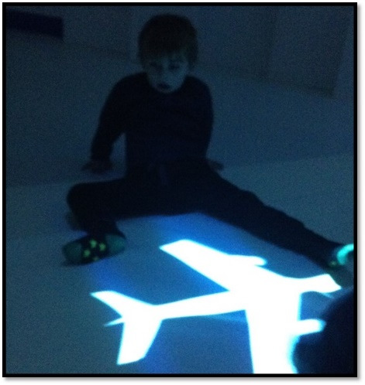
4D Immersive Space
Setting a new scene for learning.
Responding to sound and touch in time to the music.
Creating a ‘safe’ space to explore a new learning experience.
Learning new words related to a theme.

Slide 20


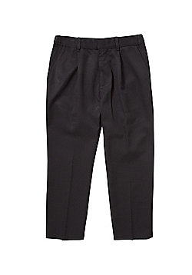


School Uniform
Royal blue jumper or cardigan
Black or grey trousers/skirt/ pinafore/shorts
Polo neck t-shirt- white, blue, red, yellow.
Items of clothing with the school logo are available to order from
www.whittakersschoolwear.co.uk
or
www.mclellanclothing.com
More information about uniform is available at: https://www.springwoodschool.org.uk/school-uniform/
Please label all items of clothing clearly

Slide 21

PE Kit and Outdoor Clothing
Please send a pair of shorts, t-shirt and pumps for PE lessons
Please send into school, a pair of wellingtons and a waterproof coat for outdoor activities
In the warmer weather, please send a hat and sun cream in for your child.

Slide 22


Information for Parents
At Springwood we use Weduc. Connect to communicate with our parents. If you have not yet got this please see the Parent Information Handbook pages 6, 7, 8, 9 for information on how to register.
Page 10 will show you how messages can be sent to your child’s class team
Payments to school are made through our online payment system, School Gateway.
If you have not yet got this please see the Parent Information Handbook pages 9 and 12 information on how to register with School Gateway.

Slide 23
Free School Meals
If your child is eligible for free school meals, they may also be entitled to additional funds, paid to school, to boost their learning.
Children qualify for free school meals if you receive benefits.
All pupils in Reception and Year 1 are entitled to a Universal Free School Meal. Pupils can also bring their own packed lunch.

Slide 24
Free School Meals
If you are in receipt of benefits and your child qualifies for free school meals, it’s important that you apply , even if they're in Reception or Year 1 and receive Universal Free School meals, so that school can access the additional funds.
Telephone 0161 793 2500 - opt 2, then opt 5
Or apply online via the following web page:
http://www.salford.gov.uk/schools-and-learning/free-school-meals/
For further details, see the Parent Information Handbook page 11.

Slide 25
Community Playground Pass
Once you have registered on Weduc and you have activated your account, you will be able to apply for a Springwood Community Playground pass. This involves filling in a short form, we will process the information and send a pass home with your child.
The community playground is at the Swinton site. It can be accessed after the school day, at weekends and during school holidays. The pass activates both the pedestrian gate and large gate so you have access to the carpark.
The playground gate has a carabiner on it. Please make sure that this is back on when you have finished your time on the playground.
The pass will also let you gain access to the community bathrooms.

Slide 26
Parental Engagement
Parents play a very important part in their child’s education. Good communication links between home and school will benefit your child and help their learning and development.
In addition to our communication via Weduc, at Springwood we have:
Parents’ Day/Evening in the Autumn and Summer Term
Annual review of EHC Plan
Termly Parent’s Weeks where you will be invited into school
Weekly photographs via Weduc
Where necessary, we can hold two meetings so that both parents can attend separately.

Slide 27

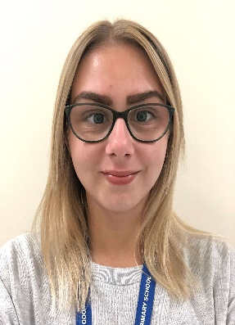
Family Liaison Officers
Our Family Liaison Officers, Rachael and Faye, are available to speak to you should you have any questions or concerns while your child is at Springwood. Both FLOs support families work across all of our sites.
As part of they role they provide:
Mental Health Support
Parenting Support and Programs
Parent Events
Advocacy for you and your child
Information about events and services in the local area

Slide 28
Arrangements for September
Pupils will be given staggered start dates during September. You should have been informed of these before your child begins.
When applying for transport, please put a start date of 01/09/24. We will inform transport of your child’s actual start date.

Slide 29
Thank you for attending this morning
Questions?
If you have any further questions following this presentation, please email:
springwood@salford.gov.uk

