Slide 1
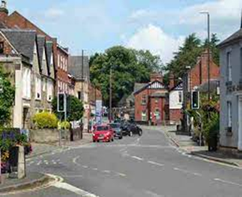

Curriculum Overview
William Gilbert Endowed Church of England Aided Primary School
Curriculum Overview For Parents
Term: Summer 1 2024 |  | Mrs Reed
Theme: ‘Who Lives Here?’ (Local Study)
Curriculum Overview
Mathematics | English | Geography
Unit 11 Multiplication and Division Counting in 2s, 5s and 10s Finding equal groups. Adding equal groups Arrays Making doubles Grouping and sharing Unit 12 Fractions Recognise and find half of a shape Recognise and find half of a number Recognise and find a quarter of a shape. Recognise and find a quarter of a shape. Unit 13 Position and Direction Describe turns Describe position – left/right, forwards/backwards, above/below Ordinal numbers Unit 14 Numbers to 100. Counting from 50 to 100 Counting in 10s to 100 Partition numbers into 10s and 1s Using a number line to 100. One more/less Comparing numbers to 100 | Fiction (Traditional Tales) Features of traditional tales Good characters Bad characters Story language (Once upon… and they all lived….) Problem Good overcomes bad and the problem is resolved. Hansel and Gretel Little Red Riding Hood The Three Little Pigs The Three Billy Goats Gruff Goldilocks and the Three Bears | The United Kingdom is in the continent of Europe and is an island surrounded by seas and oceans. England, Scotland, Wales and Northern Ireland are the four countries of the United Kingdom. London is the capital city of England. Duffield is a village, Belper is a town and Derby is a city. Human features of Duffield include a school, church and park. Physical features of Duffield include a river, hill and trees. There are desirable and undesirable features in our village.

Slide 2
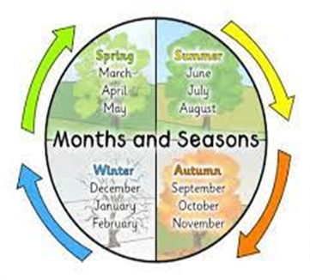
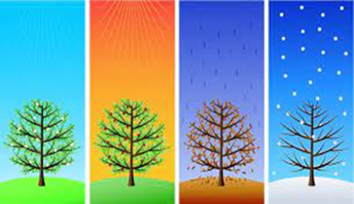
Curriculum Overview
William Gilbert Endowed Church of England Aided Primary School
Curriculum Overview For Parents
Term - Summer 1 2024 |  | Mrs Reed
Theme: ‘Who Lives Here?’ (Local Study)
Curriculum Overview
RHE | Design Technology | R.E
Family and friends should care for one another. Families are important because they give us love and community. Special people are in our lives. Understand what it means to ‘borrow’ something. Know the importance of sharing. | Identify natural and man-made structures. Identify stable and unstable structural shapes. Understand that the shape of structure affects its strength. Create joints and structures from paper, card and tape. Produce a finished structure and evaluate its strength, stiffness and stability. | Everyone is valuable and unique. The Golden Rule for everyone is to ‘treat others how we would like to be treated’. At the Jewish festival of Sukkot, people spend time living outside to remember the Israelites escape from Egypt. The Good Samaritan tells us how to be a good neighbour to everyone. Tzedakah is the Jewish idea of charitable giving to those in need. This is to help make the world a better place. Jews and Christians share the stories from Genesis.
Science | Computing | P.E
Identify and name a variety of common wild and garden plants, including deciduous and evergreen trees. Identify and describe the basic structure of a variety of common flowering plants, including trees. Discuss and observe changes across the four seasons. Observe and describe weather associated with the seasons and how day length varies. | Digital Painting Create pictures by drawing, painting, photographing and using computers. Different tools on the computer can create different lines, shapes and colours. Artwork can be created using computers. | Orienteering Understand what it means to work in a team. Work within a team to achieve an objective. Understand how to solve a problem. Recognise key landmarks on a map. Follow instructions from a map. Following directions and working as a team.
Things to look for and do at home/Any other information
Top Tiger – this is an opportunity for you child to write about their weekend with either Snowy and Whiskers, please encourage your child to write their own news. You can help by ruling lines to keep their writing neat, encourage them to sound out words, use full stops and capital letters. Give them a sharp pencil to write their news, all them time to practice reading their news aloud ready to share in class! Creative Homework Ideas https://www.bbc.co.uk/bitesize/topics/zkvv4wx/articles/zyfhxbk https://www.bbc.co.uk/bitesize/topics/zkvv4wx/articles/z3kbydm Create a seasons/calendar wheel to show the relationship between the seasons and months. Produce a piece of artwork to show seasonal change. Go on a walk – look out for common and wild plants, can you identify them? Remember to take some photographs and send them to enquiries@williamgilbertend.derbyshire.sch.uk Use the computer to create a piece of digital art linked to our topic. Visit the Garden Centre and/or help your grown-up plant some flowers in your garden. Please can work be brought into school by Monday 13th May (or before!) to receive a FREE STAR!!!

