Slide 1

How we teach Maths in Year 4

Slide 2

Across school, we do Maths Mastery.
The whole idea is that ALL children can access the Maths lesson.
Lesson structure:
Hook question
Fluency and variation
Independent work
Challenge question if appropriate

Slide 3
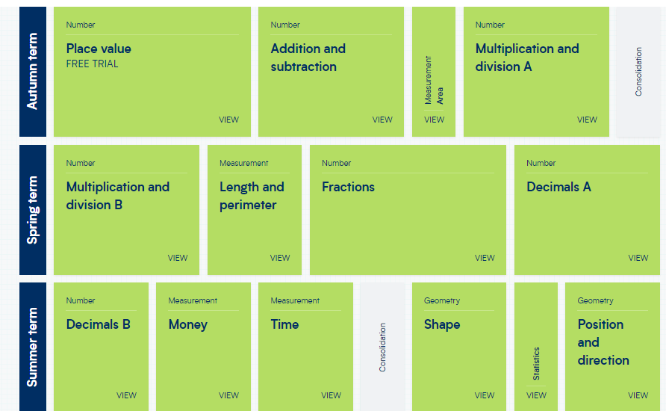
Year 4 Overview

Slide 4
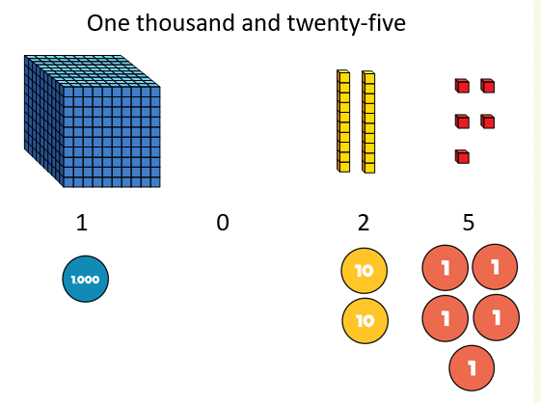
Importance of place value:
In Year 4, we start by consolidating children’s understanding of place value in numbers up to 10 000.
This includes –
representing numbers in
different ways

Slide 5
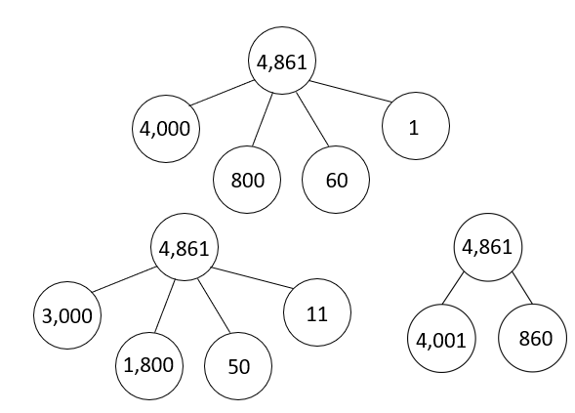
Importance of place value:
In Year 4, we start by consolidating children’s understanding of place value in numbers up to 10 000.
This includes –
partitioning numbers
in different ways

Slide 6
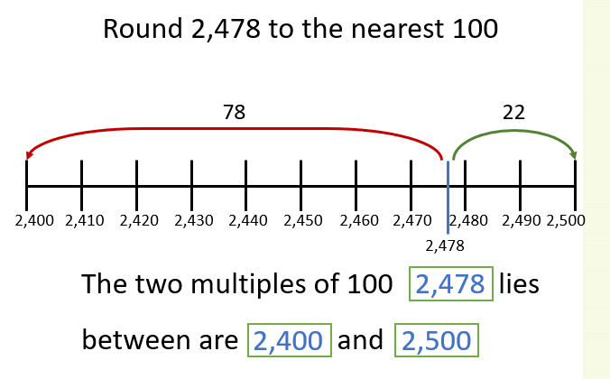
Importance of place value:
In Year 4, we start by consolidating children’s understanding of place value in numbers up to 10 000.
This includes
– rounding numbers

Slide 7




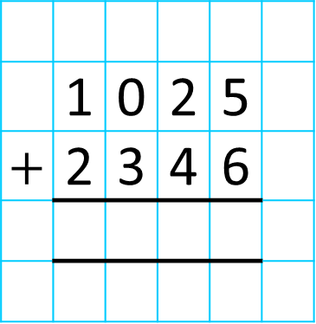
Column Addition:
Th | H | T | O
 | 1 | 0 | 2 | 5
$+$ | 2 | 3 | 4 | 6
3
3
7
1
1
3
3
7
1

Slide 8

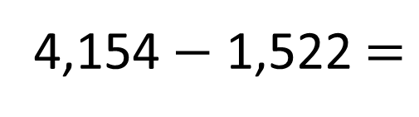
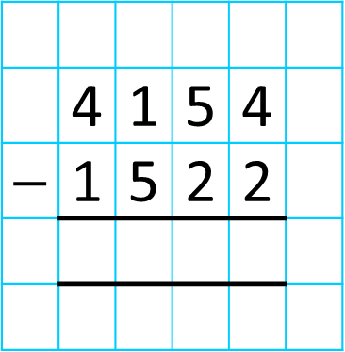

Column Subtraction:
4,154 $−$ 1,522 $=$
Th | H | T | O
 | 4 | 1 | 5 | 4
$−$ | 1 | 5 | 2 | 2
3
2
3
2
3
2
5 tens$−$ 2 tens $=$ ___ tens
4 ones $−$ 2 ones $=$ ___ ones
An exchange is not needed

Slide 9

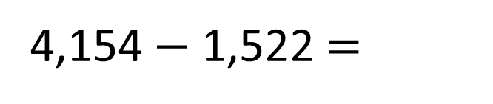
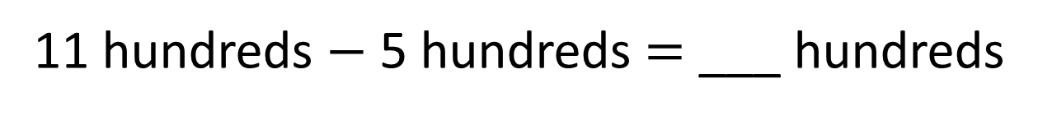
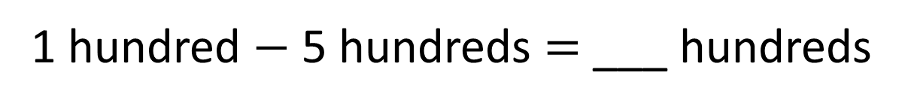

Column Subtraction:
4,154 $−$ 1,522 $=$
2,632
Th | H | T | O
 | 4 | 1 | 5 | 4
$−$ | 1 | 5 | 2 | 2
3
1
2
6
3
2
2
6
3
2
6
2
11 hundreds $−$ 5 hundreds $=$ ___ hundreds
3 thousands $−$ 1 thousand = ___ thousands
1 hundred $−$ 5 hundreds $=$ ___ hundreds
An exchange is not needed
An exchange is needed

Slide 10

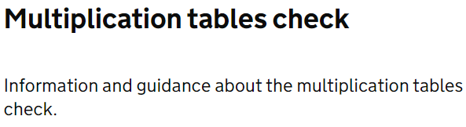

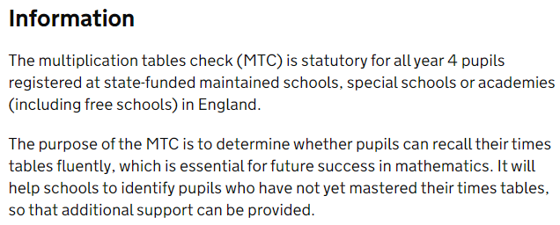
MTC:
In June of Year 4, children sit the MTC which tests them on ALL the times tables up to 12 x 12.

Slide 11
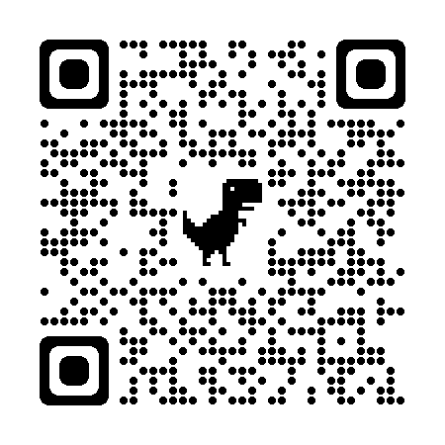
MTC:
In June of Year 4, children sit the MTC which tests them on ALL the times tables up to 12 x 12.
Let’s have a go!
https://www.timestables.co.uk/
multiplication-tables-check/

Slide 12
How can you support your child at home?
Times Tables!
Frequent repetition of the tables is crucial to learning them. We are looking at them daily in school but why not practice when you have a spare moment e.g. on the journey in to school?
  1 x 6 = 6, 2 x 6 = 12, 3 x 6 =18 …
Discuss which tables your child is finding the most problematic and focus on them first.
Use technology – TT Rockstars, Hit the Button and many more!

Slide 13

Please feel free to use our remaining time to look at some example questions.
Thank you for coming.
Any questions?

