Slide 1


Issue 23 June 2026
William Gilbert Endowed C of E Primary School and Nursery
www.williamgilbertend.derbyshire.sch.uk Safeguarding and Child Protection
at William Gilbert School
Welcome to our Safeguarding Newsletter
Coming up in this issue – Transition to secondary school (including the dangers of vaping) Understanding Behaviour: Supporting Emotional Wellbeing, Online Safety, Keeping Safe in the Community – the importance of wearing a helmet when cycling or scooting, sun safety, road and water safety.
Safeguarding & Child Protection is the most important issue for our children and young people. At William Gilbert School, we feel it is crucial to work with our parents and the multi agencies that support schools and young people, so that we can offer a safe environment allowing children to be aware of the risks they may face and how to respond to them safely.
Safeguarding and promoting the welfare of children is everyone's responsibility
At William Gilbert School we have the attitude of ‘it could happen here’ when safeguarding is concerned.
The well-being and safety of our children is at the very centre of school life. Please be reassured that the issues covered here are dealt with in school in a sensitive and entirely age-appropriate way. We have a moral and legal duty to raise awareness and provide this information.
The Safeguarding Team at William Gilbert Primary
The William Gilbert safeguarding team has five Designated Safeguarding Leads or DSLs. These members of staff have enhanced safeguarding training and have a vital role in taking lead responsibility for child protection issues in school. The senior DSL is Mrs Britten. A DSL is always available during school hours for pupils, parents and staff to discuss any safeguarding concerns. Outside of school hours a DSL can always be reached via the dedicated safeguarding email safeguarding@williamgilbertend.derbyshire.sch.uk information sent to this email is highly confidential. Mrs Aston continues to support pupils and their families in her role as Pastoral and Wellbeing Mentor. Part of her role is to provide advice and access help as soon as a need emerges. Mrs Aston can support families with a wide range of issues, including but not limited to, mental health and wellbeing, attendance, persistent lateness, the impact of community safeguarding issues including bullying and online safety. Mrs Aston can be accessed at the school gate most mornings, via the school office or via pastorallead@williamgilbertend.derbyshire.sch.uk
Useful Acronyms & Vocabulary
DSL: Designated Safeguarding Lead
PREVENT: Part of the Governments Counter Terrorism Strategy to stop people being drawn into extremism
LADO: Local Authority Designated Officer - who deals with position of trust safeguarding issues
CEOP: Child Exploitation and Online Protection Centre
KCSIE: Keeping Children Safe in Education (available on the school web pages)
Who’s Who at WGES
Mrs E H Britten - Senior DSL
Mrs Z Kibble - Deputy DSL
Mrs A Aston - DSL and pastoral wellbeing lead.
Mrs S Owen – DSL and mental health first aider
Mrs R Manners – DSL and SBM
Dr N Ruggins – Safeguarding Governor
Miss K Whiting –Mental Health First Aider
Mrs E Davies – SENCO
Designated Safeguarding Leads can be accessed at all times via our safeguarding email
safeguarding@williamgilbertend.derbyshire.sch.uk
If you believe that a child or an adult is at immediate risk of harm and in need of protection then you should call the Police - 999, straight away.
Alternatively, if you want advice from the Police and the child or adult is not in immediate need of protection, you can call the Police on the telephone number 101.
Here are some examples coming this term that you can discuss with your child
Weekly Safeguarding Awareness Assemblies covering the following topics this term – Peer Pressure, Online safety – gaming, YouTube, social media and privacy settings, Child Safety, water safety – canals/rivers/beach, staying safe in the sun, NSPCC speak out to stay safe, Fire safety – BBQs/beach fires and ‘How to stay safe away from school’.
Religious Education lessons reinforce messages of tolerance and respect for others. Opportunities to learn about other faiths and visit places of worship.
RSHE lessons – see knowledge mats on the school website for year group information
Engagement with charities that broaden pupils' awareness, understanding and worldview
Local community representatives to support the curriculum -PSCO from Derbyshire Police
Transition work from pre-school settings to Reception and Year 6 to Year 7

Slide 2

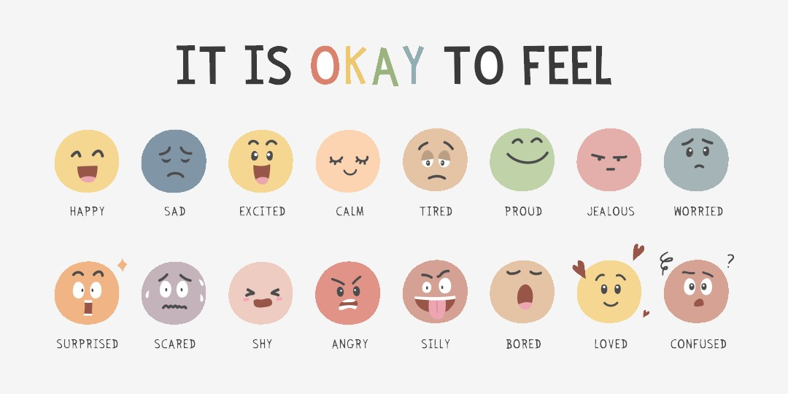

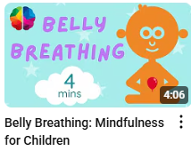
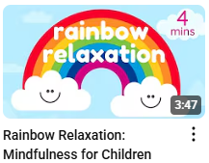

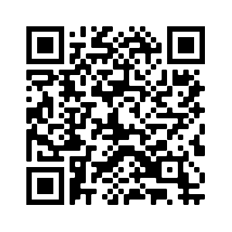
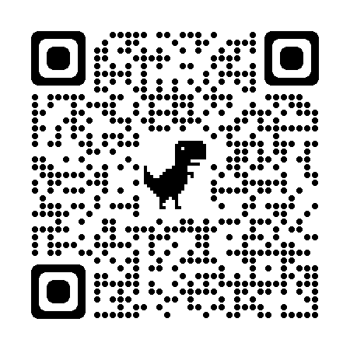
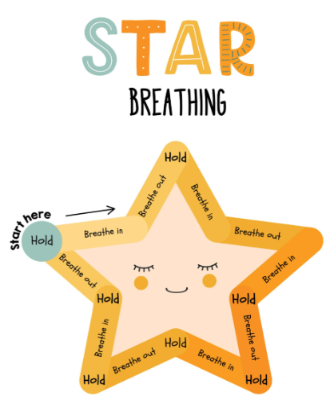

Understanding Behaviour: Supporting Emotional Wellbeing
Children’s behaviour is often a reflection of how safe and regulated they feel. When calm, they can use their thinking brain to make good choices. But when overwhelmed, their emotional brain takes over, triggering automatic responses like fight, flight, freeze, or fawn. This means that challenging behaviour is often not a choice, but a sign of distress or unmet needs.
As parents and carers, how we respond to behaviour matters. Our reactions can either help children feel safe and supported—or increase their stress. It’s important to ask ourselves: Are my expectations realistic? Am I helping my child feel understood? Am I modelling calm and emotional regulation?
Taking time to reflect on our own emotional responses can also make a big difference. Our past experiences, beliefs, and even fears can shape how we react to our child’s behaviour. By becoming more aware of these influences, we can respond with greater patience and empathy.
💡 Practical Tips to Support Your Child
Co-regulate: Stay calm and offer reassurance—children borrow our emotional state.
Name emotions: Help your child identify what they’re feeling.
Offer safe outlets: Encourage movement, creativity, or sensory play.
Avoid isolating discipline: Stay with your child through tough emotions when possible.
Model coping tools: Use breathing, grounding, and problem-solving strategies.
Reconnect after conflict: Repairing relationships builds emotional security.
For more guidance, including how to have restorative conversations with your child, download the free booklet “Responding to Behaviour” from Bridge the Gap:
🔗https://www.jwbridgethegap.com/_files/ugd/c72ecf_b25a8bda520b4bf3a21706cc4f55721b.pdf
Useful Acronyms & Vocabulary
CAMHS: Child and Adolescent Mental Health Services
My Concern – Safeguarding record system (safeguarding and child protection software for schools used at WGES).
NSPCC: National Society for the Prevention of Cruelty to Children
EHA: Early Help Assessment
SEND: Special Educational Needs & Disabilities
Safeguarding Information at WGES
We have a wealth of information on our school website for parents to access, including important documents and contact details.
Please visit www.williamgilbertend.derbyshire.sch.uk
Scan the QR code below to take you to our safeguarding page
Scan the QR code below to take you to our parenting support page
Try some calming co-regulation breathing
Try some of these breathing exercises found on The Mindfulness Teacher YouTube channel which the children use in school.
https://www.youtube.com/@TheMindfulnessTeacher
Breathing techniques are a powerful way to help children regulate their emotions when they’re feeling overwhelmed, anxious, or upset. One simple and effective method is Star Breathing. Children trace the five points of a star with their finger—breathing in as they trace up one side, and out as they trace down the next. This visual and physical guide helps them slow their breathing and calm their nervous system. Practising breathing regularly helps children build emotional resilience and gives them a tool they can use anytime they feel big emotions rising.
Try asking your child:
"Can you show me the
breathing technique, you’ve
learned to help you feel calm?“
The children’s mental health charity, Place2Be, has launched a new website aimed at helping parents with typical situations they may experience with children.
Advice can be found on over forty topics including:
Understanding sibling rivalry
My child is lying, what does it mean, what should I do?
My child has trouble going to sleep
My child says ‘I hate you!’
Cultural identify: who am I?
‘Our mealtimes are becoming a battleground’
The Parenting Smart website can be found here: https://parentingsmart.place2be.org.uk/

Slide 3
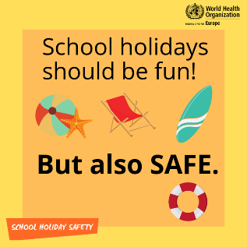

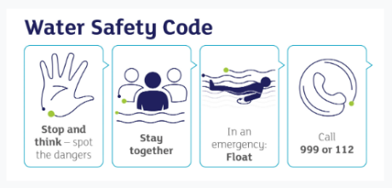
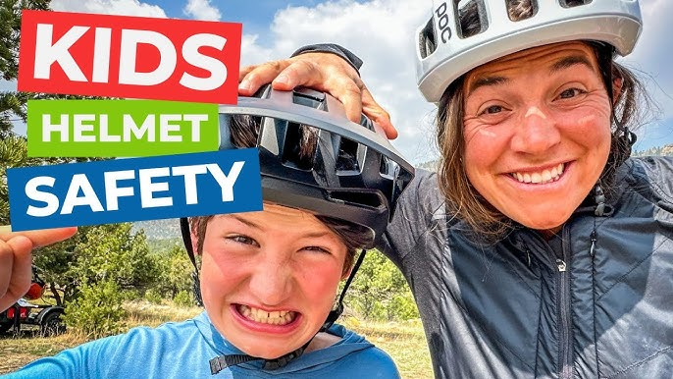
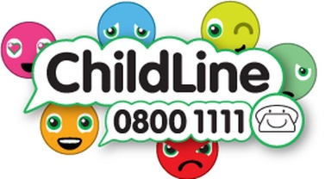
Keeping safe in the
holidays
Useful Acronyms & Vocabulary
CAMHS: Child and Adolescent Mental Health Services
My Concern – Safeguarding record system (safeguarding and child protection software for schools used at WGES).
NSPCC: National Society for the Prevention of Cruelty to Children
EHA: Early Help Assessment
SEND: Special Educational Needs & Disabilities
Safeguarding Information at WGES
We have a wealth of information on our school website for parents to access, including important documents and contact details.
Please visit www.williamgilbertend.derbyshire.sch.uk
If you believe that any child is in danger ring Call Derbyshire Tel: 01629 533190 choosing the option for urgent child protection calls at any time
Sun Safety
Sun damage when you’re young could lead to skin cancer developing in later life. Whether you’re heading to the beach, playing in the park or out in your own garden, it’s important to think about sun protection for all the family – especially young children.
Sun safety tips
Spend time in the shade when the sun is strongest. In the UK, this is between 11am and 3pm from March to October.
Make sure you:
spend time in the shade between 11am and 3pm
never burn
cover up with suitable clothing and sunglasses
take extra care with children
use at least factor 15 sunscreen
The following website has more information and fun activities that you can share with your children to keep them safe over the summer holidays
https://www.bbc.co.uk/cbeebies/watch/sun-safety-for-kids
https://www.nhs.uk/live-well/seasonal-health/sunscreen-and-sun-safety/
Water Safety
The Royal Life Saving Society UK report that drowning is the third highest cause of accidental death of children in the UK and that a person can drown in as little as 2cm of water. Hot weather can make rivers, lakes and paddling pools more appealing for children and families – make sure you know how to teach your child to be safe when cooling off and playing this summer.
The water safety code
Water may look safe, but it can be dangerous. Learn to spot and keep away from dangers. You may swim well in a warm indoor pool, but that does not mean that you will be able to swim in cold water.
The dangers of water include:
it is very cold
there may be hidden currents
it can be difficult to get out (steep slimy banks)
it can be deep
there may be hidden rubbish, for example shopping trolleys, broken glass
there are no lifeguards
it is difficult to estimate depth
it may be polluted and may make you ill
Please visit the following websites to help inform your family and keep them safe
https://rnli.org/safety/beach-safety
https://www.rospa.com/leisure-water-safety/water/advice/water-safety-code
Safety First: Why Helmets Matter for Scooting and Cycling to School
As the weather brightens and more children scoot or cycle to school, it’s the perfect time to remind everyone about the importance of wearing a helmet. Helmets aren’t just a good idea—they’re a vital part of keeping your child safe.
Top Reasons to Wear a Helmet - Here are some key reasons to make helmet-wearing a daily habit:
Protects the brain: Helmets reduce the risk of serious head injury by up to 85%.
Sets a good example: Children who see others wearing helmets are more likely to wear one themselves.
Boosts confidence: Kids feel safer and more in control when they know they’re protected.
Tips to Encourage Children to Wear Helmets
Let them choose: Allow your child to pick a helmet in their favourite colour or with fun designs.
Make it a routine: Treat the helmet like a seatbelt—something you never ride without.
Use positive reinforcement: Praise or reward your child when they remember to wear their helmet.
Lead by example: If you cycle or scoot, wear your helmet too!
Personalise it: Add stickers or their name to make it feel special and unique.
Educate gently: Talk about how helmets protect their “super-smart brain” in a way they understand.
In the UK, it is not a legal requirement for children (or adults) to wear a helmet when cycling or scooting. However, it is strongly recommended by safety organisations, the government and William Gilbert School. Take a look at these useful resources and websites to remind children of the key safety messages about riding a bike and wearing a helmet.
https://www.youtube.com/watch?v=NF8CiNXEmcU (Always wear a helmet)
https://www.youtube.com/watch?v=dkoVxBnnGko (Bicycle safer Journey)NB Please note that this is a video made in the USA so whilst much of the content is excellent and relevant it mentions riding on the right which is not the case on UK roads.

Slide 4


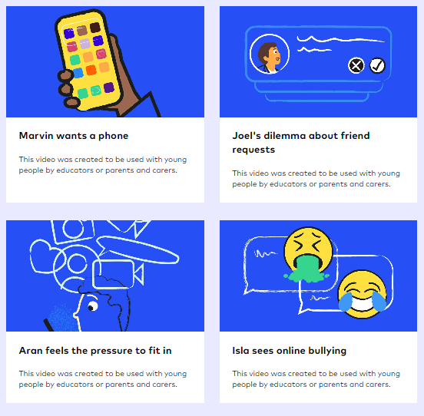

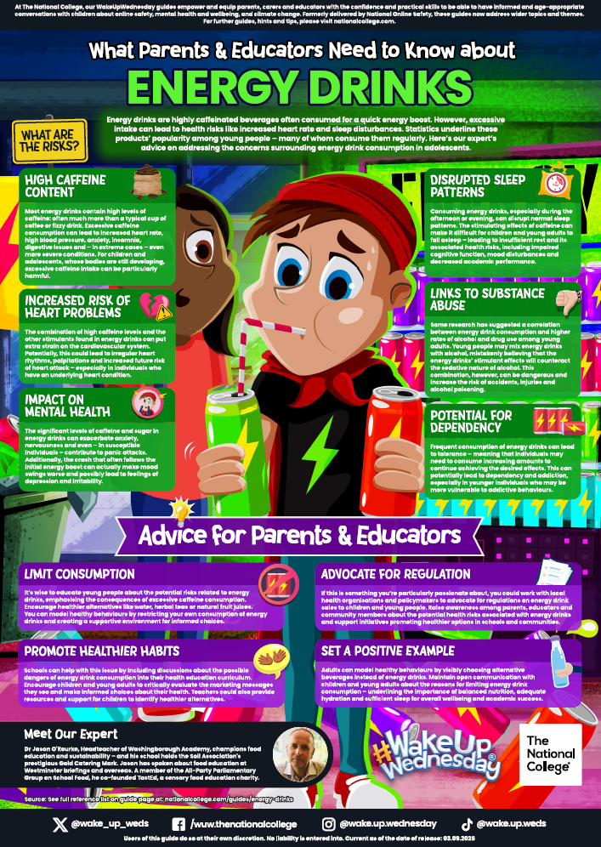

Useful Acronyms & Vocabulary
Peer pressure is the direct or indirect influence on peers, i.e., members of social groups with similar interests, experiences, or social statuses. Members of a peer group are more likely to influence a person's beliefs, values, and behaviour. A group or individual may be encouraged and want to follow their peers by changing their attitudes, values or behaviours to conform to those of the influencing group or individual.
Advice around Peer Pressure and support for young people can be found here:
https://www.childline.org.uk/info-advice/friends-relationships-sex/friends/peer-pressure/
Safeguarding Information at WGES
We have a wealth of information on our school website for parents to access, including important documents and contact details.
Please visit www.williamgilbertend.derbyshire.sch.uk
For more resources visit BBC Bitesize below
Moving on…
With the end of term rapidly approaching our year 6 pupils are preparing for their next adventure, secondary school. We’re sure there are a lot of different emotions about this new start. We hope the prevailing emotion is excitement- about all the new experiences to be had, new friends to be made and new goals to be achieved. That said, it’s natural and normal to feel a little apprehensive and maybe even anxious also (both parents and children alike!),
Here are some links to useful transition resources to support you:
https://www.place2be.org.uk/our-services/parents-and-carers/getting-ready-to-start-secondary-or-high-school/
https://www.annafreud.org/schools-and-colleges/resources/supporting-childrens-transition-to-secondary-school-guidance-for-parents-and-carers/
https://www.bbc.co.uk/teach/transitioning-to-secondary-school/zkc9pg8
Childnet have devised some useful videos. These share with parents of the challenges ahead but also as a useful discussion points with your child.
Childnet.com https://www.childnet.com/resources/moving-on-up/
Independence but with boundaries
The move to secondary school often signals a shift in the levels of freedom and independence our older pupils are given by parents. Our duty to safeguard these pupils remains. We feel it is important to share information that will support parents in keeping children safe when they are away from their caregivers. We are aware of groups of teenagers from a range of secondary schools in the area gathering in groups within Duffield. Younger pupils can be drawn into these groups through ‘peer pressure’ and take part in unsafe and sometimes anti-social behaviours. With light nights and warmer weather children may be granted the opportunity to play/hang out at the park or within the village. We would urge parents to set clear boundaries to keep them safe. These could include giving a time that they must return; going to and from the agreed place, e.g. the park (as they earn your trust and demonstrate they can keep themselves safe the places they go can grow; that they keep in contact with you through their phone, if they have one, and discuss what to do if something happens to make them feel worried or unsafe.
Energy drinks
There is local information to show that secondary school pupils are accessing and drinking energy drinks. This continues to be an issue locally and as Year 6 pupils moving to Year7 spend more time away from parents, particularly on light, warm evenings the temptation to try them is an issue facing our pupils. These are soft drinks that contain high levels of sugar and caffeine. They also contain stimulants such as guarana which adds to the level of caffeine. Caffeine is an addictive substance. The NHS has stated that because of the high levels of caffeine, sugar and acidity in energy drinks, they are ‘unnecessary’ and ‘unsuitable’ for children under 16.- Young people who drink energy drinks are more likely to drink alcohol, smoke or use drugs
Some reasons why young people choose to drink energy drinks;
To fit in with their friends as part of socialising in the evenings / weekends on the park, BMX tracks, skate parks.
Whilst gaming to help them stay awake at night
Whilst taking part in sports
To help with concentration and study.
To mix with alcohol
There currently is no law to prevent the sale of these drinks to under 16s in the UK but many shops operate a responsible retailing policy and do not sell them to under 16s. We are aware that not all shops in Duffield support this responsible retailer policy and continue to sell them to secondary age pupils.
PCSO UPDATES
Challenges that face a perceived affluent area such as Duffield.
During the Summer months there has been an increase in anti-social behaviour in areas of the village including the nature reserve, Greys Rec and the surrounding streets.
There are also gangs coming into the village and targeting teenage groups and parties, offering drugs.
As your Year 6 children begin to experience more freedom over the summer, ensure appropriate boundaries are in place. As parents you are responsible for safeguarding them.

Slide 5
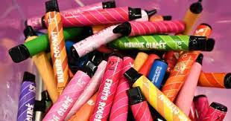
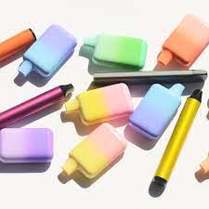


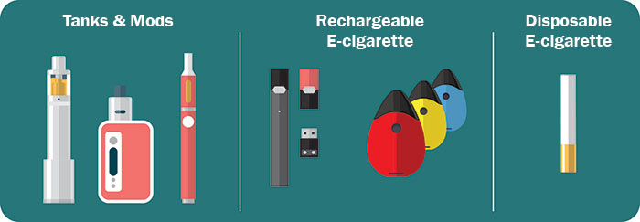
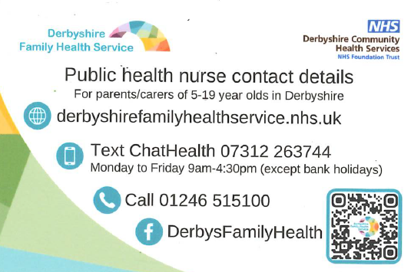
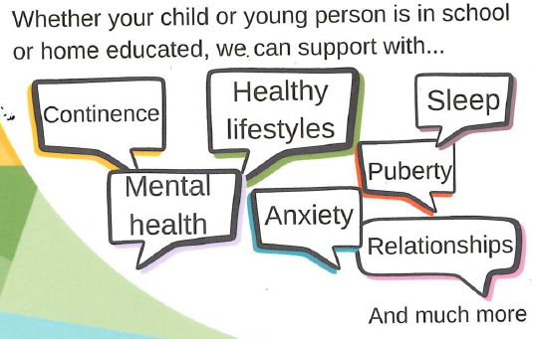

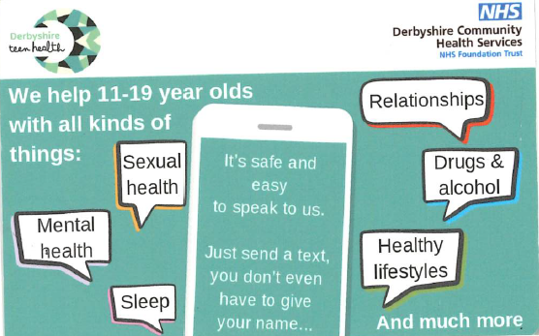
Keeping Safe in the Community
Useful Acronyms & Vocabulary
My Concern – Safeguarding record system (safeguarding and child protection software for schools used at WGES).
E-cigarettes: E-cigarettes are electronic devices that heat a liquid and produce an aerosol, or mix of small particles in the air.
E-cigarettes come in many shapes and sizes. Most have a battery, a heating element, and a place to hold a liquid.
E-cigarettes are known by many different names. They are sometimes called “e-cigs,” “e-hookahs,” “mods,” “vape pens,” “vapes,” “tank systems,” and “electronic nicotine delivery systems (ENDS).”
Using an e-cigarette is sometimes called “vaping.”
Advice for parents – Vaping
Visit Kids Health for more advice https://kidshealth.org/en/parents/e-cigarettes.html
How to support your child with peer group pressure and the need to ‘fit in’. Visit childline
https://www.childline.org.uk/info-advice/friends-relationships-sex/friends/peer-pressure/
Further advice about managing peer group pressure can be found on the CBBC website.
https://www.bbc.co.uk/cbbc/joinin/handling-peer-pressure
The Dangers of Vaping – proactive, preventative actions.
Vapes are a particularly pernicious problem since they are highly addictive and easily accessible. Their small size and their lack of odour also make them harder to spot (at least the lingering smell of tobacco made it obvious when a cigarette had been smoked). In a recent Action on Smoking and Health Smokefree GB Youth Survey 2023 of 11- to 17-year-olds, 2 out of 5 young people said they smoke vapes “just to give it a try” and about 1 in 5 because “other people use them, so I join in”.
We understand that As parents, you may feel that sharing information about vaping at primary school level is not always appropriate. However, although our children are carefully protected and nurtured in these early years, they will very soon transition to secondary school, where they will encounter a wider range of social influences. Vaping is a real and growing issue in secondary schools, and it is important that children are equipped with age-appropriate knowledge to help them make safe and informed choices.
Last week, the Derbyshire School Nursing Team visited our Year 6 pupils to provide clear, age-appropriate information about vaping, including the potential risks and the importance of making healthy choices.
We believe that working in partnership with families to raise awareness, at an age-appropriate level, helps prepare pupils for the challenges they may face as they grow older. Small, timely conversations can make a big difference in supporting children to stay safe and make positive choices.
If you would like further advice or support, the Derbyshire School Nursing Team can be contacted via their Single Point of Access on 01246 515100 or through their website, where you can find helpful guidance and resources for parents.
Here is some advice to bear in mind to help prevent children from vaping:
The most important way in which schools can support parents and children is by providing information and strategies so that both parties feel empowered to avoid and deal with potential threats.
Start early conversations
Begin discussing the risks and dangers of vaping with your children at an age-appropriate level. Teach them about the harmful effects of nicotine and the potential health consequences associated with vaping.
Educate your children about marketing tactics
Make your children aware of the marketing tactics used by vape companies to target young people. Teach them to critically analyse advertisements and recognise manipulative tactics.
Be a positive role model
Set a good example by not vaping or using any tobacco or nicotine products yourself. Children are more likely to adopt healthy behaviours when they see them modelled by trusted adults.
Build a strong parent-child relationship
Foster open lines of communication with your children. Create a safe and non-judgmental space where they feel comfortable discussing their thoughts, concerns, and peer pressures related to vaping.
Teach refusal skills
Role-play different scenarios with your child to help them develop assertiveness and practice saying no to peer pressure. Help them come up with strategies to navigate social situations where vaping may be present.
Encourage healthy coping mechanisms
Teach your child healthy ways to cope with stress or peer pressure that do not involve vaping. Encourage activities like sports, hobbies, art, music, or spending time with friends who share similar values.
Seek professional help if needed
If you suspect your child is already vaping or struggling with nicotine addiction, seek professional help. Talk to their doctor who can provide guidance and support. Remember, prevention is key, and ongoing communication is crucial. By educating children about the dangers of vaping, fostering a strong parent-child relationship, and promoting healthy choices, you play a vital role in preventing your child from starting vaping.

Slide 6

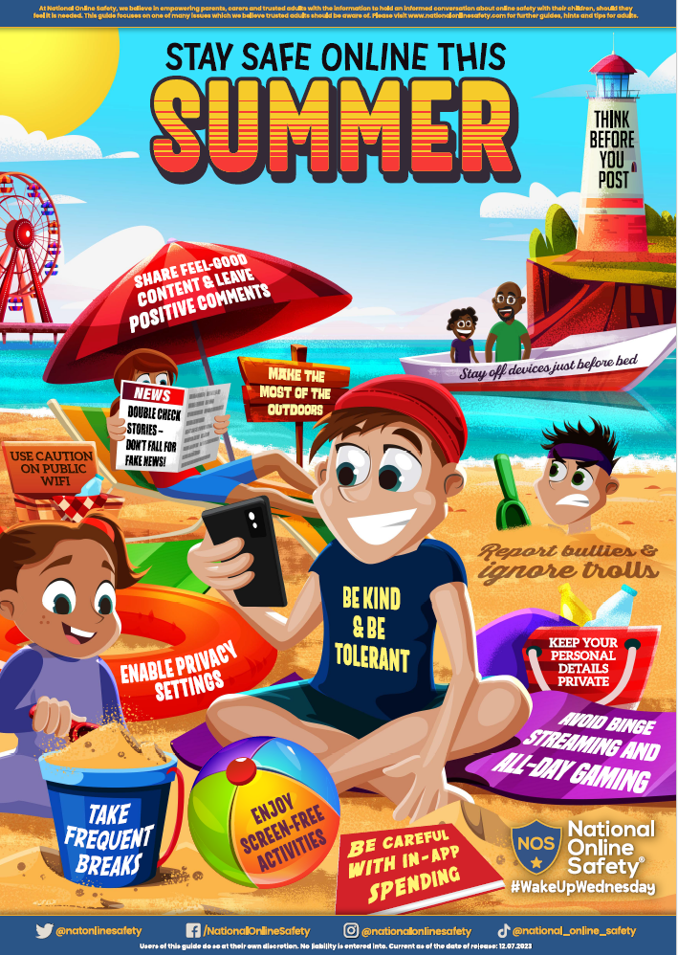
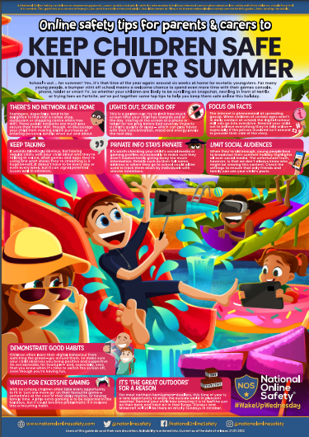


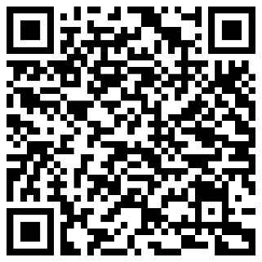
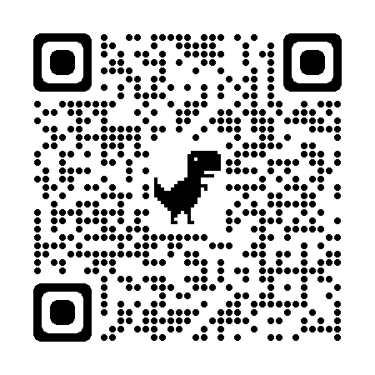
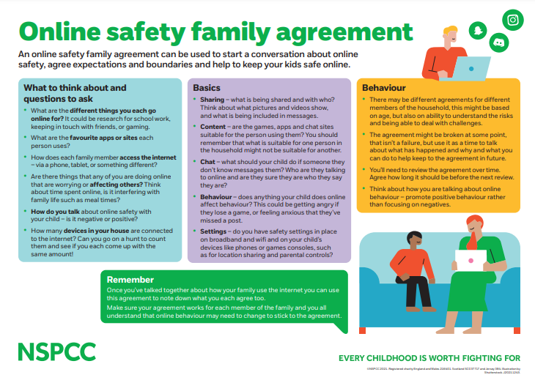

Keeping safe online
Useful Acronyms & Vocabulary
My Concern – Safeguarding record system (safeguarding and child protection software for schools used at WGES).
CEOP: Child Exploitation and On-line Protection Centre
https://www.thinkuknow.co.uk/parents/
Online Safety
Information at WGES
We have a wealth of information on our school website for parents to access.
Please visit https://www.williamgilbertend.derbyshire.sch.uk/staying-safe-on-the-internet/
Or scan the QR code below
-
Help manage what they see and do online
Parental controls and privacy settings can help you manage how your child spends time online and help to keep them safe.
Device settings – manage things like location sharing, screen time and in-app purchases. Most tech and gaming companies have dedicated pages to support with setting these up.
App or game settings – in-app tools that can help to keep your child’s account private and manage who they’re talking to. You can normally find information on these in account settings or directly on the platforms website.
Mobile or network provider settings – help to manage browsing access and stop your child from visiting inappropriate sites or downloading apps that aren’t suitable. Contact your mobile or broadband provider for more information about setting this up.
Summertime, Screentime
Summertime presents us with opportunities for important conversations with children and young people about healthy habits, what they enjoy doing online, and how we can help them to be safer on digital platforms.
National College ~ Free Online Safety guides for parents
As a school we subscribe to the National College. Here parents can access a wealth of online safety resources. These National College online safety guides focuses on staying safe online this summer. It highlights a number of tips such as reporting inappropriate behaviour online, making time for other hobbies and not giving out personal information. To access the National College, follow the link or scan the QR code opposite.
Signing up to the National College platform is simple. Just follow https://nationalcollege.com/enrol/william-gilbert-endowed-church-of-england-primary-school and complete your details. Once you’re set up, you’ll be able to choose ‘Parent/Carer’ as your user type and get instant access to all training and resources.
Create an online safety family agreement
Use resources on the NSPCC website. They have created resources to help your family talk about online safety. Find their top tips for helping to keep your child safe online. Have fun finding out how much your family already knows with their quiz. Consider creating an online safety family agreement to help keep your whole family safe online. Visit https://www.nspcc.org.uk/keeping-children-safe/online-safety/talking-child-online-safety/
Visit Google’s Interland to play fun games as a family to be internet awesome
https://beinternetawesome.withgoogle.com/en_us/interland

