Slide 1

Year 2
Notes:
Change to your year group

Slide 2
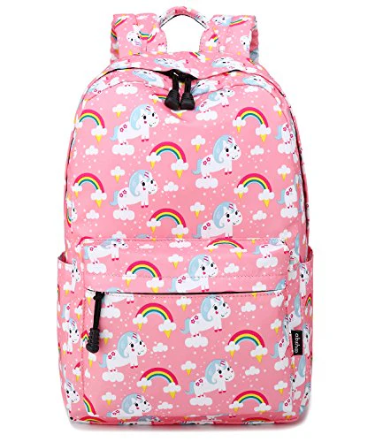
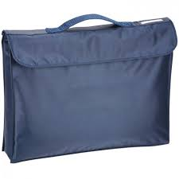





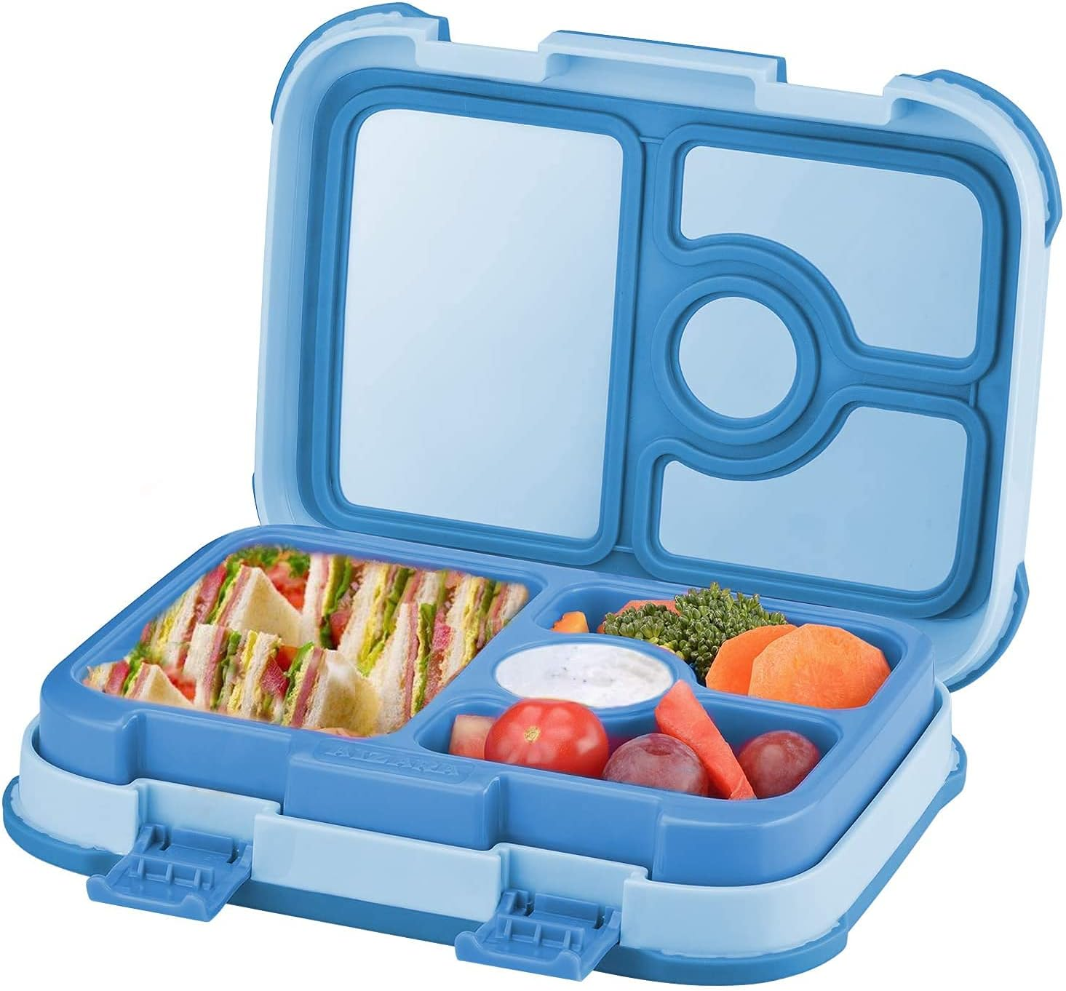
What to bring to school?
Please name all your child’s belongings
please ensure your child brings their:
school bag
book bag (reading book and yellow diary)
Waterproof coat
water bottle (filled with water)
healthy snack (we do provide fruit snacks in year 2)
lunch box if needed
Notes:
Add info:
Coats
Water bottles- filled with water not juice
Snacks- please push healthy snacks
Bookbags/ reading books
PE kits- if kept in school
PLEASE NAME EVERYTHING

Slide 3
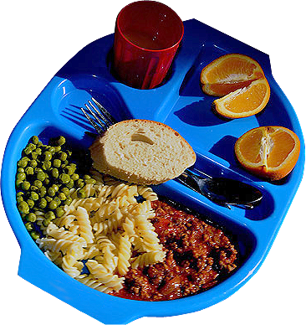
School dinners
If your child is having school dinners, please make sure they know what they are having before they arrive at school.
These are free for children in year 2
Please collect a menu from below
Notes:
Add info:
Coats
Water bottles- filled with water not juice
Snacks- please push healthy snacks
Bookbags/ reading books
PE kits- if kept in school

Slide 4



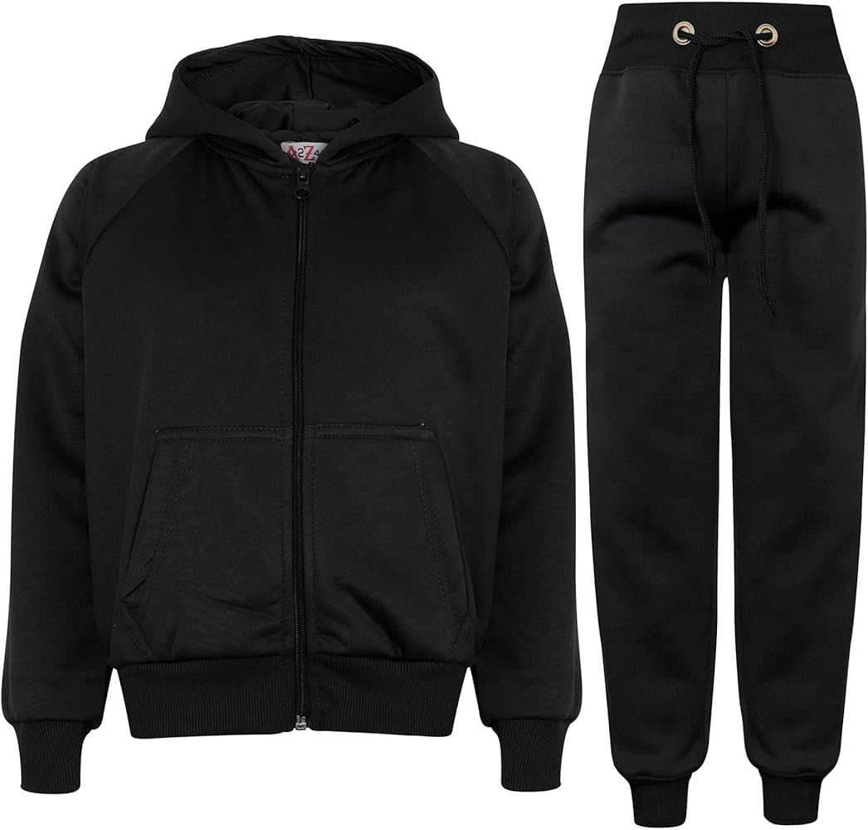
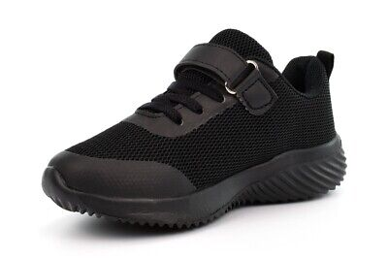
PE- days/ kit arrangement
Our PE days are Tuesday and Thursday (we cannot always guarantee PE will be taught on these days )
Your child’s PE kit is kept in school in a suitable bag:
White t-shirt
Dark coloured shorts
Dark coloured tracksuit (for winter)
Trainers
Long hair should be tied up and earrings removed before coming to school.
Notes:
Add in info about your pe days- when?
Arrangements for PE kit- where its kept?
What kit: white t-shirt, dark coloured shorts, jogging bottoms/ dark coloured tracksuit (for winter), trainers

Slide 5

Reading
You will receive regular updates on Tapestry from your child’s reading teacher.
Your child should be reading at home for at least 15 minutes daily with an adult.
This should be recorded in their yellow reading diary (these are checked by the teachers weekly)
When reading with your child ask them questions about the text.
Your child will also bring home a library book for you to enjoy together.
Notes:
Have reading question sheets available
Expectation for reading- at least 15 minutes of reading at home daily
Most children should be quizzing once a week (change depending on your year group)
Parents can levels of children’s books at home- AR book finder
Discuss types of reading with children- listening to them (fluency), reading to them (developing love of reading) and reading/ asking questions (developing comprehension)

Slide 6


Sparx/ Spellings
You child has been placed into a spelling group- please practice these spellings at home.
We will test them weekly on these spellings (all spellings correct 3x they move on to the next group)
Sparx- all children have a login to Sparx maths for them to explore and play times table games- after Christmas this homework will become compulsory.
Notes:
Spelling lists available
Sparx weekly times table home work- set Friday 4pm and due following Friday 3pm
If homework is not completed at home, the children will complete this during their own time at school.

Slide 7
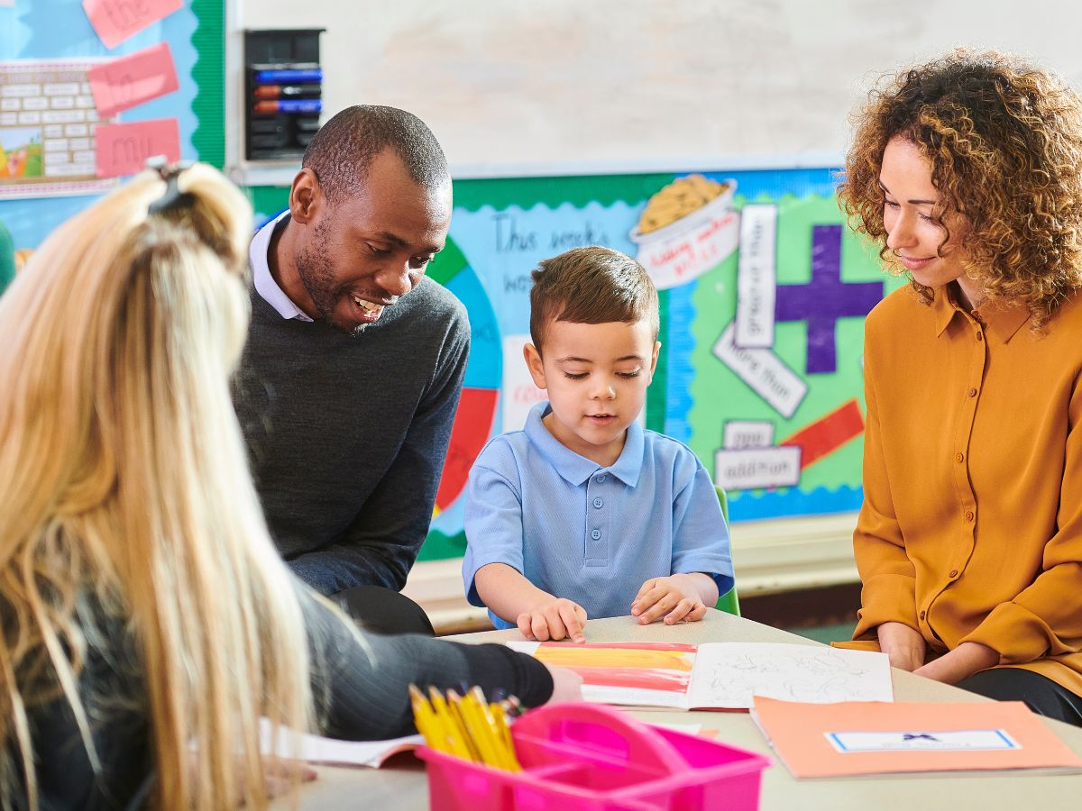
Events throughout the year
Open classrooms
Throughout the year we will be holding open classroom events so you can come and share your child’s learning with them.
Memorable experiences
Our memorable experiences include:
A trip to the zoo
Meeting important historical people
Christmas performance
Great Fire of London Day
Keep an eye on our school newsletter for dates
Notes:
Add in any memorable experiences- trips/ residentials (dates if known)
Open classrooms- mention these and that dates will follow- keep an eye on the newsletter

Slide 8
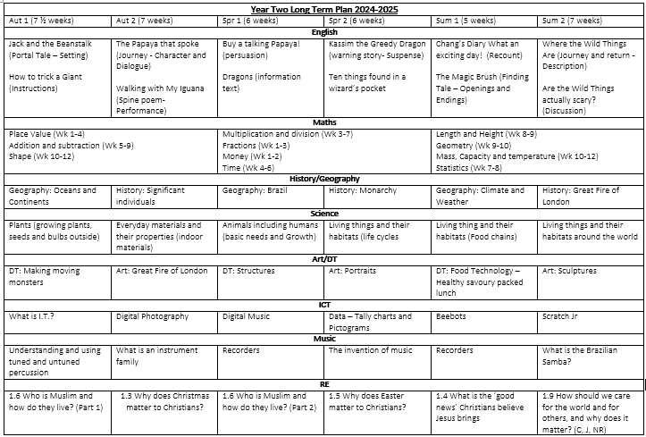
Long-Term Plan- year 2
Notes:
Add in LTP for year group

Slide 9
Any questions
Please contact your child’s teacher via tapestry (non-urgent/ non-confidential) or via email
Miss Mott
Katy.mott@kingsbridgeprimary.org.uk
Mrs Trembath
Caroline.trembath@kingsbridgeprimary.org.uk
We adopt an open-door policy in our classrooms, so please don’t hesitate to contact us or arrange to meet with us to discuss your child’s progress and wellbeing.
Notes:
Add in your teacher email address if you want to. Parents can directly email the office and they will forward it to you.

