Slide 1
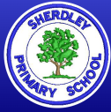
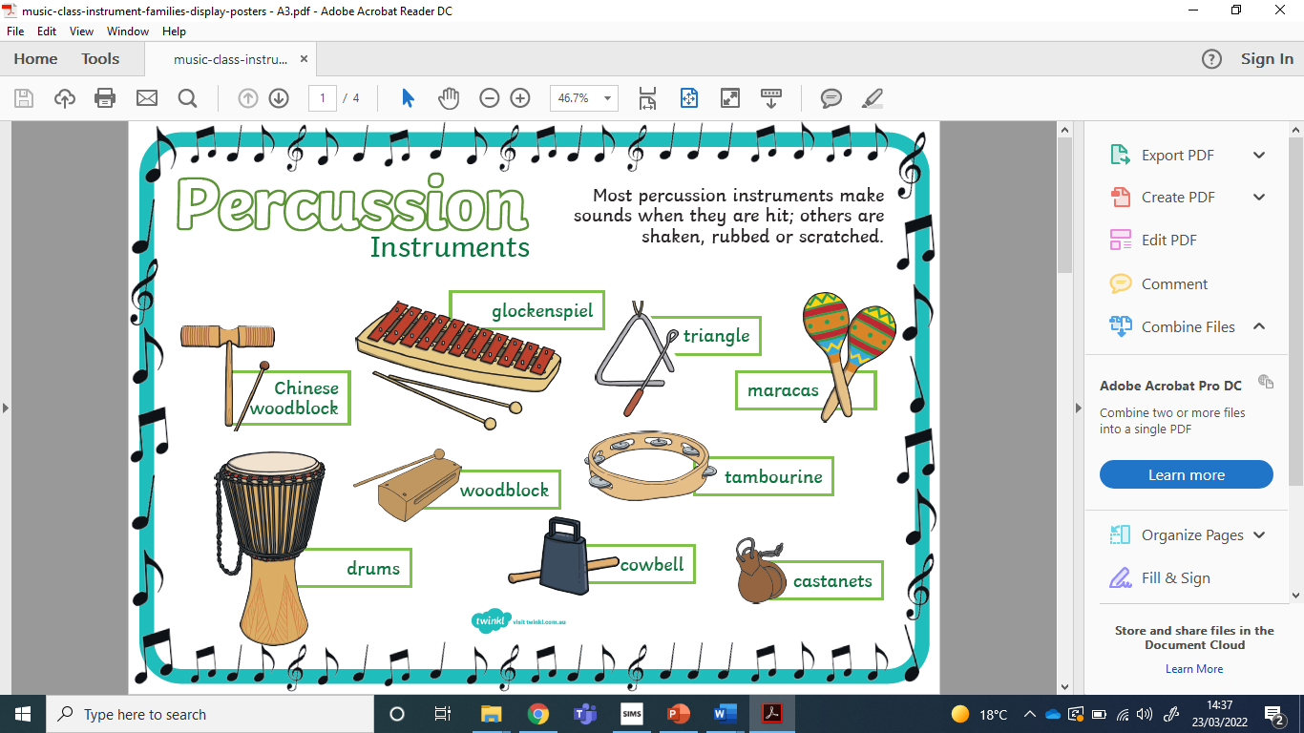
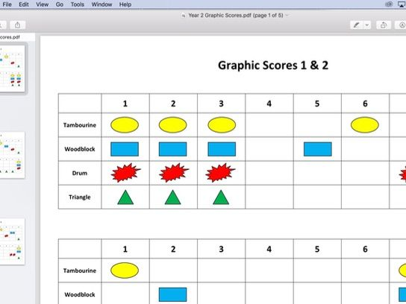
Music Knowledge Organiser – Year 1
Some Genres of Music
1 | Rock
2 | Pop
3 | Rhythm and Blues
4 | Classical
5 | World Music
6 | Jazz/Funk
7 | EDM (Dance)
8 | Rap/Hip-Hop
Which genres do you know?
Can you name any pieces of music and their genre?
Graphic Scores
Can you explain what this score shows? Can you create your own?
Key Vocabulary – can you explain each word to a partner?
1 | Pulse | the steady beat
2 | Rhythm | long and/or short notes
3 | Pitch | how high or low a note is
4 | Tempo | speed- is it fast, slow or somewhere in between?
5 | Dynamics | levels of sound – is it loud, soft or somewhere in between?

