Slide 1
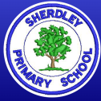
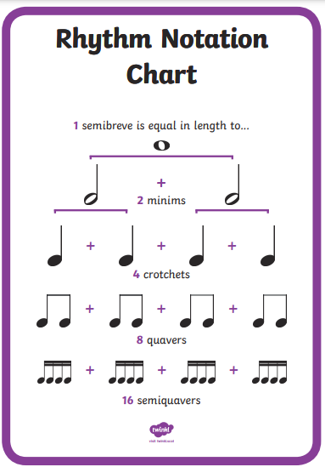
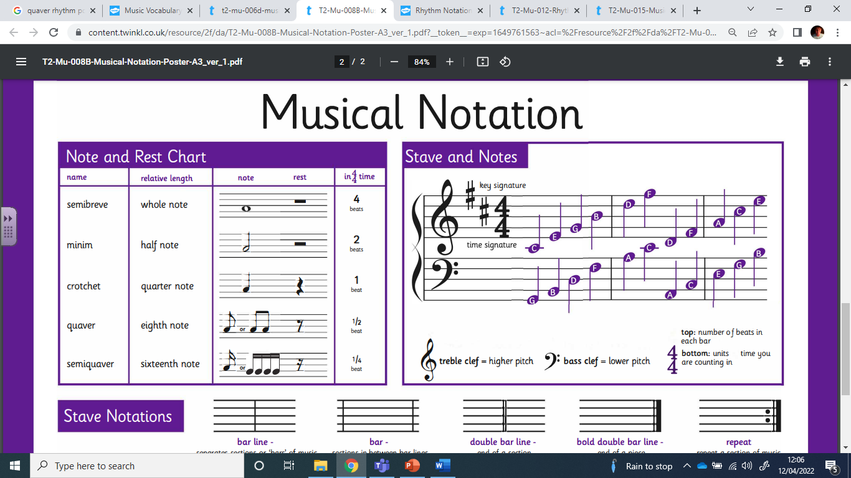
Music Knowledge Organiser – Year 3
Key Vocabulary – can you explain the definitions of each word?
Pulse | A steady beat. Does the beat change?
Rhythm | What types of notes do you hear? Crotchets/quavers? Are there any rests?
Pitch | How high or low a note is. How does this change in a piece of music?
Tempo | Speed the music is played at – fast or slow? Does this change?
Dynamics | Levels of sound. Use some of the vocabulary on the back to describe.
Timbre | The character of the sound – is it wooden, metallic, breathy?
Texture | How the different sounds and instruments work together. Thick or thin? How many layers can you hear?

Slide 2
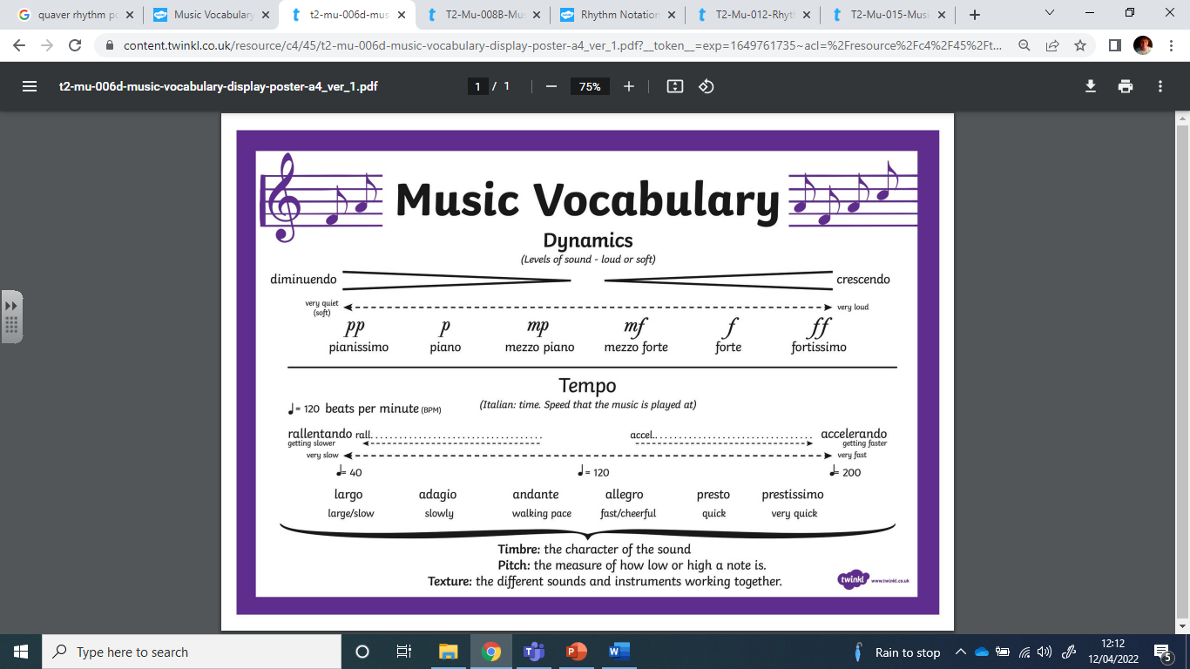
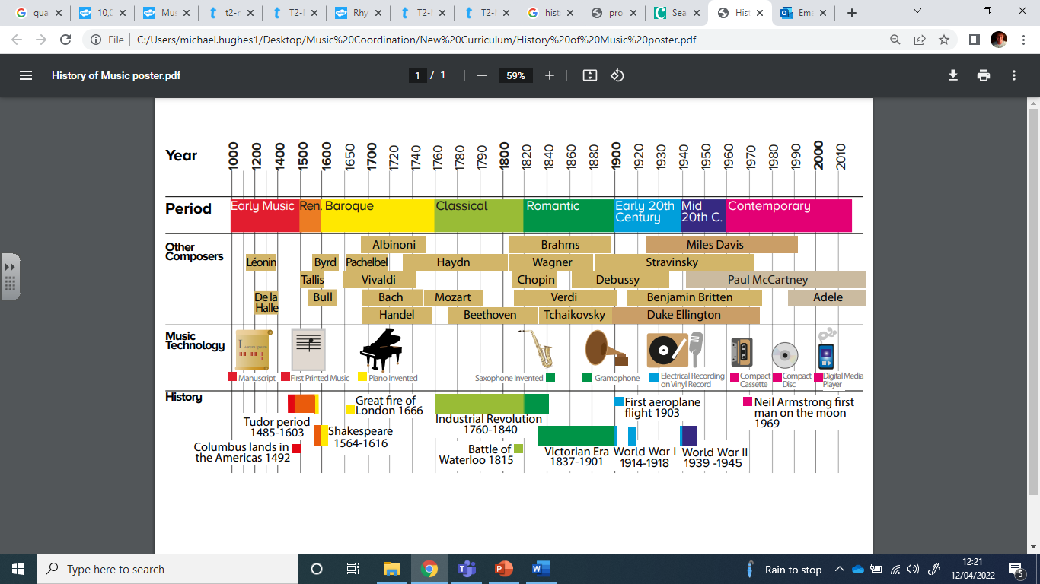
Music Knowledge Organiser – Year 3

