Slide 1

The abcDe of…
@Unicef/Fields
Notes:
Image: Unicef/Fields

Slide 2

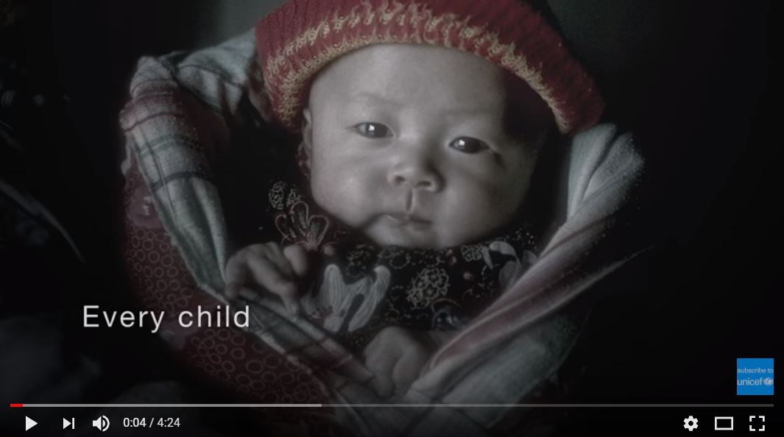
A: Rights are for ALL children
Key idea: Rights are for all children and young people across the world.
Key word: Universal
SPREAD THE MESSAGE THROUGH…
Assemblies
Pupils could use flags to help represent different countries within the United Nations. Form a ‘circle of flags’ to show how the UN works and demonstrate the universality of rights.
2. Curriculum links
Geography based topics involving comparisons between countries and how access to rights may vary.
Linking global based themes with particular rights such as exploring different foods from around the world linked to Article 24.
3. Pictures in displays
4. Videos
Notes:
Image: Unicef

Slide 3
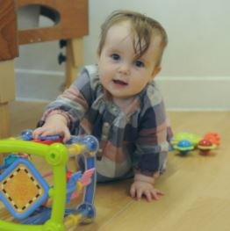
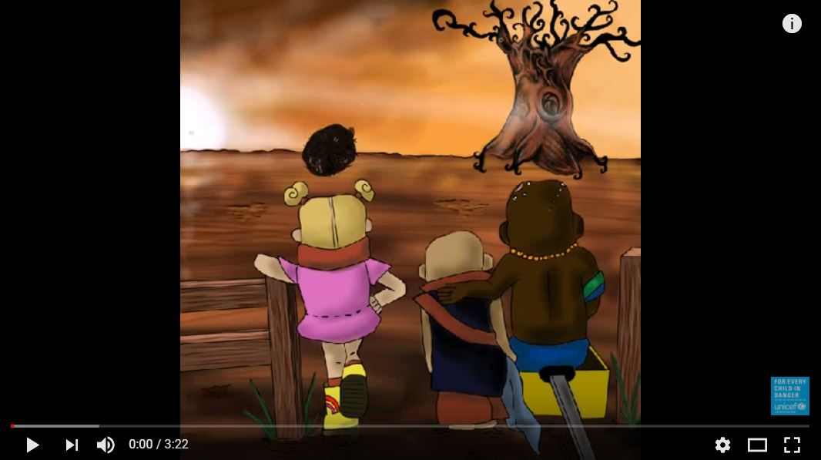
B: Rights are there at birth
Key idea: Humans are born with rights.
Key word: Inherent
SPREAD THE MESSAGE THROUGH…
Assemblies
A role play where pupils identify some of the rights such as the right to safety, health, shelter, nutritious food, clean water, which all humans have when they are born.
2. Curriculum links
Topics about how discrimination has been overcome, for example the civil rights movement.
Linking global themes with particular rights, like the right to be registered and have a name at birth with Article 7.
3. Pictures in displays
4. Videos
0 18
Unicef UK/Mead
Notes:
Image: Unicef UK/Mead

Slide 4


c: Rights CANNOT BE TAKEN AWAY
Key idea: Rights cannot be given, taken away, bought or sold
Key word: Inalienable
SPREAD THE MESSAGE THROUGH…
Assemblies
As part of anti-bullying week, a pupil led assembly can explore the effects that bullying has on an individual’s rights and their right to have these protected.
2. Curriculum links
Explore themes where children’s right have been denied. For example, in Victorian times, child evacuees during the second world war, in modern day conflict and in the local community as result of the impact of poverty. Explore stories, both fictional and factual, where rights have been denied.
3. Pictures in displays
4. RRSA Resources
In Search of Safety explores how the rights of child refugees have been affected by conflict.
Find out more.
Notes:
Image: Wiki Commons

Slide 5

D: Rights do not have to be earnt
Key idea: Rights do not come with any conditions attached and are not linked to responsibilities as they are not earnt.
Key word: Unconditional
SPREAD THE MESSAGE THROUGH…
Assemblies
Pupils could explore the ‘right to an education’ and how Malala Yousafzai has campaigned for girl’s right to an education and that governments are responsible for this.
2. Curriculum links
In PSHE, use class charters to explore the role of adults as duty bearers.
Link school events such as visitors from the emergency services, internet safety day and road safety training to the role of duty bearers.
3. Pictures in displays
4. Follow on activity
Write a song or poem about children’s rights.
Class discussion - what does ‘respecting everyone’s rights look like in our class?’
Notes:
Images: Unicef

Slide 6


E: All Rights Are equally important
Key idea: Every right is important in order for children and young people to survive, develop and reach their full potential. Rights are a whole package and are interlinked.
Key word: Indivisible
SPREAD THE MESSAGE THROUGH…
Assemblies
Build a picture on screen, piece by piece, and ask the children to guess what the final picture is. Pictures used could illustrate different rights such as the right to healthy food, clean water, to education. Emphasise the idea that all the pieces are needed to get the full picture - the same as with rights.
2. Curriculum links
In PSHE, use ‘wants and needs’ cards to identify ‘needs’ and then follow with an activity showing that all of these needs are required not just some.
Geography based topics showing how issues such as climate change or extreme poverty can affect a range of rights because they are often interconnected
3. Pictures in displays
4. Follow on activity
Create a school word cloud or collage of different rights to show how they are all important and promote through displays, newsletters and website.
Notes:
Image left: Wiki Commons
Image right: Unicef resources

Slide 7
Thank you
Notes:
Image: UnicefUK/Sutton-Hibbert

