Slide 1

Phase
2

Slide 2
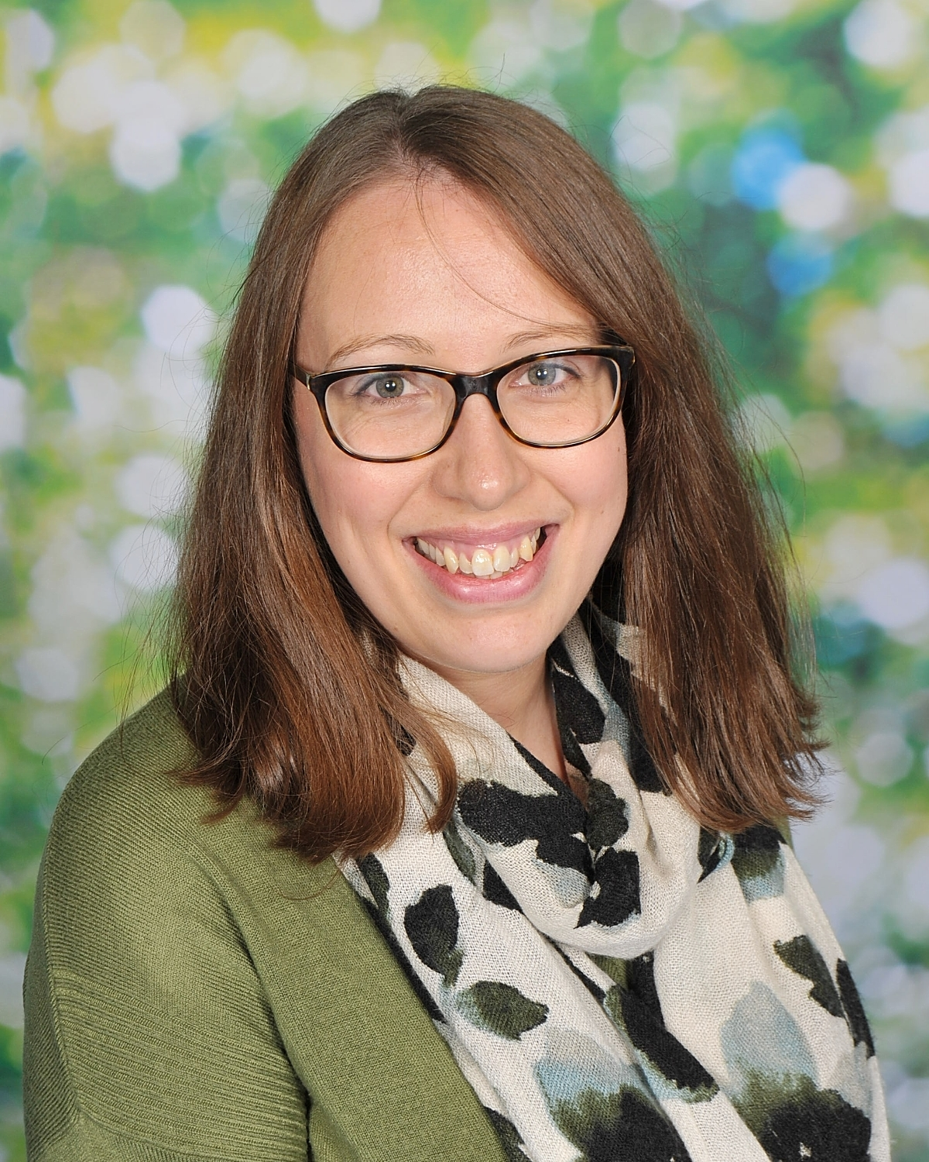
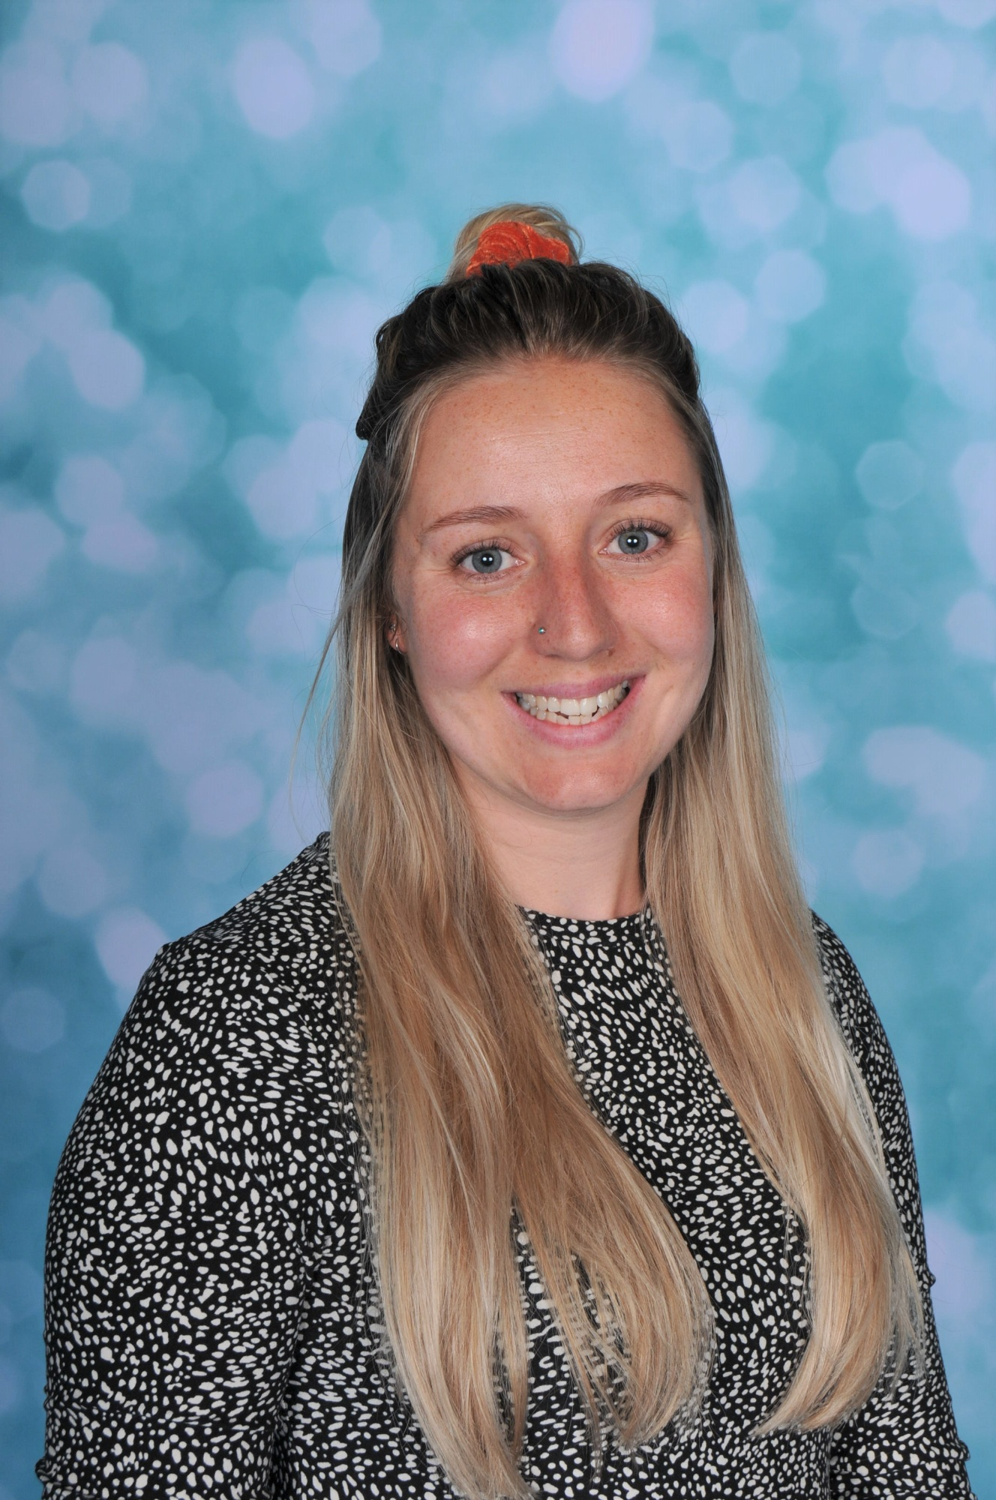
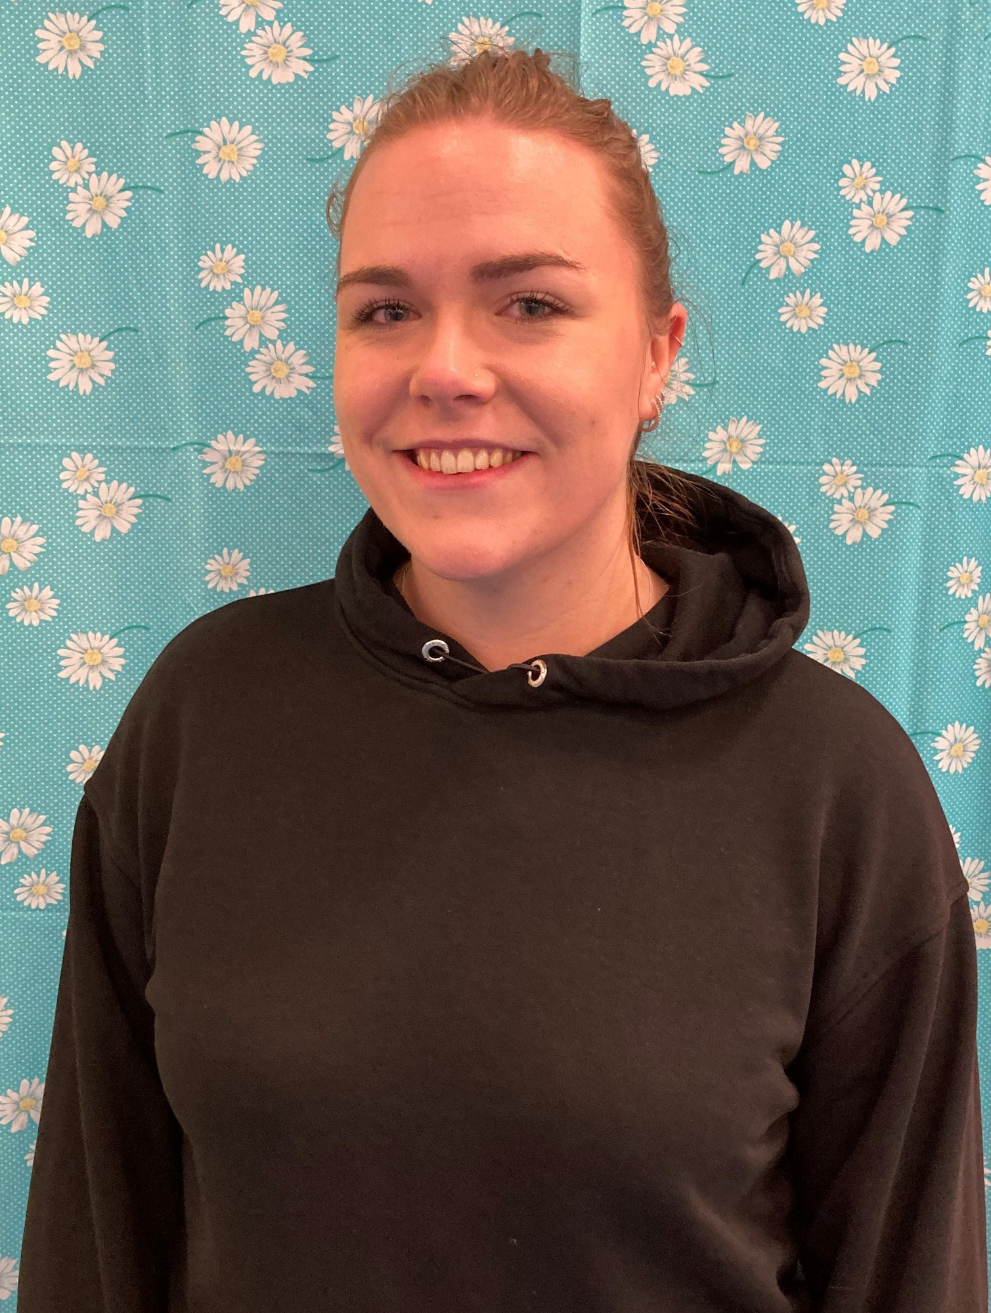
Staff structure
Head teacher- Mr Howells
Assistant head – Miss Martyn
SENDCO- Mrs Dudley
Phase leaders:
Phase 1: Miss Sullivan Phase 2: Miss Mott Phase 3: Miss Thom
Lead teacher for foundation and year 1
Lead teacher for year 2 and 3
Lead teacher for years 4, 5 and 6
Notes:
Introduce staff structure
Talk about our role/ experience in school
Who to contact- teachers, phase leader (if available), SLT
If you’d like our email please see the slide at the end

Slide 3


Tapestry and emailing
You will receive updates about your child’s learning and events within school via tapestry.
Please be aware that messages sent to your class teacher, on tapestry, can be viewed by any member of staff at school with a login to tapestry.
If you need to discuss a confidential or sensitive topic with your child’s class teacher, please email them or the admin team directly, who will pass the message onto your child’s teacher or alternatively talk to your child’s teacher in person.
If you cannot access tapestry or are unsure of an email, please contact the school admin team.
admin@kingsbridgeprimary.org.uk
Notes:
Discuss RWI/ Reading updates on tapestry
When emailing teacher’s, you may not receive a reply straight away as many teachers will reply within work hours (before or after school). As you can appreciate the school day is busy and we will often not reply during lunch/ break times.

Slide 4

Attendance
‘Attendance is the essential foundation to good outcomes’ Working together to improve school attendance DFE 2024
Registration in class opens at 8:50- 9:05
After 9:05 your child is registered as late
The register closes at 9:10. If your child arrives at school after this time, they must go to the office before going to their classroom.
If your child misses… | That equals at least… | Which is the same as around…. | And over 13 years of education that’s… | Or at least…
1 day a fortnight | 78 lessons per year | 4 whole school weeks per year | Nearly 1.5 whole years | 1014 lessons
1 day a week | 156 lessons per year | 8 whole school weeks per year | Over 2.5 whole years | 2028 lessons
2 days a week | 312 lessons per year | 16 whole school weeks per year | Over 5 whole years | 4056 lessons
3 days a week | 468 lessons per year | 23 whole school weeks per year | Nearly 8 whole years | 6084 lessons
Notes:
Understand that children are poorly/ medical needs
Touch upon missing day fortnightly

Slide 5
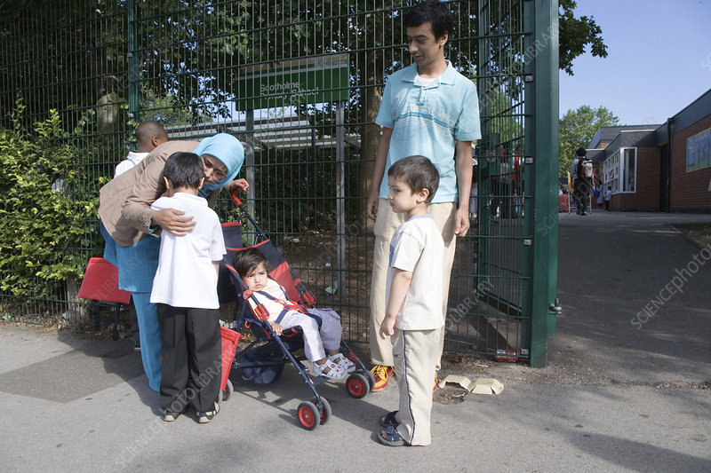
Arrive at school each morning
We aim to support all our pupils to develop confidence and independence from the moment they step through the school gates.
Please can we encourage you to say goodbye to your child at the gate.
Teachers will meet the pupils as they arrive in class and settle them into school.
The school environment can become incredibly busy when lots of parents and families are walking their children to their classrooms. This can be very overwhelming for our pupils.
Notes:
Understand that children are poorly/ medical needs
Touch upon missing day fortnightly

Slide 6

Reading
Reading the most important aspect of your child’s learning and is something we are all passionate about!
RWI- If your child is still learning their sounds through our RWI programme, they will have a RWI group of tapestry where you will receive regular updates. We will continue to assess the children’s reading progress each term.
Children in year two will begin to move onto our whole class reading programme and will be assessed each term. They will bring home book band books
Year 3 children will be assessed each term using AR STAR tests and will bring home a reading book within the ZPD range.
at least 15 minutes of daily reading at home.
Reading to your child is just as valuable throughout their primary years. Please continue to read out loud to your child.
Notes:
Check levels of children’s books at home- AR book finder
Discuss types of reading with children- listening to them (fluency), reading to them (developing love of reading) and reading/ asking questions (developing comprehension)

Slide 7

sparx
Children are set weekly compulsory times table homework on Sparx maths.
This is set on Fridays at 4pm and due the following Friday at 3pm.
The expectation is for the homework to be completed at home. If you have concerns around this, please contact your child’s teacher.
We celebrate Sparx achievements weekly in celebration assemblies.
Notes:
If homework is not completed at home, the children will complete this during their own time at school.

Slide 8
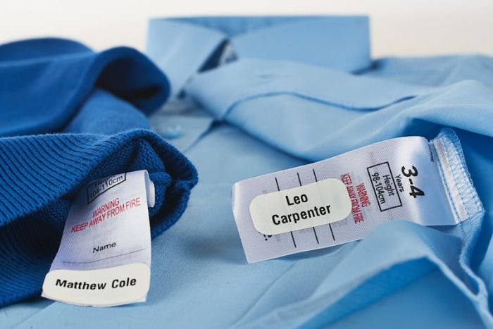
Reminder
Please can we remind you to label your child’s belongings.
We remind children to take all their belongings home and try our best to reunite owners with lost items.
Please check the lost property box (in the office) if your child has lost items.
If your child brings home items that don’t belong to them, please return them to school as soon as possible.

Slide 9
Phase 2 leader email
Katy.mott@kingsbridgeprimary.org.uk

