Slide 1
Bridgelea primary school gold evidence
Strand A

Slide 2
Strand a: Teaching and learning about rights evidence for outcome 1
Most children and young people are familiar with a wide range of Articles of the CRC.
Children are taught about a wide range of Articles.
We teach 10 key Articles explicitly (see additional powerpoint)
We teach the wider Articles cross curricular where appropriate. (see curriculum overview)
We teach assemblies linked to Rights weekly (see the calendars for each week)
Surveys and learning walks captured an improvement in the amount of Articles the children are aware of.

Slide 3
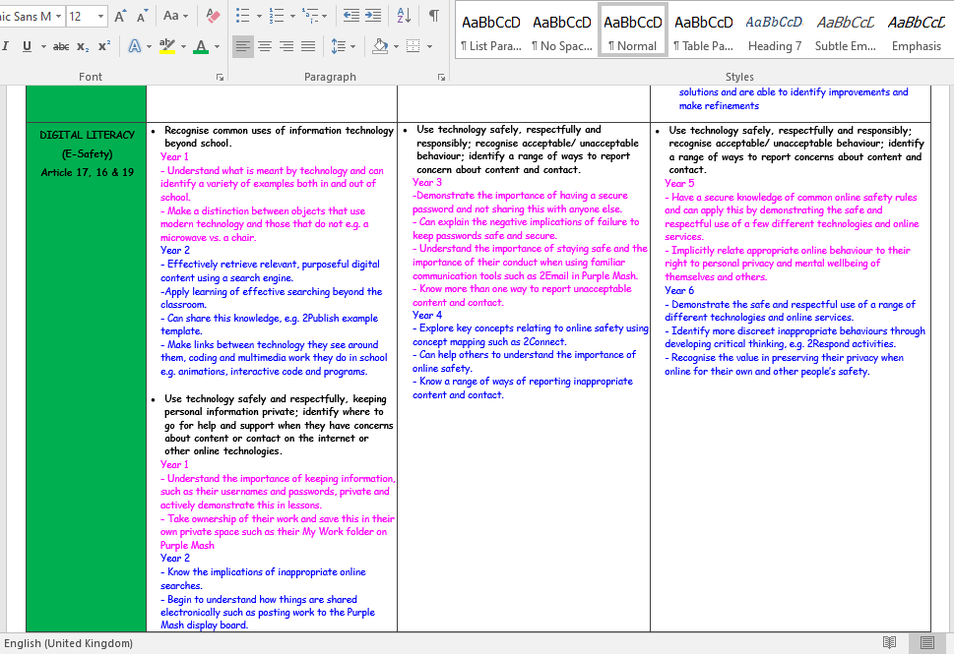
Strand a: Teaching and learning about rights evidence for outcome 1
Most children and young people are familiar with a wide range of Articles of the CRC.
We teach the wider Articles cross curricular where appropriate. (see curriculum overview)

Slide 4
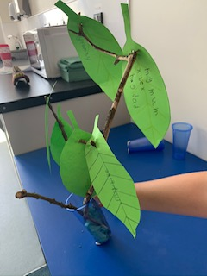
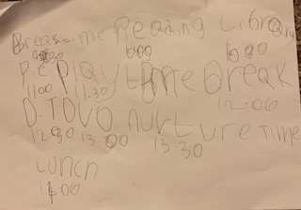
Strand a: Teaching and learning about rights evidence for outcome 1
Most children and young people are familiar with a wide range of Articles of the CRC.
Children are taught about a wide range of Articles. We have done Article of the Week activities during Lockdown. See below :
Article 28 : an ideal day in school

Slide 5
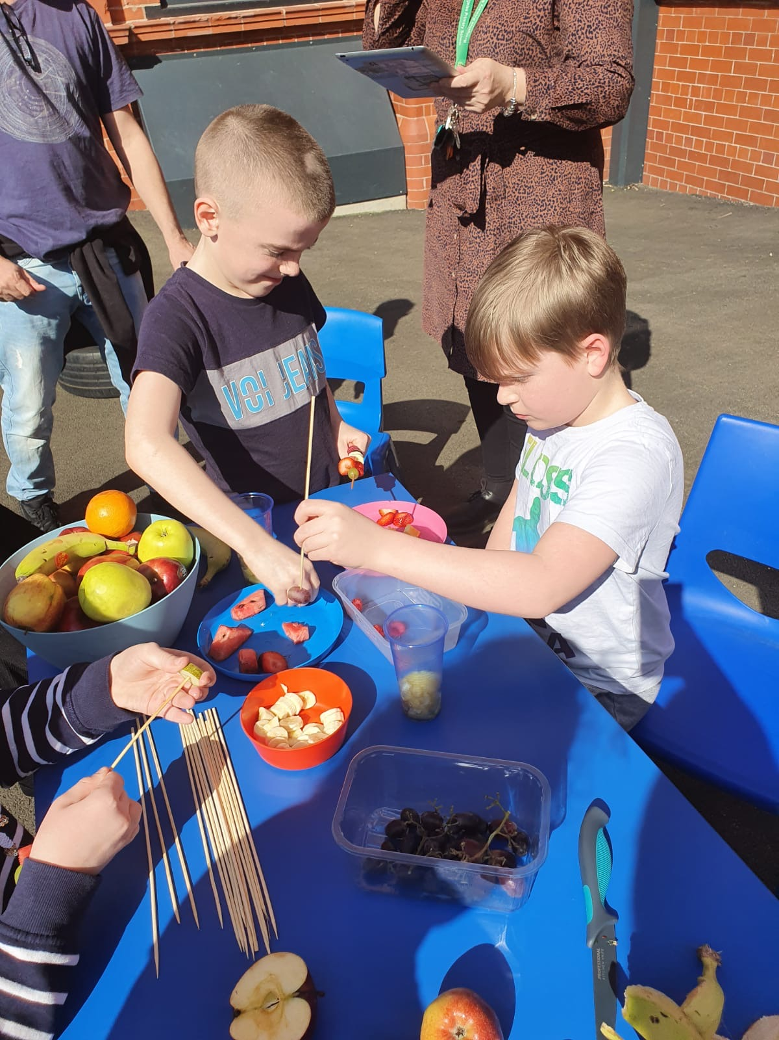
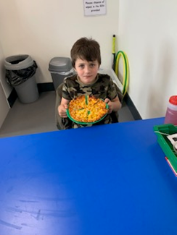
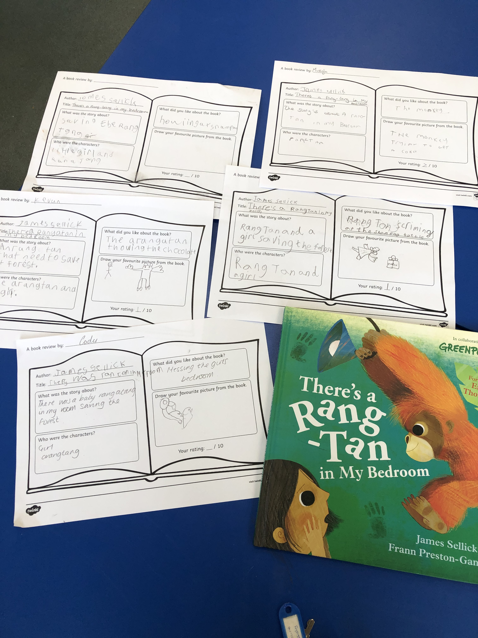
Strand a: Teaching and learning about rights evidence for outcome 1
Children learnt about healthy food and good quality food (Article 30).
During lockdown, they had a go at making home made recipes such as pizza, spaghetti, sandwiches.
They also made fruit kebabs.
To link to SDG the children learnt about where the food came from and talked about sustainable food. We linked this to the story “There’s a Rang tan in my bedroom.”

Slide 6
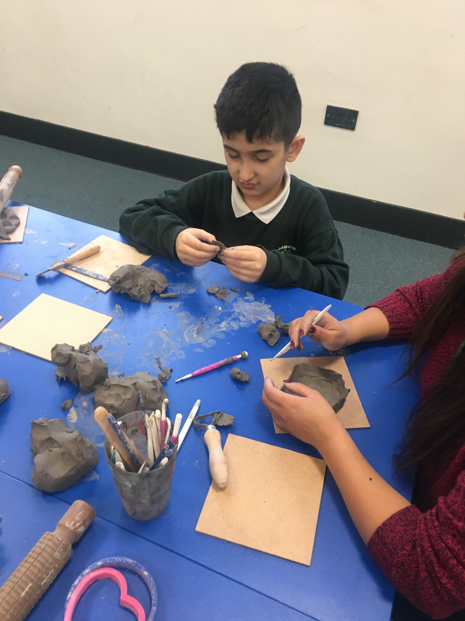
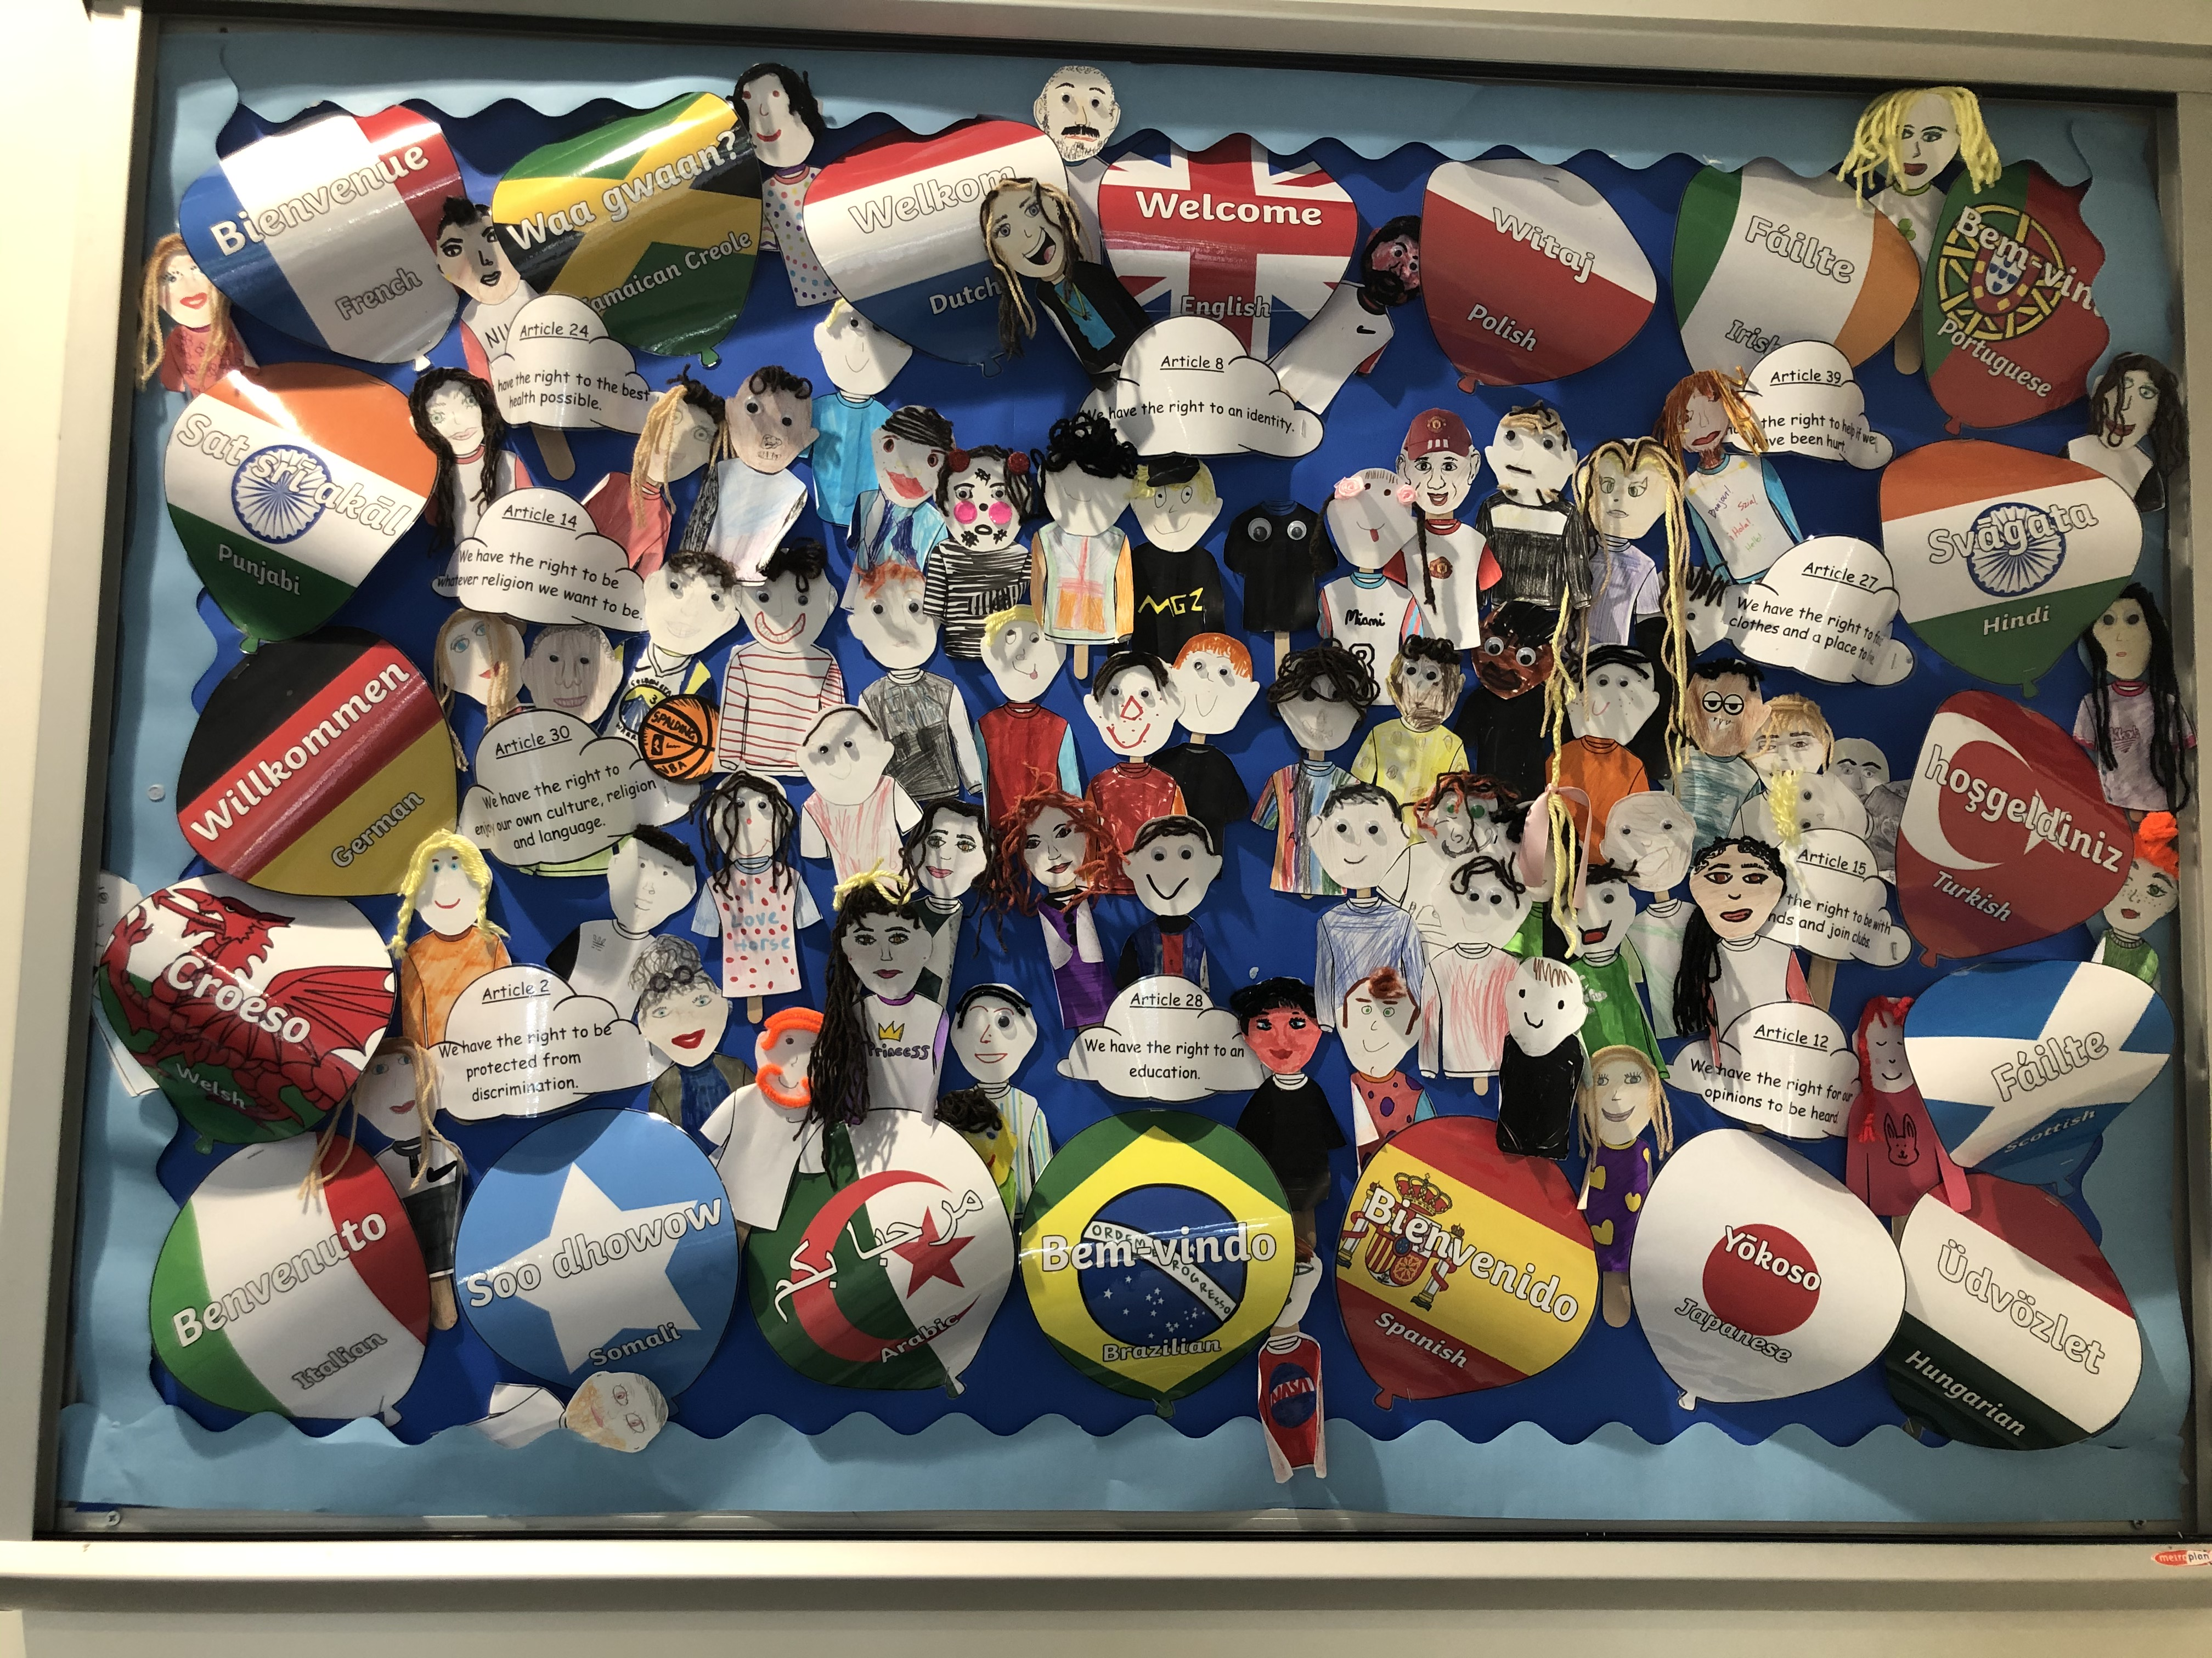
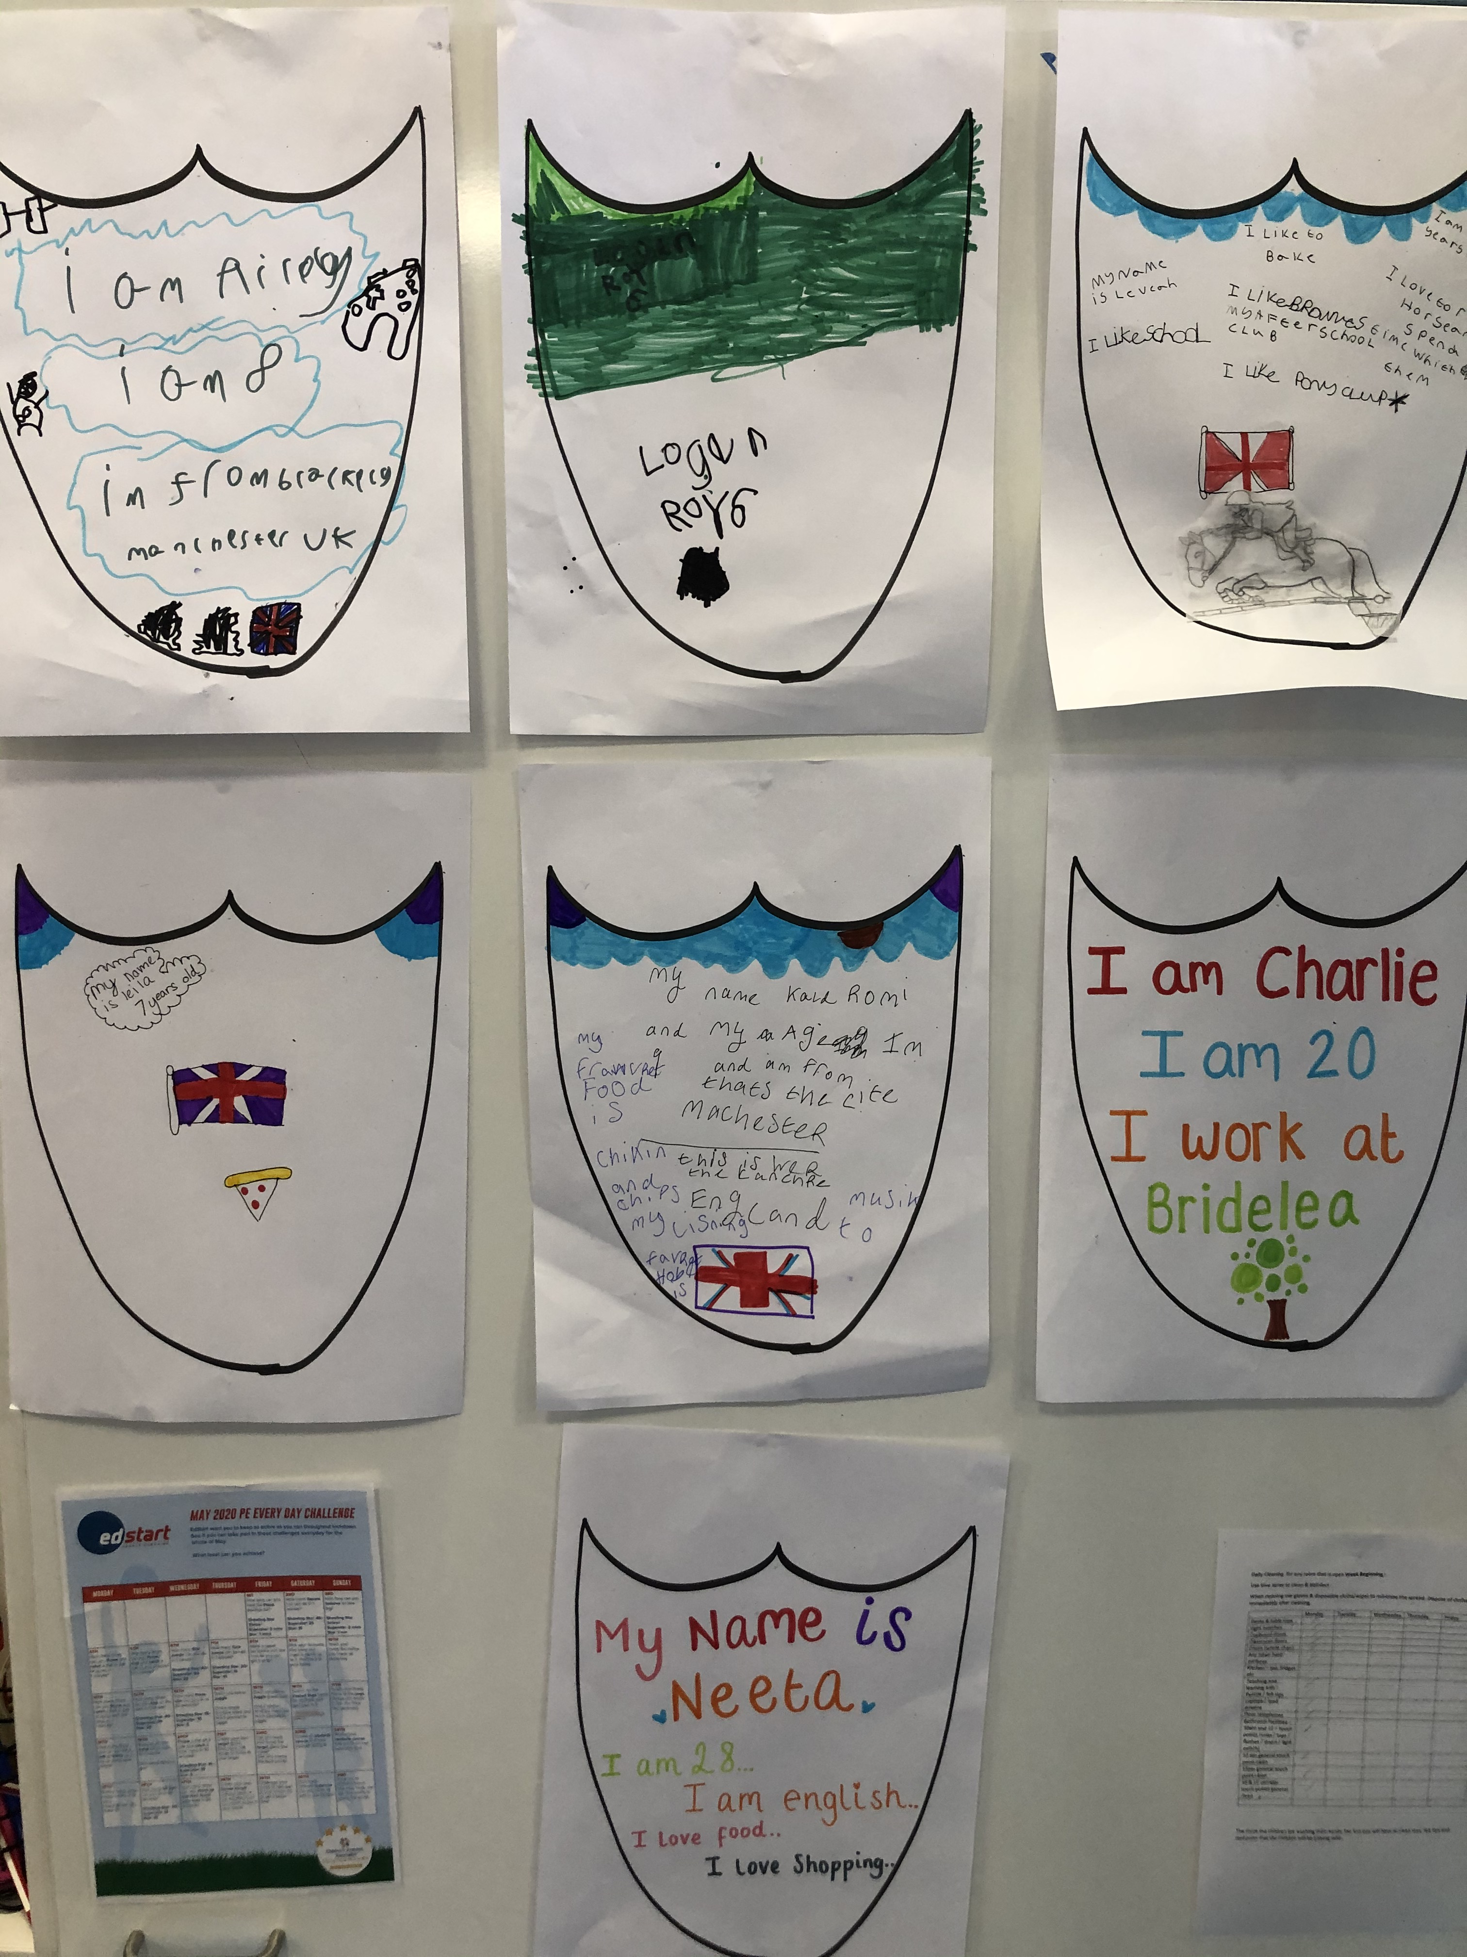
Strand a: Teaching and learning about rights evidence for outcome 1
For Article 7 the children completed some work on their identity. They made shields, first paper shields and then an image of themselves for our display.– these all went home before we got chance to take a picture!
With clay, the children made images of themselves.
They were able to discuss children all around the world and how some children may not have a right to a name or know their identity, especially when fleeing the war.

Slide 7
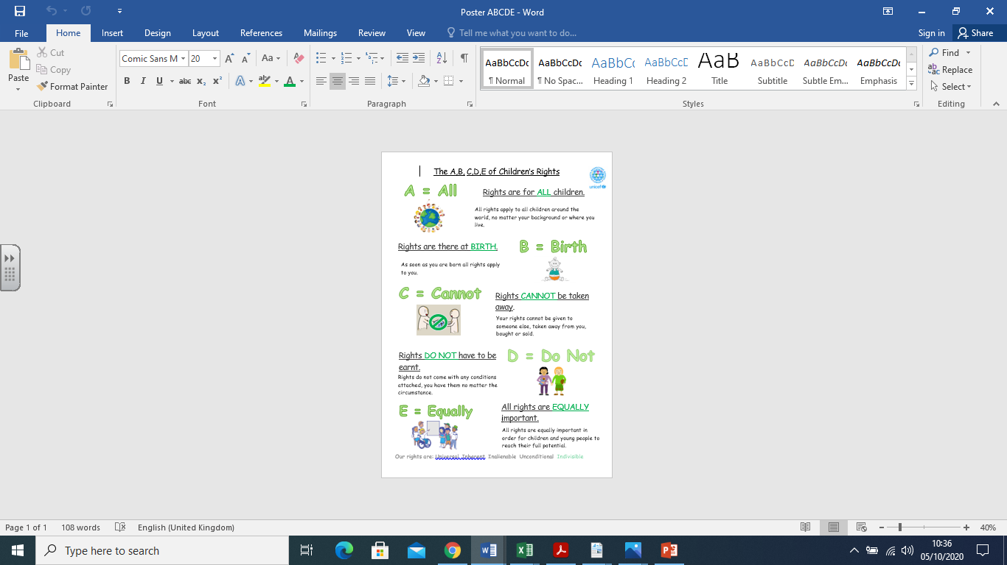
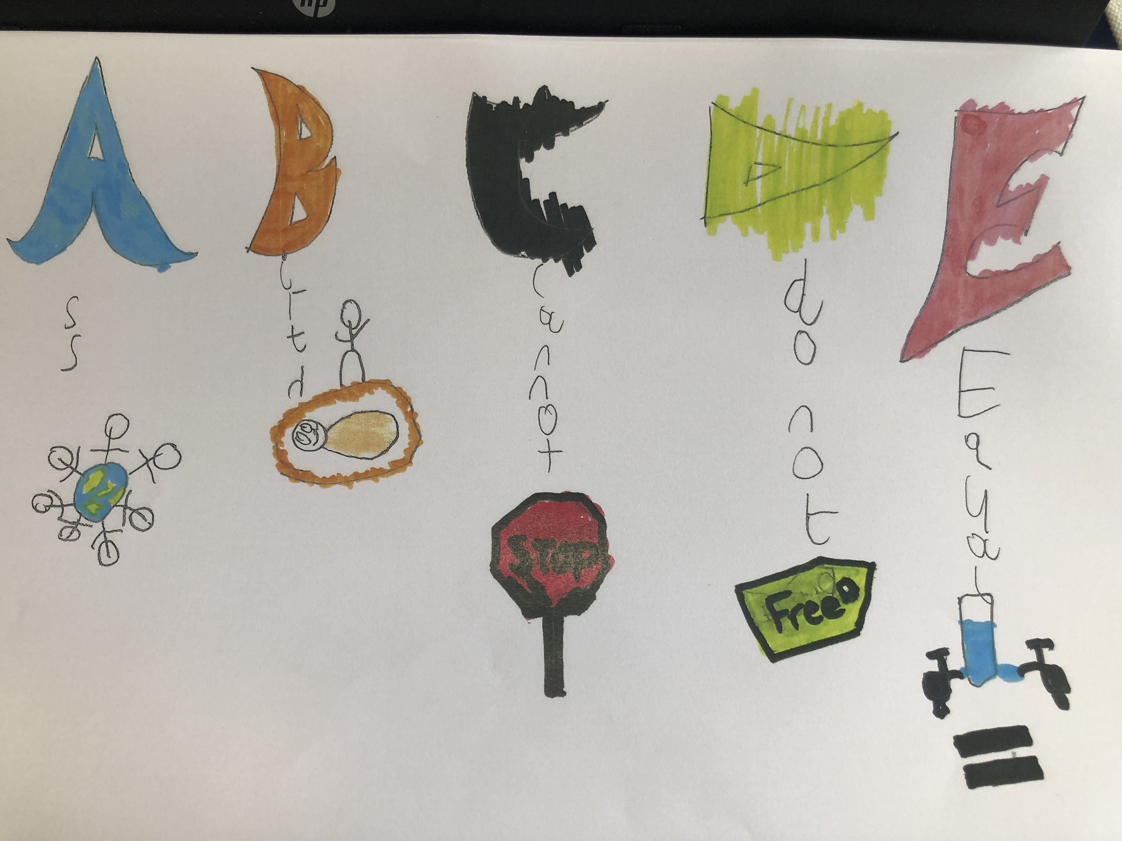
Strand A: Teaching and learning about rights evidence for outcome 1
They understand the concept of duty bearers and the concepts of rights being inherent, inalienable, indivisible, universal and unconditional
Children have made posters. Article 12 Squad made a video about ABCDE of Rights. The ABCDE of Rights are displayed in each classroom.

Slide 8
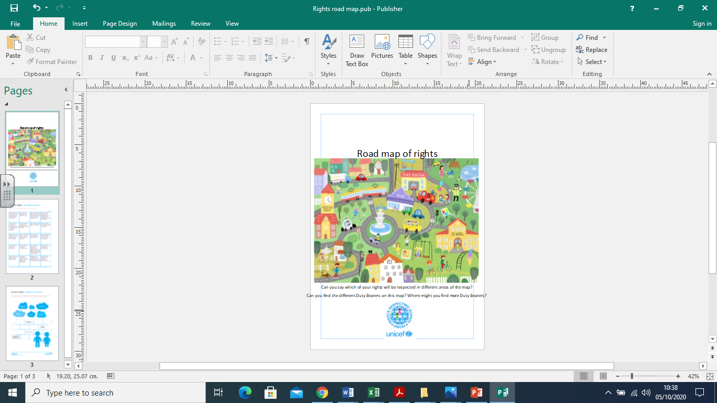
Strand A: Teaching and learning about rights evidence for outcome 1

