Slide 1
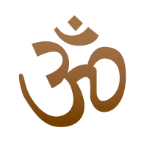
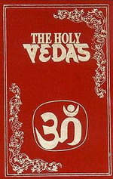
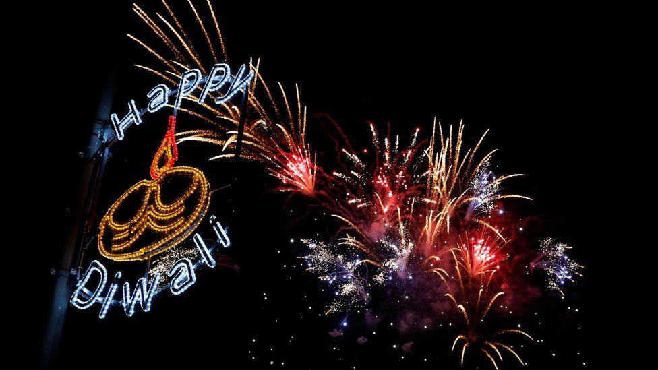
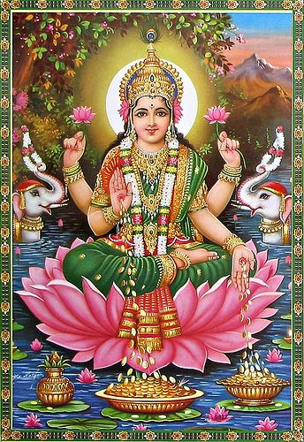
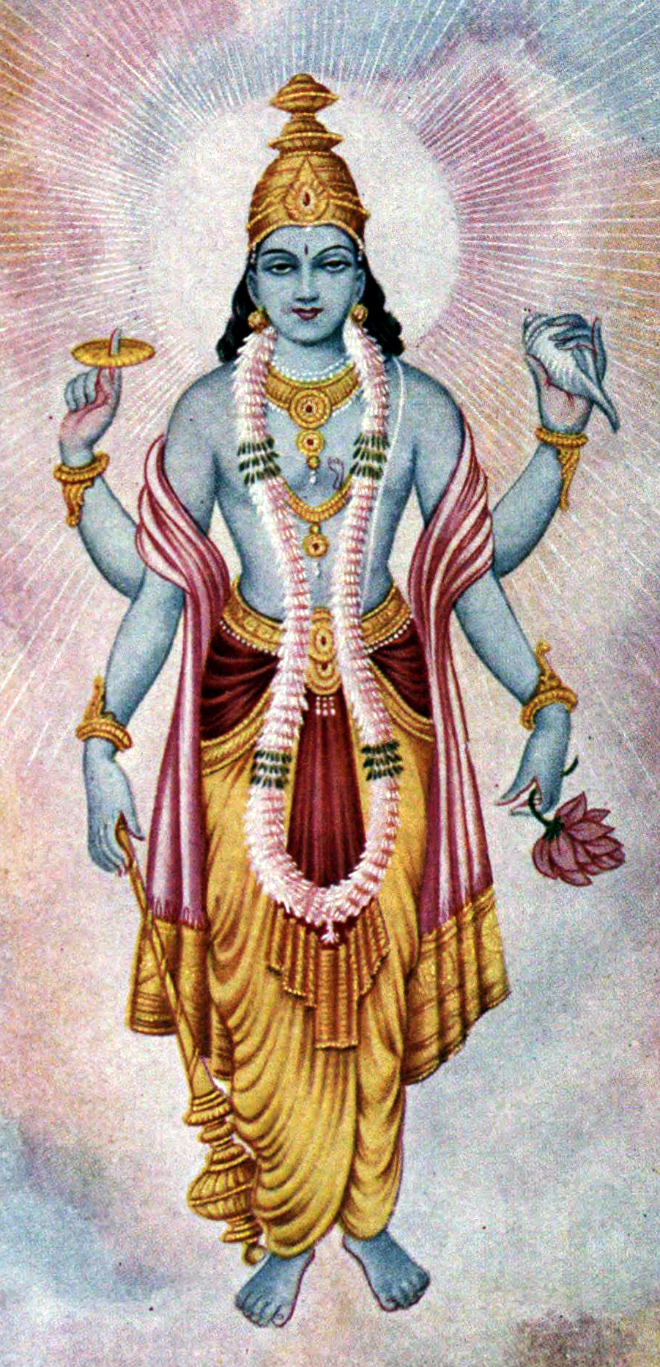
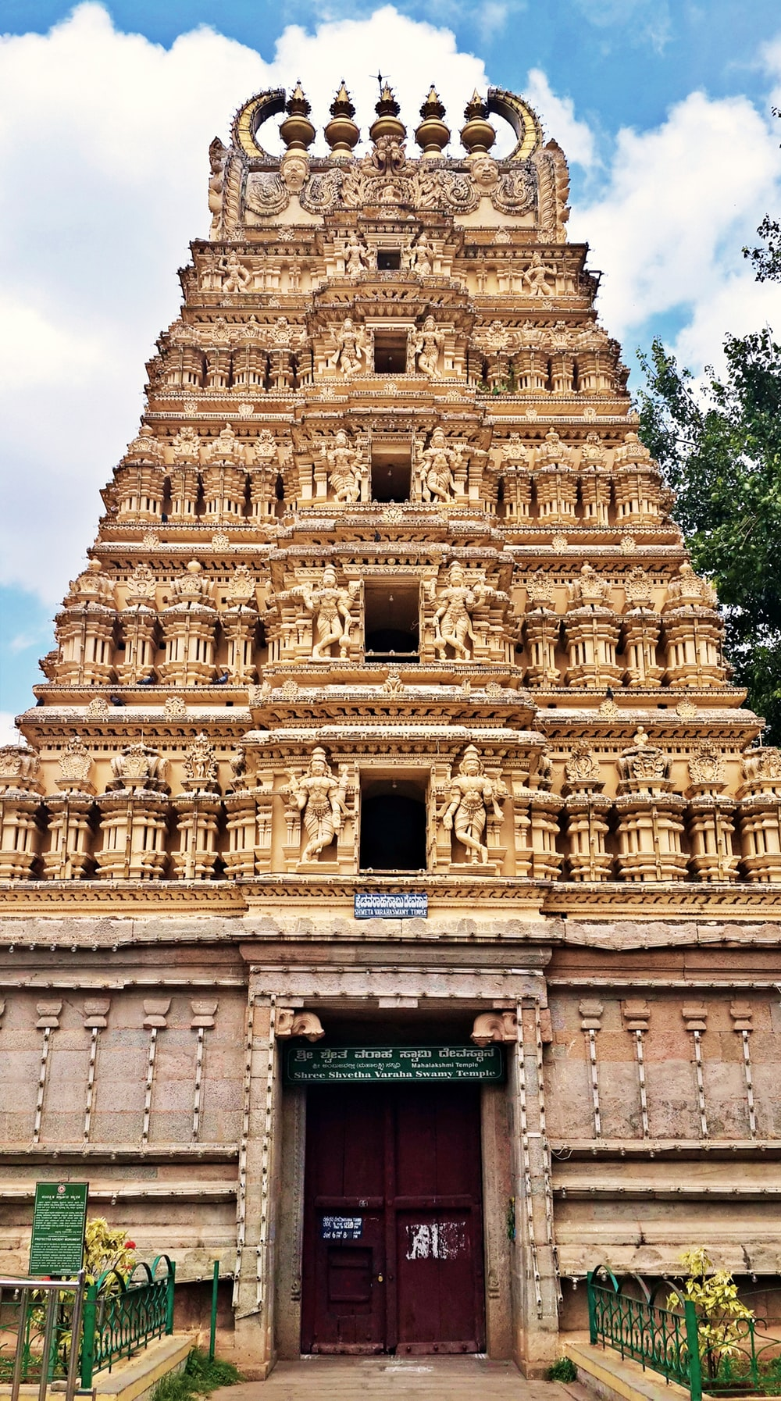
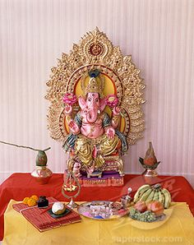
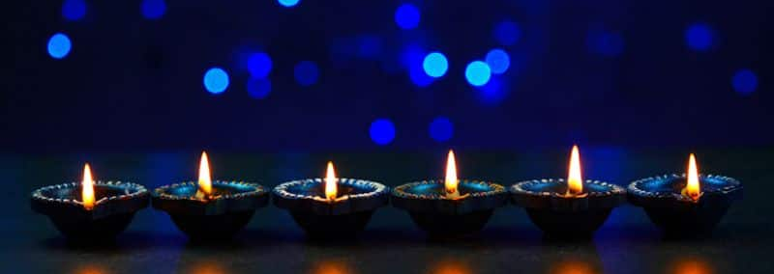
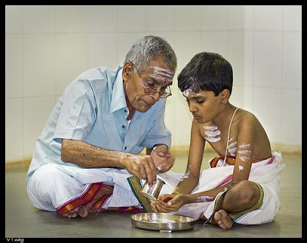
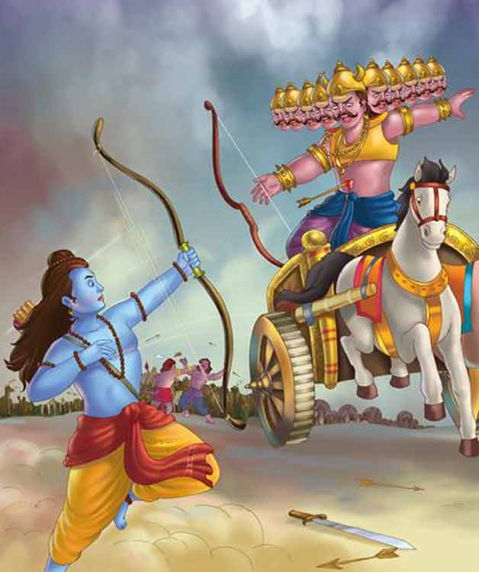
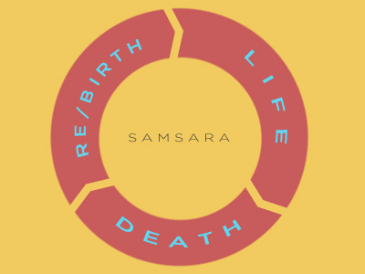
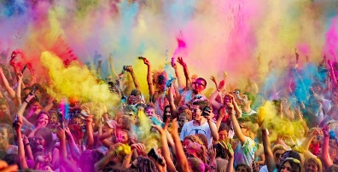
Vocabulary
Avatar – A deity (God) may appear in a different form.
Deity – A God
Holi – is a festival of colour
Hindu – a person who follows Hinduism
Karma – good deeds bring good things – doing bad things brings bad luck.
Krishna – a main deity who is an avatar of Vishnu
Reincarnation – after death the soul is reborn into another being.
Samsara – cycle of life, death and rebirth
Hinduism – Y5/6
Where Hinduism Began: India
Om symbol
Gods
One supreme being: Brahman
Popular Deities (Gods): Brahma, Vishnu, Shiva, Hanuman, Lakshmi, Ganesh.
Timeline of Hinduism compared to other religions
Sacred Text:
The Vedas
Hinduism Buddhism Islam
2000 BCE 590 BCE 0 610 CE
1500 BCE 33 CE 1500 CE
Judaism Christianity Sikhism
Main Festivals
Divali, Holi, Maha Shivaratri, Onam
Lakshmi–Goddess of wealth and purity.
Vishnu – is the preserver God he comes to earth in many forms (avatars) – the most famous avatar is Rama or Krishna.
Sacred Thread Ceremony
The Sacred Thread ceremony is when Hindu boys confirm they are of an age to take on religious responsibility and are presented with the special thread. Girls are sometimes honoured in the same way.
Diwali is a festival that celebrates a story of good winning over evil. Rama and Sita are the main characters. Prince Rama defeats the 10 headed demon Ravava.
Diwali is the five-day Festival of Lights, celebrated by millions of Hindus. They decorate their homes and give presents.
Places of Worship:
- The Mandir
- A shrine at home
Diva lamps for
Diwali time
Main Beliefs
Hindus believe in one supreme being (God) – Brahman who can appear in many forms known as deities (Gods). These deities can also appear as different avatars.
Dharma-right way of living
Reincarnation- Hindus believe that after death of the body the soul enters another living thing.
The cycle of Samsara – the cycle of life, death and rebirth.
Moksha-freeing of the soul from the cycle of death and rebirth.
Karma – Hindus believe in the law of Karma whereby if a person does good things then good things will happen to them. Also if a person does bad things then bad things may happen to them.
Sacred Thread ceremony – a young boy wearing his thread.
A home shrine containing one of the Hindu Gods ,Ganesh - he is remover of obstacles and God of wisdom.
Rama fighting the ten headed demon. (From the Diwali story.)
Hindu Temple is called a Mandir.
Four ashramas
These are four stages of life that some Hindus still live by. At each stage they are meant to do a list of things.
Brahmacharyya – A time for education
Grihasta – the household stage – sometimes they marry and have a family
Vanaprastha – the retired stage
Sannyasa – the renounced stage of priestly families.
Holi is a Hindu festival known as the festival of colour. Different colours symbolise different virtues of the soul, such as power, purity and love.
Holi festival – throwing paint at each other

