Slide 1

Meet the Teacher
September 2024

Slide 2

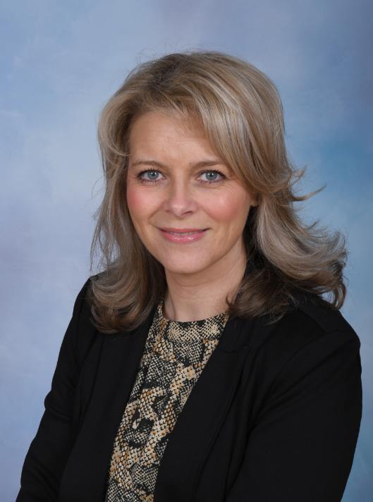
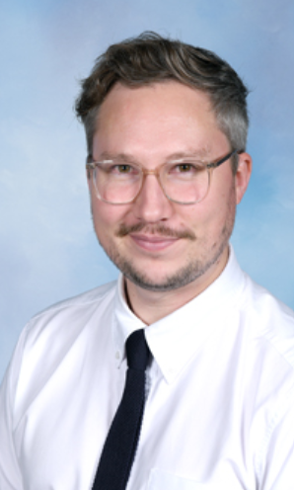
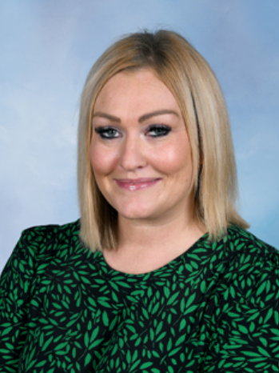
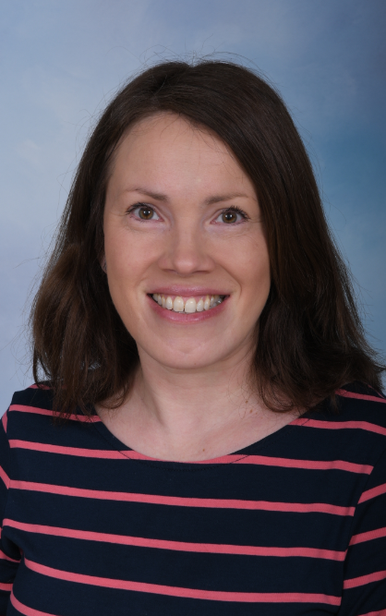
Sherdley SLT
Mrs Bennett
Acting Headteacher
Mrs Davies Mrs Stroud Mrs Fleming
Assistant Head Acting Deputy Head KS1 Lead
& SENCO

Slide 3
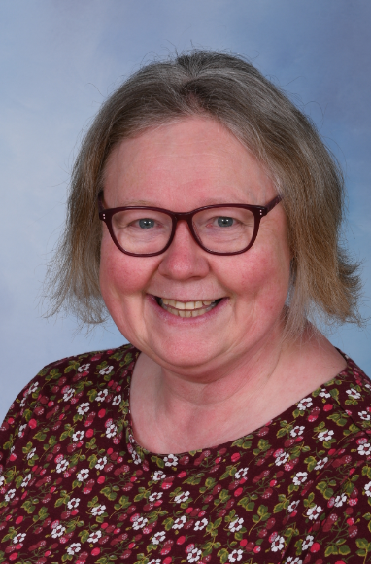
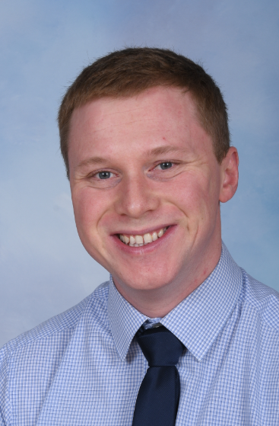
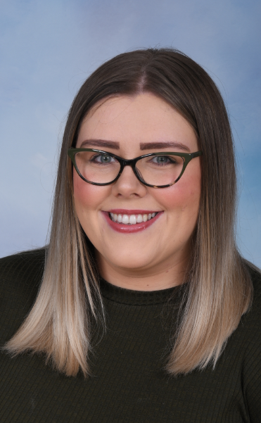
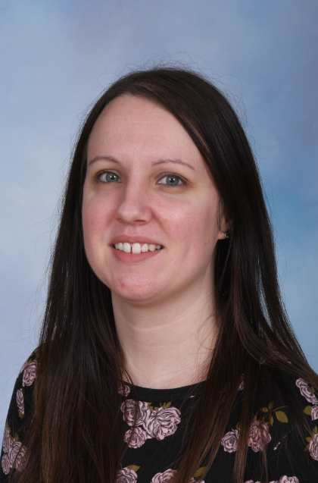
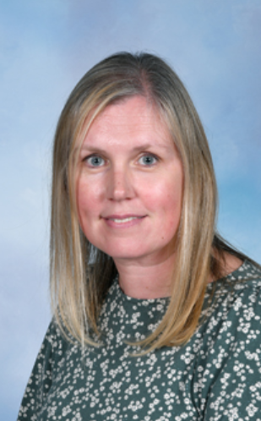
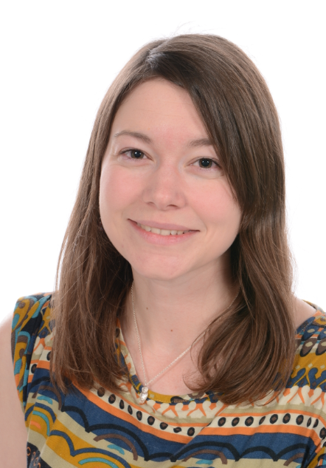
Sherdley MLT
Mrs Roberts Mr Hughes Miss James Mrs Williams Mrs Orbison Mrs Wrenn
EYFS Lead LKS2 Lead UKS2 Lead Deputy SENCO English Lead Phonics & Early
Reading

Slide 4
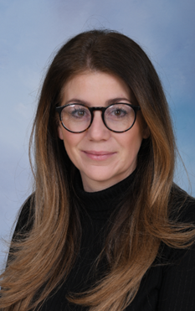


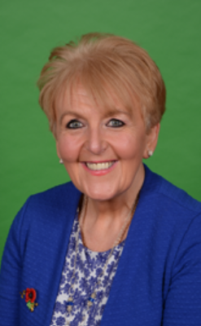
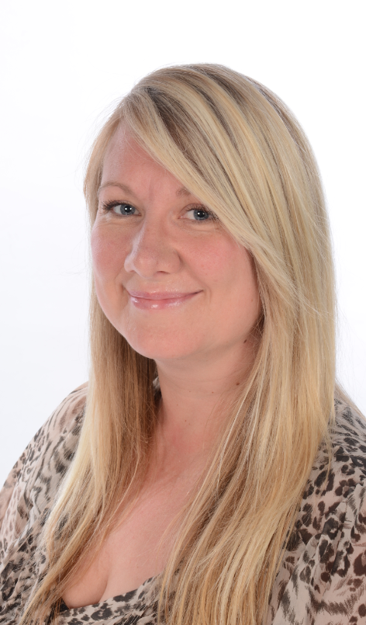
Sherdley Pastoral & Safeguarding Team
Sherdley DSLs
Mrs Stroud Mrs Eccleston

Slide 5


Slide 6

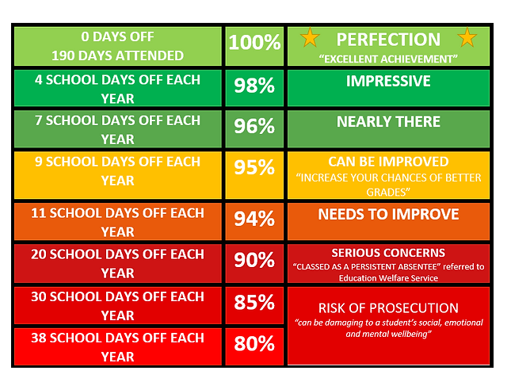


Notes:
As a parent, you are legally responsible for making sure your child gets a suitable fulltime education.
​
To help your child attend as much school as possible, you can:
Promote positive and healthy attendance patterns with your child and set good bedtime and morning routines.
​
Ensure your child arrives at school every day, on time and equipped and ready to learn.
​
Ensure we have at least three up-to-date addresses and telephone numbers so we can contact you quickly when required.
​​
Report absence via Class Charts before 8:30am each day until your child returns to school.
​
Ensure medical appointments are made outside of school time.
​
Avoid making holiday requests during term time.
​
Contact school if you are experiencing difficulty getting your child to attend school.
​
Work with the school and any other agencies of support to resolve any difficulties which may affect regular school attendance.

Slide 7
What we expect from parents / carers: | What you can expect from us:
As a parent, you are legally responsible for making sure your child gets a suitable fulltime education. ​ To help your child attend as much school as possible, you can: Promote positive and healthy attendance patterns with your child and set good bedtime and morning routines. | Celebration of excellent student attendance and punctuality on a weekly and termly basis in assemblies with a variety of rewards and recognition.​ ​
Ensure your child arrives at school every day, on time and equipped and ready to learn. | An onsite Attendance Team dedicated to working with students, families and staff to improve attendance each and every day.
Ensure we have at least three up-to-date addresses and telephone numbers so we can contact you quickly when required | A pastoral team to carry out pastoral work with students in raising their attainment and achieving their full potential.
Report absence via school app before 8:30am each day until your child returns to school. Aim for medical appointments to be made outside of school time. | Counselling service that children can access (waiting lists apply)
Avoid making holiday requests during term time
Contact school if you are experiencing difficulty getting your child to attend school.
Work with the school and any other agencies of support to resolve any difficulties which may affect regular school attendance.

Slide 8
New attendance legislation: Sherdley will adopt from 19th August 2024
Holidays during term time will not be authorised.
Parents can request ‘Leave of Absence’ in exceptional circumstances. Evidence of this will be required to support any decision made by the head teacher.
Thresholds for Penalty Notice have changed. Reduced to 5 days / 10 sessions (am/pm/late after the close of register) in a 10 week period. Fines are £160 per parent, per child. Reducing to £80 if paid within 21 days.
Second year, if a Penalty Notice is issued, the fine is £160 with no option to reduce.
Third year – the family will be legally prosecuted.
National agenda and will cross boroughs.

Slide 9

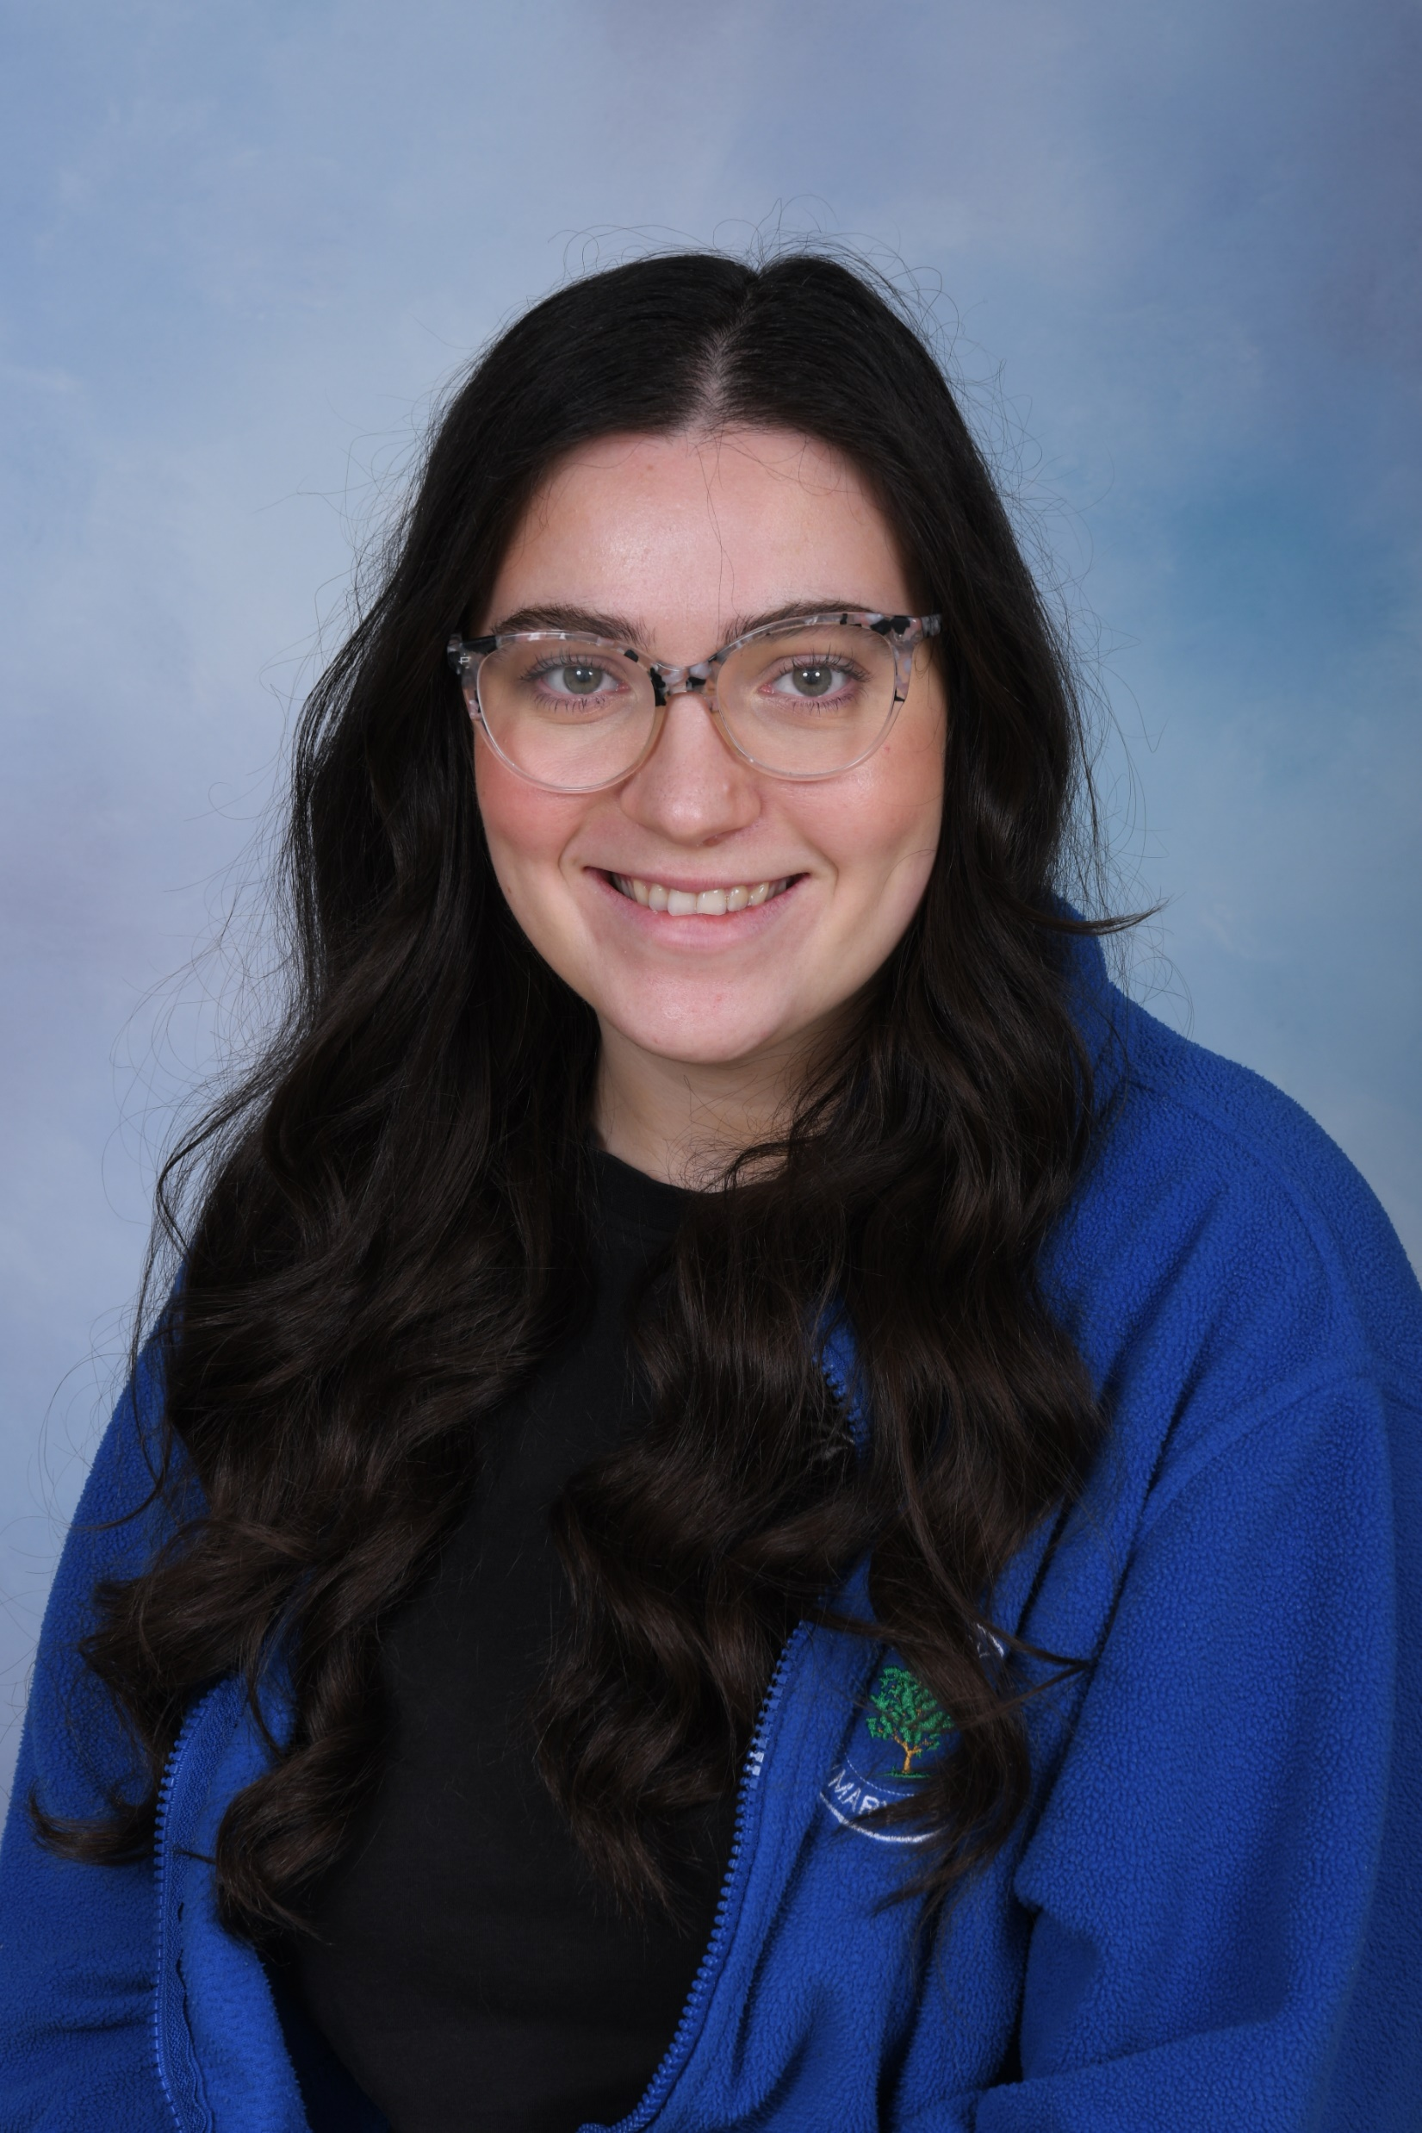
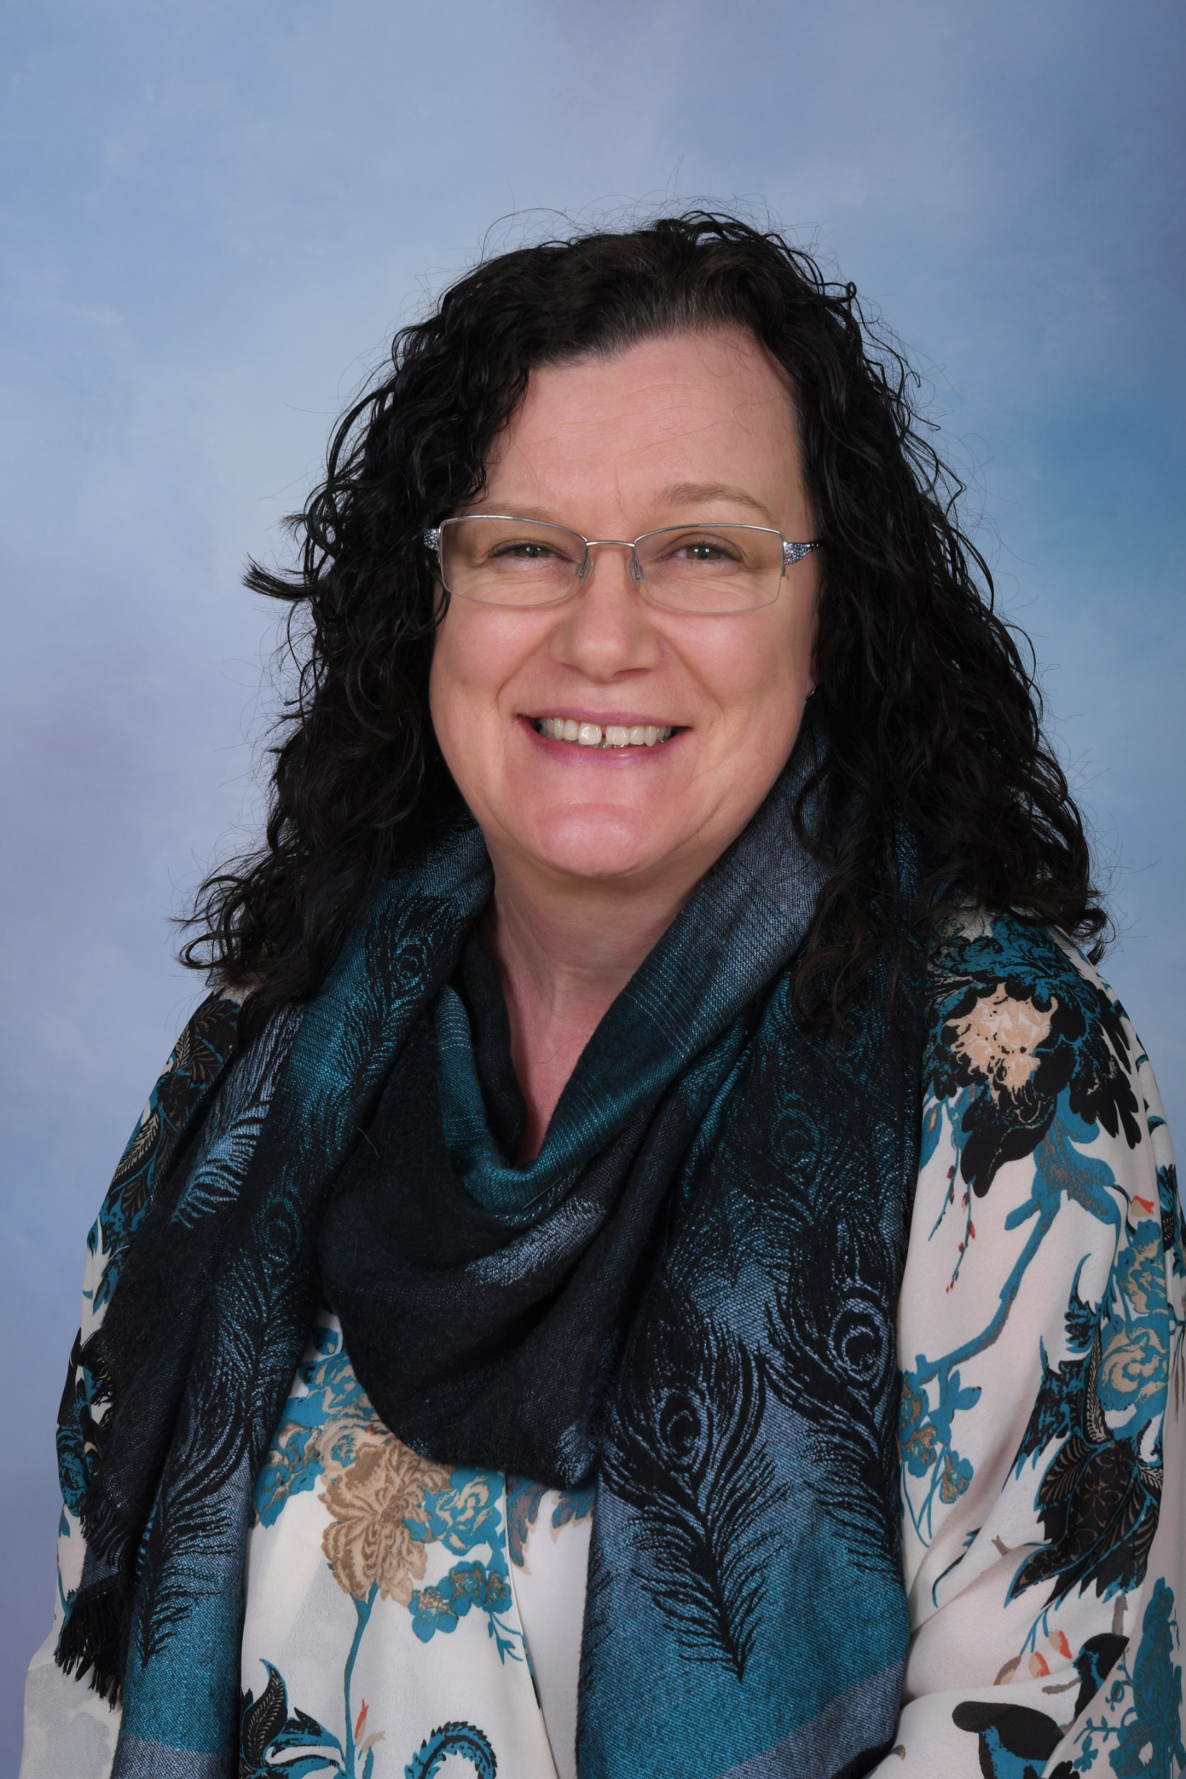
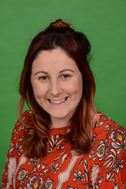
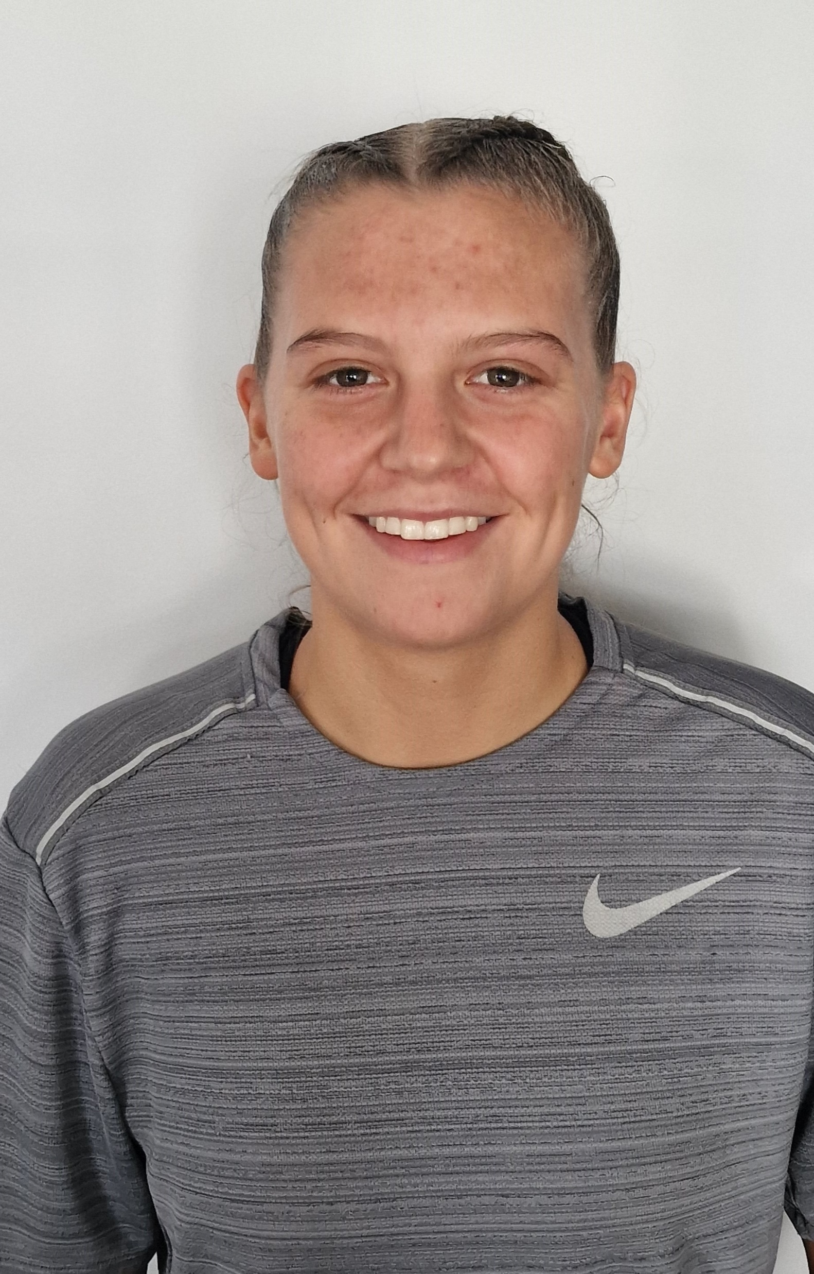
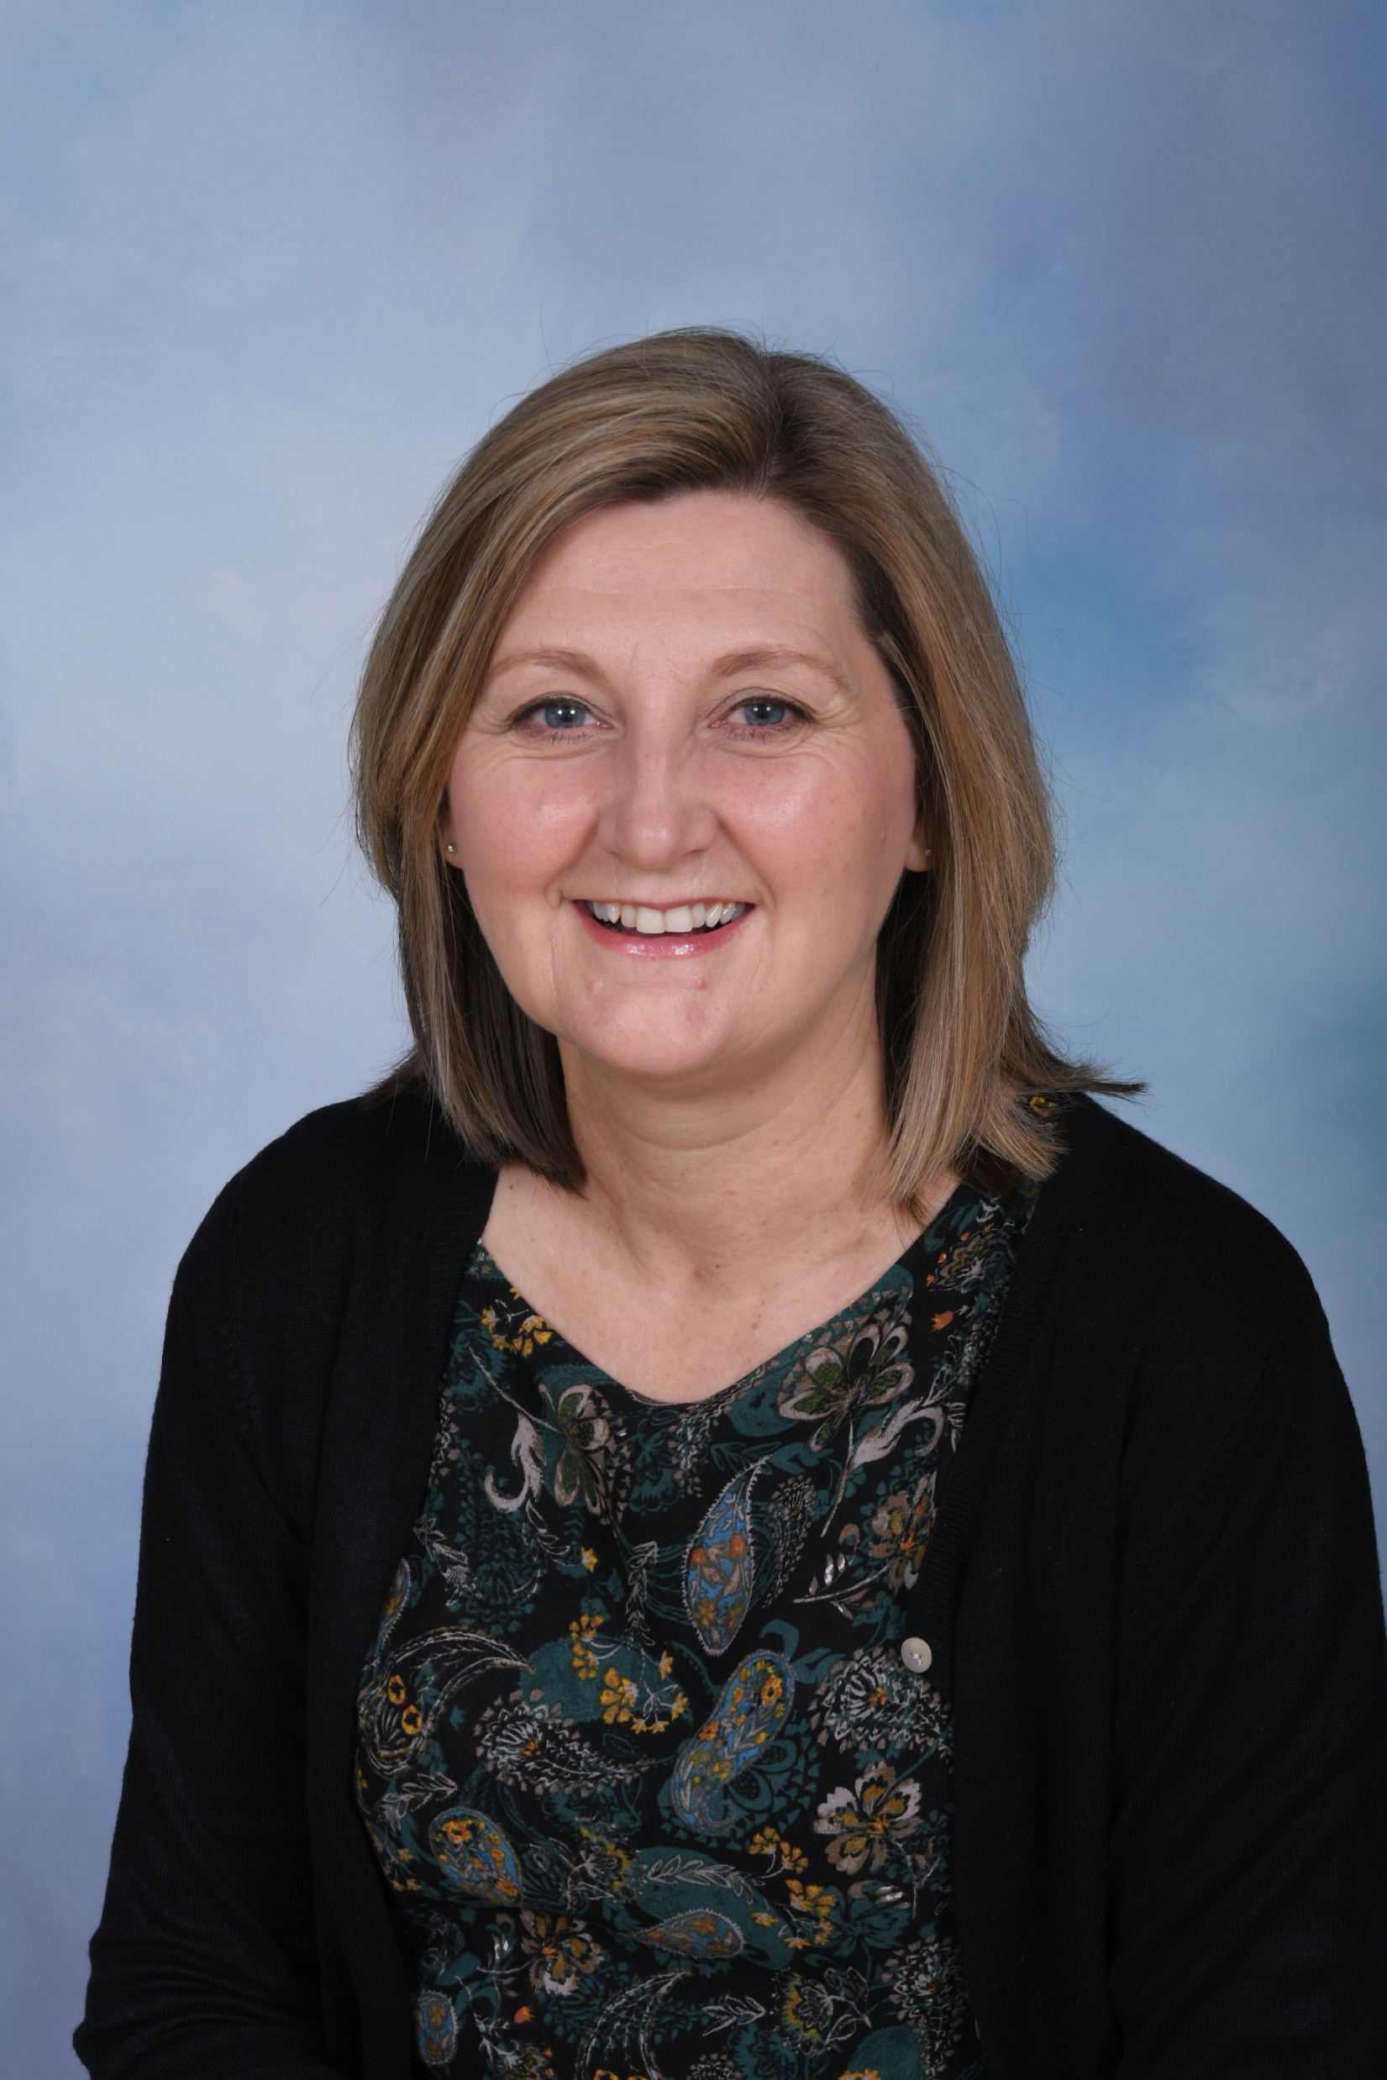
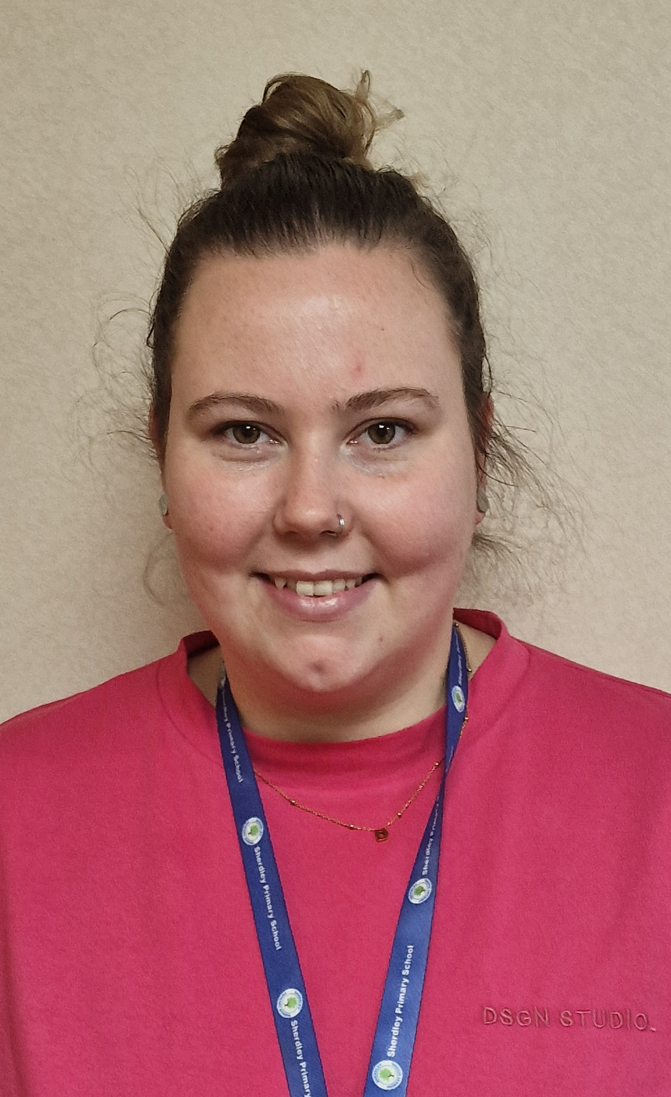
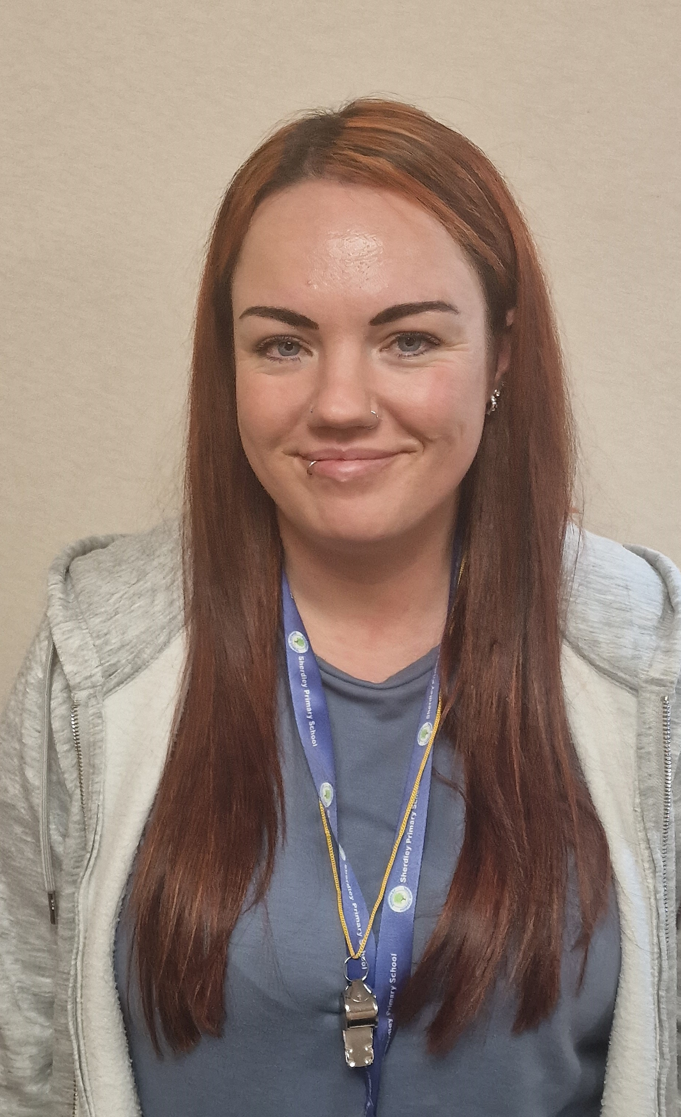
Staff in year 5

Slide 10
The School Day – new times
Year 3 - 6
8:45 – Bell rings to enter school – children to line up on the KS2 yard
3:15 – School closes

Slide 11
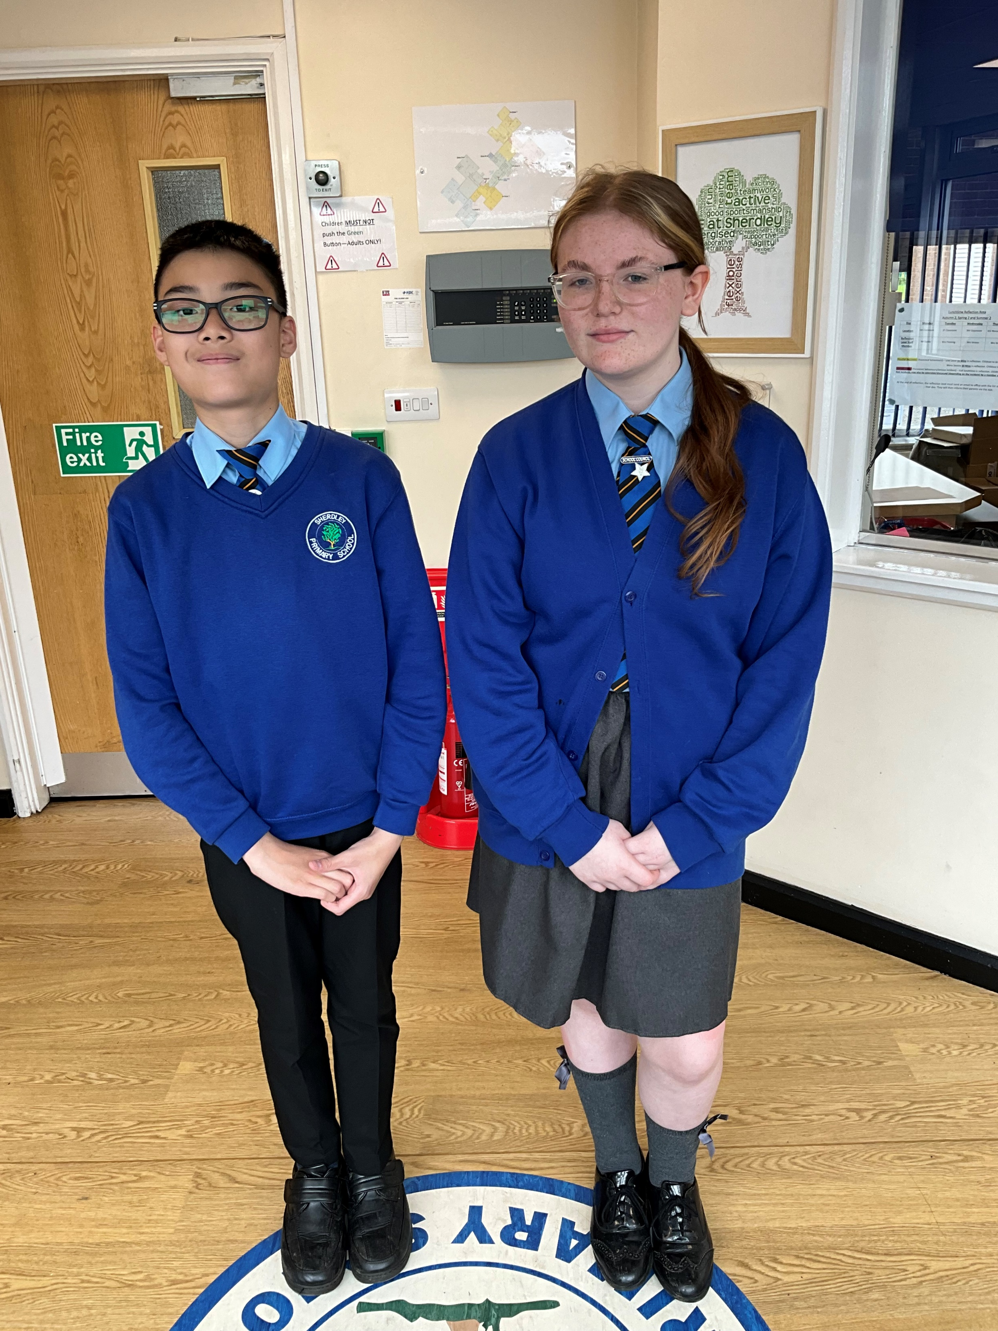
Uniform expectations

Slide 12
Parent survey feedback
Communication
Parent App for Trackit Lights developed
New App – Reach more parents
After School Clubs
Particularly KS1 and EYFS
Knowing what my child is learning
New app – curriculum maps shared more frequently

Slide 13
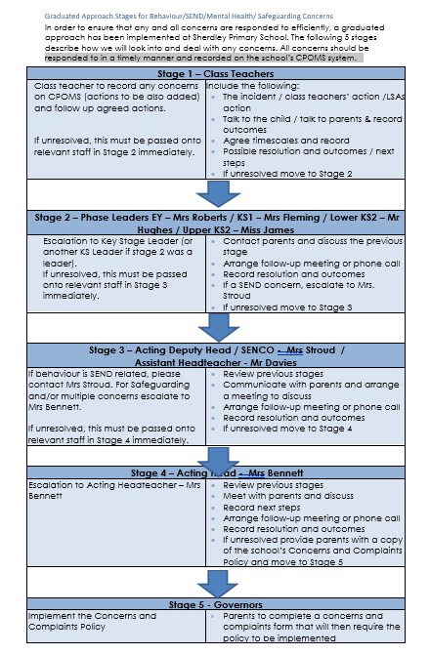






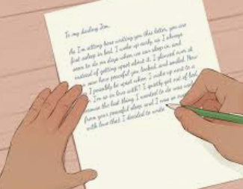

Graduated Approach

Slide 14
Autumn 1 term curriculum
Spellings will be put the website for the term.
English | Maths | Class novel | Science | History | Art | Computing | RE | PE | music | MFL | PSHE
Narrative writing | Place value Addition and subtraction | Anglo – Saxon Boy | Earth and Space | Anglo-Saxons | Peter Thorpe (Space) | Coding | Christianity The Church | Dance/ Tag rugby | Melody and harmony in music (Living on a prayer) | Feeling and talking about us | Being me in the world

Slide 15
Key info and dates / expectations / swimming / meetings

Slide 18


