Slide 1
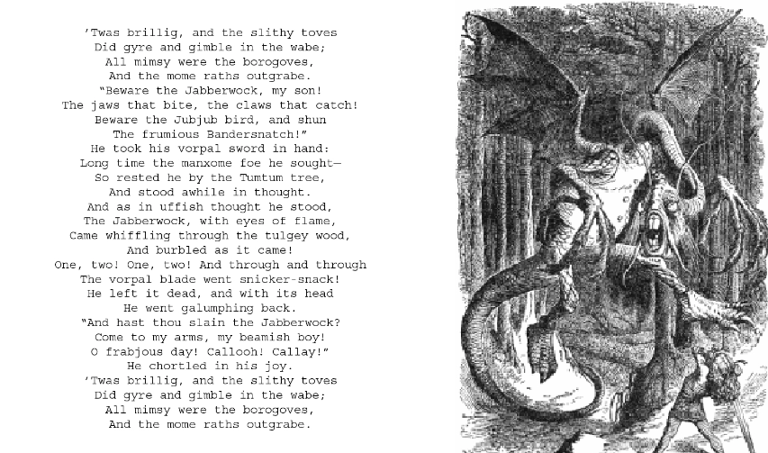
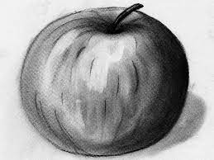
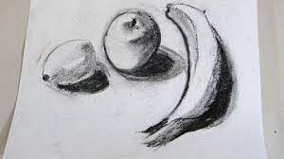
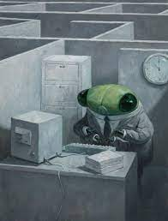
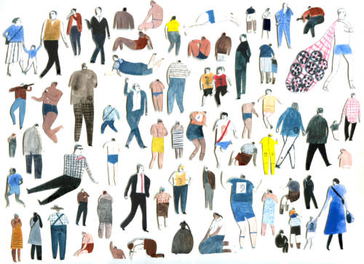
Key Vocabulary
Key Word | Definition
illustration | A picture or diagram that helps make something clear or attractive.
inspiration | Something that makes someone want to do something or that gives someone an idea about what to do or create.
interpretation | To explain or tell the meaning of.
monochrome | A photograph or picture created using black and white or in varying tones of only one colour.
line weight | The visual strength or intensity of a line.
ink | An ancient writing and drawing medium in liquid or paste form, traditionally black or brown in colour.
water-soluble | Pencils, chalk, pastels or felt-tip pens - that can be used with watercolour techniques and give a similar end result.
sequencing | The order in which pieces of art are place so that they tell a story or give information.
Art: Autumn Term
Story telling through drawing
Learning Sequence
The Jabberwocky
Explore how Laura Carlin and Shaun Tan tell stories through imagery.
The Jabberwocky
1
Create a piece of artwork to represent a small World scene.
2
Expressing the elements through drawing and use of monochrome media. (Introduce the Jabberwocky)
3
Use monochrome to create a zig zag book depicting the Jabberwocky.
4
Laura Carlin
Use monochrome to create a zig zag book depicting the Jabberwocky.
5
Use colour pop to emphasise elements of black and white drawing.
Share, review and reflect on artwork.
Shaun Tan
6

