Slide 1
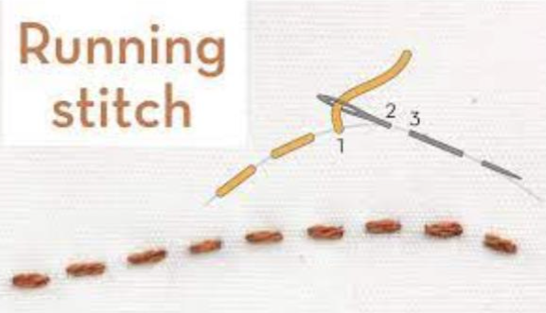
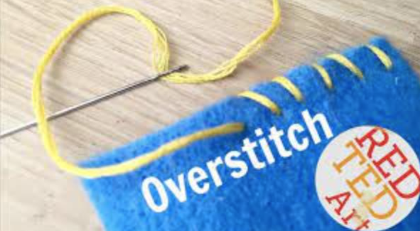
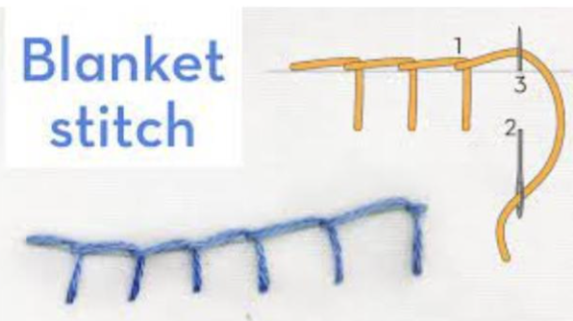
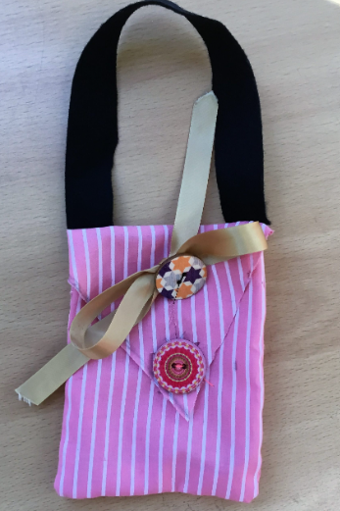
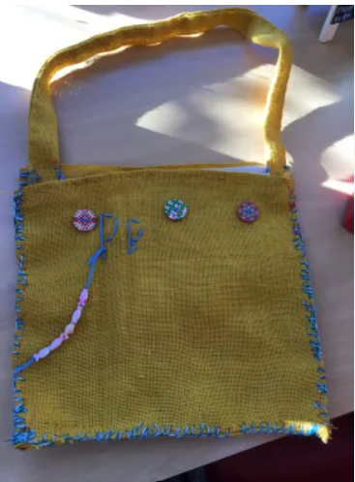
Textiles Summer Term
Bag (Evaluate)
Learning Sequence
Key Vocabulary
Key Word | Definition
Blanket stitch | A type of sewing stitch used to join pieces of fabric together.
Research | Careful study and investigation to gather information.
Fabric paint | Paint designed for using on fabric.
Evaluate | The process of deciding if something has been done in the best way and identifying what could be improved.
Investigate | To find out about different materials and components and how they can be used.
Constraints | Things that limit or control what you do.
Ideas | A thought or opinion.
Explore and evaluate a range of bags.
1
Practice and compare
running stitch, over stitch and blanket stitch.
2
Design a bag to match a given criteria.
3
Make the bag.
4
Make the handles.
5
Finish and evaluate the product.
6

