Slide 1
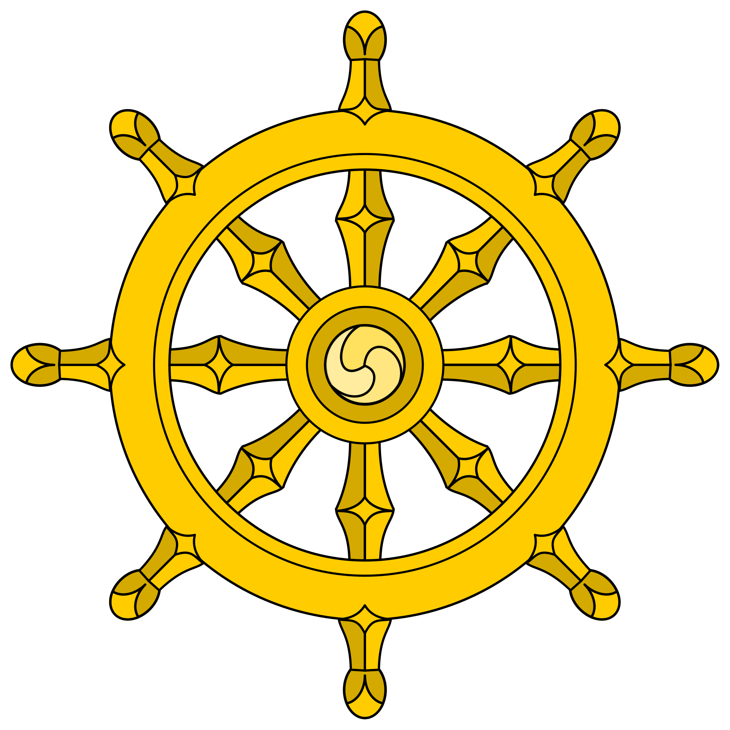

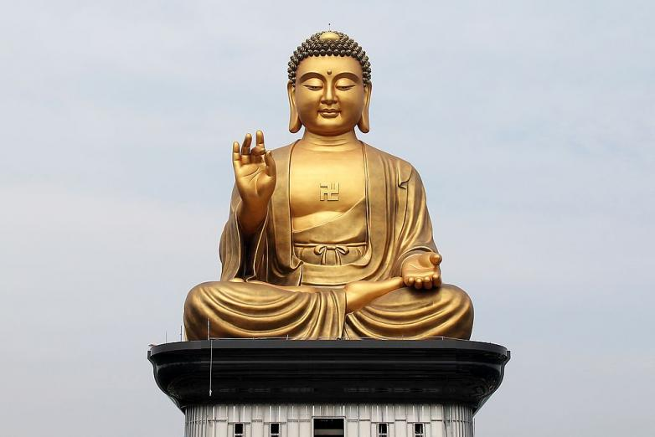

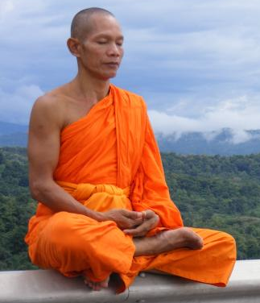
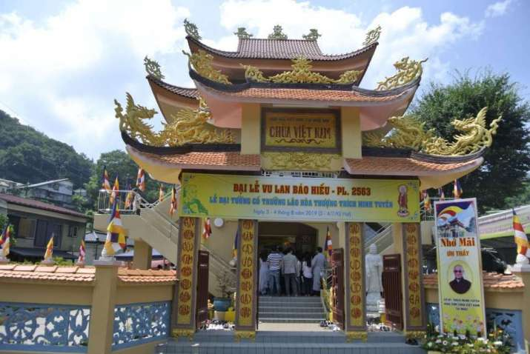
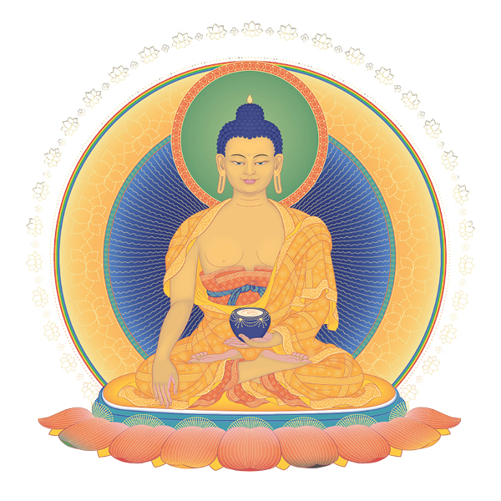

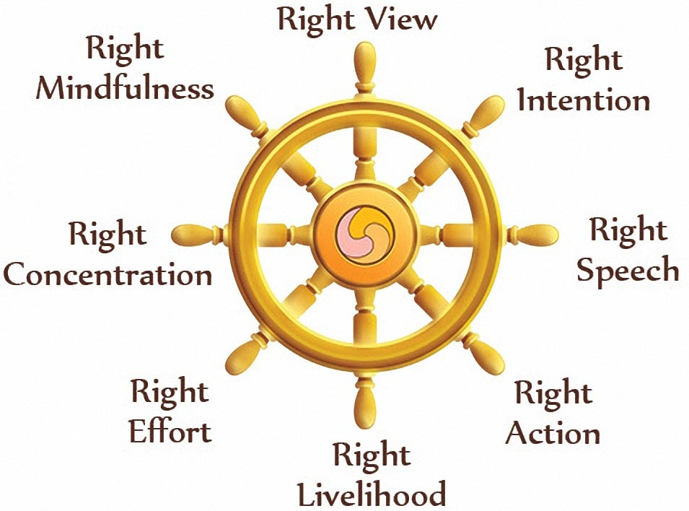
Vocabulary
Cessation – To end something
Dharma – means the right way of living – Buddhists have a dharma wheel which is a symbol of the Eight Fold Path
Dukhka – existence of suffering
Enlightenment – This is what Buddha achieved – it is the end to all suffering. Buddhists hope to reach this state which will be the end of the cycle of life and death and being reborn.
Karma – is the act of if you do good things, good things will happen but if you do bad things then bad things may happen.
Meditation – A form of relaxing and emptying the mind.
Nirvana – you reach the end of suffering
Samudaya – A noble truth – that suffering has a cause
Buddhism – Year 6
Buddhism is one of the six main world religions.
Where Buddhism Began: North East India
Buddhists do not pray to a god, the Buddha was human and Buddhists show reverence to him and his teachings..
Popular Festival:
Wesak (Buddha day)
Dharma wheel is a symbol of Buddhism.
Sacred Text: The Tripitaka also known as Pali Canon is one of the main texts.
Worship and prayer
Buddhists usually pray at home or they can visit a temple.
Worshippers may sit on the floor barefoot.
They face an image of Buddha and chant.
Their feet however must not face the Buddha.
In a temple they listen to the monks chanting from religious texts and take part in prayers chanting mantras.
At home a room will be set aside especially for praying which will contain a shrine.
On a shrine will be an image or statue of Buddha, incense burner and candles.
Timeline of Buddhism compared to other religions
Hinduism Buddhism Islam
2000 BCE 590 BCE 0 610 CE
1500 BCE 33 CE 1500 CE
Judaism Christianity Sikhism
Buddhism symbol, endless knot – it means endless wisdom and compassion
Places of Worship:
The Temple.
At home.
Prayer flags – Buddhists write prayers on flags and let them blow in the wind to have more affect.
A Buddhist
monk meditating
Statue of the Buddha
Enlightened
Buddha
Lotus flower is a Buddhism symbol.
Meditation
Buddhists often meditate which is a form of sitting quietly and emptying the mind of everything – it is meant to lead eventually to nirvana one of the Four Noble Truths.
The Buddha and how Buddhism Began
Prince Siddhartha Gautama was born in 570 BCE in Nepal had led a very sheltered life and was not allowed outside the palace. When he did venture out as a young adult on four different occasions he came across an old man, a sick man, a dead man and a wandering priest. The first three experiences saddened him deeply as he had never come across this before. But the priest that he saw seemed happy and got him thinking.
He wanted to find happiness too. So he left all his worldly riches behind and became a wandering monk. After many years he became enlightened to knowledge that everyone suffers but you can finally find happiness in trying to stop some of the suffering and one way was simply not wanting things. He began to teach this to everyone and so Buddhism began.
Main Beliefs
Buddhists believe in a constant cycle of life and death and they will be reborn unless they reach enlightenment and nirvana.
They believe in karma which determines what they are reborn as.
They believe in the
Four Noble truths :
Dukhka – the existence of suffering
Samudaya – that suffering has a cause mainly craving for things.
Nirvana - the cessation of suffering – if you reach this it is also known as Enlightenment.
Eight Fold Path – the path that leads to the cessation of suffering.
Buddhist temple, pagoda
Rules
Eight fold path is the pathway of eight steps that lead Buddhists to the cessation of suffering.
The Five Precepts
No killing of any life being.
No stealing.
Respect each other.
Speak kindly of others and no lies.
No alcohol or drugs.
The Eight Fold Path – Eight steps that will lead to Enlightenment which is the end of suffering.

