Slide 1


I am going to be an Owl Baby!

Slide 2
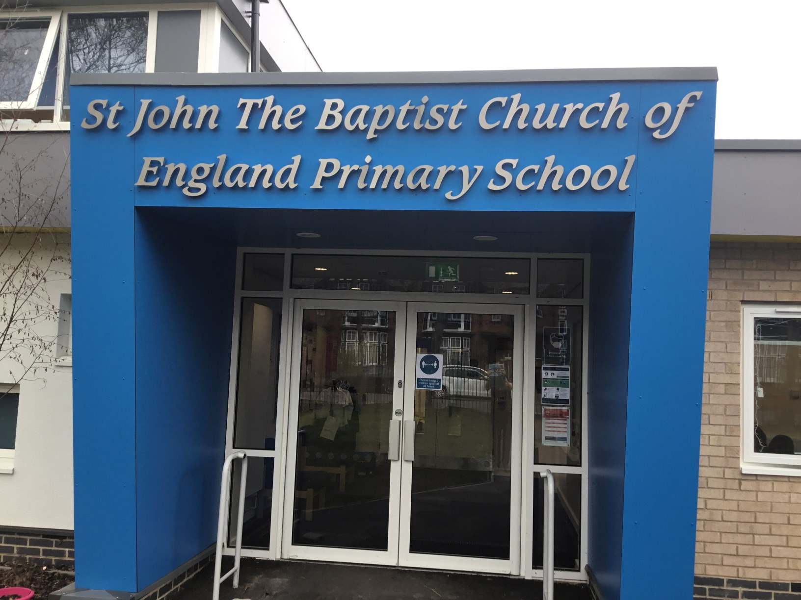
This is my new school.

Slide 3
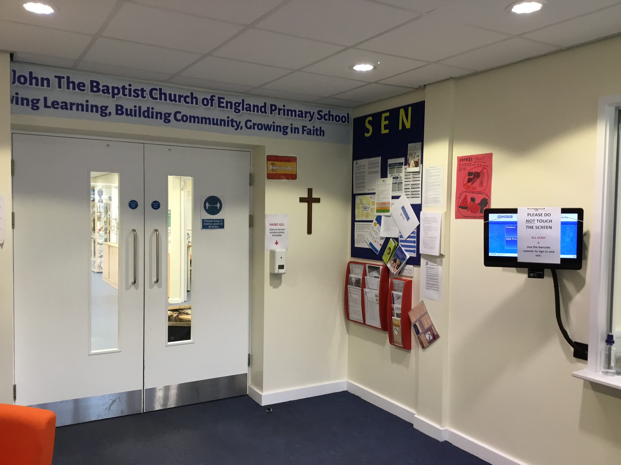
This is the school office.

Slide 4
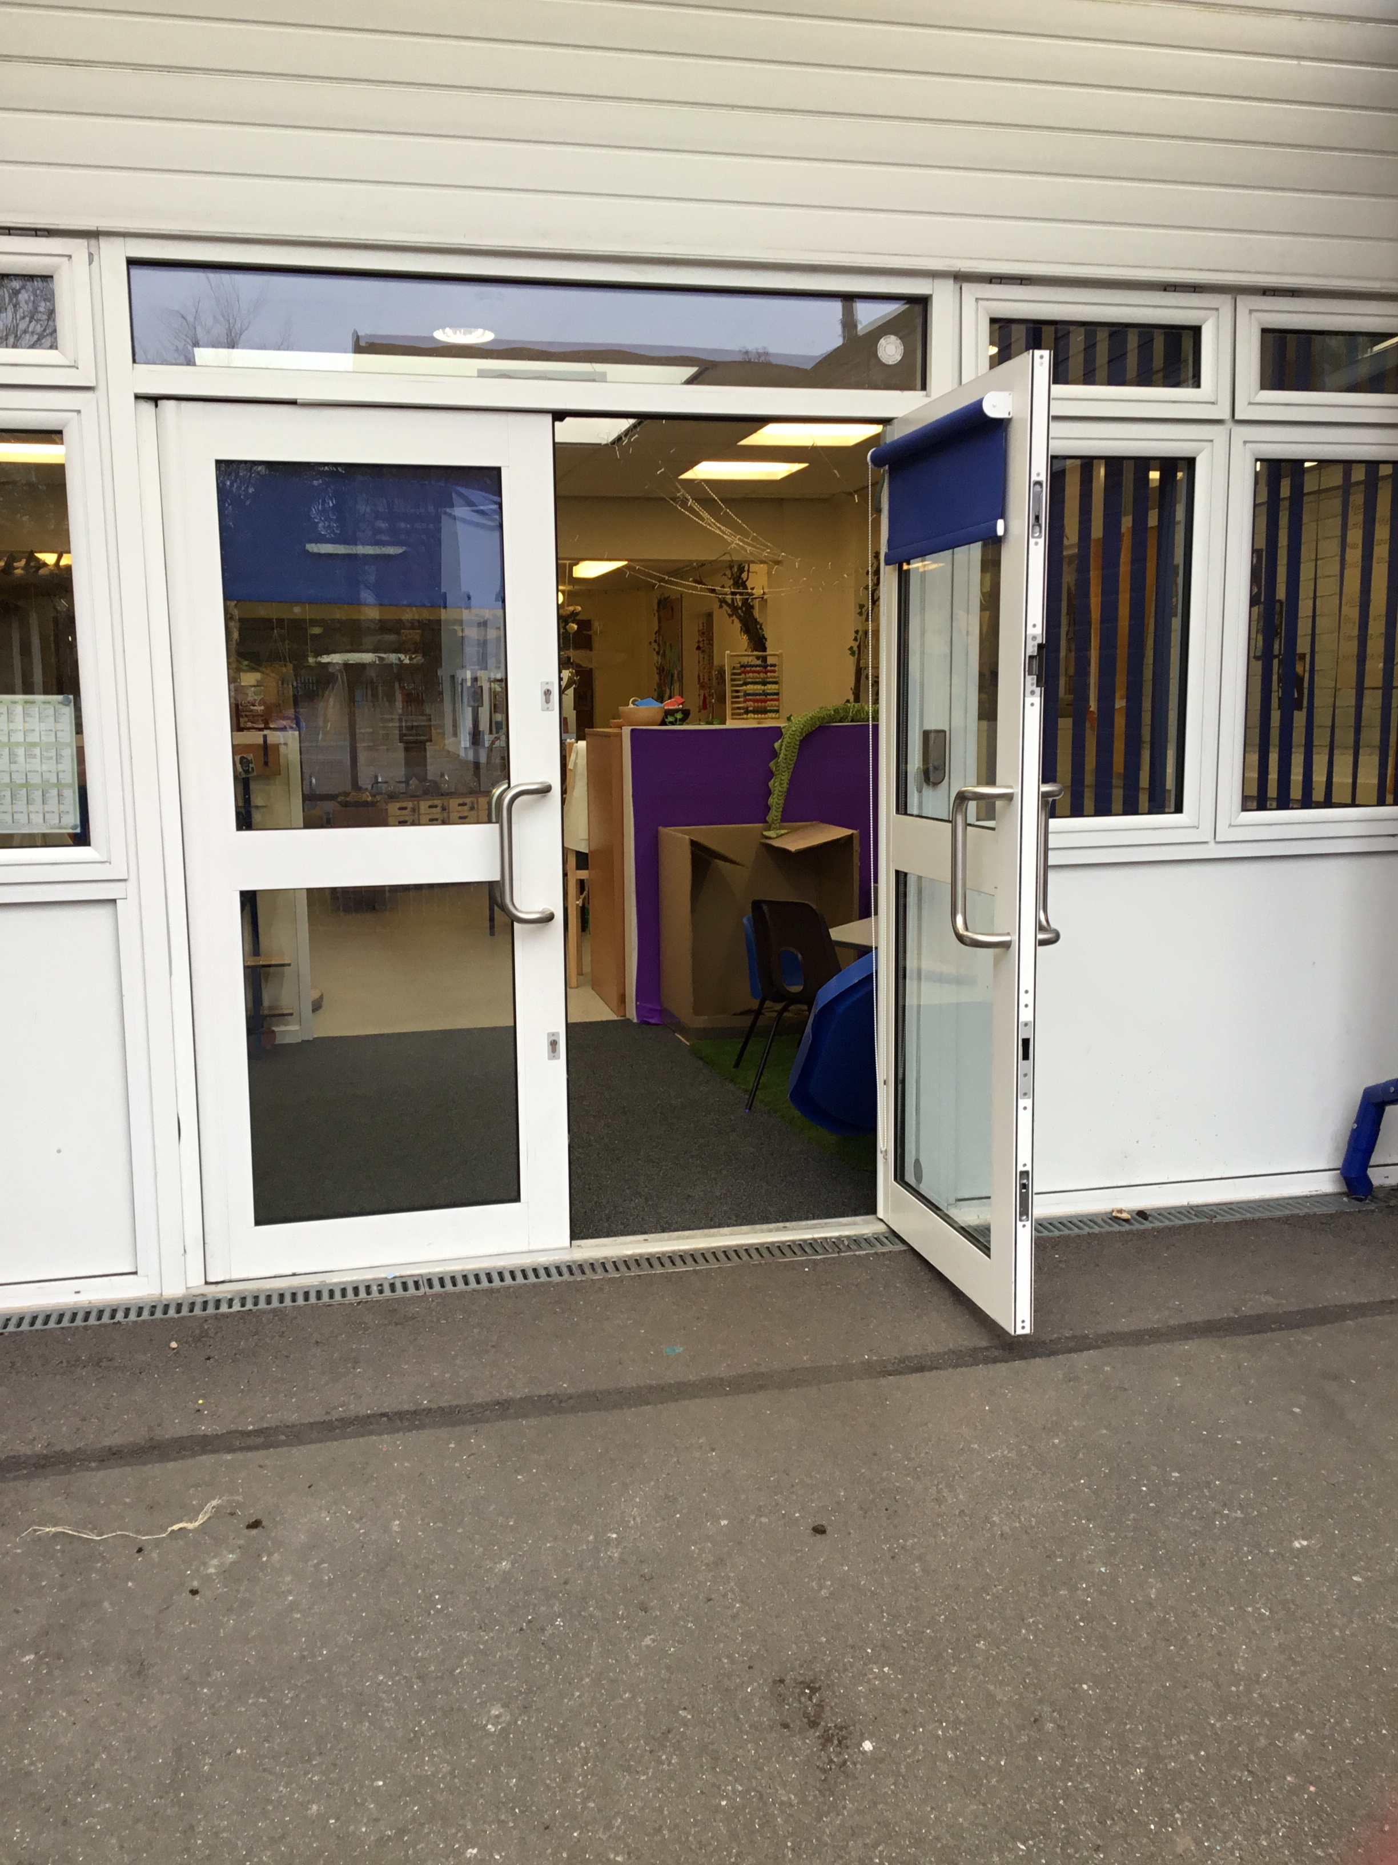
This is where I will walk into school.

Slide 5
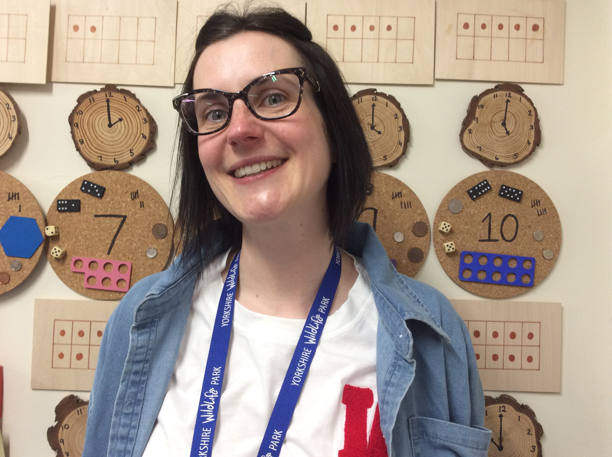
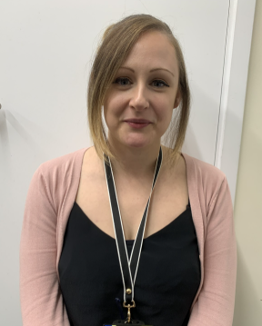
Miss Higgs or Miss McManus will be waiting for me at the door. They will be very happy to see me!

Slide 6
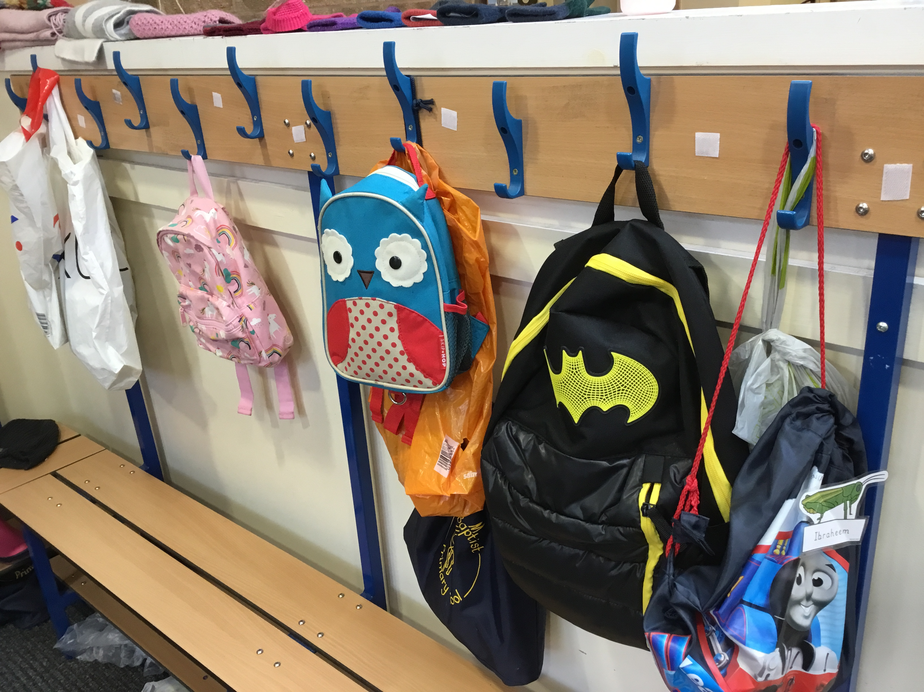
This is where my peg is. I will keep my coat, wellies, PE kit and spare clothes here.

Slide 7
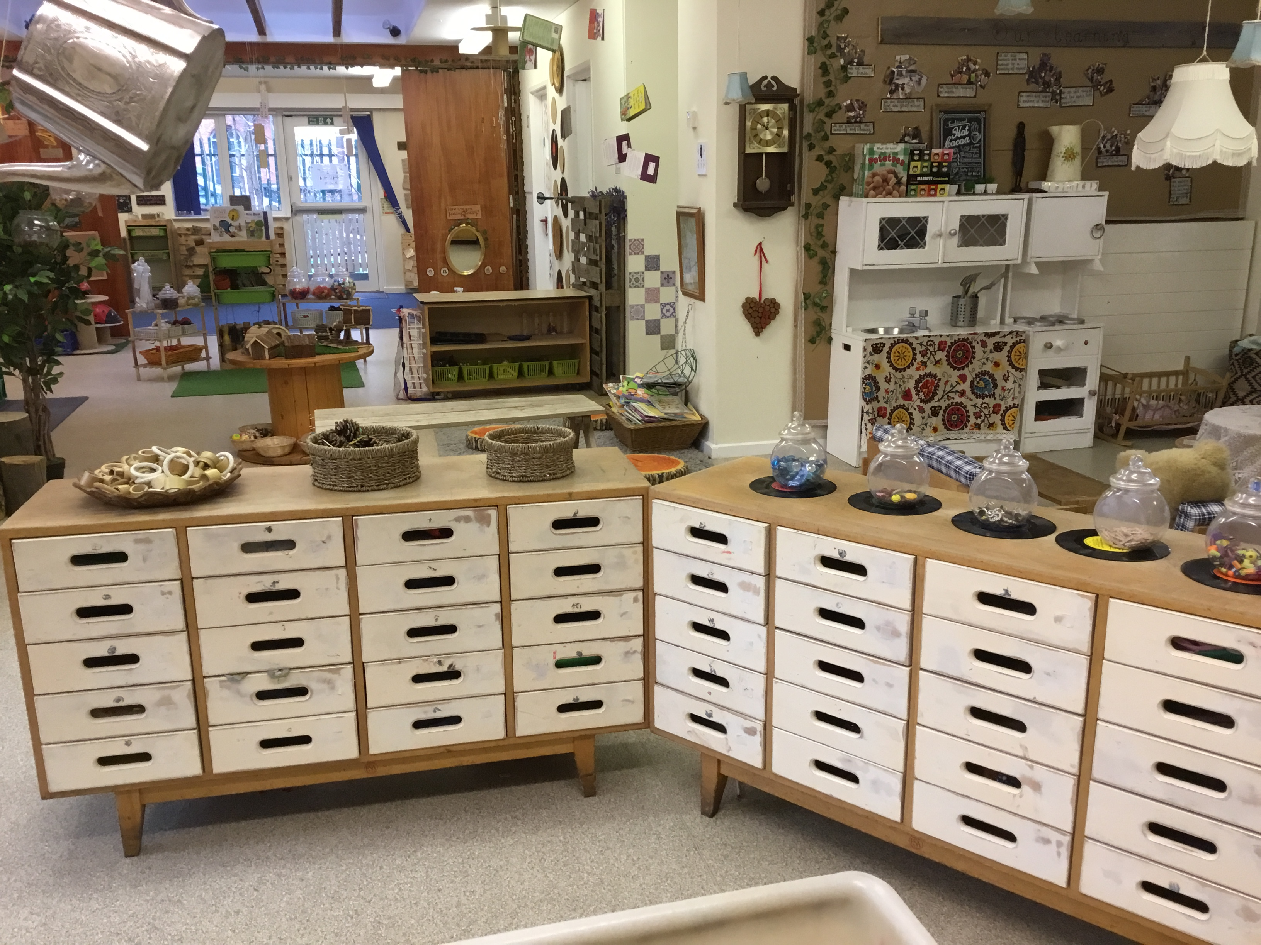
This is where my drawer is. I will keep my pictures and belongings in here.

Slide 8
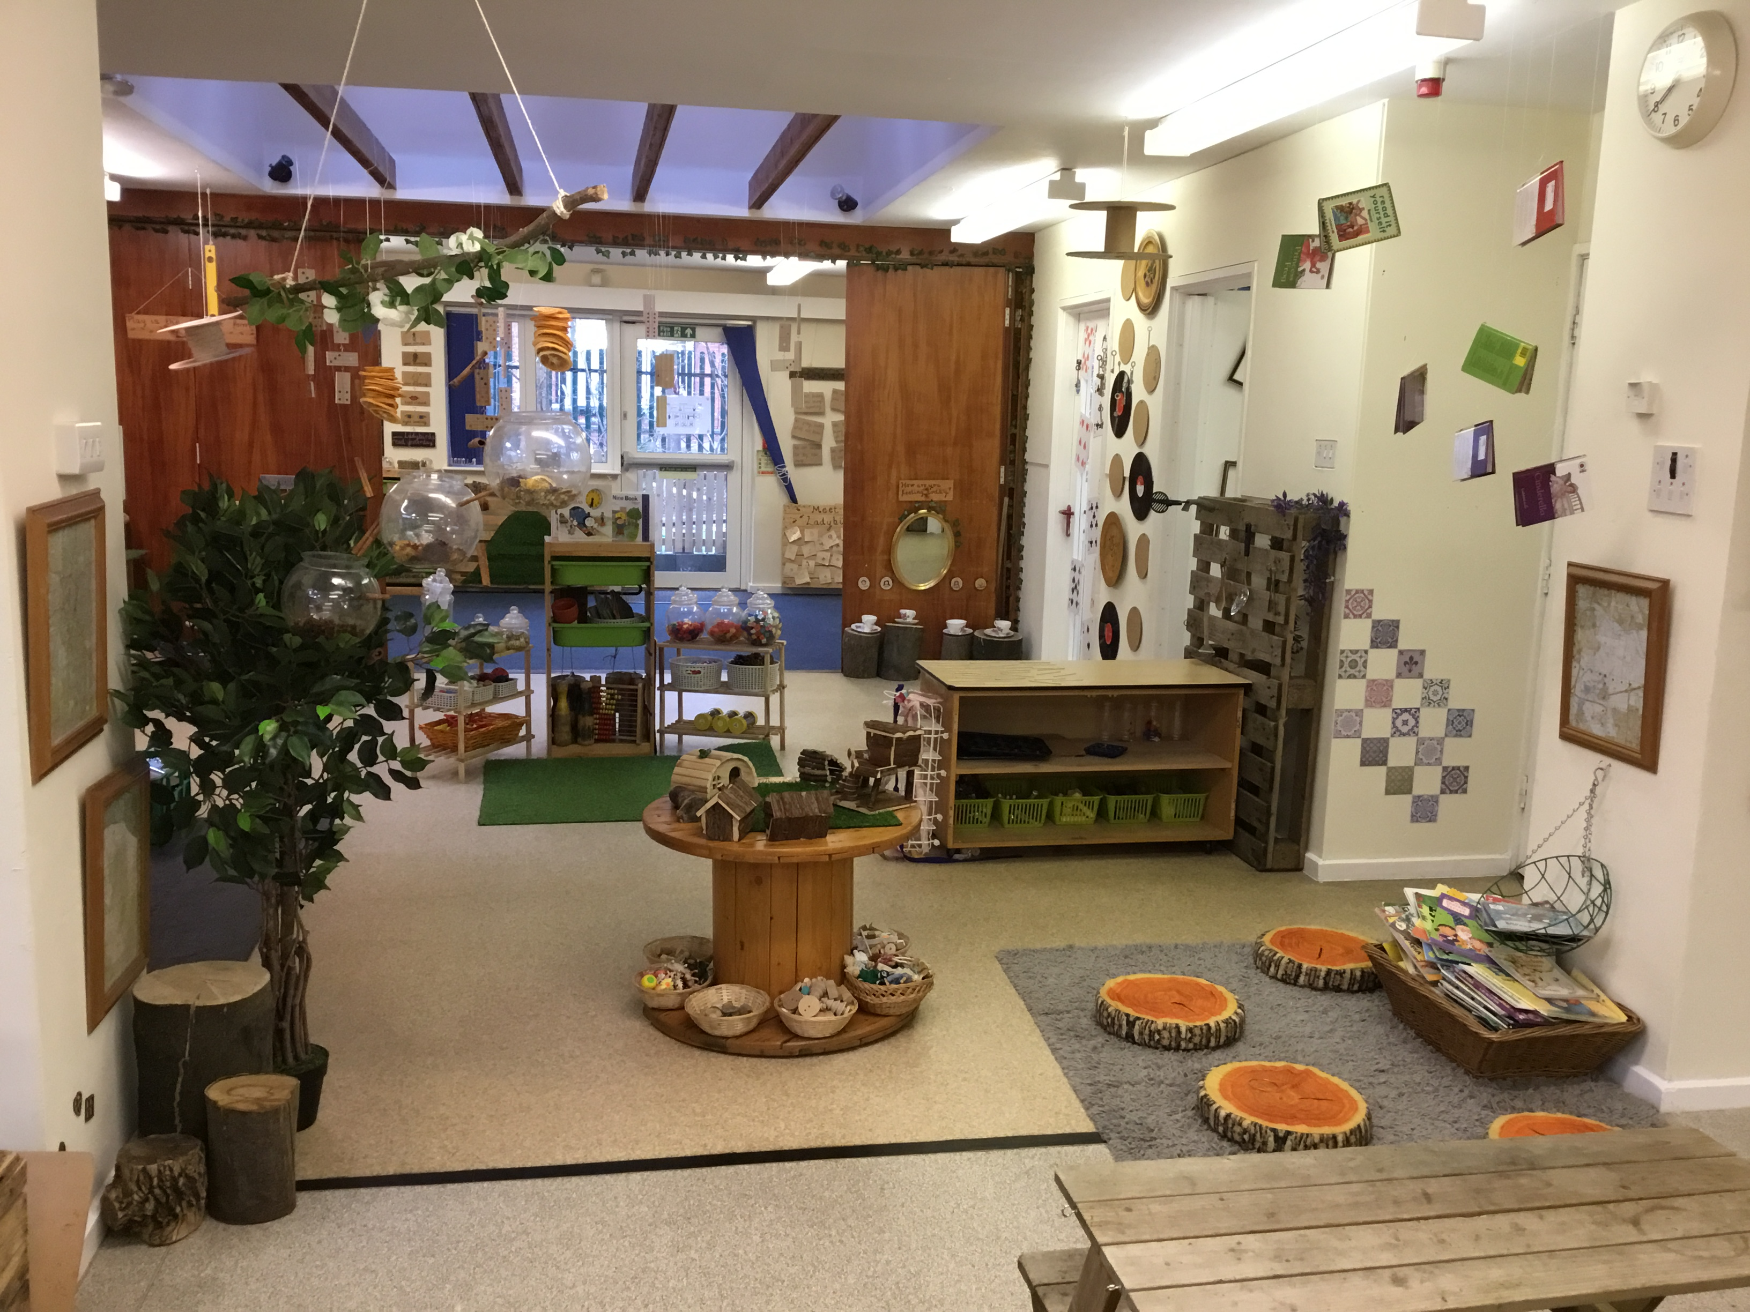
This is my classroom. I will play and make new friends here. I will also help to keep it tidy!

Slide 9
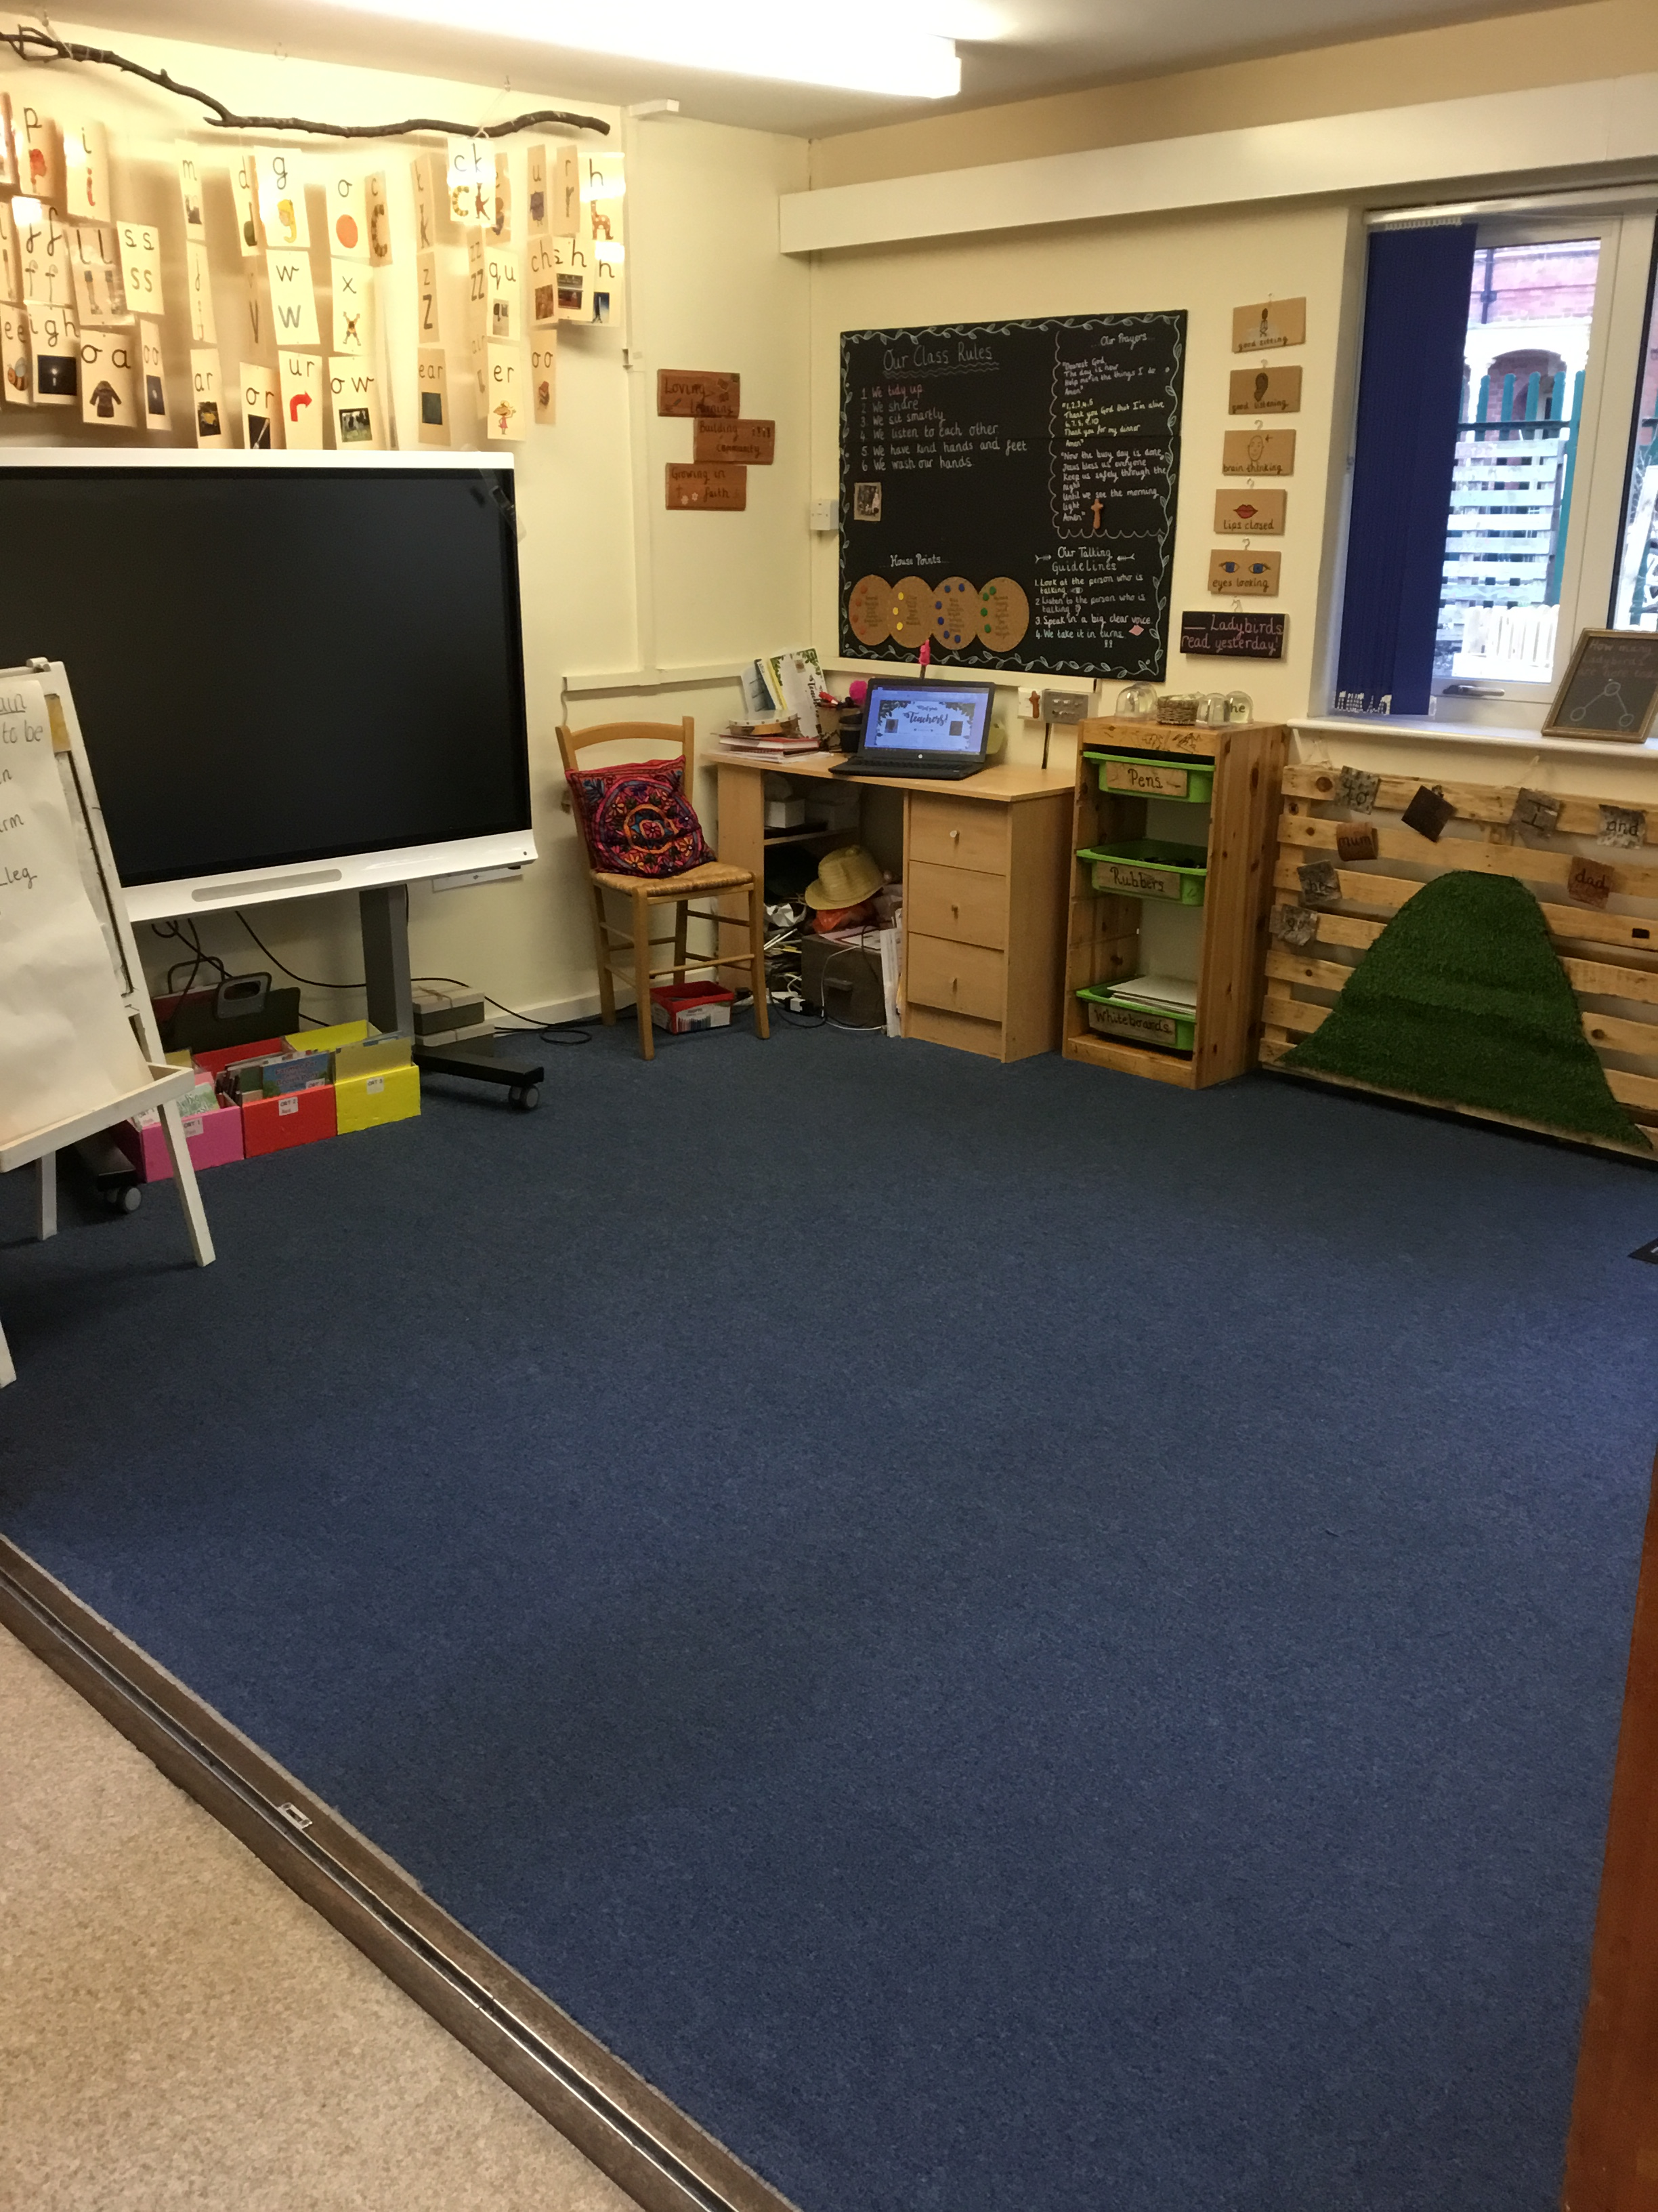
This is our carpet. We will listen to stories and learn together here. When I am on the carpet I will sit smartly and listen to my teachers.

Slide 10
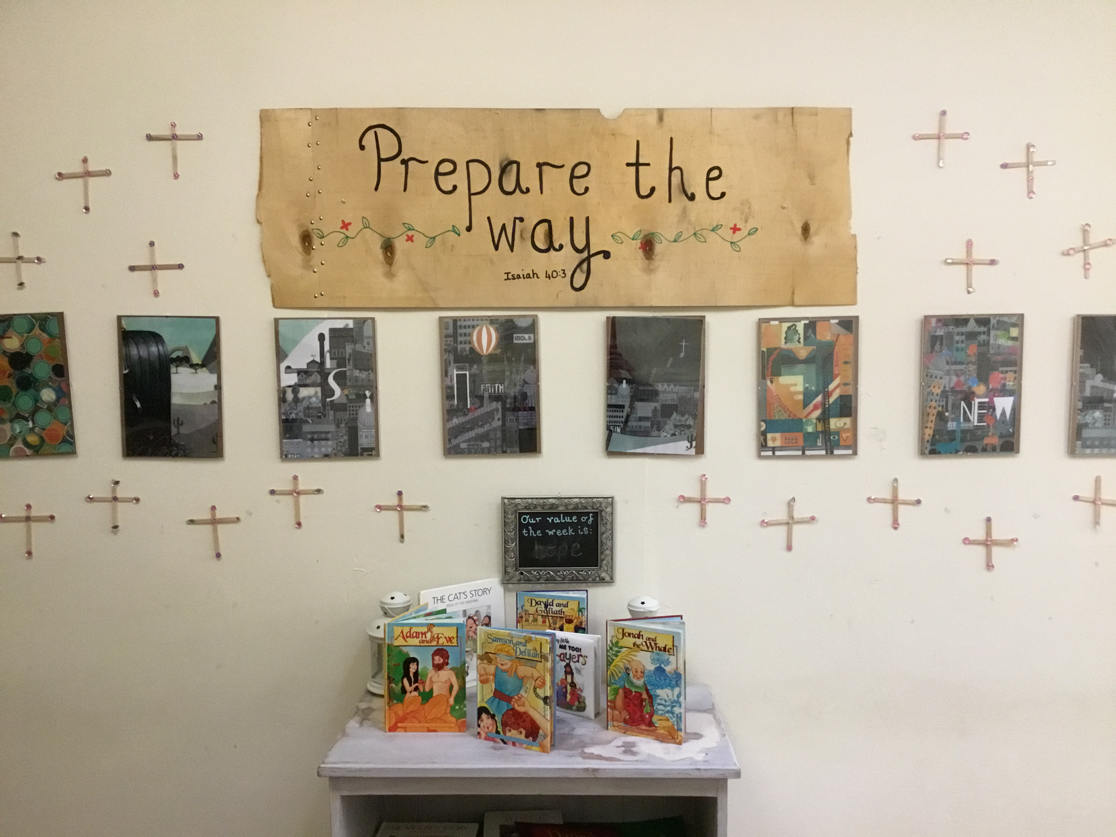
This is our reflection area. This is where I will read stories and think about God.

Slide 11
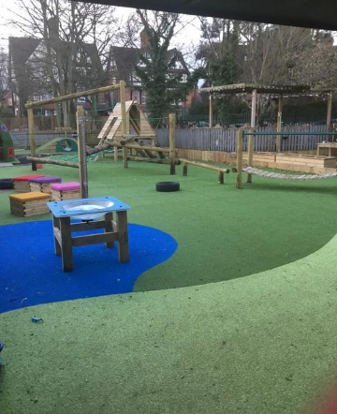
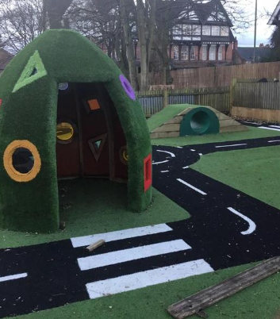
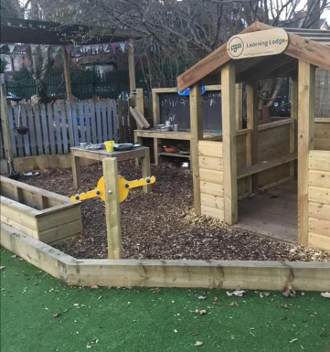
This is our outdoor area. We will learn and play together out here.

Slide 12
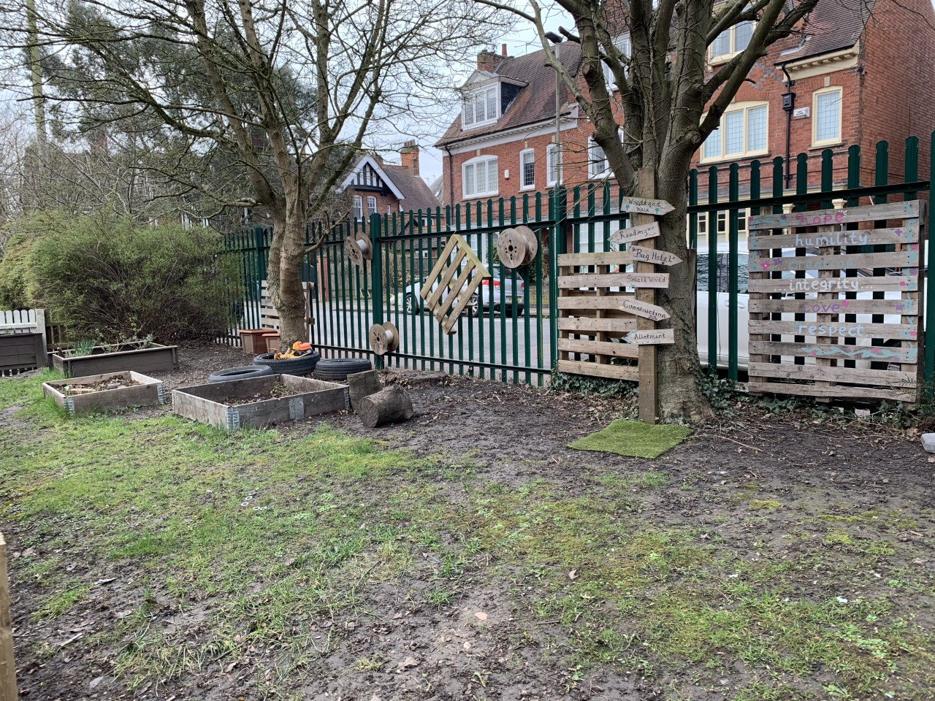
This is our Secret Garden. We will grow plants and vegetables out here and learn about nature.

Slide 13
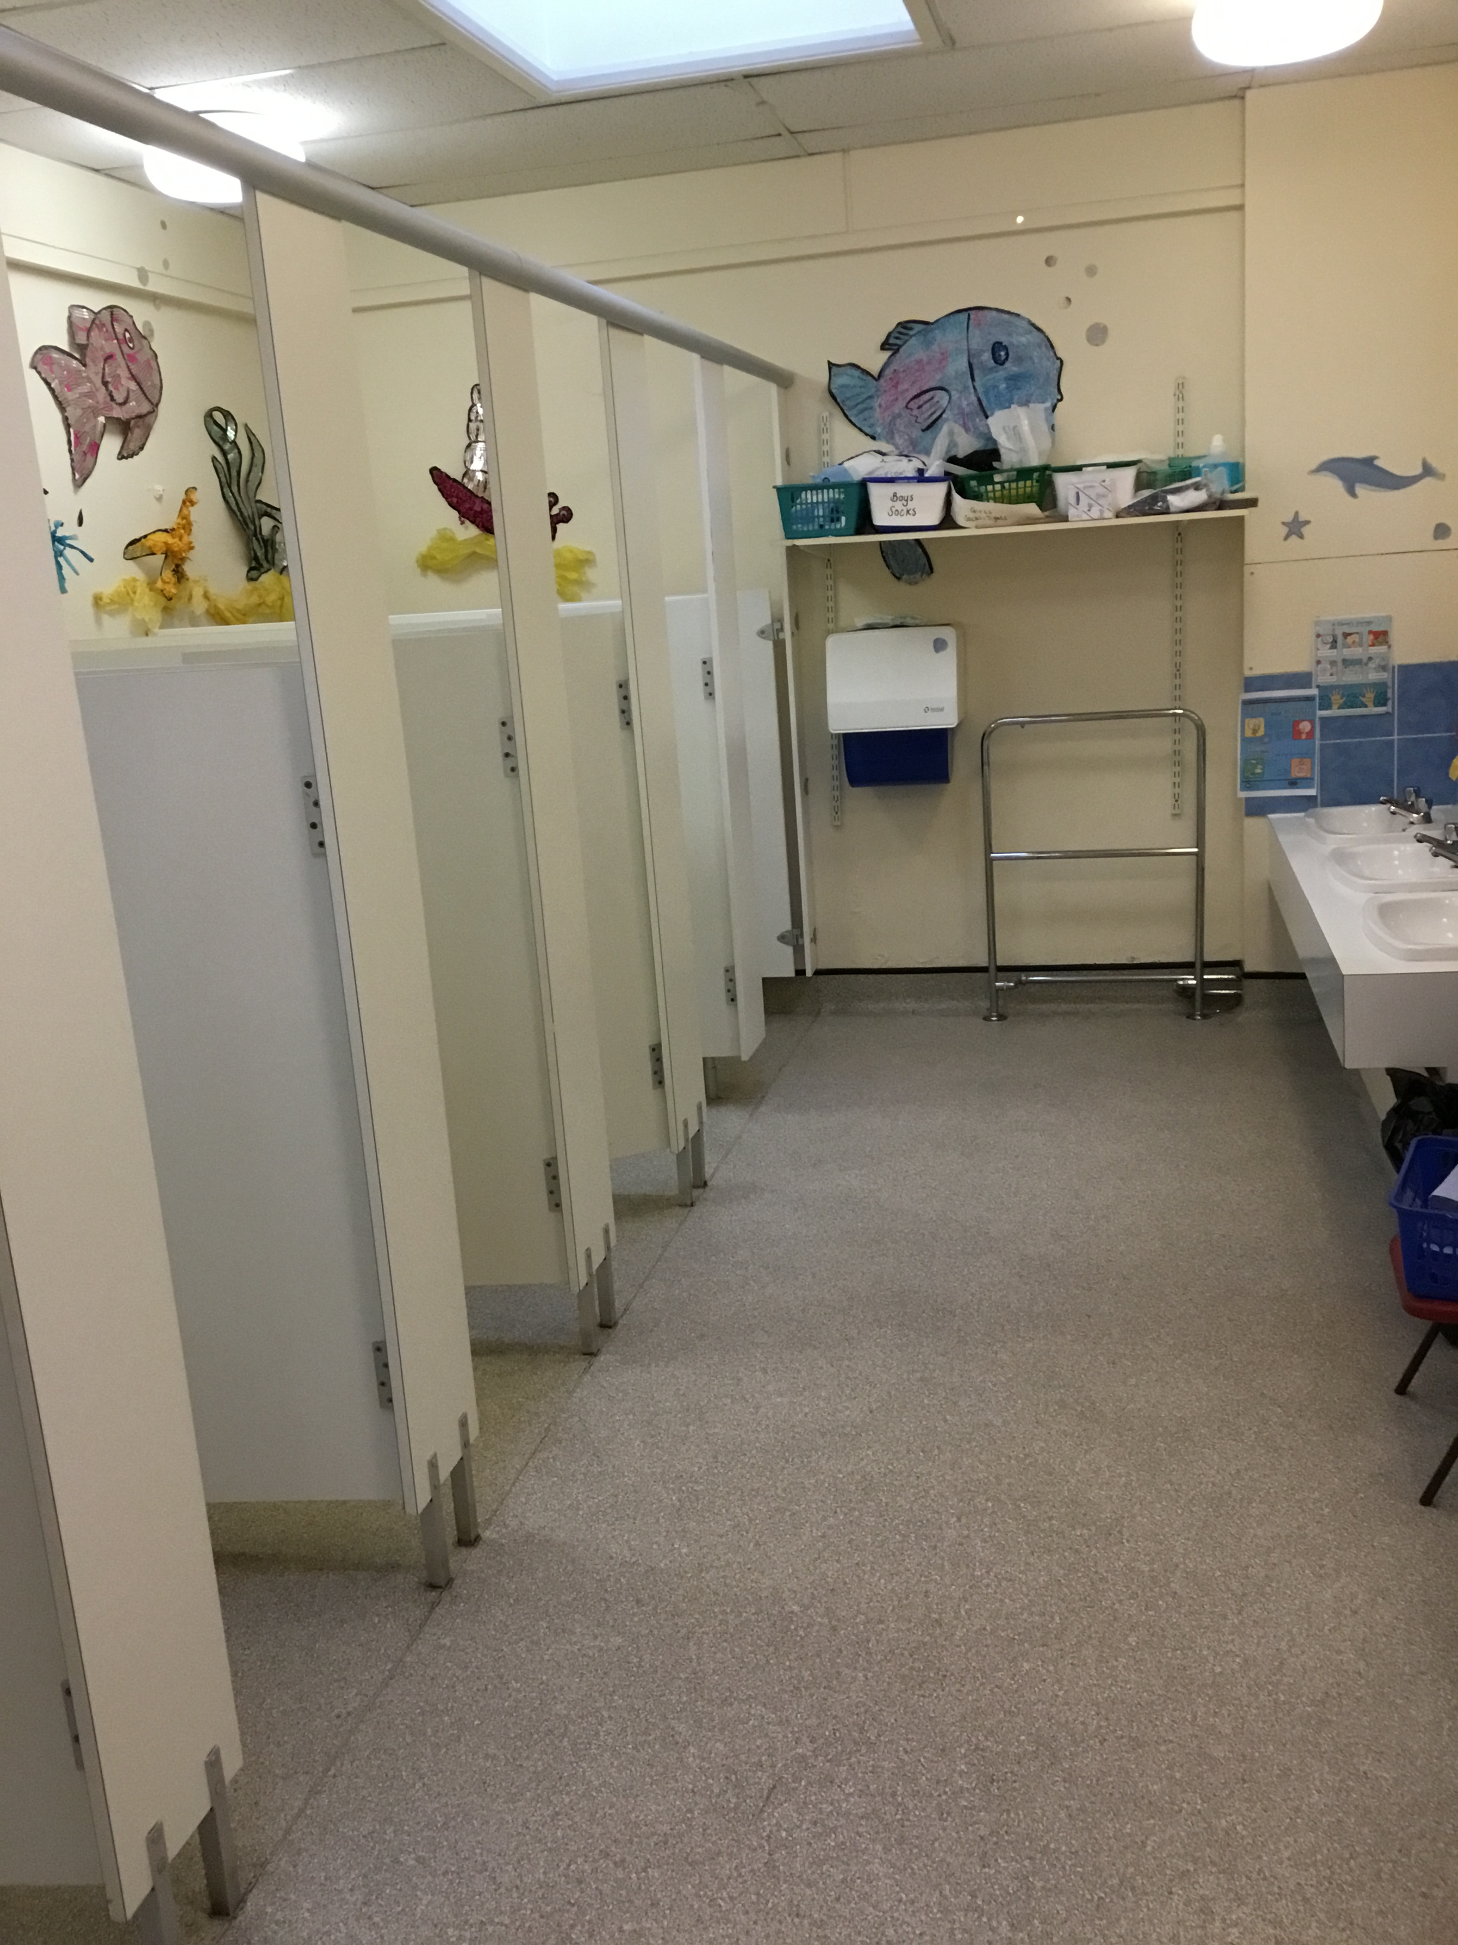
This is where I will go to the toilet.

Slide 14
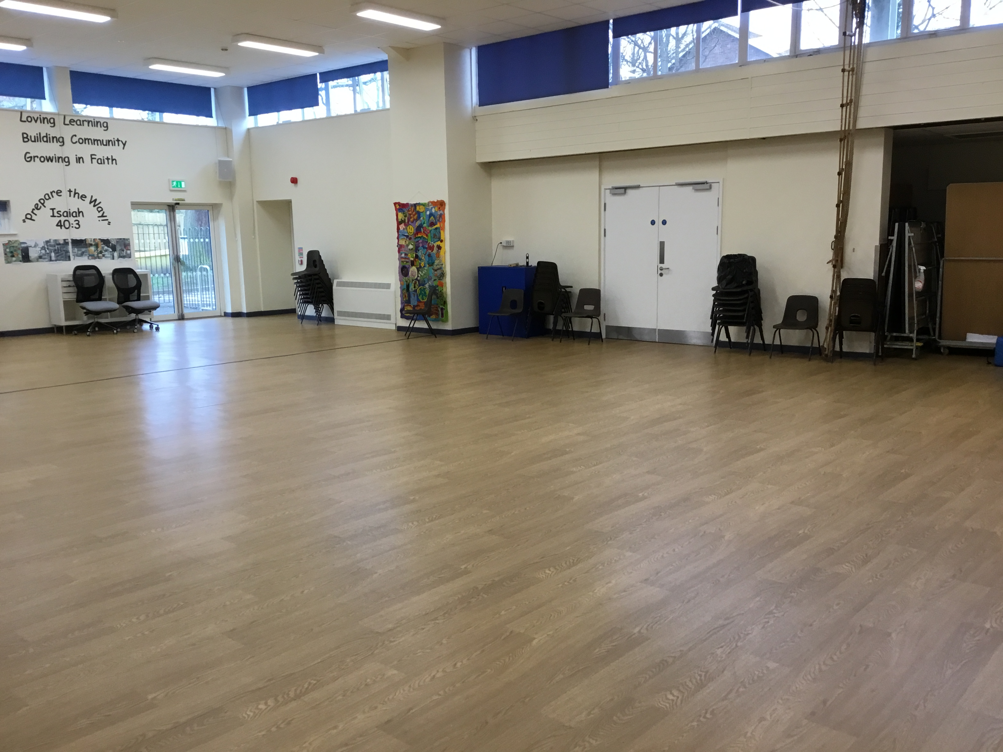
This is the hall. We will do our PE lessons in here. We will eat our lunch in here too.

Slide 15
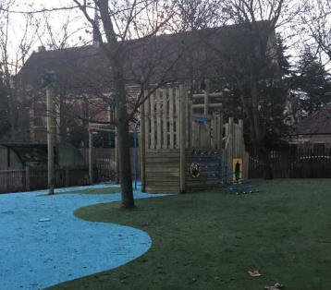
This is the playground. I will play with lots of children out here.

Slide 16
At home time, my grown up will pick me up from here.

Slide 17
I am going to love being an Owl Baby!

