Slide 1

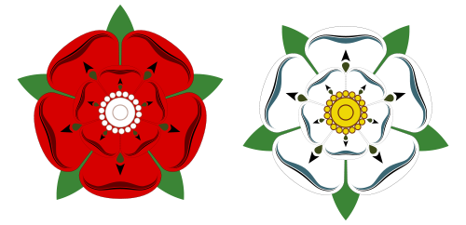
Background to the Wars of the Roses: Transition Work

Slide 2
Transition Work
Please, work through this PowerPoint.
It focusses on the situation BEFORE the Wars of the Roses. Although this will not be on your exam, it is invaluable background detail that will give you an appreciation of the situation c.1450, the starting point of our course. You are not expected to memorise all of this, but knowing who the kings were from Edward III, as well as an awareness of the changing political situation is very useful.
You will need to read sections, and complete activities as you go through.
There are 3 main activities to work on. Complete these to the best of your ability.
There is opportunity for additional work to prepare you for the course.

Slide 3

Outline
Traditional view – The Wars of the Roses = a dynastic conflict stemming from rival claims from descendants of Edward III’s 2nd and 3rd sons – Lionel, Duke of Clarence + John of Gaunt, Duke of Lancaster.
Richard II (son of Edward’s eldest son) was childless + he favoured the Mortimer line (descendants from the Duke of Clarence) to succeed.
1399 – Henry IV usurped Richard II but he had a rival with a stronger claim.
1413 – Henry IV died. Henry V ruled. Perhaps one of the most able kings of the Middle Ages.

Slide 4
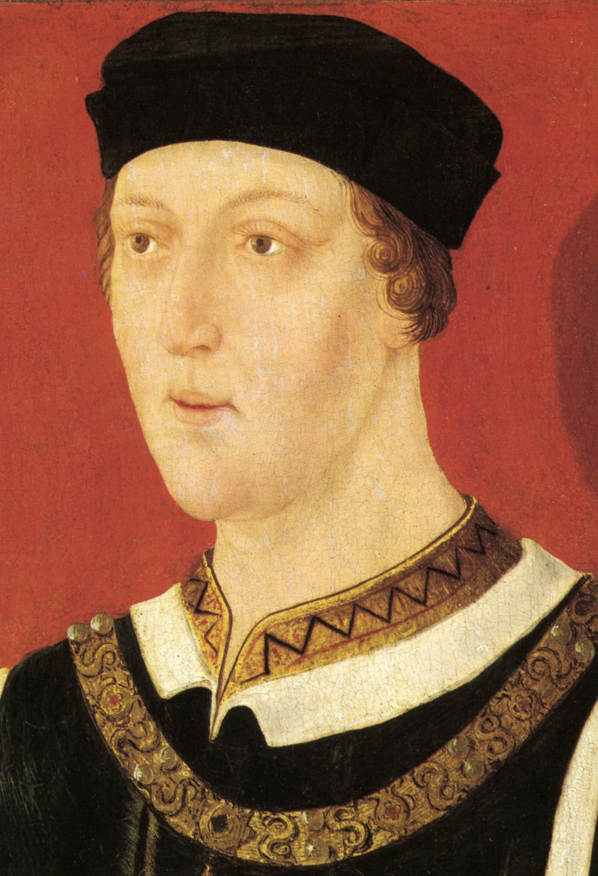
1422 – Henry V died. Premature. Only 35.
Henry’s son was nine months old and became Henry VI.
A lengthy minority began leading to the rise in factions and rebellion at home and the struggle to maintain English stronghold of France.

Slide 5
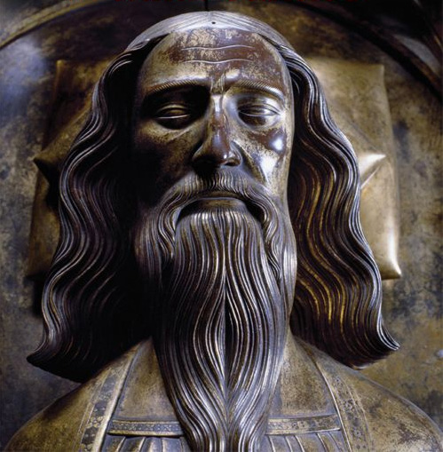
Part One: Edward III (13th November 1312 – 21st June 1377)
1327 – Crowned King of England at age fourteen after his father (Edward II) was deposed by his mother, Isabella of France, and her lover Roger Mortimer.
Aged seventeen – took the throne for himself from his mother and Mortimer.
1337 - After a successful campaign in Scotland he declared himself rightful heir to the French throne. This started the Hundred Years' War.
First phase of the war went exceptionally well for England - victories at Crécy and Poitiers led to the highly favourable Treaty of Brétigny, in which England made territorial gains, and Edward renounced his claim to the French throne.

Slide 6
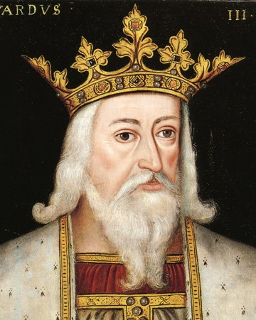
Edward III (13th November 1312 – 21st June 1377)
Transformed the Kingdom of England into one of the most formidable military powers in Europe.
Later years - inactivity and poor health led to failures.
Reign saw vital developments in legislation and government, in particular the evolution of the English Parliament, as well as the Black Death.
Edward was a temperamental man but capable of unusual mercy.

Slide 7
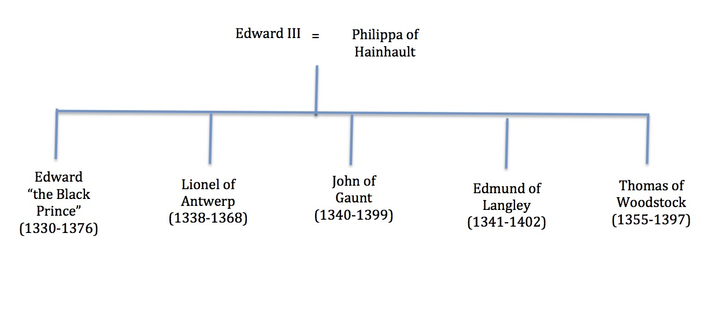
Edward III’s Children

Slide 8
Activity 1
Create a copy of Edward's immediate family tree. (As seen on the previous slide).
Add notes about the lineage of Edward following his three eldest children.
Use the following slides to support.

Slide 9
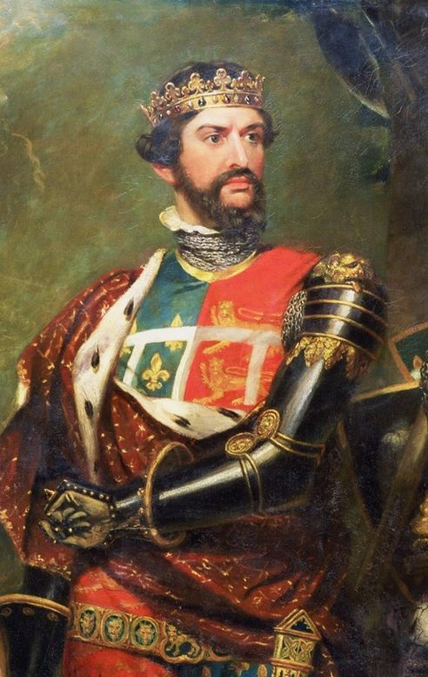
Edward ‘The Black Prince’ (15th June 1330 – 8th June 1376)
Known as Edward of Woodstock (place of birth).
Guardian of the kingdom in his father's absence in 1338, 1340, and 1342.
1343 – Made Prince of Wales (aged 13).
1346 – commanded the vanguard at the Battle of Crécy, Edward III intentionally leaving him to win the battle. Knighted.
1355 - was appointed the king's lieutenant in Gascony – pillaged Avignonet and Castelnaudary, sacked Carcassonne, and plundered Narbonne.
Offered terms of peace to King John II of France, who had outflanked him near Poitiers, but refused to surrender himself as the price of their acceptance. This led to the Battle of Poitiers, where his army routed the French and took King John prisoner. Peace was negotiated.

Slide 10
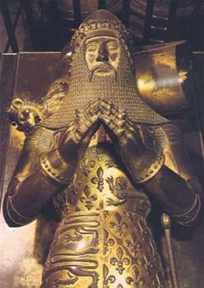
Edward ‘The Black Prince’ (15th June 1330 – 8th June 1376)
1369 - drawn into open war with Charles V of France.
1370 - he gave orders for an indiscriminate massacre in revenge for the voluntary surrender of Limoges to the French by its bishop, who had been his private friend.
1371 – returned to England.
1376 - He led the commons in their attack upon the Lancastrian administration.
Died of dysentery, caught whilst on campaign in France.
Known as one of the most successful English commanders during the Hundred Years' War.
Regarded by the English as a model of chivalry and one of the greatest knights of his age.

Slide 11
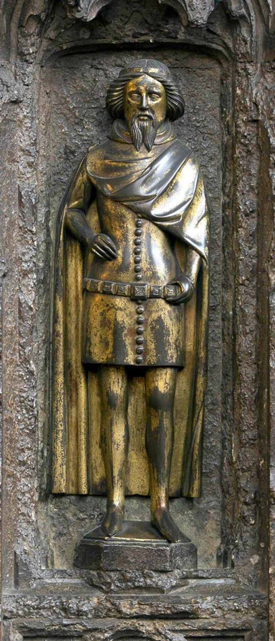
Lionel of Antwerp (29th November 1338 – 17th October 1368)
Betrothed to Elizabeth de Burgh Countess of Ulster when he was a child.
1345 – Known as the Earl of Ulster.
1352 – married.
The earldom came to him through his wife.
1355 – Only legitimate child, Philippa, was born.
1362 - created 1st Duke of Clarence.
1563 - Elizabeth de Burgh died
Remarried - Violante Visconti, the daughter of the Count of Pavia.
Lionel went to Italy with his new wife.
Although unproven, it was suggested his father-in-law poisoned him.
1368 – Philippa married Edmund Mortimer (2nd Earl of March) – the grandson of Roger Mortimer.

Slide 12
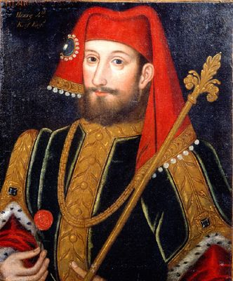
John of Gaunt (6th March 1340 – 3rd February 1399)
Duke of Lancaster and founder of the House of Lancaster.
Born in Ghent – corrupted in English to become Gaunt.
One of the richest men of his era, and was an influential figure during the reigns of both his father, Edward, and his nephew, Richard II.
Early career - in France and Spain fighting in the Hundred Years' War.
Claimed to be the King of Castile, during his second marriage.
Took control of government functions when the Black Prince and Edward III became incapacitated due to poor health.
Became one of the most powerful political figures in England.

Slide 13
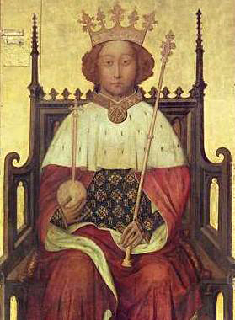
Part Two: Succession
1377 – Edward III died.
Edward the ‘Black Prince’ had one son – Richard of Bordeaux. Crowned King Richard II.
Richard only 10.
Early reign – a minority - government in the hands of a series of regency councils, influenced by Richard's uncles John of Gaunt and Thomas of Woodstock.
England faced various problems – the Hundred Years' War, which he tried to end.
John of Gaunt gradually became an extremely unpopular figure with Parliament and the ruling class.
Rumours circulated that he was the son of a Ghent butcher NOT Edward III.
1381 - the Peasants' Revolt = major problem. Richard dealt with it.

Slide 14
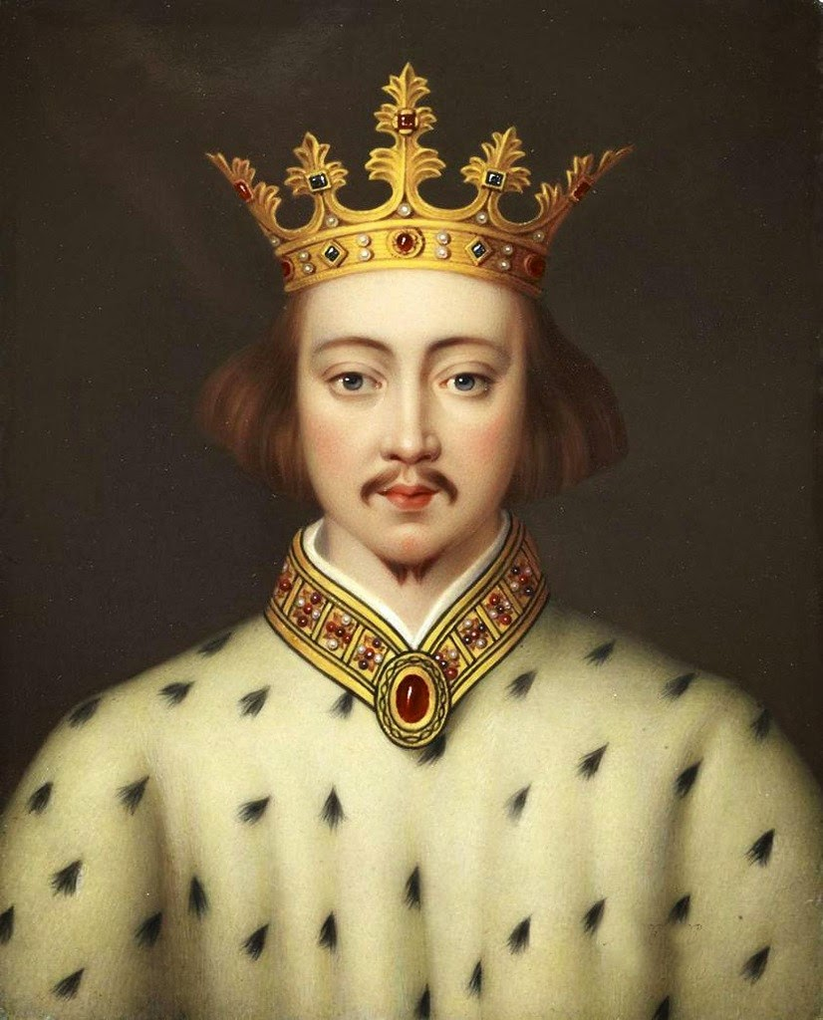
Richard II
Richard cultivated a refined atmosphere at court, in which the king was an elevated figure, with art and culture at its centre.
1387 - control of government was taken over by a group of aristocrats known as the Lords Appellant.
1389 - Richard had regained control, and for the next eight years governed in relative harmony with his former opponents.
1397-99 – Known as Richard's "tyranny” and took his revenge on the Appellants, many of whom were executed or exiled.
1399 - John of Gaunt died. Richard disinherited Gaunt's son, Henry Bolingbroke, who had previously been exiled.
June 1399 - Henry invaded England with a small force that quickly grew in numbers. He deposed Richard and had himself crowned king.
Richard is thought to have been starved to death in captivity, although questions remain regarding his final fate.

Slide 15
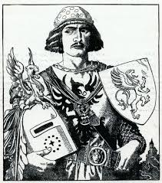
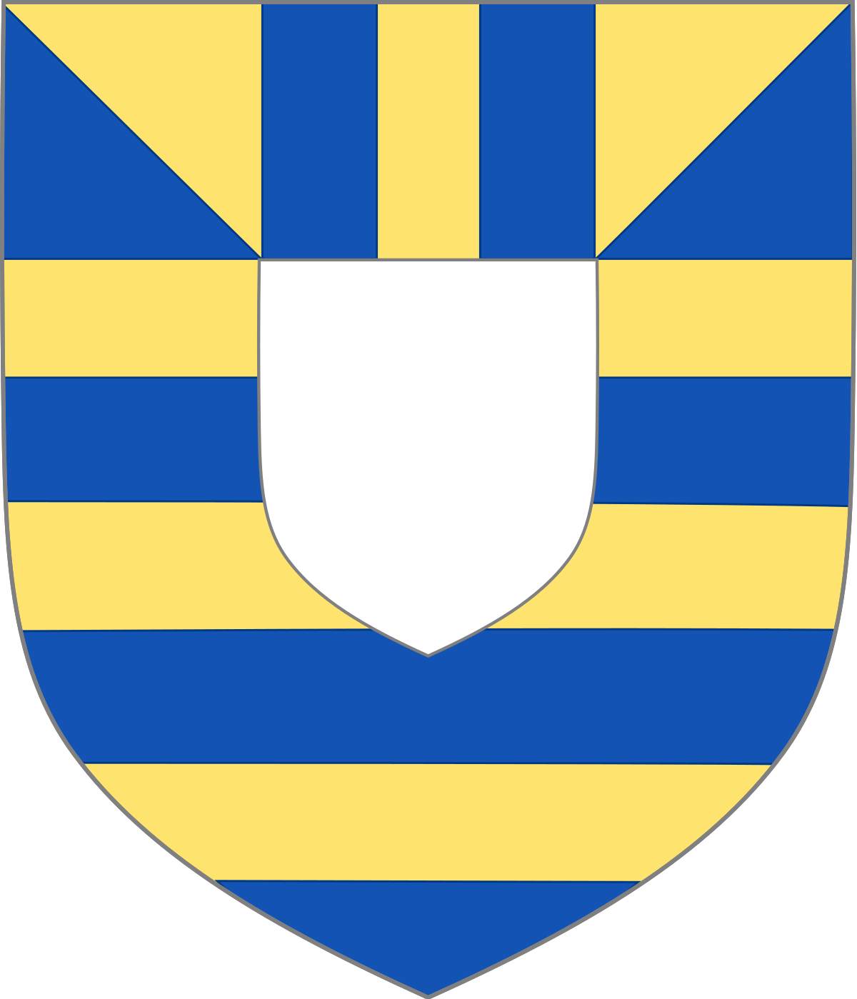
Henry IV and the Mortimers
Richard II had no children.
Roger Mortimer (4th Earl of March) – Son of Philippa and Edmund Mortimer, grandson of Lionel of Antwerp and great-grandson of Edward III BUT died in 1398.
Son, Edmund (5th Earl of March), became Richard’s heir presumptive.
Mortimer's claim was the basis plots against Henry IV and his son Henry V.
Uncles Edmund and Henry ‘Hotspur’ Percy (married to Elizabeth Mortimer) rebelled against Henry IV.
BUT Mortimer distanced himself from these and was loyal to Henry V.
Anne Mortimer (sister of Edmund) was ancestress to the House of York claim to the throne.

Slide 16
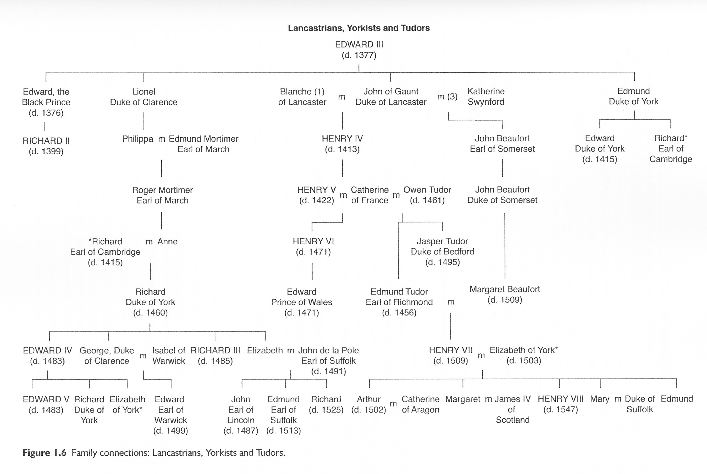

Slide 17
Activity 2
What do you think were the five most important themes of the reigns of Edward III to Henry V? (e.g. rebellion)
Justify your choices using evidence and explanation.
Aim for a short paragraph for each theme.
Challenge: Should we be viewing the Wars of the Roses as a distinct period of political upheaval or part of the on-going dispute over power in the Late Medieval period? Justify your opinion.

Slide 18
Activity 3
Using the textbook pages provided, make a page of notes for each of the following monarchs:
Richard II
Henry IV
Henry V
Challenge: Explain why of these individuals was most significant in shaping English monarchy before the reign of Henry VI*? Justify your opinions with reference to at least two of the kings.
*(Henry VI inherits the throne at the age of 9 months after the death of his father, Henry V, in 1422)

Slide 19
Stretch: Additional Resources to read, watch or listen to
Reading (Lots of other articles available on History Extra) | Watching | Listening
Did Richard III really kill the princes in the tower? The Wars of the Roses - York v Beaufort Henry VI - lovely guy, terrible king The women behind the Wars of the Roses Edward IV - Champion of the Wars of the Roses 5 Greatest Mysteries behind the Wars of the Roses The Battle of Bosworth The Downfall of Richard III | Britain's Bloody Crown - The Mad King Britain's Bloody Crown - The Kingmaker Must Die Britain's Bloody Crown - The Princes Must Die Britain's Bloody Crown - A Mothers Love Timelines - The Battle of Towton Timelines -Richard III - Fact or Fiction | A fresh view on the Wars of the Roses - Dan Jones The House of York - Thomas Penn Henry VI - A terrible king by Lauren Johnson History Hit - Margaret Beaufort

