Slide 1

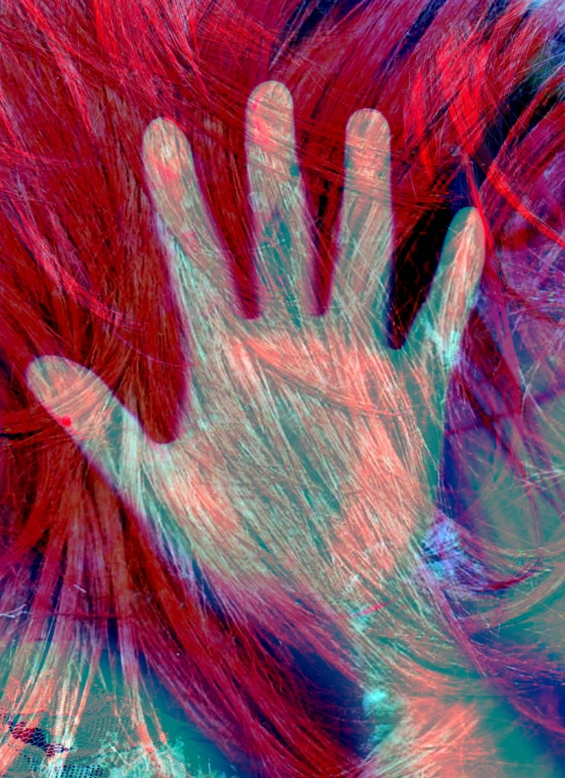
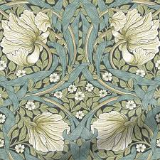
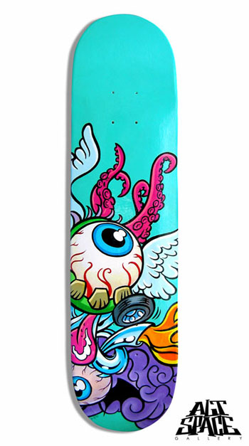
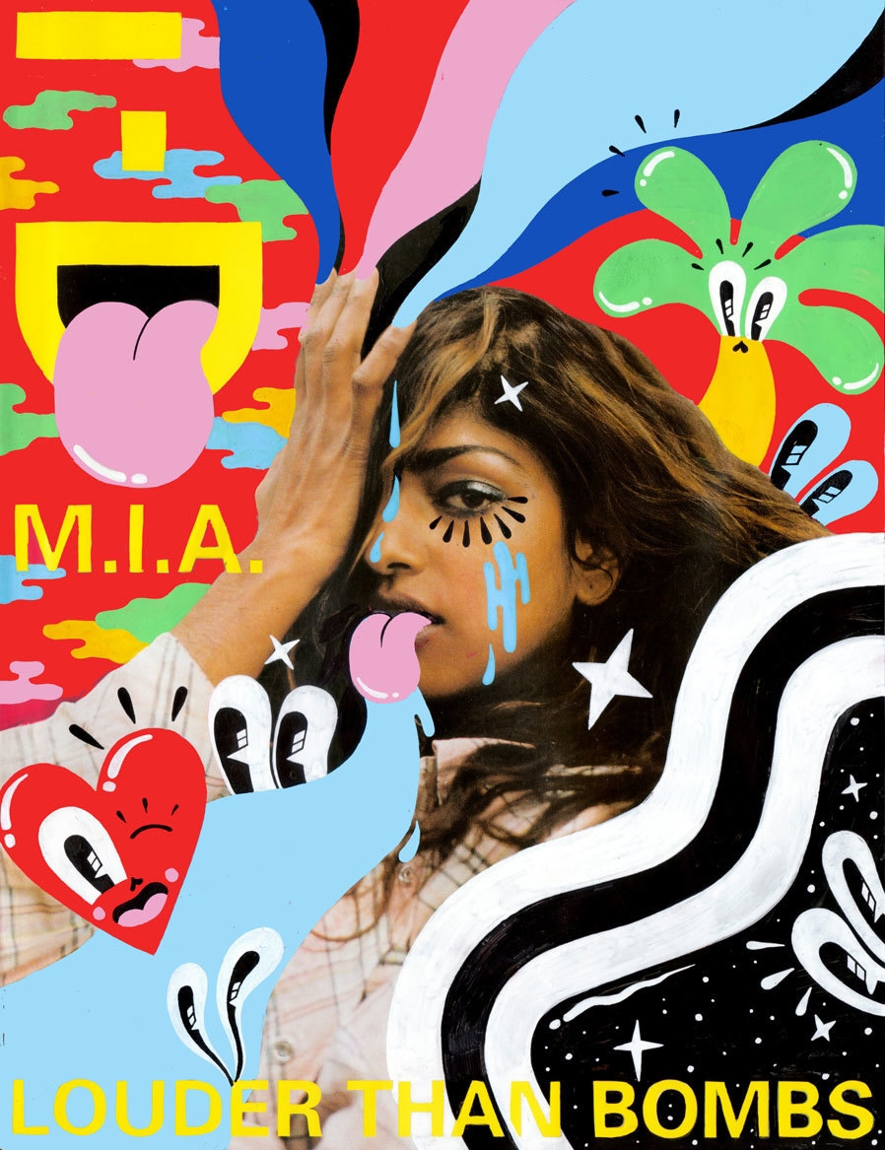
Name ___________________________________ Class____________________
Yr9 Cycle 1
DESIGN/PRINT
CREATIVITY AND CAREERS
Homework and Knowledge Organiser
Booklet.
Refer to epraise for homework deadline.
Complete tasks in booklet and hand in on deadline date.

Slide 2

GOLDEN WORDS
Line - is a mark made on a surface that joins different points. Lines can vary in length, width, direction and shape.
Shape - is a flat area surrounded by edges or an outline.
Composition - is the term given to a complete work of art and, more specifically, to the way in which all its elements work together to produce an overall effect.
Design - shapes and creates ideas to become practical solutions and propositions for customers and users.
Proportion- is the accuracy and the sizes of one object to another.
Overlapping - is when shapes are in front of other shapes. If one shape overlaps another it communicates an illusion of depth.
Fragmentation - an interest in manipulating a structure's surface and shape which appears to distort and dislocate.
Collage - the technique in which pieces of paper, photographs, fabric and other materials are arranged and stuck down onto a supporting surface.
Experimentation – is exploring new and different ideas using a range of media and materials.
Mixed Media - is a term used to describe artworks composed from a combination of different media or materials.
Colour blending-Two or more colours are mixed/ worked together or on top of each other.

Slide 3
GOLDEN WORDS
Photo Montage- is the process by cutting, gluing, rearranging and overlapping two or more photographs into a new image.
Lino Block Printmaking - Lino printmaking is a method of relief printing, which involves carving a drawing into a soft linoleum block, rolling a thin layer of ink over it, and pressing paper on top to transfer the image.
Bauhaus – BAUHAUS was a German art school operational from 1919 to 1933 that combined crafts and the fine arts. The school became famous for its approach to design,
William Morris - William Morris was a British textile designer, poet, artist, novelist, architectural conservationist, printer, translator and socialist activist associated with the British Arts and Crafts Movement
Hattie Stewart – Contemporary Artist/Illustrator/Graphic Designer
Helmo – Parisian Design Studio and Contemporary Artist/Illustrator/Graphic Designers

Slide 4
Who works in art?
Jobs in art fit into two broad categories based on whether you’re making art yourself or looking after and presenting the work of others. There are countless career opportunities for artists; here is a small selection:
Creating:
Fine artists create original artwork (such as paintings and sculpture) and sell it.
Illustrators work to a specific brief from an employer or client, perhaps drawing images for book covers or logos and marketing materials.
Graphic designers tend to work at a higher level of design than illustrators (although there is some overlap between the two roles), designing and putting together entire book covers or product packaging.
Photographers work to a brief agreed with a client – maybe a fashion company, advertising agency, or a wedding couple – to find and prepare a location for a photo shoot, take the pictures, edit and process them, and present the best ones to the client.
Make-up artists research and design make-up and hairstyles then work with production designers and performers (maybe musicians or actors on stage or screen) to create the right look.
Ceramicists design and create products made from clay (such as bowls, vases, mugs, or plates), either for large companies or on a self-employed basis.
Curating:
Gallery curators organise exhibitions, selecting work and liaising with artists and other galleries to arrange its presentation.
Conservators are like art doctors – they use specialist scientific tools to diagnose deterioration of artwork, do what they can to protect the object from degrading further, and even restore it to its former glory.
Advertising art directors direct the work of artists, writers, photographers, and/or film companies to produce a visual campaign that targets a particular audience and promotes a client’s business or product.
This information was taken from the Unifrog ‘Know How’ Library

Slide 5
Homework 1- Key words revision
1. Revise the key words and their meaning.
REVISION NOTES ON THIS PAGES PLEASE

Slide 6
Homework 1- Key words revision
1. Revise the key words and their meaning.
2. Next – Collect images from magazines and the internet to use in your photomontages

Slide 7
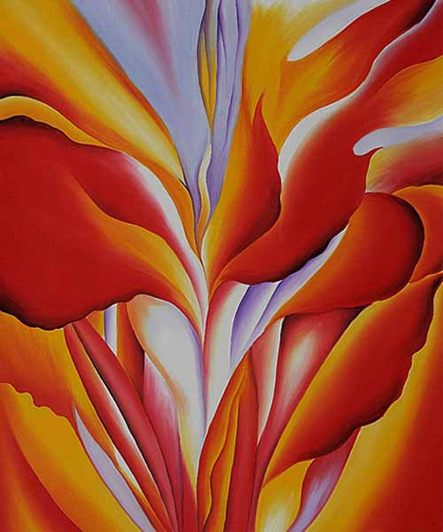
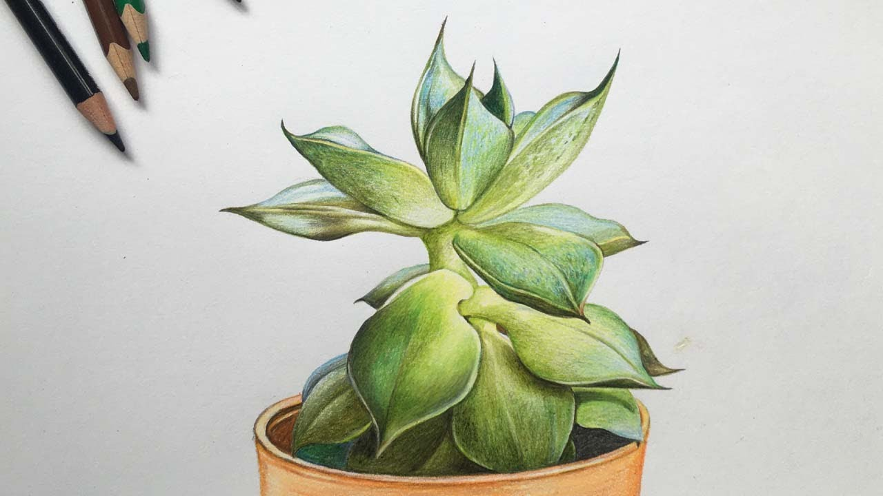
Learning Outcome
Draw the flowers or plants accurately add shading, tone and colour.
Focus on detail, really look at shape and form.
Focus on colour blending.
For a tonal drawing focus on using a minimum of 5 tones blended dark to light.
Homework Task 2 : Observational colour pencil drawing of Flowers, Plants and Leaves.

Slide 8
Homework Task 3 :
Contemporary Artist/Illustrator/Graphic Designer – Hattie Stewart
Learning outcome-
1) Look at the examples of Hattie Stewart art work.
2) Collect images from magazines and the internet
3) Make your own collage in the same style
PROGRESSION STEPS
Collect and print a range of images
Cut and arrange the shapes of fragmented FACES, TEXT, WORDS AND EMOJIS with pop style images.
Arrange and Overlap the shapes
Glue the composition into the text box

Slide 10
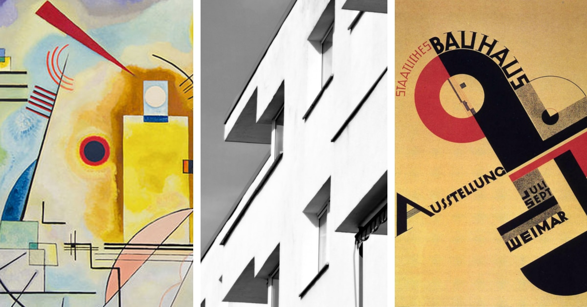
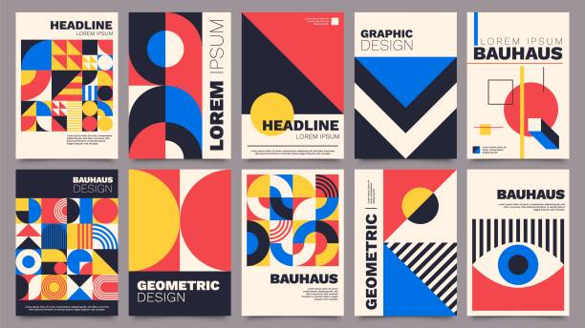
Homework task 4:
Modern Artist Study – Bauhaus
Learning Outcome-
Create your own geometric design for a postage stamp. Research The Bauhaus design style first!
PROGRESSION STEPS
Sketch out a geometric design
Darken the line work
Apply flat colour to the shape
Add a key word or numbers
Fill the whole design
BAUHAUS was a German art school operational from 1919 to 1933 that combined crafts and the fine arts. The school became famous for its approach to design, which attempted to unify the principles of mass production with individual artistic vision and strove to combine aesthetics with everyday function

Slide 11

Present your task 4 create your geometric BAUHAUS design in the postage stamp template

Slide 12
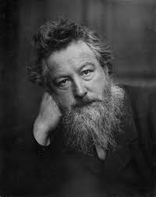
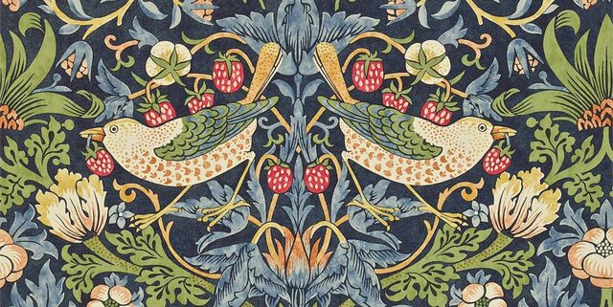
Homework 5 : - Historical Artist Study and Research of William Morris
William Morris was a British textile designer, poet, artist, novelist, architectural conservationist, printer, translator and socialist activist associated with the British Arts and Crafts Movement. He was a major contributor to the revival of traditional British textile arts and methods of production.
Learning Outcome & PROGRESSION STEPS-
Use the internet to research artist. Put his name into the search engine
Choose 5 images of his art work, copy and paste them into word ( if printing ) or power point if doing a presentation.
Find some key facts about him and write in own words.
4) Present your research consider back ground, a title, layout of page, have 5 images and key facts in own words.

Slide 13
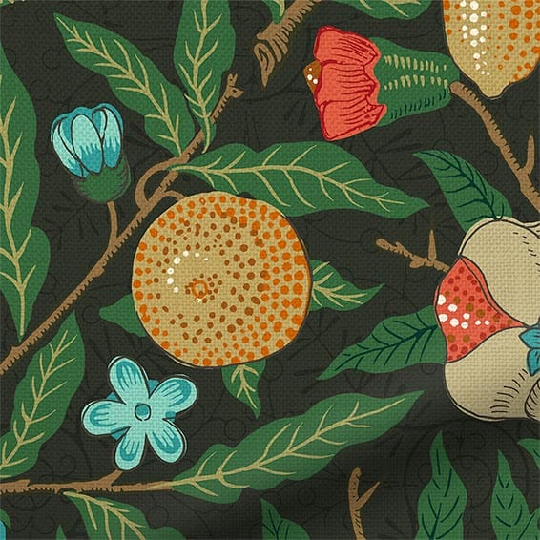
Present your task 5 homework on here with images and text.
Complete a small colour pencil sketch of this design

Slide 14
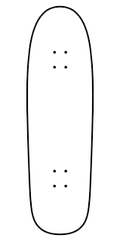
Homework 6: Create a design for a skateboard.
Use some ideas from the previous homeworks
Learning outcome
Draw the design in line accurately and add strong colour and tone.
Focus on a bold striking design.
Use proportion, shape, detail and tone and colour blending
PROGRESSION STEPS- Grid technique
Line drawing of the design
Sketch the basic shapes and composition.
Add flat colour
Add the detail and firm up the outlines.
Add tone , min 5 tones black to white

Slide 15
TASKS | SELF ASSESSMENT GRADES 1-5 * | DATE
Task 1 – REVISION OF KEY WORDS AND PHOTOSHOOT LEARNING OUTCOME Key word definition. Revise the Key Words! Collect images for the photomontages | 1- NOVICE 2-DEVELOPING 3-MODERATE * ** *** 4-SECURE 5- ADVANCED **** *****
Task 2 - Observational drawing of Flowers , Plants and Leaves Learning Outcome - You could work from a real life or from a photo of the above. Draw accurately adding tone and colour. Focus on detail, really look at the shape and form . Include a lot of colour blending. | 1- NOVICE 2-DEVELOPING 3- MODERATE * ** *** 4-SECURE 5- ADVANCED **** ******
Task 3 - Contemporary Artist. CRITICAL STUDY – Hattie Stewart Illustrator/Graphic artist Learning outcome – Create and make a pop style collage like Hattie Stewart, using text, images, emojis, letters and faces. | 1- NOVICE 2-DEVELOPING 3- MODERATE * ** *** 4-SECURE 5- ADVANCED **** *****
Task 4 - Modern Artist. CRITICAL STUDY – Bauhaus Design School Learning Outcome- Create a postage stamp design in a geometric BAUHAUS style. | 1- NOVICE 2-DEVELOPING 3- MODERATE * ** *** 4-SECURE 5- ADVANCED **** *****
Task 5 -Historical Artist. CRITICAL STUDY – William Morris Textile Designer Learning Outcome- Research William Morris and present your findings in a power point or print the images and present creatively. Write in your own words. Think about title, back ground and layout. Include a sketch. | 1- NOVICE 2-DEVELOPING 3- MODERATE * ** *** 4-SECURE 5- ADVANCED **** *****
Task 6 – Design your own skateboard deck Learning outcome- Design and draw an Imaginative and creative idea for a skateboard deck. Use some of the ideas from the previous homeworks | 1- NOVICE 2-DEVELOPING 3- MODERATE * ** *** 4-SECURE 5- ADVANCED **** *****
TEACHER FEEDBACK PASS 1-2 MERIT 3-4 DESTINCTION 5 | OVERALL HOMEWORK GRADE: 1 – 2 – 3 – 4 – 5

