Slide 1
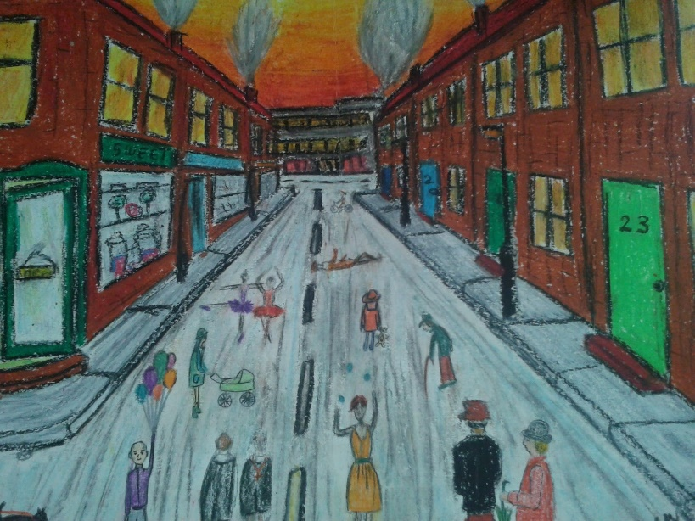

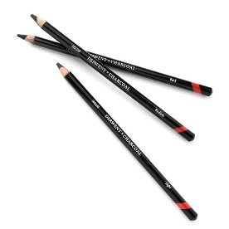
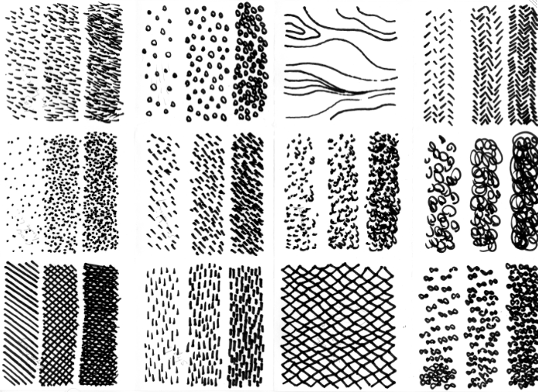
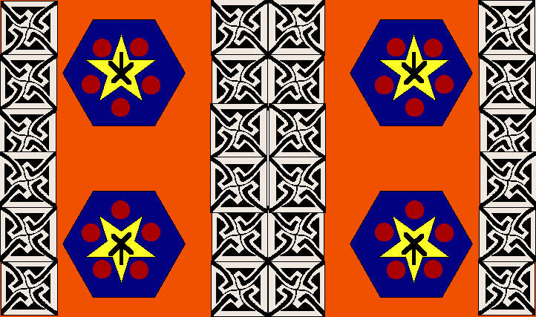
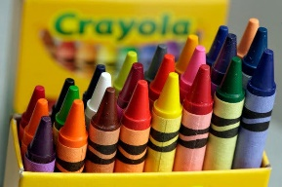
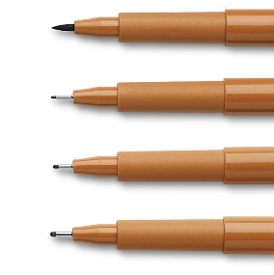
Sherdley Primary School: Art Knowledge Organiser.
Drawing: KS1
Delightful drawing vocabulary!
tools | An object which helps us to complete a task.
texture | The feel and appearance of a surface.
observing | Watching or noticing something.
pattern | A repeated, decorative design.
surface | The outside part or top layer of an object.
shadow | A darker area of shape created by blocking the source of light.
shading | Darkening/colouring of a drawing using straight lines which are side by side.
sketch | A rough drawing used to assist in the final piece of artwork.
Year 1
Year 2
Extend to a variety of drawing tools and explore different textures with these tools.
Observe and draw simple landscapes.
Observe and create simple patterns.
Observe patterns and simple anatomy such as faces and limbs.
Extend to a variety of drawing tools and varying surfaces.
Draw a way of recording my experiences and feelings.
Discuss and use shadows, light and dark shading.
Develop sketching skills to make quick records of objects.
Lowry Landscapes!
Super sketching examples!
Dandy drawing tools!
Pretty pattern examples!

Slide 2
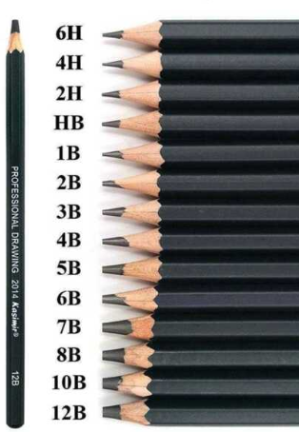
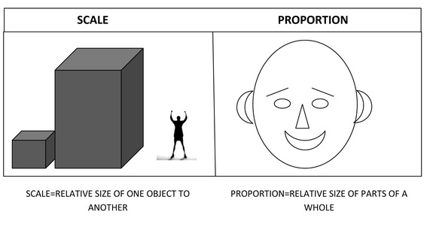
Sherdley Primary School: Art Knowledge Organiser.
Drawing: LKS2
Drawing vocabulary!
observing | Watching or noticing something.
accuracy | Creating something which is correct and precise.
scale | The size of an object in relation to another.
proportion | The size of an object when compared to another.
placement | The area in which you position sketched or painted aspects on a page.
sketch
stimuli | Something which interests an artist or designer and gives them new ideas.
Year 3
Year 4
Experiment with the potential of various pencils.
Identify and draw the effect of light, scale and proportion on various stimuli.
Create accurate drawings of whole people including proportion and placement.
Work on a variety of scales using viewfinders to create a closer effect.
Create computer generated drawings using ICT software
Create close observation sketches of stimuli.
Create initial sketches as preparation for painting.
Create accurate drawings of people, particularly faces.
A rough drawing used to assist in the final piece of artwork.
Scale and proportion
Sketching pencils!
Sketching techniques!

Slide 3
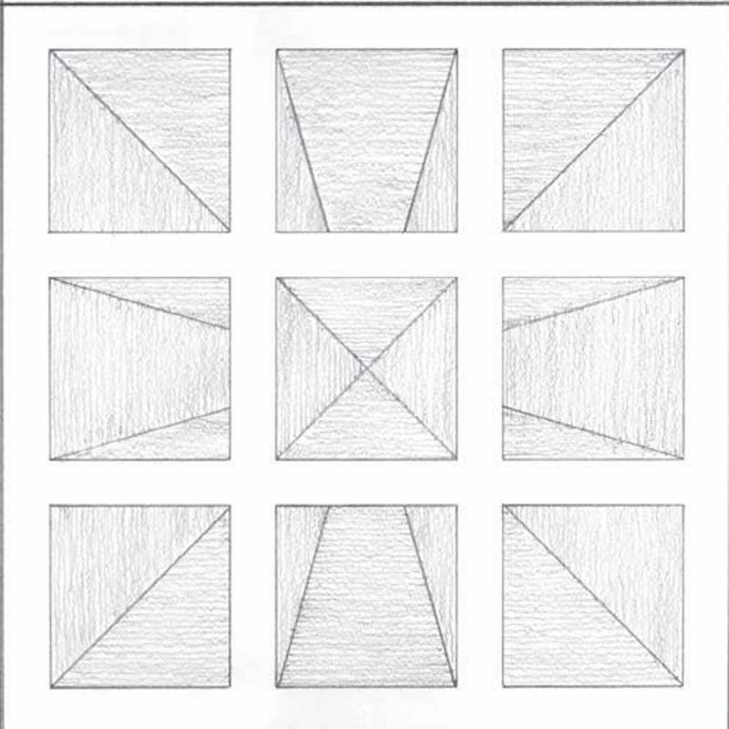
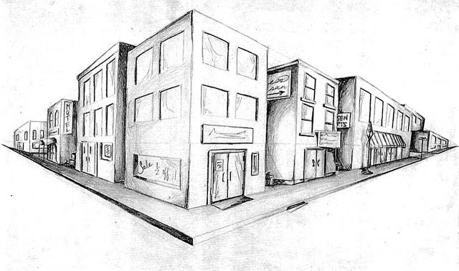
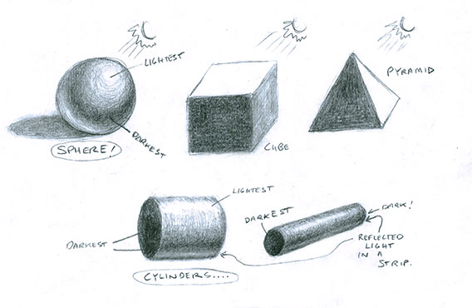
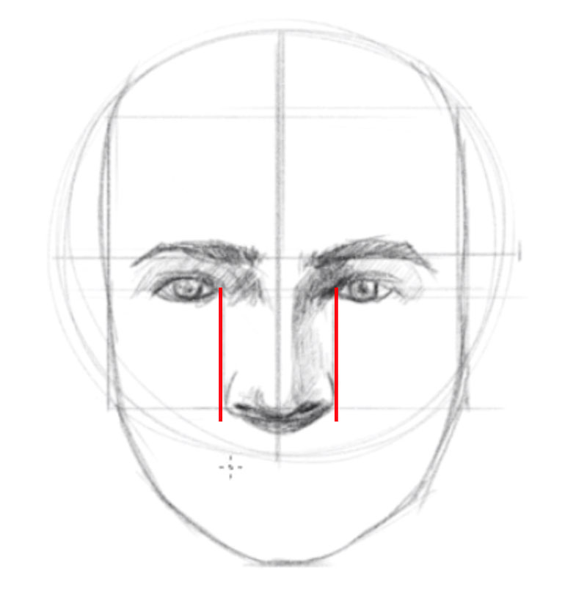
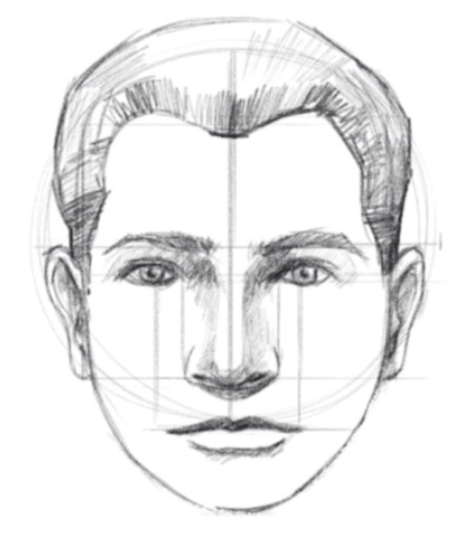
Drawing vocabulary!
Sherdley Primary School: Art Knowledge Organiser.
Drawing: UKS2
surface | The outside part or top layer of an object.
texture | The feel or appearance of an object or surface.
perspective | Creating a 3-dimensional object on a 2-dimensional surface (paper/card etc.) in a way that is natural and realistic.
accurate | Creating something which is correct and precise.
direction (light) | Looking and interpreting light on objects from their source and observing the effect of this.
develop | Growing an idea or piece so that it improves and refines over time.
evaluate | Discussing work to assess its particular strengths and weaknesses.
Year 5
Year 6
Interpret and use different textures and surfaces.
Produce increasingly accurate drawings of people.
Develop and discuss the effect of light on object and people from different directions.
Interpret the texture and use of surface in various artists work.
Produce accurate drawings of people.
Use different perspectives to create a variety of sketched and painted work.
The effect of light from different directions!
Examples of perspective!
Accurate drawings of people!

