Slide 1
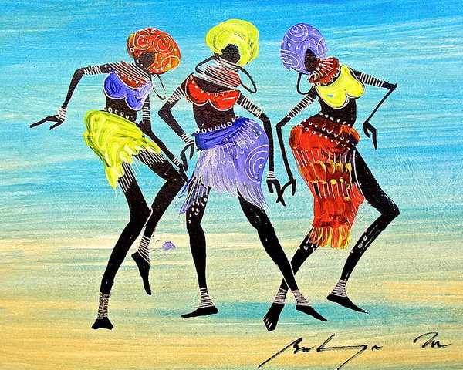
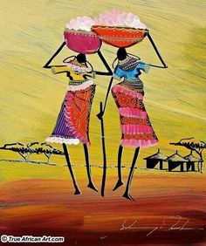

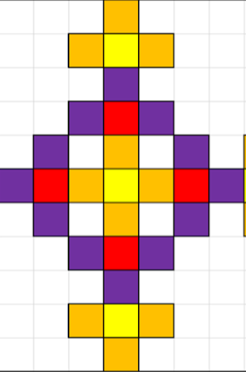
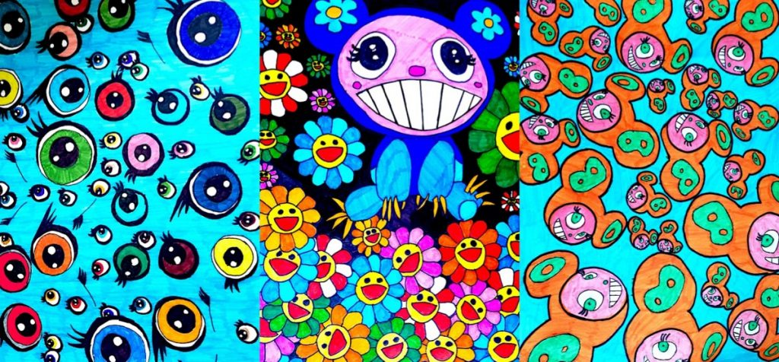
Perfect pattern vocabulary!
Sherdley Primary School: Art Knowledge Organiser.
Pattern: KS1
C
symmetry | An object or design that has identical, reflected parts through a mirror line.
materials | The objects and substances used to create a piece of artwork.
repeating | The appearance of the same line, colour, shape or other visual element of a design.
patterns | A design consisting of colours, shapes and position in a piece of work. This is often repeated for effect.
overlapping | Placing one or more artistic materials on top of one another.
Year 1
Year 2
Develop an awareness and discuss different patterns by artists.
Create simple repeating patterns using symmetry.
Experiment and develop own work by arranging, folding, repeating and overlapping.
Takashi Murakami patterns!
Symmetrical patterns!
C
C
Martin Bulinya
patterns!
C

Slide 2
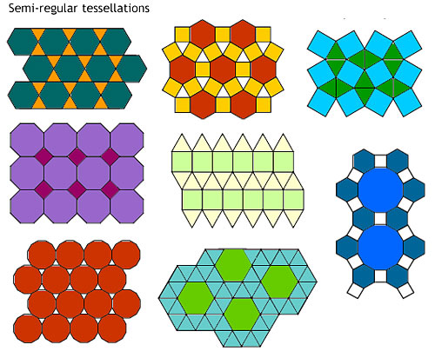
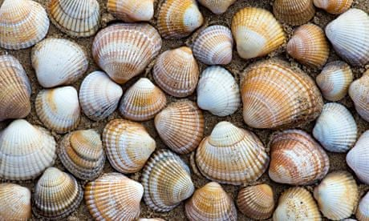
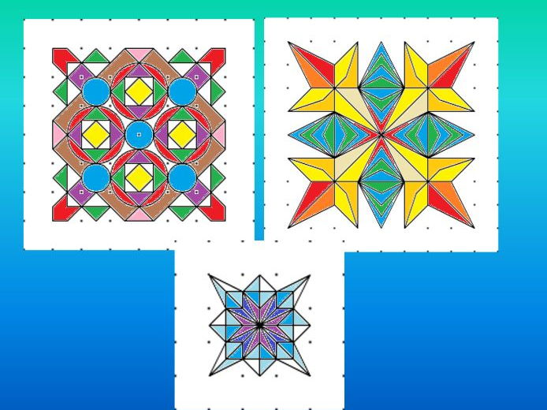

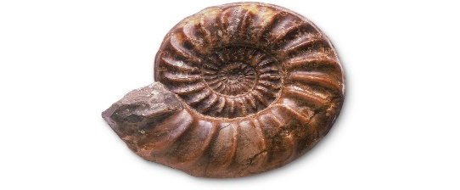
C
Perfect pattern vocabulary!
Sherdley Primary School: Art Knowledge Organiser.
Pattern: LKS2
symmetry | An object or design that has identical, reflected parts through a mirror line.
tessellation | A piece of work in which a shape is repeated over and over again without any overlapping or gaps.
patterns | The appearance of the same line, colour, shape or other visual element of a design.
environmental patterns | Patterns which are formed naturally. Such as the designs on shells, trees and fossils.
man –made patterns | Patterns which are created by human hands. Such as artists, sculptors and architects.
repeating | The appearance of the same line, colour, shape or other visual element of a design.
Year 3
Year 4
Experiment and develop own work by observing pattern in the environment, the design world and use ICT software and other media to represent this.
Develop patterns on a range of surfaces using symmetry.
Explore, sketch and develop man made and environmental patterns.
Use tessellation to create interesting repeating patterns.
Symmetrical patterns!
Environmental patterns!
C
C
Tessellated patterns
C

Slide 3
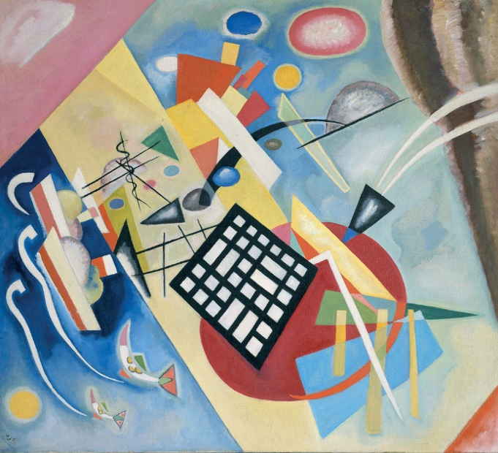
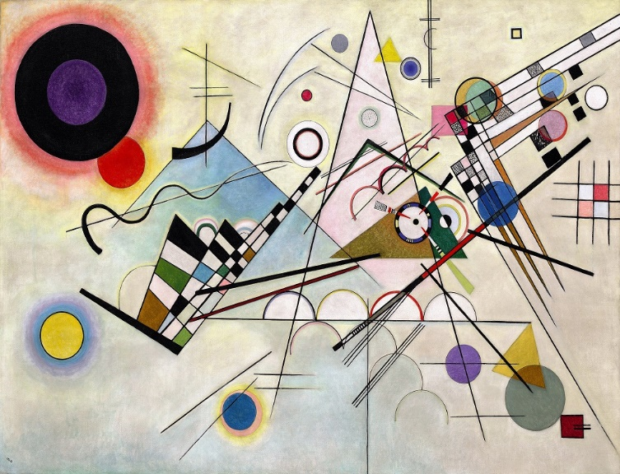
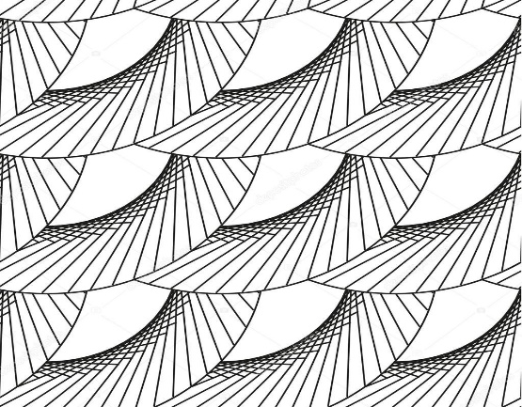
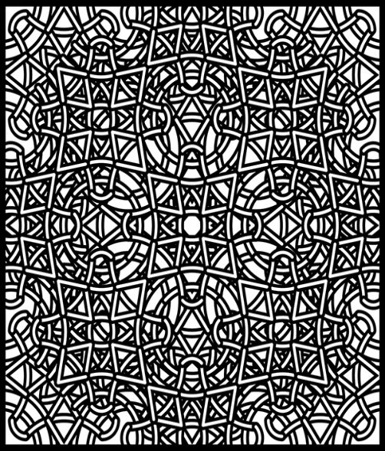
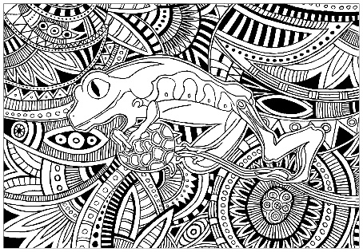
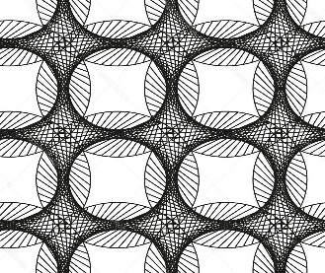
Perfect pattern vocabulary!
Sherdley Primary School: Art Knowledge Organiser.
Pattern: UKS2
C
abstract | A piece of artwork that does not imitate anything else. It uses shapes, colours and marks to achieve this effect.
purpose | The reason why an object or product is created.
expression | The visual representation of an artists’ thoughts, feelings and emotions.
patterns | A design consisting of colours, shapes and position in a piece of work. This is can be repeated for effect.
complex | A more complicated piece of work which has several techniques and/or strategies.
Year 5
Year 6
Create own abstract patterns to reflect personal experiences.
Create patterned work for a specific purpose.
Create own abstract patterns to reflect personal experiences and expression
Create more complex patterns in their work for a range of purposes.
Complex patterns!
C
C
C
Kandinsky abstract patterns!

